Slide 1
Self-Adjusting Binary Search Trees
D. D. Sleator and R. E. Tarjan | AT&T Bell Laboratories
Journal of the ACM | Volume 32 | Issue 3 | Pages 652-686 | 1985
Presented By:
James A. Fowler, Jr. | November 30, 2010
George Mason University | Fairfax, Virginia

Slide 2
Self-Adjusting Binary Search Trees
Topics for Discussion
Topics for Discussion
Paper and Authors
Splay Tree
Splaying
Basic Splaying Operations
Splay Tree Operations
Analysis
Applications and Further Research
References

Slide 3
Self-Adjusting Binary Search Trees
Paper and Authors
Paper and Authors
D. D. Sleator and R. E. Tarjan, “Self-adjusting binary search trees,” Journal of the ACM, vol. 32, no. 3, pp. 652-686, 1985.
http://www.cs.cmu.edu/~sleator/papers/self-adjusting.pdf
Daniel Dominic Kaplan Sleator, PhD
Professor of Computer Science, Carnegie Mellon University
Robert Endre Tarjan, PhD
James S. McDonnell Distinguished University Professor of Computer Science, Princeton University

Slide 4
Self-Adjusting Binary Search Trees
Splay Tree
Splay Tree
A splay tree is a type of self-adjusting binary search tree (BST) that supports all BST operations (access, join, split, insert, delete) and reorganizes itself automatically on each access
The driving force behind splay trees is the concept that “for the total access time to be small, frequently accessed items should be near the root of the tree often”

Slide 5
Self-Adjusting Binary Search Trees
Splaying
Splaying
Splaying is the key operation of splay trees
After a node is accessed, splaying moves the node to the root of the tree
There are two major methods of splaying:
Bottom-Up
Top-Down
Due to time constraints, I’ll focus on bottom-up splaying

Slide 6
Self-Adjusting Binary Search Trees
Splaying
Splaying
In bottom-up splaying, a splay tree element is accessed BST-style
If the element exists in the tree, the tree is splayed at that element before it is returned
If the element doesn’t exist, the tree is splayed at the last non-null element traversed

Slide 7
Self-Adjusting Binary Search Trees
Splaying
Splaying
In bottom-up splaying, three basic splaying operations are repeated from the element being splayed up to the root
One of the three operations, zig, zig-zig, or zig-zag, is chosen based on the configuration of the element, its parent, and grandparent
To describe these operations, let x be the element being splayed, p(x) be the parent of x, and g(x) be the grandparent of x

Slide 8
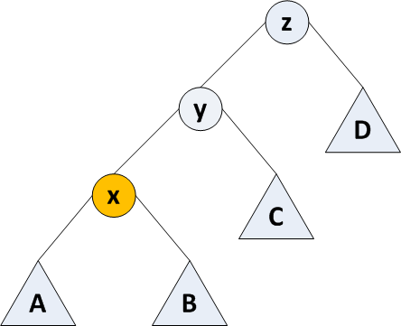
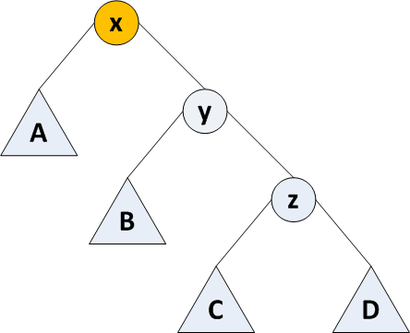
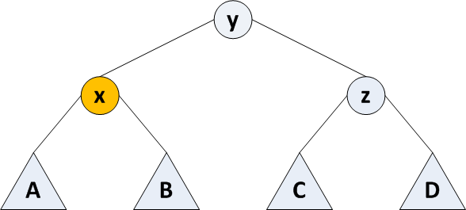
Self-Adjusting Binary Search Trees
Basic Splaying Operations
Basic Splaying Operation: Zig-Zig
If x and p(x) are both left or both right children and p(x) ≠ root
Rotate the edge joining p(x) and g(x)
Rotate the edge joining x and p(x)

Slide 9
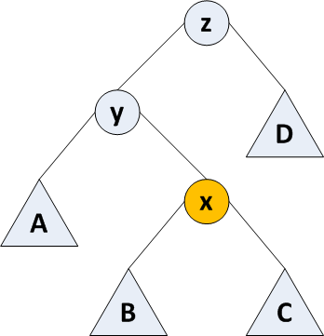
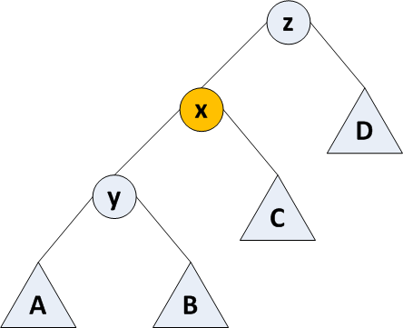
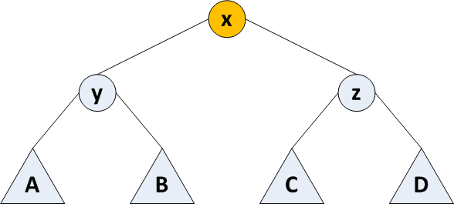
Self-Adjusting Binary Search Trees
Basic Splaying Operations
Basic Splaying Operation: Zig-Zag
If x is a right child and p(x) is a left child (or vice-versa) and p(x) ≠ root
Rotate the edge joining x and p(x)
Rotate the edge joining x (in its new position) and the original g(x)

Slide 10
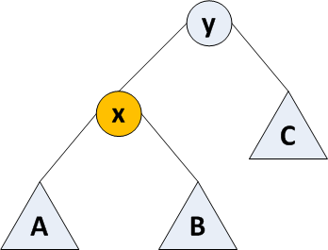
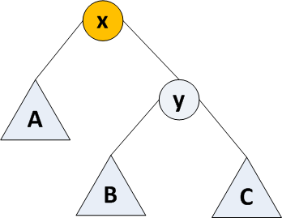
Self-Adjusting Binary Search Trees
Basic Splaying Operations
Basic Splaying Operation: Zig
Zig-Zig and Zig-Zag move x up two edges at a time—what about odd depths?
When p(x) = root and depth is odd, use Zig as a final splay step
Rotate edge joining x and p(x)

Slide 11
Self-Adjusting Binary Search Trees
Splay Tree Operations
Operation: access(i, t)
Inputs: Tree t and an element i to access
Output: A pointer to the node containing i or null if not found
Algorithm:
Traverse from the root of t going left if the current node is < i, right if > i, stopping if = i, or stopping and storing the previous node if = null
If traversal stopped at i, splay at i and return a pointer to the new root of t
Otherwise, splay at the previous non-null node and return null

Slide 12
Self-Adjusting Binary Search Trees
Splay Tree Operations
Operation: join(t₁, t₂)
Inputs: Trees t₁ and t₂ where all elements in t₁ are less than all elements in t₂
Output: A single splay tree combining t₁ and t₂
Algorithm:
Access the largest element in t₁
The root of t₁ is now the largest element
Point the null right child of t₁‘s root to t₂
Return t₁

Slide 13
Self-Adjusting Binary Search Trees
Splay Tree Operations
Operation: split(i, t)
Inputs: Tree t and a value i on which to split
Output: Trees t₁ and t₂ containing the elements of t < i and > i respectively
Algorithm:
Perform access(i, t)
If t’s root < i: t₂ = right(t), right(t) = null, t₁ = t
If t’s root > i: t₁ = left(t), left(t) = null, t₂ = t
Return t₁ and t₂

Slide 14
Self-Adjusting Binary Search Trees
Splay Tree Operations
Operation: insert(i, t)
Inputs: Tree t and a value i to insert
Output: Tree t with element i inserted
Algorithm:
Perform split(i, t) to get t₁ and t₂
Create a new tree t with i in the root element
Set left(t) = t₁
Set right(t) = t₂
Return t

Slide 15
Self-Adjusting Binary Search Trees
Splay Tree Operations
Operation: delete(i, t)
Inputs: Tree t and a value i to delete
Output: Tree t with element i removed
Algorithm:
Perform access(i, t)
Save a pointer to the root node of t
Perform join(left(t), right(t)) to get the new t
Free the old root node of t
Return the new t

Slide 16
Self-Adjusting Binary Search Trees
Analysis
Analysis: Advantages
Never much worse than non-self-adjusting data structures
Need less space since no balance info needed
Adjustment to usage patterns means they can be more efficient for certain sequences
Splaying reduces the depth of the nodes on the access path by roughly half

Slide 17
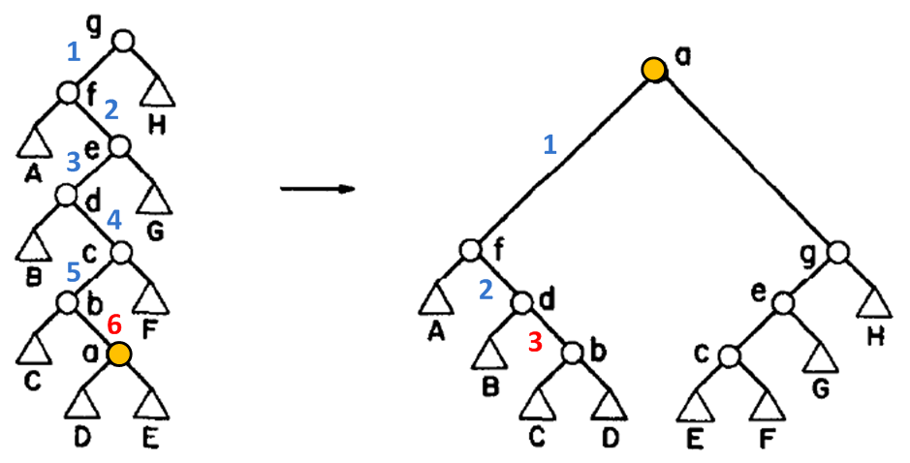
Self-Adjusting Binary Search Trees
Analysis
Analysis: All Zig-Zag Steps
In this example (accessing element a):
Depth of access path: 6 → 3
Reduced by: 1/2

Slide 18
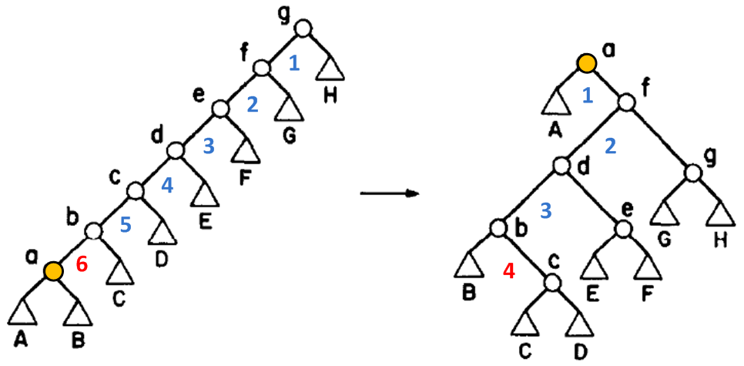
Self-Adjusting Binary Search Trees
Analysis
Analysis: All Zig-Zig Steps
In this example (accessing element a):
Depth of access path: 6 → 4
Reduced by: 1/3

Slide 19
Self-Adjusting Binary Search Trees
Analysis
Analysis: Disadvantages
More adjustments
Adjustments on accesses, not just updates
Individual operations can be expensive

Slide 20
Self-Adjusting Binary Search Trees
Analysis
Analysis: Comparison to Balanced BST
Balance Theorem [1] proves the total access time is O[(m+n)log n + m] for m accesses of an n-element splay tree
The average-case total access time for a balanced BST is m log n
For very large access sequences, the splay tree total access time is of the same order of a balanced BST

Slide 21
Self-Adjusting Binary Search Trees
Analysis
Analysis: Sequential Access
Accessing all of the elements in sequential order of an n-element splay tree is O(n)
Tarjan [2] proved an upper bound of 10.8n rotations in 1985
Elmasry [3] proved the best known upper bound so far of 4.5n rotations in 2004

Slide 22
Self-Adjusting Binary Search Trees
Applications and Further Research
Applications and Further Research
Double-Ended Queue (Deque)
Deque operations require sequential access when implemented using a splay tree
Deque conjecture [2] proposes that m deque operations on an n-element splay tree is O(n+m)
Tarjan [2] proved upper bound of 11.8n + 14.8m for the specific case excluding eject operations
Elmasry [3] proved upper bound of 4.5n + m for this same specific case

Slide 23
Self-Adjusting Binary Search Trees
Applications and Further Research
Applications and Further Research
Associative Arrays
Priority Queues
Data Compression [4]
Douglas W. Jones of the U. of Iowa has done extensive research on this topic: http://www.cs.uiowa.edu/~jones/compress/
He claims for images, it compresses as good as LZW and uses less memory

Slide 24
Self-Adjusting Binary Search Trees
References
References
[1] D. D. Sleator and R. E. Tarjan, “Self-adjusting binary search trees,” Journal of the ACM, vol. 32, no. 3, pp. 652-686, 1985.
[2] R. E. Tarjan, “Sequential access in splay trees takes linear time,” Combinatorica, vol. 5, no. 4, pp. 367-378, 1985.
[3] A. Elmasry, “On the sequential access theorem and deque conjecture for splay trees,” Theoretical Computer Science, vol. 314, no. 3, pp. 459-466, Apr. 2004.
[4] D. W. Jones, “Application of splay trees to data compression,” Communications of the ACM, vol. 31, no. 8, pp. 996-1007, 1988.

Slide 25
Self-Adjusting Binary Search Trees
Questions
Questions?

