Slide 1
Energy-efficient algorIthms Introduction to deterministic online power-down algorithms
Len Matsuyama
CS 695

Slide 2
Introduction
Energy-Efficient Algorithms - Susanne Albers [Communications of the ACM, Vol. 53]
Energy consumption is critical for Cost and Availability
The article surveys Algorithmic solutions (as opposed to hardware/system design).

Slide 3
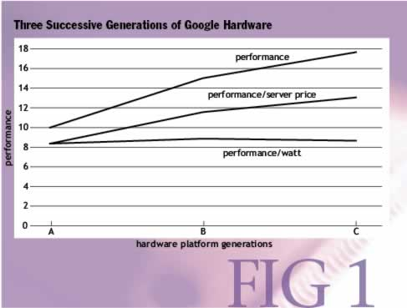
Projection of Significant Power Consumption Costs
If power consumption continues to grow, it can take over hardware costs by a large margin (Google).

Slide 4
Evidence of Significant Power Consumption Costs
Office environment: Computer and monitor energy consumption is significant.
2009: HSBC (deployed nightly power down software) Saved $1M energy costs, reduced CO2 emmissions by 3M kg.
Battery-Powered devices
Portable devices: Laptops, mobile phones
Autonomous distributed devices: Sensor networks
Heat dissipation
Wear, reduced reliability of components.
Notes:
Sensor Networks: Monitor physical/environmental conditions (temperature, sound,vibration, pressure, motion or pollutants)

Slide 5
Overview
Power Down with Two States
A Deterministic Algorithm
Analysis of Deterministic Algorithm
Power Down with Multiple (>2) States
Lower Envelope Algorithm
Analysis of Lower Envelope
Dynamic Speed Scaling (Time Permitting)
YDS Algorithm
Average Rate Algorithm

Slide 6
Power Down with Two States - Setup
Consider a system with two power states: active and sleep. (e.g. computer monitor)
Let r be the power consumption rate in the active state. (Assume r=0 in sleep state)
Let B energy units be required to transition from the sleep state to the active state. (B > 0)
The system experiences an idle period T which is not known in advance (by definition of our online algorithm).

Slide 7
Power Down with Two States - OPT
If rT < B then remain in the active state
Otherwise transition to the sleep state at the beginning of T. And transition to the active state at the end of T.

Slide 8
Power Down with Two States – Online ALG-Det
In an idle period T, first remain in the active state.
After B/r time units if T has still not ended yet, transition to the sleep state.
Just like the ski rental problem where T is the number of days skiing, B is the cost of buying skis, and r is the rental fee per time unit (1 day of skiing).

Slide 9
Power Down with Two States – Online ALG-Det (cont’d)
Easy to see that ALG-Det is 2-competitive. Only need to consider the two cases:
If rT < B then ALG-Det consumes rT energy during T. (Same as OPT)
If rT >= B then ALG-Det consumes r * (B/r) = B energy during T, plus B for transitioning to the active state. So 2B units of energy. (B for OPT)

Slide 10
Power Down with Two States – Online ALG-Det (cont’d)
Verify that the best which any deterministic ALG can do is a competitive ratio of 2:
ALG transitions to sleep state in exactly t time units
Worst case would be T = t
This would mean ALG was active for exactly the amount of time the system was idle.
Cost of ALG = rt + B
Cost of OPT = min{rt, B}
Clearly, competitive ratio is 2.

Slide 11
Power Down with Multiple States
Real World: Many modern devices have not only one but several low-power states.
E.g. Intel Core i7 Mobile Processor
Full On Processor executing code
Auto-Halt Processor no longer executing code.
Deep Sleep Cores flush caches. Clocks shut off to each core.
Deep Power Down Cores save architectural state and removes core voltage.

Slide 12
Power Down with Multiple States
Referenced Paper: Irani, Shukla, Gupta - Online Strategies for dynamic power management in systems with multiple power-saving states. [ACM Trans. Embedded Computing Systems 2 (2003) 325-346

Slide 13
Power Down with Multiple States - Setup
Consider a deterministic system with K power states S1, …, SK. S1 being the active state and the rest being low-power states.
Each state Si has power consumption rate Ri
States are ordered such that R1 > … > RK
Each state will have a transition cost Bi when going back to the active state such that B1 <= … <= BK
Transition energies are assumed to be additive. Transition cost from state j to i is Bj – Bi where i < j.

Slide 14
Power Down with Multiple States - OPT
Observe that OPT will only change states at the beginning and end of the idle period T. (The state that it’s in consumes the least energy for idle period T).
We know for OPT that state Si is used for the entire T so total energy consumption is Ri*T + Bi
OPT simply chooses the state that minimizes the cost:
OPT(T) = min {Ri*T + Bi} where 1 <= i <= K

Slide 15
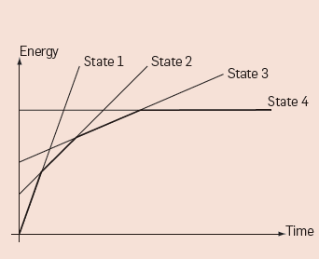
Power Down with Multiple States – Lower Envelope
Illustration of the optimum cost in a four-state system
Note: Point on line represents energy consumed during idle duration T for OPT.

Slide 16
Power Down with Multiple States – Lower Envelope
Let Sopt(t) be the state used by OPT in an idle period of total length t
Sopt(t) = Si for min {Ri*T + Bi} where 1 <= i <= K
Lower Envelope:
In an idle period, at any time t use state Sopt(t).

Slide 17
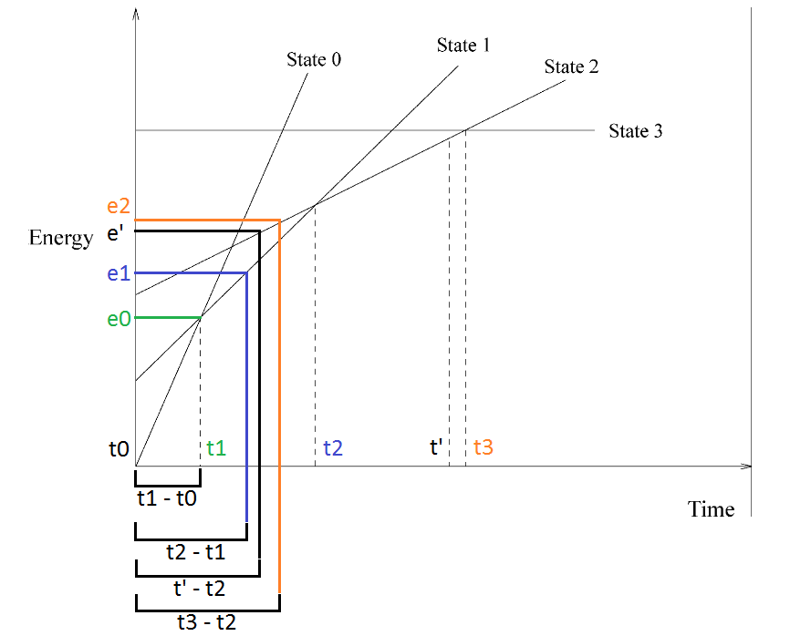
Power Down with Multiple States – Lower Envelope (cont’d)
How to calculate energy consumed by LowerEnvelope:
If t = t’ then energy consumed = e0 + e1 + e’ + B2

Slide 18
Lower Envelope Analysis – 2 Competitive
First, establish that the worst case is just after a transition time. (t_j: time of transition to state j)
Consider (amount of time in idle state)
Where
Where there are k total states
LE:
OPT:
Ratio of above (LE/OPT) is maximized with

Slide 19
Lower Envelope Analysis (cont’d)
Now with we have:
Thus, it suffices to prove that:

Slide 20
Lower Envelope Analysis (cont’d)
In LE, each tl was chosen so that:
where tl is the solution to
We can substitute these values into:
(a0*t1 – a0*t0) + (a1*t2 – a1*t1) + (a2*t3 – a2*t2) + (a3*t4 – a3*t3)…
We have:

Slide 21
Lower Envelope Analysis (cont’d)
Collapsing the telescoping sum, we get:
Using the fact that B0 = 0, t0 = 0, and that alpha_j >= 0, t_j >= 0. The inequality holds. Q.E.D.

Slide 22
Take Away
The fundamentals of online power management algorithms are analogous to the ski rental problem
The basic model presented forms a foundation for more sophisticated power management algorithms.

Slide 23
Dynamic Speed Scaling
Consider n jobs J1, … Jn that have to be processed on a variable-speed processor.
Jobs are defined by:
Ri: release time (job is available for processing)
Di: Deadline
Wi: Processing Volume. (can be viewed as #CPU cycles necessary to finish the job)
If Ji is executed at constant speed s, it takes Wi/s time units to complete the job.

Slide 24
Dynamic Speed Scaling (cont’d)
Preemption of jobs is allowed
Goal: Construct a feasible schedule that minimizes total energy consumption.
Assumtions:
No upper bound on the maximum processor speed. (Hence there always exists a feasible schedule)
Continuous spectrum of speeds is available.

Slide 25
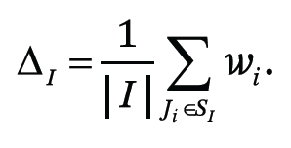
YDS
YDS Algorithm (Yao, Demers, Shenker)
First we consider the offline algorithm
Define interval I = [t, t’] for which contains a set of a number of jobs Ji where their release and deadline times Ri, Di are within the interval.
Define the density of I Δ_{I} as the total work to be completed in I divided by the length of I.

Slide 26
YDS (cont’d)
Can also be thought of as the minimum average speed necessary to complete all jobs within the interval I.

Slide 27
YDS (cont’d)
YDS proceeds in a series of iterations.
In each iteration, a time interval I of maximum density ∆_{I} is identified and a corresponding partial schedule is constructed.
Once the interval I is identified, the jobs are scheduled according to Earliest Deadline First (EDF)
The scheduled jobs are then removed from the problem instance, and the partial schedule becomes part of the final ordering of the jobs

Slide 28
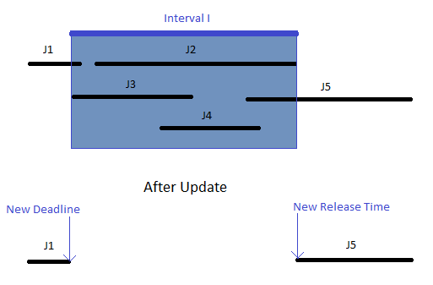
YDS (cont’d)
The final step of an iteration is to take into account those jobs that are not entirely in the interval I. But have either of their release or deadline times in the interval.
Notes:
These jobs were not part of the EDF schedule and therefore were not removed.
For these jobs their release and deadlines have to be updated accordingly.

Slide 29
YDS (cont’d)
ALG:
Intially J:={J1, …, Jn}
While J Not Empty:
Determine the interval I of maximum density.
In I, process the jobs of SI at speed ∆_{I} according to EDF.
Set J:=J\SI
Update the release and deadline times of unscheduled jobs.

Slide 30
YDS Example
Lets say we have the following jobs Ji = (Ri, Di, Wi)
J1 = (0, 25, 9)
J2 = (3, 8, 7)
J3 = (5, 7, 4)
J4 = (13, 20, 4)
J5 = (15, 18, 3)

Slide 31
YDS Example (cont’d)
I1 = [5, 7] → ∆_{I} = 4/2 = 2
I1 = [3, 8] → ∆_{I} = (4+7)/5 = 2.2
I2 = [15, 18] → ∆_{I} = 3/3 = 1
I2 = [13, 20] → ∆_{I} = 7/7 = 1
I3 = [0, 25] (what remains)

Slide 32
YDS Example (cont’d)
I1 = [3, 8]
I2 = [13, 20]
I3 = [0, 25]

Slide 33
Average Rate (Online ALG)
At any time t, use speed of s(t):
Jobs are scheduled using EDF.
Yao et al. Comp Ratio Upper Bound:
2^(α-1) α^ α for any α > 2
If a processor runs at speed s, then the required power is s^α where α>1 is a constant.

Slide 34
Questions?

