Slide 1
A Near-Tight Approximation Algorithm for the Robot Localization Problem
Sven Koenig, Joseph S. B. Mitchell, Apura Mudgal, Craig Tovey
Presented by: Mike Paton

Slide 2
Introduction: Mobile Robot Localization

Slide 3
Robot localization methods
Localization with a known map:
Kalman Filters: A local based robot localization method used to account for errors in the robot’s odometry and sensing.
Markov localization
Global localization using markov models, requires a discrete representation of the world.
Particle Swarm: global localization using a swarm of particles ( candidate solutions).
SLAM: Simultaneous localization and Mapping
EKF: Extended Kalman Filter.
FASTSlam

Slide 4
When the path to localizing is important
The previous methods do not care about where the robot travels while it is localizing, just that it moves around and gathers data.
Figuring out the optimal path is an NP hard problem.
This paper presents a solution.
An O(log^2(n)log(k))-approximation algorithm is introduced, where the optimal solution is the shortest path the robot needs to take to localize.

Slide 5
Previous work
Kleinberg competitive ratio localization
Compares the dist. Traveled by the robot to a omniscient verifier: a robot with priori knowledge
Environment is a geometric tree G(V,E)
The algorithm has a O(n^(2/3))-competitive ratio

Slide 6
The ½ Group Steiner problem
Group Steiner problem
Given a weighted graph G(V,E) with k groups of vertices g1,g2,g3……….,gk in V; find a minimum-weighted tree that contains at least one vertex from each group.
½ Group Steiner problem
Find a minimum weight tree that contains vertices from at least half of the groups.
There exists a O(log^3(n)))-approximation for the Group Steiner problem and a O(log^2(n))-approximation for the ½ Group Steiner problem.

Slide 7
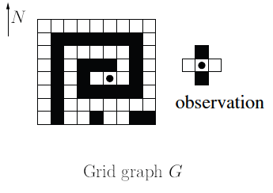
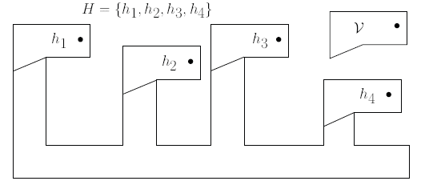
Representation
Grid Graph model
Vertices are discretized squares of the map.
An edge is made when traversable vertices are adjacent to each other.
Robot can either travel north,south,east,or west
Each piece of the map is either blocked or unblocked.
An observation is the values of the blocks adjacent to the robot

Slide 8
Terminology
G(V,E) = Grid Graph Map.
G’(V,E) = Local Graph. The robot makes observations from diff. positions in G to make a larger and larger G’
C0 = The initial position of the robot with respect to G’
C(x,y) = A cell in G’ lying x units east and y units north of C0.
H = the set of hypothesis.
h = A potential starting point for the robot in grid graph G.
H’ = the set of active hypothesis
O(h, C) is the opinion of hypothesis h about position C.
H(C) = Hypothesis partition of the set of hypotheses according to the following relation: h1 ~ h2 IFF O(h1, C) = O(h2, C).
Maj(C) = largest set in H(C)
G(C, o) = class of opinion o of coordinate C (bbbb,btbt…)

Slide 9
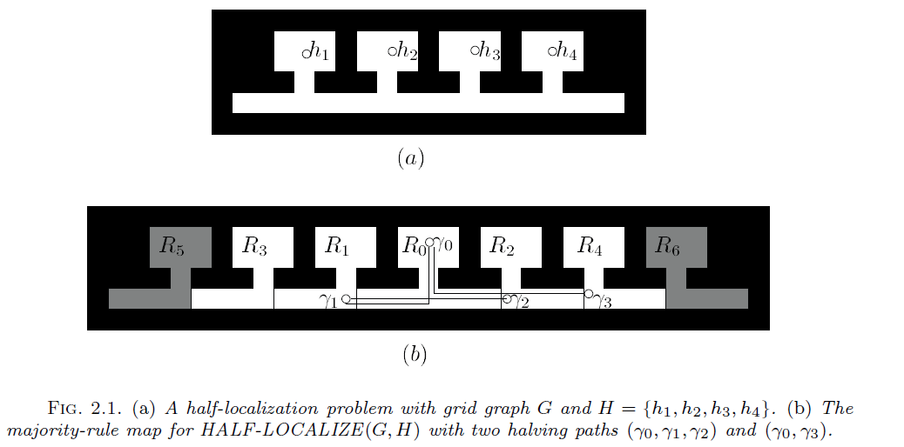
Majority rule map
The majority rule map: Gmaj, is a local map in which each cell is blocked or traversable according to what the majority of hypotheses have to say about it.
A Cell is blocked IFF |Maj(C)| > ½ |H| and V(Maj(C) == 0

Slide 10
Half Localization
A strategy where the robot can correctly eliminate at least half of the hypotheses in H.
To achieve half localization a halving path is calculated.
A Halving path is a path the robot takes that will effectively eliminate at least ½ of the hypotheses in H (Half-Localize).
Let halving path P = {C0, C1…,Cm} (Ci+1 is a neighbor of Ci in the majority rule map).
The robot starts at its initial position and follows the coordinates in P, at each step observation oi is taken.
Once the robot reaches coordinate Cm, at least half of the hypotheses in H will be eliminated.

Slide 11
Half Localize Algorithm
Input: G, H, halving path S(c)
H’ = H
For I = 0 to size of S(c)
Move the robot to ci
Make observation oi at ci
H’ = H’ ∩ G(ci,oi)
stop if |H’| <= ½ |H| End
END

Slide 12
Computing halving paths
The computation is approximated by reducing it to an instance of the ½ group Steiner problem.
Convert the majority rule map to a weighted graph.
V = set of traversable coordinates in the majority-rule map.
Weight of edge (v1,v2) = length of shortest path joining cells v1 and v2 in the majority rule map.
The graph is rooted at the origin.
k groups are made, one for each hypothesis h(i) in H
Group gi = the set of all coordinates c in V, that hi do not share the majority opinion at c.
Once the weighted graph is made, the ½ Group Steiner problem is run and a path is returned.

Slide 13
Repeated Half Localization
Input: Grid graph G, set of Hypothesis H
Output: The robot localizes to a hypothesis h in H
Algorithm:
While |H| > 1
{
Compute Majority rule map Gmaj
Convert Gmaj to a weighted graph Ig,h
Solve Ig,h using the ½ Group Steiner problem
to compute a halving path C
Half-localize by strategy S(C)
Move back to origin.
}

Slide 14
Repeated half localization analysis
Approximation Ratio
O(log^2(n)log(k))-approximation alrogithm.
K = size of hypothesis list.
N = size of map.
Proof:
The number of active hypotheses reduces by at least half after each phase
The robot localizes in m <= log(|H|) = log(k) phases.
Theorem 1.1: There exists an O(log^n) approx. algorithm A for the rooted ½ Group Steiner Problem.
Let C be the halving path and C* be the optimal halving path, then C <= O(log^2(n)) * C*
|C*| <= HALF-OPT(G,hi) <= OPT(G,H)
Since there are at most log(k) phases the total worst case travel distance is O(log^2(n)log(k)) * OPT(G,H)

Slide 15
Future Work
Robot without compass
Limited range
Polygon with holes
Geometric trees
3d grid graph

Slide 16
References
Sven Koenig, Joseph S. B. Mitchell, Apurva Mudgal, and Craig Tovey. 2009. A Near-Tight Approximation Algorithm for the Robot Localization Problem. SIAM J. Comput. 39, 2 (June 2009), 461-490. DOI=10.1137/070682885 http://dx.doi.org/10.1137/070682885

