Slide 1
CS 425 game programming Three.js
Zhonghua xi
zxi@gmu.edu
SEP. 30 2013

Slide 2
Outline
Three.js
Overview
Camera
Objects and scene
Geometry
Material / Texture
Lighting
Keyboard/Mouse Event
Demos
G.Viewer / Origami Simulator
Examples / Games

Slide 3
Three.js
Object-Orientated JavaScript 3D library
http://mrdoob.github.io/three.js/
Very Lightweight (r61: 410.858 KB, gzipped: 98.775 KB)
Provides <canvas>, <svg>, CSS3D and WebGL renderers
Hide all details of rendering, low level of complexity

Slide 4
Three.js
Create a scene
Create camera, light(optional), objects and add them to the scene
Render the scene from a camera’s view
That’s it!

Slide 5
using three.js
// include Three.js library
<script src="path-to-js/three.min.js"></script>
<script>
// define global variables
var camera, scene, renderer;
var geometry, material, mesh;
init();
animate();
</script>

Slide 6
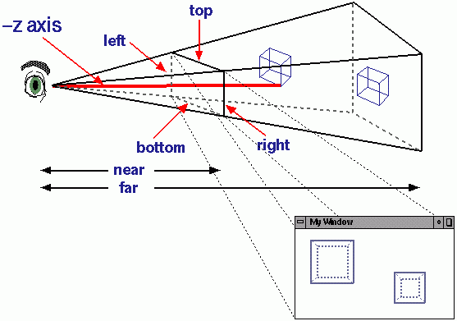
Camera
// create a camera
camera = new THREE.PerspectiveCamera( 75, window.innerWidth / window.innerHeight, 1, 10000);
camera.position.z = 1000;

Slide 7
Perspective vs Orthographic

Slide 8
Object and Scene
// create a scene
scene = new THREE.Scene();
// create geometry of a cube, width = height = depth = 200
// 8 vertices, 6 faces
geometry = new THREE.CubeGeometry( 200, 200, 200 );
// create material of the cube
material = new THREE.MeshBasicMaterial( { color: 0xff0000, wireframe: true } );
// create the mesh
mesh = new THREE.Mesh( geometry, material );
// add the mesh (displayable object) to the scene
scene.add( mesh );

Slide 9
Renderer
Canvas:
+ High compatibility : any HTML5 browser
+ Easy to code
- Low performances
WebGL:
+ Super fast, more features - Comlicated
- Low compatibility: Chrome, IE11, Firefox
// create a renderer
renderer = new THREE.CanvasRenderer();
// set the size of the renderer to full window size
renderer.setSize( window.innerWidth, window.innerHeight );
// append the renderer to html body element
document.body.appendChild( renderer.domElement );

Slide 10
Animation
function animate() {
// call animate after 1/60 s
requestAnimationFrame( animate );
// update the world
// rotate the cube
mesh.rotation.x += 0.01;
mesh.rotation.y += 0.02;
// render the scene from camera’s view
renderer.render( scene, camera );
}

Slide 11
Live demo

Slide 12
Geometry
You can use pre-defined geometry class by Three.js
Cube, Cylinder, Sphere, Cone, etc.
Or define your own geometry
var triangle = new THREE.Geometry();
triangle.vertices.push(new THREE.Vector3( 0.0, 1.0, 0.0));
triangle.vertices.push(new THREE.Vector3(-1.0, -1.0, 0.0));
triangle.vertices.push(new THREE.Vector3( 1.0, -1.0, 0.0));
triangle.faces.push(new THREE.Face3(0, 1, 2));
var squre = new THREE.Geometry();
squre.vertices.push(new THREE.Vector3(-1.0, 1.0, 0.0));
squre.vertices.push(new THREE.Vector3( 1.0, 1.0, 0.0));
squre.vertices.push(new THREE.Vector3( 1.0, -1.0, 0.0));
squre.vertices.push(new THREE.Vector3(-1.0, -1.0, 0.0));
squre.faces.push(new THREE.Face3(3, 2, 1));
squre.faces.push(new THREE.Face3(1, 0, 3));

Slide 13
Circle geometry
var circle = new THREE.Geometry();
var pieces = 50;
var la = 0;
circle.vertices.push(new THREE.Vector3(0.0, 0.0, 0.0));
for(var i=0;i<pieces;i++){
var a = (i+1)/pieces*Math.PI*2;
circle.vertices.push(new THREE.Vector3(Math.cos(la), Math.sin(la), 0.0));
circle.vertices.push(new THREE.Vector3(Math.cos(a), Math.sin(a), 0.0));
circle.faces.push(new THREE.Face3(0, 2*i+1, 2*i+2));
la = a;
}
O

Slide 14
Geometry

Slide 15
Polygon with holes
var shape = new THREE.Shape(outer_boundary);//boundary is an array of points
var hole1 = new THREE.Shape(inner_boundary_1);
var hole2 = new THREE.Shape(inner_boundary_2);
shape.holes.push(hole1);
shape.holes.push(hole2);
var polygon = new THREE.ExtrudeGeometry(shape, { amount: 0.5, bevelEnabled: false });

Slide 16
Material
Materials describe the appearance of objects.
Three.js provides a lot of pre-defined materials:
MeshBasicMaterial, MeshLambertMaterial, LineBasicMaterial, ParticleBasicMaterial, etc.
Properties:
Opacity
Transparent
Color / vertexColors
Wireframe
Map (texture)

Slide 17
Colors
squareMaterial = new THREE.MeshBasicMaterial({ color:0x0000FF });
var c = (i+1)*100.0/pieces;
face.color = new THREE.Color("rgb(" + c + "%," + c + "%," + c + "%)");
circleMaterial = new THREE.MeshBasicMaterial({vertexColors:THREE.VertexColors});
tri.faces[0].vertexColors[0] = new THREE.Color(0x0000FF);
tri.faces[0].vertexColors[1] = new THREE.Color(0x00FF00);
tri.faces[0].vertexColors[2] = new THREE.Color(0xFF0000);
triMaterial = new THREE.MeshBasicMaterial({vertexColors:THREE.VertexColors});

Slide 18
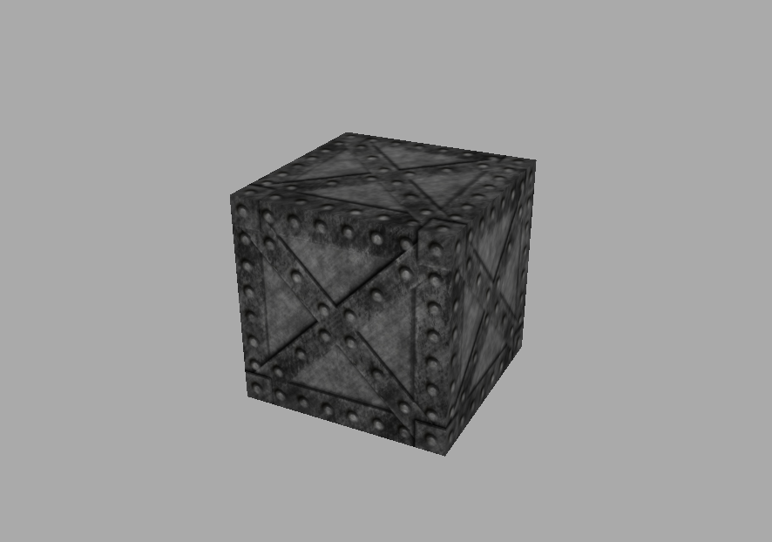
Texture
var cubeMaterial = new THREE.MeshBasicMaterial({
map : THREE.ImageUtils.loadTexture( 'textures/box.jpg' )});

Slide 19
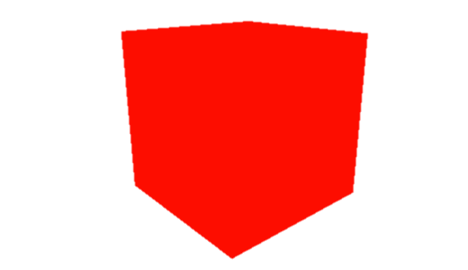
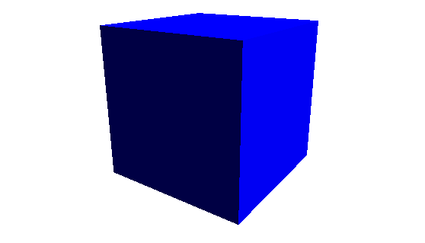
LIGHTING
To create a material that will be affected by light and shadow, we can use the MeshLambertMaterial material.
Light supported by Three.js: AmbientLight, AreaLight, DirectionalLight, HemisphereLight, PointLight, SpotLight
var directionalLight = new THREE.DirectionalLight(0xffffff);
directionalLight.position.set(1, 1, 1).normalize();
scene.add(directionalLight);
Basic material
Lambert material
with DirectionalLight

Slide 20
Point light
http://threejs.org/examples/webgl_lights_pointlights.html

Slide 21
Keyboard/mouse event
Keyboard event and Global Mouse Event
Add event listener to document element
document.addEventListener('mousedown', mouseDownHandler, false);
document.addEventListener('mouseup', mouseUpHandler, false);
document.addEventListener('mousemove', mouseMoveHandler, false);
document.addEventListener('DOMMouseScroll', mouseWheelHandler, false);
document.addEventListener('mousewheel', mouseWheelHandler, false);
document.addEventListener('keydown', keyDownHandler, false);
function mouseDownHandler (e) {
e.stopPropagation();
if(e.button==0) rotate=true;
orgX=e.clientX;
orgY=e.clientY;
return false;
}

Slide 22
Mouse event on 3d object
Not supported by DOM or THREE.js
Plugin needed: threex.domevent.js
Available events are click, dblclick, mouseup, mousedown, mouseover and mouseout.
<script src='threex.domevent.js'></script>
mesh.on('click', function(){
mesh.scale.x *= 2;
});

Slide 23
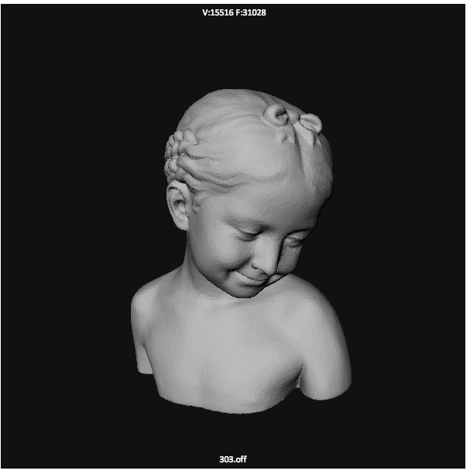
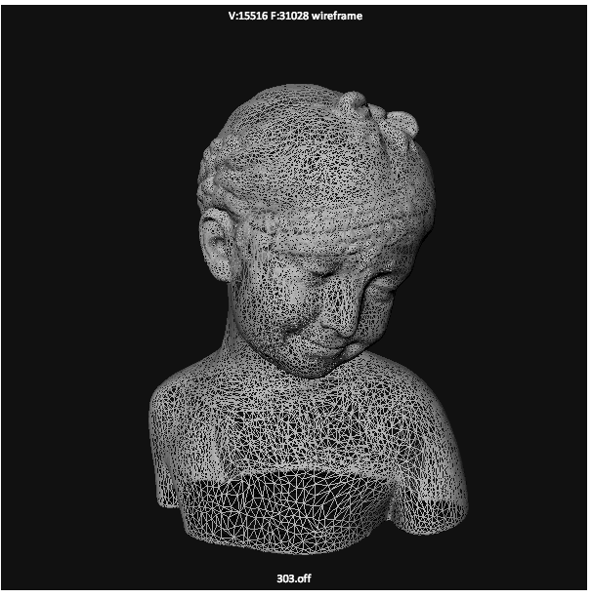
G.Viewer
A 2D/3D Model viewer based on Three.js
http://masc.cs.gmu.edu/wiki/ObjViewer

Slide 24
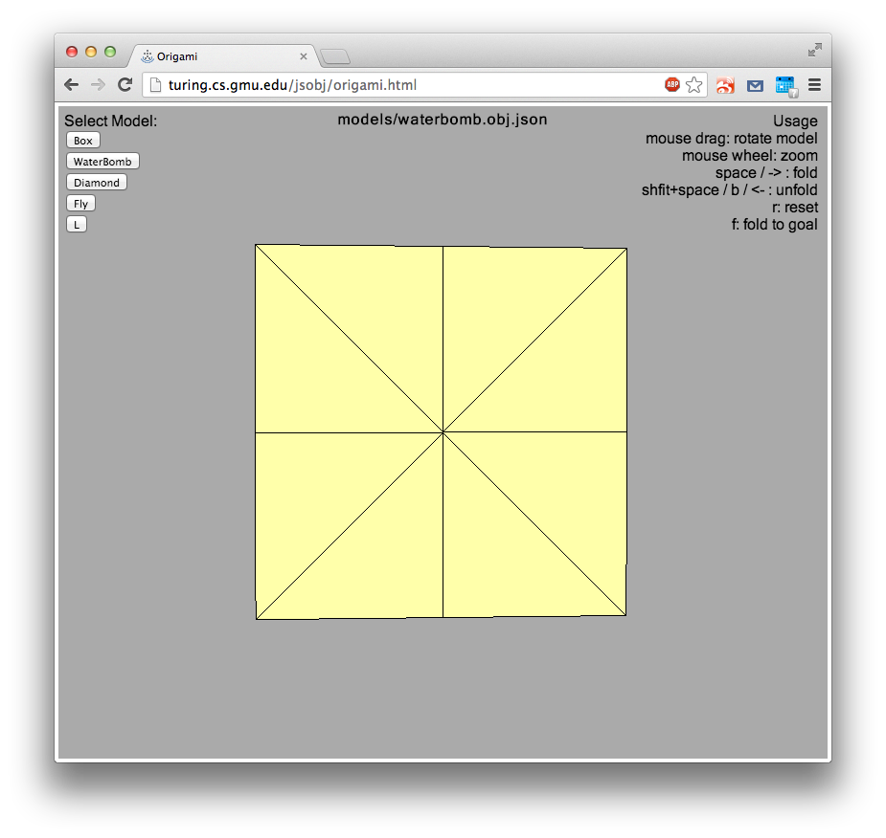
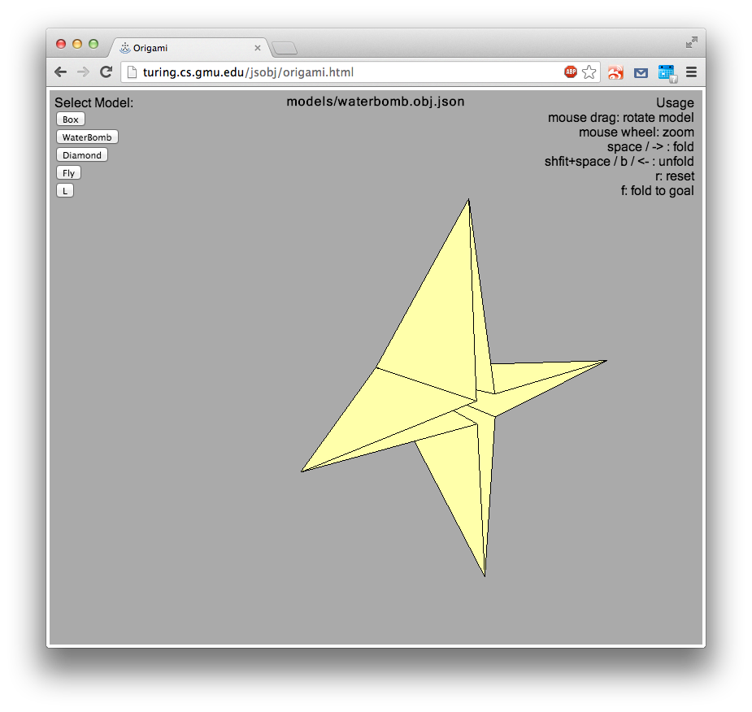
Origami simulator
http://turing.cs.gmu.edu/jsobj/origami.html

Slide 25
Demos
Examples:
http://threejs.org/examples (strongly recommended)
Trigger rally https://triggerrally.com/
hello racer http://helloracer.com/webgl/

