Slide 1
Considering Human Factors
Designing Collaborative
Machine Assistants
Randy Pitts
SWE 821, Fall 2011

Slide 2
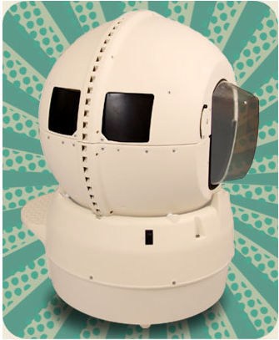
Outline
Introduction
Collaborative Machine Assistants (CMA)
User Acceptance
Design Guidelines
Conclusion

Slide 3
Outline
Introduction
Collaborative Machine Assistants (CMA)
User Acceptance
Design Guidelines
Conclusion

Slide 4
Introduction
Paper: Human Factors Consideration for the Design of Collaborative Machine Assistants
Park, Fisk & Rogers

Slide 5
Introduction…
Technological improvements:
Entertainment
Engineering
Education
Healthcare

Slide 6
Introduction…
Technological improvements:
Entertainment
Engineering
Education
Healthcare
Useful and usable assistants!

Slide 7
Introduction…
Interdisciplinary Approach
Engineering
Computer Science
Psychology

Slide 8
Introduction…
Interdisciplinary Approach
Engineering
Computer Science
Psychology
Contribution: Psychological Design Guidelines

Slide 9
Outline
Introduction
Collaborative Machine Assistants (CMA)
User Acceptance
Design Guidelines
Conclusion

Slide 10
CMAs
Affective Virtual Humans
Anthropomorphic Agents
Embodied Conversational Agents
Relational Agents
Social Robots
Assistive Robots

Slide 11
CMAs
Affective Virtual Humans
Anthropomorphic Agents
Embodied Conversational Agents
Relational Agents
Social Robots
Assistive Robots
Collaborative Machine Assistants

Slide 12
CMAs
“Performs or assists a human in the performance of a task in a collaborative manner.”
Virtual (on screen representation)
Robotic
May form long-term relationship

Slide 13
Outline
Introduction
Collaborative Machine Assistants (CMA)
User Acceptance
Design Guidelines
Conclusion

Slide 14
User Acceptance
Impacted by:
Technology Characteristics
Incremental Change or Radical Change?
User Characteristics
How individuals respond
Relational Characteristics

Slide 15
User Acceptance…
Involves:
Attitudinal acceptance
Intentional acceptance
Behavioral acceptance

Slide 16
User Characteristics
Age
Technophobia
Knowledge
Culture

Slide 17
User Characteristics…
Age
Age was traditionally correlated negatively to new product acceptance
Relates more to confidence and perceived ease of use, than age

Slide 18
User Characteristics…
Age
Age was traditionally correlated negatively to new product acceptance
Relates more to confidence and perceived ease of use, than age
Training Programs diminish fears

Slide 19
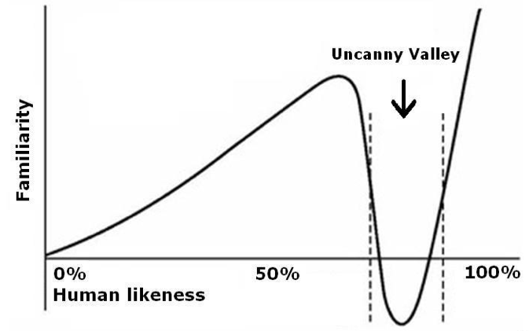
User Characteristics…
Technophobia
Fear or dislike of [new] technology
“Uncanny Valley”

Slide 20
User Characteristics…
Technophobia
Fear or dislike of [new] technology
“Uncanny Valley”

Slide 21
User Characteristics…
Knowledge
Of a product group
Prior knowledge
Continuous evolution seems OK
Radical changes are more stressful

Slide 22
User Characteristics…
Knowledge
Of a product group
Prior knowledge
Continuous evolution seems OK
Radical changes are more stressful
Consider user population when designing

Slide 23
User Characteristics…
Culture
There are sometimes inexplicable cultural differences
Uncertainty avoidance?
Collectivist (more or less)?

Slide 24
Technology Characteristics
Perceived Usefulness
Perceived Ease of Use
Perceived Complexity
Perceived Social Skill (of the CMA)

Slide 25
Technology Characteristics
Perceived Usefulness
Expectation of improving performance
Summary measure of all benefits
More important than ease of use

Slide 26
Technology Characteristics
Perceived Usefulness
Expectation of improving performance
Summary measure of all benefits
More important than ease of use
Include users from the start!

Slide 27
Technology Characteristics
Perceived Ease of Use
Effects initial acceptance heavily
Flexibility helps

Slide 28
Technology Characteristic
Perceived Complexity
Complex systems may be discouraging

Slide 29
Technology Characteristics
Perceived Social Skill
An interface with “social intelligence” is viewed positively
Wizard of OZ technique is good for designing

Slide 30
Relational Characteristics
Relationships
A goal of many CMAs is to establish relationships with users
Beginning v. Maintaining Relationships
Service v. Advisory Relationships

Slide 31
Outline
Introduction
Collaborative Machine Assistants (CMA)
User Acceptance
Design Guidelines
Conclusion

Slide 32
Design Guidelines
Not unlike good practice
User-centered design principles
Extensive end-user attention, in all phases!

Slide 33
Design Guidelines …
Users should be carefully ID’ed
Age
Cultural background
Experience with technology
Well-constrained group, or broad group
etc

Slide 34
Design Guidelines …
Sample Questions (user perspective):
Are users accepting of CMAs?
What tasks require assistance?
What kind of “intrusion” is acceptable?
What kind of social interaction is OK?

Slide 35
Design Guidelines …
Sample Questions (user perspective):
Are users accepting of CMAs?
What tasks require assistance?
What kind of “intrusion” is acceptable?
What kind of social interaction is OK?
Conduct training!

Slide 36
Design Guidelines …
Sample Questions (technical):
Perceived need for CMA?
Will CMA solve a problem?
Will CMA be easy to use? Complex?

Slide 37
Design Guidelines …
Sample Questions (technical):
Perceived need for CMA?
Will CMA solve a problem?
Will CMA be easy to use? Complex?
Conduct Usability studies with users

Slide 38
Outline
Introduction
Collaborative Machine Assistants (CMA)
User Acceptance
Design Guidelines
Conclusion

Slide 39
Conclusion
In practice
Good SWE practice is appropriate for CMA, but
CMA is very complex, so it’s even more critical to follow good practice
Testing is also more complex

Slide 40
Conclusion
From the paper
Authors present heuristic guidelines, from a psychological perspective, to help in the design process

Slide 41
Title

Slide 42
Title

Slide 43
Title

Slide 44
Title

Slide 45
Title

