Slide 1
End-user Customization of Intelligent Environments Chen, Vallaghan, Clark
Patrick Davis
Notes:
I customized by changing the spelling of Customisation
Relevant quote: Do I really need to read the functional specification… because if your program does not function the way that I expect to I will make you change it. Even if the spec says otherwise.

Slide 2
Meet the Jetson’s (only not as primitive cause sprockets are so 2012)
Imagine if all devices could speak
Visualize a central device that can speak that language
How far away are we…
Meta – Appliances or Meta – Applications (MAps)
Notes:
A lot of devices currently in the home connect to home networks speak. The Authors extend this reality and foresee homes will have more and more network capable devices with services that allow these devices to be interacted with.
The authors also foresee middleware that can discover these devices and their services, combine them and create a new composite virtual appliance (When an physical appliance is connected to another appliance to perform an new function)
By extension this middleware will make these services accessible to an end user. Allowing the user to gain functionality by interlinking devices. A simple example, from my own point of view, when an end user leaves the home, all connected appliances go into power saving mode. The paper goes into later how the devices connect and how the End user will “program” what a power saving mode is and even what defines leaving home.
Food for thought… How far away from interlinking devices are we…
Currently manufactures make independent devices that connect to the internet… TVs that connect to the internet to stream Netflix. There are home file servers store and display pictures and home videos to connected devices, and even thermostats that are wifi capable that allow you to set temperatures from the network (for sale at home depot for $100) .
Is it to far a stretch to have middleware that can communicate with the TV, home file server and thermostat and thus making MAps?
Maps -- Let’s say we where to take every device in our house and provide a software wrapper for them in such a way that the end user can reconfigure and connect the appliances. This can create new applications or even new virtual appliances.
The authors do not talk about auto discovery but it is a natural question on how these devices will connect to the middleware.
A challenge exists in how we get the non technical people to do this.
This brings us to the crux of the problem and the topic of the paper. How do we accomplish this connection so the end user can decide the functionality and the use of new virtual appliances or applications. (especially for end users that do not turn off a computer for fear of breaking it)
It should be noted the authors focus on PIP and the service model of MAps

Slide 3
Customizing Digital Homes
Rules
Pre-Programmed Rules
Agent Programmed Rules
User Programmed Rules
Program by Example
Atomic & Nuclear Functions
Notes:
Rules – Form behavior that describe the methods that a given appliance or service interacts with other appliances or services. Rules form a common approach to customizing homes and environments. The paper divides rules into three sections.
Pre-Programmed Rules: Describe prepackage rules that the developer/manufacturer fixes the rules for coordination before the produce is supplied to the end users. This is where the programmer tries to decide the future use (what functionality is available) and what devices will work together. This limits the flexibility between preprogrammed tasks
One of the ways we can remain flexible is to make the rules small and atomic. This allows the rules to be composed into larger actions. A disadvantage to this is to some extent programmers must “guess” what the user needs.
Agent Programmed rules: These are rules formed from the use of intelligent agents. In general these are pre-emptive decision making systems that utilize models derived from monitoring past behavior to predict the users next actions. Agents are self-governing , and learn new rules based on past behavior.
One way to enable agents to act integelently is to have all the services and their attributes listed to allow for a similarity search and service aggregation to be accomplished. Another involves the middleware that can make decision on the users preferences and also make decisions on device replacements based on device attributes.
User Programmed rules: These are rules formed from explicit guidance from the end user hence end user-programming. This can be done though graphical user interfaces. The author mentions that the user program can “generalize” the program so that it can work in similar situations but not exactly the same as what is described this is called program by example PBE.
PBE can be views as merging user requirements and the program functionality thus reducing the gap.
Atomic and Nuclear functions are functions at the smallest point of decomposition. To make the rules (and thus functionality) these atomic functions are grouped together to form the Map.

Slide 4
Pervasive interactive Programming (PiP)
End User Programming
Program By Example (PBE)
For Non techies
Creating Maps
Atomic & Nuclear Functions
Notes:
The goal is now to make the smart home customized to the creativity of the user
PIP is a form of end user programming meant to address the creativity and security of a smart home.
This allows the non technical to create rules for the smart home and affect their environment though appropriate GUI support
PIP – Is an end user programming that simplifies the end user setting rules for the system
PBE – Is the case where the program (most often user programming) is generalized so that the program can be used in similar situations that not exactly the same.
Atomic & Nuclear Functions – are functions that are atomic and perform the simplest of tasks

Slide 5
Meta – Appliances / Applications (Maps)
What is it again?
What is the difference between a MAp and a Task
Notes:
The smart home needs to have customized functionality. An example is provided in the texts
Janet is watching the news on TV in the living room when an interesting news item starts. She calls up John to watch the same program. John is currently upstairs listening to a web audio broad cast. He in starts the TV application that uses the same audio device for the TV as the web audio which is now paused. Once the report finishes John turns off the TV application and the web audio resumes from where it was last paused
The difference between a task and a Map… A task refers to a set of functions, actions, that are required to be performed via a specific command and thus requires expertise to setup. A Map although it may provide the same functionality that a task provides it is an ongoing – non termination process that requires no expertise for its formation. A Map can provide the same functionalities that the user originally created as a continually running process.
My example a task would be the functions in the web audio wrapper that is told to play the TV sound. Where as the Map would be the actual accumulated function of the playing of the TV show along with the web audio pause.

Slide 6
PiP System Architecture (Terms)
Interaction Execution Engine (IEE)
Event Handler (EH)
Knowledge Engine (KE)
Real-time Map Maintenance Engine (RTMM)
Real-Time Rule Formation Engine (RTRF)
GUI (PiPView)
Notes:
IEE: Module that manages communication between PiP components. It can interface with components at a low network level. It passes signals to the knowledge engine and for outbound event passes network actions though to the network.
Responsible for
Device Discovery
Service events
Subscription
Performing network action requests
EH: This module is the message handler that passes events between interested parties. Each party needs to register with the Event Handler in order to receive the proper events and data.
KE – This mod assembles and instantiates a MAP it also updates the record of a device status as well maintaining the content of the knowledge bank and keeping it up to date. Using the knowledge bank it keeps interested parties aware of device status.
RTMM: This module maintains all MAP records for event handling. When the user connects components this registers with the HE that these components need to be
associated with an event
RTRF : assembles the rules formed by monitoring the user interactions during the demonstration mode in the PiPeditor. It registers with the EH to get the events from the knowledge ending Map, GUI and the users activities. At the end of a demonstration the rule fragments gathered though the demonstration forms the Map
GUI is the module provided to interact with the system. Includes a drag and drop designer, device control panel and help screen

Slide 7
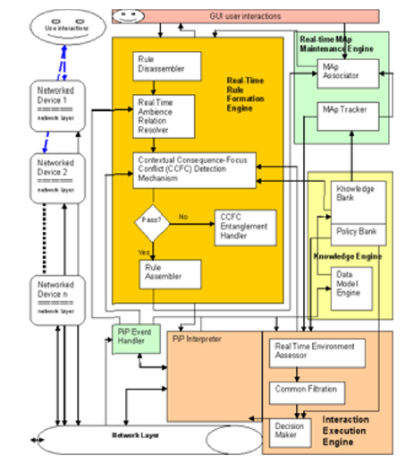
PiP Architecture (Diagram)
Notes:
Happy faces are end users

Slide 8
How the System Works
Program functionality
Create a MAp
Resolve Conflicts
To Run a Map
Notes:
All devices networked can be considered user interfaces and user can use them to start the Map or for design during demonstration. To create a map though the user does need to log into the supplied GUI. The technical process to create a Map is
A user logs into the system though PIPView
The Interaction execution Engine Mod completes a network discovery cycle and reports the devices to the Knowledge Engine
The Knowledge engine (though the Event handler) informs all registered devices
The user then starts the demonstration though
Interacting with the device
Using the GUI
Combination of both
The real time rule formation engine listens for the user interactions that are communicated to the event handler
This is then encoded to a set of rules
A rule disassemble (in the RTRFE) separates the antecedents and consequents. Then are shaped by a real-time ambience relation resolver which resolves relationships of information received from the internal system to the user. To avoid conflicts a contextual Consequence Focus Conflict Detection Mechanism tests whether the users current action conflict with other Maps
To resolve conflicts PiP will
Gather the information in the conflict
Isolate the conflicting actions from those in the current Map
Present Conflicts to the user so that he may avoid the conflict in the future.
To Play a MAP the user just drags the map on the GUI to the play mode (a little weird considering every device is a user interface)

Slide 9
dComp Ontology
What is it?
Why is it needed
Decomposed Community Programming
Notes:
ontology formally represents knowledge as a set of concepts within a domain, and the relationships between those concepts. It can be used to reason about the entities within that domain, and may be used to describe the domain.
This is a standard manner that all parties on the system can understand and forms the core internal vocabulary for information with in the network space.
In order to implement a set of explicitly well-defined vocabularies was needed to model the decomposed devices and the communications they form, the services they provide and the rule they follow to the actions that they take. The author mentions that existing ontology does not have key PIP mechanisms like decomposing functions and coordinating actions. Most of dcomp relates to decomposing and community leading to the name

Slide 10
Class types in dComp
Device class
Hardware Class
Community Class
Rules Class
Action, Person, Policy and Time Class
Preference Class
Notes:
I am not going to make the class sit though xml examples but that is what most of these examples look like. The author does not go into syntax so I will not either.
Device class – This class provides a generic description of all PiP Devices.
Hardware Class – This generalizes all PiP hardware that exists in a device class. Every device must offer their service to the system. So to use the hardware the caller must reference both the device that he uses and the service that it provides
Community Class – This is the grouping of devices that act together. There are 3 types
Solo Community – for devices that are not yet connected
Persistent Community for communities that are permanency
Transitory Communities for devices that hop from one community to another.
Rules Class– this coordinates community actions there are three types
Unchangeable
Persistent rules (rules that do not change often) like the time you set the alarm to get up for work.
Non-Persistent Rules (rules that change often) Example the number of times you press the snooze alarm after fall DST shift. First day not at all, second day more and by the third day you just learn to sleep with your hand on the button.
Action, Person, Policy and Time Class: These are classes extended by SOUPA. The author does not go into policy , person and time
Action is the union of permitted action and forbidden action for the targeted device
Preference Class: This provides a mechanism where the person can define a preference based on a situation.

Slide 11
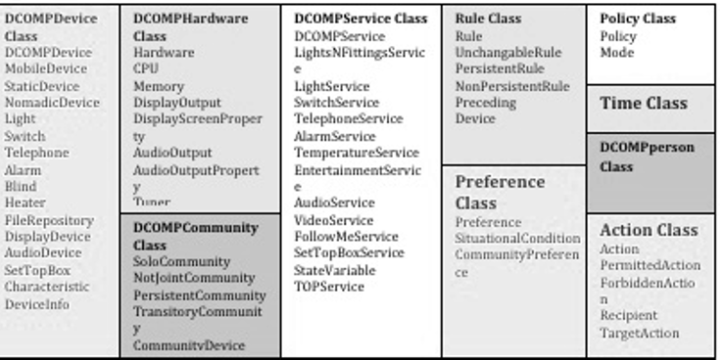
Class types in dComp

Slide 12
Evaluation
dComp Performance
PiP Evaluation
Results
Performance of PiP
Questionnaire Rating
Notes:
This was a proof of concept trial using the digital home iSpace house in Essex. Basically a 2 room apartment with lots of toys. It has space for the network cables to be hidden and a quarter a million “pounds” of networked equipment varying from appliances, sensors actuators though to special purpose equipment to support user trial. All function are controlled electrically.
Ontology can be computationally demanding and the author was concerned about not performing well in large domains. To evaluate performance the author submitted the XML in a format for all – in one that contained device information and hardware and service information in the same format. The second submit was for each segment to be broken up into hardware and service information with each segment. The information was then tested with 4 groups
3 in the all in one
3 in the decomposed
32 in the all in one
32 in the decomposed
In all with the smaller domains the decomposed ran in about half the time as the all in one. For larger domains both ran in the same amount of time. (the reason as to why is out of scope)
The PiP eval was developed with the assistance of a socio-technical research unit and focused on the usability of PiP with in the areas of (cognitive physic areas)
Conceptual
User Control
Cognitive Load – basically how hard is it to figure out what to do next when learning the system
Information Retrieval – how well information was displayed to the user
Affective Experience – the gut reaction to the system
Future thoughts -- how you will think you use it in the future
Each participant was given a questionnaire with statements and rated the statement between agree and disagree. There were minum constraints place on time , methods and tasks so that the users decided how to use the system.
There where 18 participants all with minimal computing experience (mouse and keyboard) 20% had lots programming experience and shy of 20% never did. 20 minute training was given to each person. Each was give five sets of devices drawn from a set of lights, telephone, smart sofa and an MP3 player and asked to create collective behavior of their own design. No Time limit was given to any participant and assistance was provided where needed. (I question this methodology, as if I was given a quarter million pounds of toys to play with I would be pretty happy about the experience too even though it was limited I could leave when I got bored…)
In evaluation all dimensions rated well (above 4 out of 5). After the 20 minutes of training 83 percent (15 people) of the individuals where able to use PiP with little or no assistance. Time to complete tasks was not measured but it ranged between 2-5 minutes. None of the subject found the principles difficult to understand.
On the questionnaire Affective Experience rates highest and Information Retrieval rated the lowest. The younger set found the system easier to use but difficulty did not vary across races or cultures.

Slide 13
Conclusion
Non-techies will be a part of the smart home
Rules are the key
An Interface that is easy to use
Notes:
Non-techies will be a part of the smart home.. As smart homes develop non technical persons will be user in this environment and they must be empowered to alter their environment. The easiest way to do this is programming but since they are non technical they must program simply and by example.
Rules are the key… as the programming continues the rules are an alternative to self learning as when the user want to expeclicity define behavior self programming allows the rules to be formed by the user easily.
An Interface that is easy to use. The author created a simple to use interface that seemed to be received well by the user base.

Slide 14
Questions or Comments

