Slide 1
Sharing Content and Experience in Smart Environments
Johan Plomp, Juhani Heinila, Veikko Ikonen, Eija Kaasinen, Pasi Valkkynen

Slide 2
Outline
Experience
- Definition
- Design Modeling
- Sharing
Prosumers
Smart Environment and Experience Sharing Features
- Ubiquitous Computing to Digital Ecologies
- Multimedia Storage and Retrieval
- Context and Metadata
Research Examples

Slide 3
Experience
Definition
- Primary Experience
- Secondary Experience
- Emotional Experience
Design Modeling
- Factors
- User Experience Factor Groups : Internal, Social, Cultural, Context of Use, Product Aspects
- Experience Pyramid

Slide 4
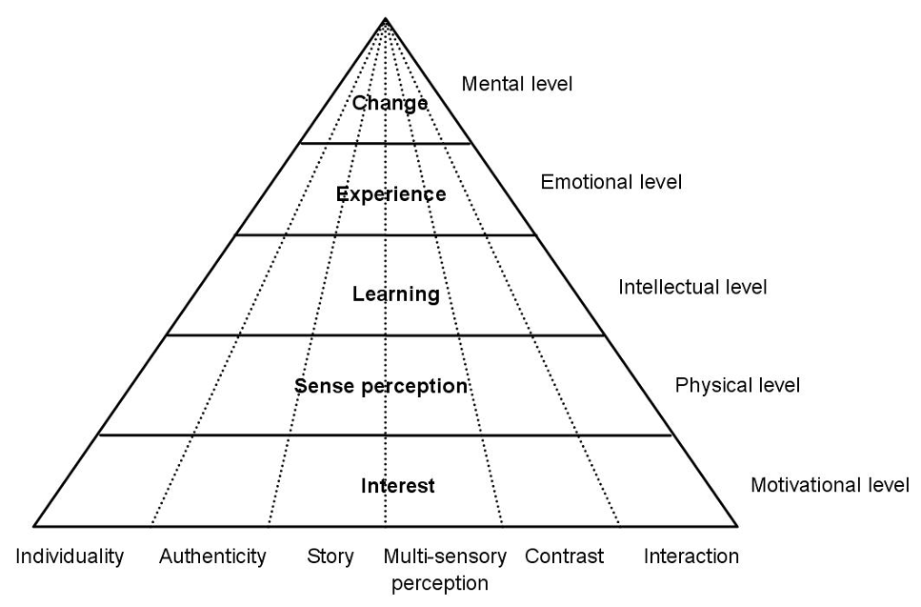
Experience Pyramid

Slide 5
Experience Sharing
Role of the user in the user experience design
Factors of the user experience
Significance of sharing
Co-experience

Slide 6
Prosumers
Social Media : User’s role
Bottlenecks of social media adaptation
- Security and Trust
- Digital Identities
- User’s Rights
- Usable Content Creation Tools
- Sharing and Storing
- Manage and Benefit of the information flow

Slide 7
Smart Environment and Experience Sharing Features

Slide 8
Ubiquitous Computing to Digital Ecologies
Environment an Ecology – shaped by constantly changing technology and users
Ubiquitous Computing Vision(UBI) → Ambient Intelligence(AmI) → Digital Ecology(ECO)
Ubiquitous Computing Vision(UBI)
Ambient Intelligence(AmI)
Digital Ecology(ECO)

Slide 9
Multimedia Storage and Retrieval
Earlier times
Photographs and Libraries
Tape Recorders and Copy Machines
CD and DVD
MP3
Digital age
Web → Instantaneous sharing of content

Slide 10
Context and Metadata
Semantic Web
Ontologies
Folksonomies
Metadata – Information about the Content

Slide 11
Examples of Research

Slide 12
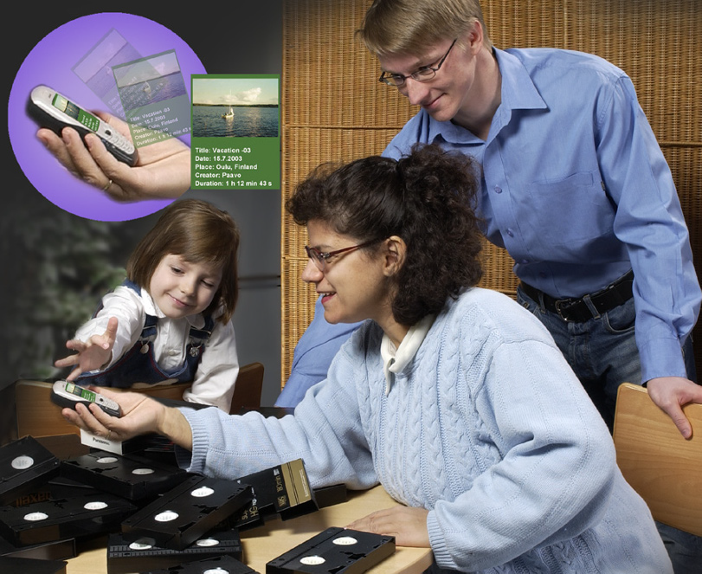
Candela

Slide 13
Candela
Identifies challenges related to growing amount of content
Allowed contents and user interfaces to be scaled for the available network and rendering client
Use of metadata with videos allowed enhancement
System capable of delivering videos over direct and wireless connections scalable to the client needs

Slide 14
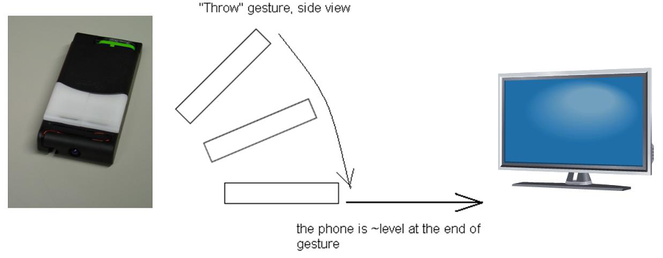
Nomadic Media Project

Slide 15
Nomadic Media Project
Developed ways to ease access and manage mobile content and services
Focused on the use of context information for adapting services to users needs
Tools developed to build a flexible service to change based on client device features/preferences
Use of gestures to enhance interactions and control environment were researched
Vocabulary based on the semantic gestures

Slide 16
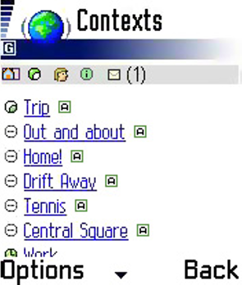
Kontti
Developed concepts and tools for offering context aware mobile services
Platform provides personal management and sharing of contexts information, content adaptation, context aware messaging
Frame based context ontologies specifying operations applied to any hierarchical level
User can create, edit contexts, monitor contexts, publish

Slide 17
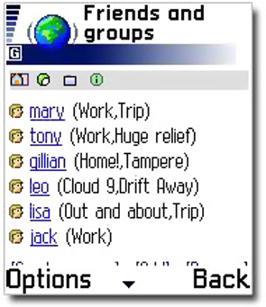
Kontti
Enabled user to send context aware messages to specifies target recipients
Object attaching to a message introduced
Users can define their own contexts called Zones
User defined contexts helped in understanding user’s significance in context management

Slide 18
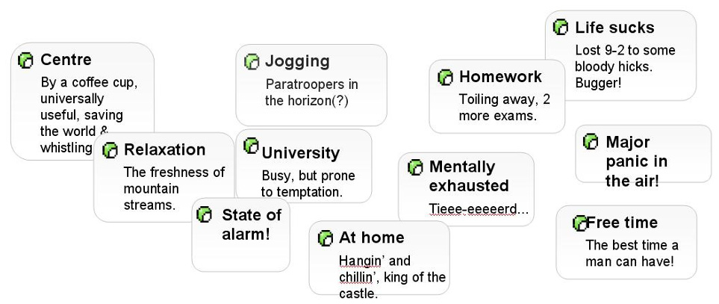
Kontti

Slide 19
m:Ciudad
Based on the vision that mobile devices providing service access should also allow service provision
User generated services relatively simple to create and use equipped with a limited amount of information called Micro-services
Users become prosumers
Will lead to more user-centric, targeted, relevant and usable services shared within the group defined
User interfaces now used to create, manipulate and manage services for a individual device

Slide 20
ExpeShare
Experience sharing in mobile peer communities
Intended to go beyond content and focus on peer communication
Researches feasibility of peer networks , services to manage on these networks
How to capture and share experiences
Mobile users should be able to exchange content and experiences
Various levels of peer to peer communication
Physical - two devices talking directly
Network - sharing content via network technologies
Service Provider – allowing end users one to one contact

Slide 21
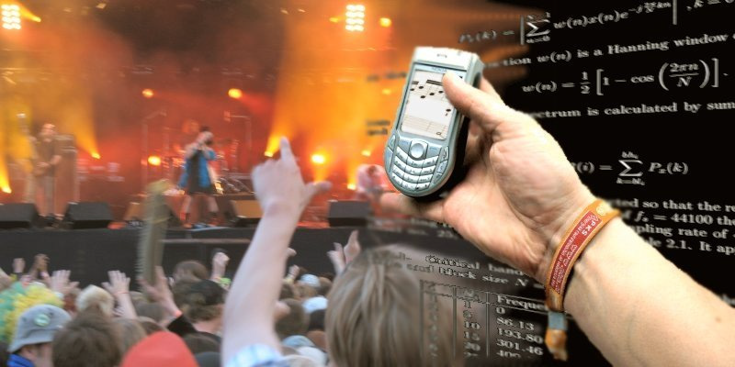
ExpeShare
Also addresses how context and presence information is distributed
how life information can be delivered

Slide 22
Ubimedia based on Memory Tags
MINAmI(Micro Nano integrated Platform for traverse Ambient Intelligence) developing a platform for accessing sensors and tags embedded in the environment.
This architecture facilitates various AmI applications one of them is development of memory tags.
Memory tags are passive(no own energy source)
Application of memory tags – ubimedia(concept where media files are embedded into everyday objects
Facilitates easy access to physical objects.

Slide 23
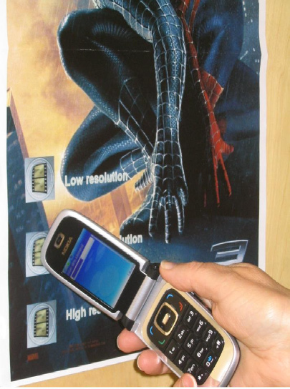
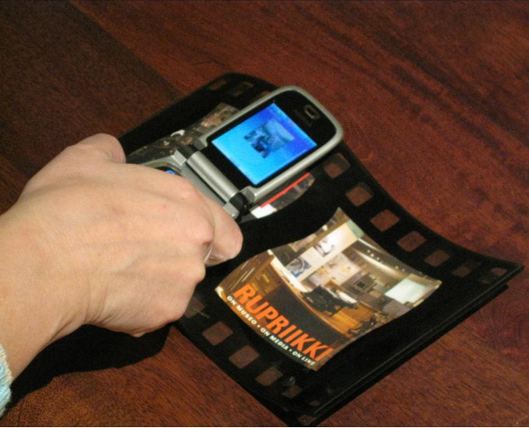
Ubimedia based on Memory Tags

Slide 24
Ubimedia based on Memory Tags
Memory tags facilitate large amount of storage of data which can be downloaded without a network connection
After the evaluation of proofs of concept for readable and writable tags it is seen that users prefer ubimedia over web downloads on cell network
Memory tags embedded in the physical environment will also extend social media to social ubimedia

Slide 25
Thank You
Questions?
- Akshay Pimprikar

