Slide 1
Smart Offices and Intelligent Decision Rooms By Ramos, Marreiros, Santos, and Freitas
Nancy Shah
October 19, 2011

Slide 2
Introduction
“Nowadays computing technology research is focused on the development of Smart Environments… to define a desired state for its inhabitants and perform adaptation to [their] desires and therefore improving their involvement and satisfaction with the environment.”
Notes:
Goals for Smart Offices and Intelligent Decision Spaces. Talking about determining the state, adapting to their desires, and improving their involvement and satisfaction with their environment. For example, adaptive lighting.

Slide 3
Introduction (cont.)
“…’intelligent’ or ‘smart’ environments and systems interact with human beings in a helpful, adaptive, active and unobtrusive way. They may still be proactive, acting autonomously, anticipate user needs, and in some circumstances the may even replace the user.”
Notes:
Group decision is one of our most coveted human traits. Now we are trying to replace the human in the process. Why? Because we now have increased business opportunities and there is intense competition. We need fast decision making to succeed. If any of you have tried to make a decision with someone overseas you are aware that takes longer to talk about ideas and to make a decision. Instead of a few hours… it might take a few days. We have to deal with time zones and differing holiday calendars, etc.
We want these environments to “[promote] an easy management, efficient actions and, most importantly, to support the creation and selection of the most advantageous decisions”.

Slide 4
Evolution of Our Environment
In-person meetings
specific time and specific place
Over the phone meetings
Meet at a specific time either over the phone or in-person
Postal Mail Meetings
Letters received and then response mailed
Web Meetings
Visual over the web and audible over the phone at a specific time
Email Meetings
Communication via Reply All can be done at any time
Shared Document Meetings
Update a shared document in response to questions by a due date
Comment Meetings
Commenting on a published topic at any time
Notes:
Let’s take a step back and look at how our environment has changed. Let’s get our mind around how we have meetings and make decisions on a daily basis in our lives.
Started as a definite time and location. Slowly moved to become non-location based. Now moving to non-time based and non-location based. Examples are Evites, Email Announcements, Google Docs, Blog Comments, Survey Monkey. All are trying to accomplish something different and each style of meeting has a different purpose. We also have surveys that are a type of meeting.
Wouldn’t it be great if when you got an evite, it would check your calendar and automatically reply and add it to your calendar if appropriate? Wouldn’t it be great if it knew certain events like jewelry parties that you did not want to attend and would automatically respond appropriately to that? What about only accepting invitations to those that you prefer to spend time with?
Extend that concept to collaboration… What if you could have evite negotiate a time to have a end of season party with others automatically based on each user’s preferences and feelings about a specific day or time? It could use Survey Monkey to understand the user’s preferences and feelings towards different ideas and then automatically negotiate between the users. Based on the results would automatically generate an evite to the group.
Better yet, it could analyze your Google calendar and understand how you like to spend your time and then generate your preferences for you. It could data-mine your email and GPS history to determine when you like to do certain activities and then generate your preferences and feelings towards doing certain activities or doing activities at certain times.

Slide 5
Characteristics of Meetings
Important events involving people at different locations
Ideas are exposed
Alternatives are considered
Argumentation and negotiation take place
Affected by the emotional and rational aspects of participants

Slide 6
Decision Making Tasks
Reactive and Rule-Based Decision Systems
Action triggered when all conditions satisfied
Planning Algorithms
Decision making agents autonomously select the best actions
Learning Algorithms
Autonomous adaptation to the inhabitants by the system
Notes:
Smart offices are used for decision making. There are three main types of ways they can be implemented.
Reactive and Rule-Based Decision Systems have a set of facts and rules representing the various states of the environment and its inhabitants. Actions are triggered when all conditions satisfied. This technique must be constructed by the programmer or the user.
Planning Algorithms have a model of the environment, the available actions, the resulting effects, and are able to generate a solution in the form of a sequence of actions that lead to desired tasks’ objectives. They use decision making agents to autonomously select the best actions.
Machine Learning Algorithms techniques have a highly complex environments to be controlled according to the preferences of its inhabitants and solution pass by hierarchical multi-agent systems with reinforced learning. But, they require the inhabitant or the programmer to provide a training set of data to the system. And pose many challenges to safety considerations and computational efficiency in large scale environments, but has the possibility to perform many useful tasks, improve comfort, and be energy efficient.
To summarize, smart offices are an environment that can adapt itself to user needs, release users from routine tasks, change the environment to suit their preferences, and access services available at each moment by customized interfaces. All of those factors as used to improve the efficiency of decision making.

Slide 7
Timeline of Projects
Intelligent Environment Laboratory of IGD Rostock (2002)
Ambient Agoras (2005)
Active Badge (1992)
Stanford’s Interactive Workspaces (2004)
MONICA (1999)
Sensor-R-Us (2005)
Smart Doorplate (2003)
Notes:
Active Badge – Badge that user wears when inside building. Allows receptionist to locate user and transfer that user’s incoming calls to the nearest phone.
MONICA – Anticipate user intentions and augment the environment to communicate useful information through user monitoring. Used gesture recognition, 3 dimensional mouse, a magic board, magic desk, finger and click detection, virtual assistance, support for distributed collaborative work, user tracking, face recognition, activity detection, and an internet agent.
Intelligent Environment Laboratory of IGD Rostock – Creates an interactive environment based on multimodal interfaces, and goal-oriented interaction (deviates from the normal function oriented interaction). Uses speech analysis and recognition, dialogue management system, context manager, different sensors for perception, planning assistant, scheduler, and lots of devices.
Smart DoorPlate – Performs simple secretarial tasks (for example: accept and forward messages). Display note and change them remotely. Has a person tracking system, additional sensors (for example detect if door is open), and actuators like door locks. Focused on the scenario of visitor direction services. Is peer-to-peer unlike usually client-server systems.
Stanford’s Interactive Workspaces – Focus on augmenting a dedicated meeting space with technology such as large displays, wireless/multimodal I/O devices, and seamless integration of mobile and wireless “appliances” including handheld PCs. Table was designed to look like a standard conference room table, but was actually a 3’x4’ display. System infrastructure is a middleware infrastructure tying together devices that have their own low-level operating system.
Sensor-R-Us – Uses “base stations” and “personal sensors” to detect the occurrence of meetings.
Ambient Agoras – A social architectural space that supports collaboration, informal communication, and social awareness. Can take certain self directed actions based on previously collected information and leaves the human out from the decision process. Empowers function in the foreground to empower users to make decisions and take mature and responsible actions.

Slide 8
Intelligent Decision Rooms
Support distributed and asynchronous meetings
Needed for today’s global nature of business
Drive attention to the problem
Keep minds from wandering on needless issues
Support multi-user interaction in real-time
Reuses past information in an intuitive, efficient, and intelligent way
Consider emotional factors of participants for argumentation process

Slide 9
Timeline of Project
SMaRT (2003)
MIT Intelligent Room Project (1997)
M4 and AMI (2004)
IDIAP Smart Meeting Room (2002)
NIST Smart Space Project (2003)
Notes:
MIT – Has two components: one is reactive and the other is adaptive. They believe that these environments should assist the user rather than requiring the user to attend to everyday activities. Supports change and adapts. Change is initiated by anonymous devices customized to users, by explicit user requests, by the needs of applications, and different operating conditions.
IDIAP – Data recorded is precisely synchronized so that every microphone, pen-stroke, and video sample can be associated with simultaneously captured samples from other media streams. Uses XML to catalogue all data which is accessible with an off-line interactive browsing system.
SMaRT – Provides meeting support services not requiring explicit human computer interaction. It enables the room to react to appropriately to user’s needs which maintains the focus on their own goals. Collects data on behaviors and analyzes the participants’ interactions and activities on the meeting.
NIST – Sense on-going human activities and respond to them. Integrates components from multiple sources, (extracts low-level semantic descriptions in the form of annotations from the data streams from which it infers higher-level annotations about the users tasks in the meeting context.)
M4 and AMI – Multi Modal Meeting Manager – Translate captured information into annotated meeting minutes that allow for high-level retrieval questions. Enables structuring, browsing, and querying of an archive of automatically analyzed meetings. (Augmented Multi-party Interaction enhances the value of the multi-modal recordings and to make human interaction more effective in real-time.)

Slide 10
LAID Project
Laboratory of Ambient Intelligent for Decision Support
Notes:
GECAD Intelligent Decision Room:
Interactive 61” Plasma screen
Interactive holographic screen
Mimio Note grabber
An interactive 26” LCD screen (6 of them) used by 3 decision points
3 cameras, microphones and activating terminals controlled by a CAN network

Slide 11
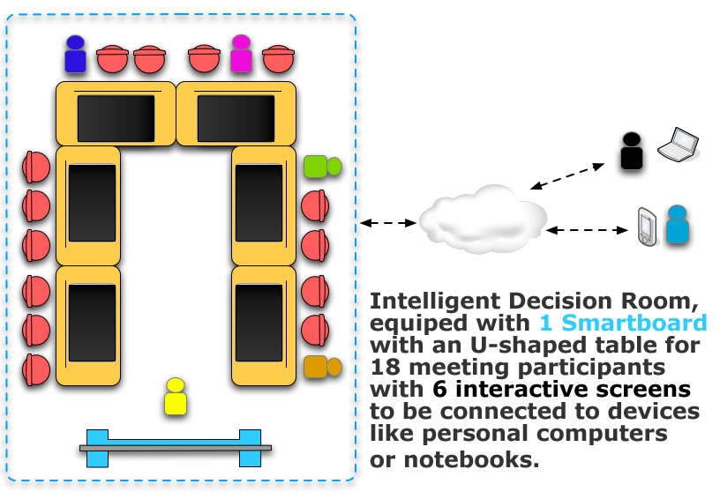
Intelligent Decision Room
Notes:
GECAD Intelligent Decision Room:
Interactive 61” Plasma screen
Interactive holographic screen
Mimio Note grabber
An interactive 26” LCD screen (6 of them) used by 3 decision points
3 cameras, microphones and activating terminals controlled by a CAN network

Slide 12
Characteristics of Meetings
Important events involving people at different locations
Ideas are exposed
Alternatives are considered
Argumentation and negotiation take place
Affected by the emotional and rational aspects of participants

Slide 13
Main Features
Supports distributed and asynchronous meetings
Participants can participate where ever they are
Uses computer networks
Shares information and services
Emotion handling is included
Supports past review in an intuitive way

Slide 14
Ubiquitous Group Decision Making
Interactive computer-based environment
Supports concerted and coordinated team effort towards completion of joint tasks
Reduce the loss associated to group work
Improve the gains of group work
High quality information and content
Available to any user, anywhere, at anytime and on any device
Notes:
Group work losses are attributed to being time consuming, having high costs, improperly using group dynamics.
Groups are better to understand problems and detect flaws, participant’s different knowledge, and processing skills allow results that could not be achieved individually.

Slide 15
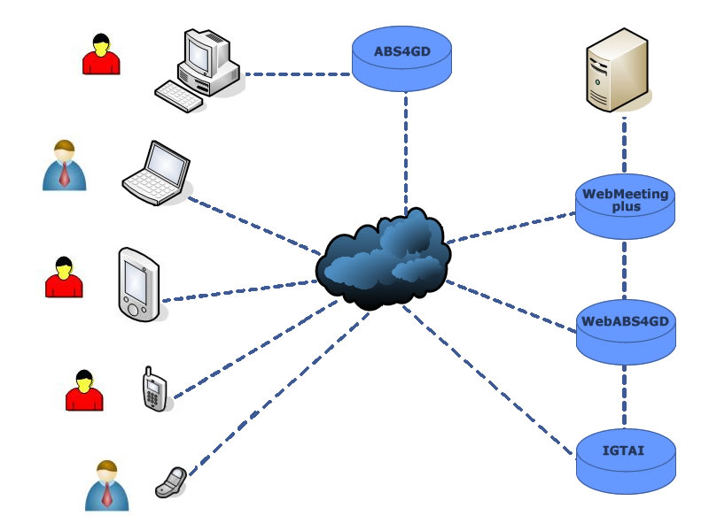
Ubiquitous System Architecture
Notes:
• Use a simplified model of Groups and Social Systems for Decision Making processes, balancing Emotional and Rational aspects in a correct way
• Use a decision making simulation system to support meeting participants. This will involve the emotional component in the decision making process
• Use an argumentation support system, suggesting arguments to be used by a meeting participant in the interaction with other participants
• The mixed initiative interface for the developed system
• The availability of the system in order to be used in any place, in different devices and at different times.
Some of the Components:
WebMeeting Plus
ABS4GD (Agent Based Simulation for Group Decision)
WebABS4GD
IGTAI (Idea Generation Tool for Ambient Intelligence)

Slide 16
WebMeeting Plus
Group Decision Support System (GDSS)
Audio and Video streaming
Focused on multi-criteria problems
Provide support for activities associated with the whole meeting life cycle
Allows participants to post arguments in favor/neutral/against
Notes:
Focused on multi-criteria problems where there are several alternatives that are evaluated by various decision criteria
Allows participants to post arguments in favor/neutral/against the different alternatives being discussed in reference to a particular problem

Slide 17
ABS4GD
Agent Based Simulation for Group Decision
Simulate group decision making processes
Considers emotional and argumentative factors of the participants
User maintains a database of participant’s profiles and group’s model history
Model is build incrementally during the different interactions of the user with the system
WebABS4GD is web version
Needed for platforms like mobile phones, etc.
Three different types of agents:
Facilitator, Assistant, and Participant
Notes:
The Facilitator agent helps the responsible for the meeting in its organization. Coordinates all the process and at the end of the meeting reports the results to the responsible
The Assistant agent works as an assistant to the participant of the meeting presenting all the updated information at the meeting. Like a bridge between the participant and the participant agent.
The participant agent is the most important agent and can best be described according to the layers it is made up by: the knowledge layer, the communication layer, and the reasoning layer.
Let’s take a closer look at its layers.

Slide 18
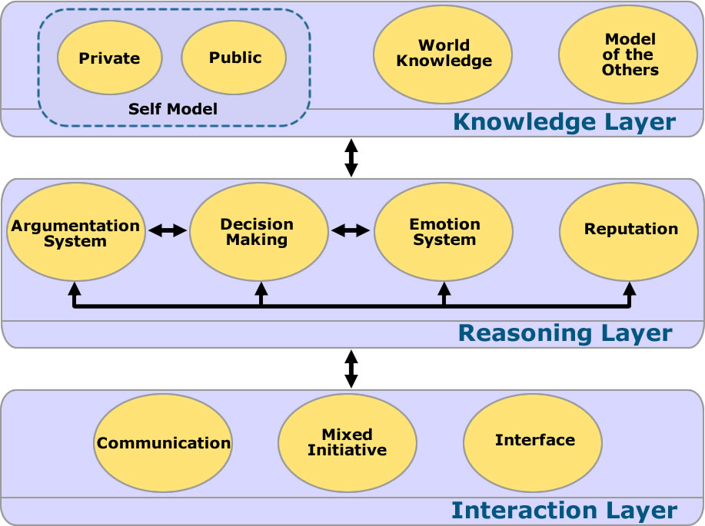
Participant Agent
Notes:
The knowledge layer has information about the environment where he is situated, about the public profile of the other participant’s agents in the decision meeting group, and its own preferences and goals. This information has a lot of uncertainty associated with it. As interactions continue it will become more accurate.
The interaction layer is responsible for the communication with other agents, the interface with the user of the group decision making simulator and by the mixed initiative interaction between participant and agent.
The reasoning layer contains four major components: the argumentative system, the decision making module, the emotional system, and the reputation module.
The argumentative system is responsible for the arguments generation. This component will generate explanatory arguments and persuasive arguments, using the internal agent’s emotional state and about what he thinks of the others agents’ profile (including the emotional state).
The decision making module will support agents when choosing the preferred alternative and will classify all the set of alternatives in three classes: preferred, indifferent and inadmissible.
The emotional system will generate emotions and moods, affecting the choice of the arguments to send to the others participants, the evaluation of the received arguments, and the final decision.
The reputation module defines the level of trust to the participant agent in the delegation of actions.

Slide 19
Argumentation System
May be classified according to six different types
threats, promise of a future reward and appeals, appeal to past reward, appeal to counter-example, appeal to prevailing practice, appeal to self interest
Generates persuasive arguments from the participant’s agent knowledge base
Allows exchange of a request, refuse, accept, request with argument
Replaces the user when he is not available
autonomy of the participant agent is connected with the trust that the user has in the agent
user can approve or reject the locutions made by the participant agent
Notes:
Types of arguments are used by agents to persuade each other.
This selection of arguments is compatible with the power relations identified in the political model: reward, coercive, referent, and legitimate.

Slide 20
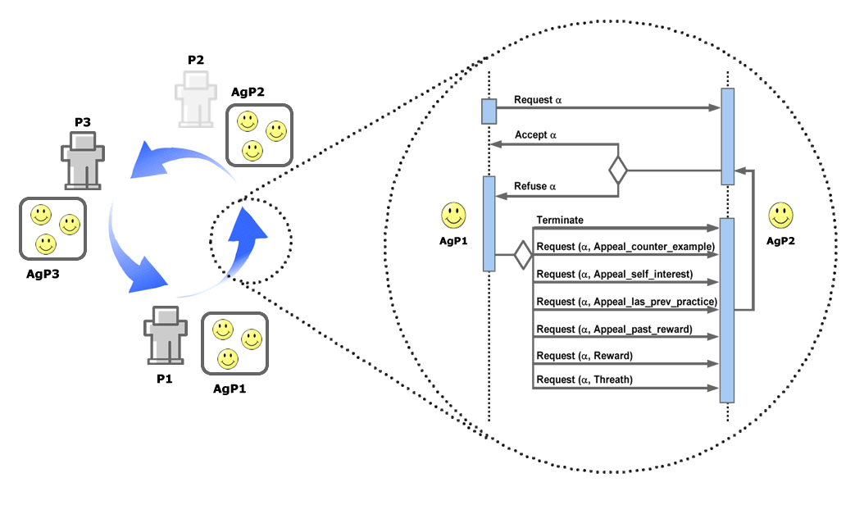
Simple Argument

Slide 21
Argument Selection
Based on agent emotional state
If the agent is in a good mood he will start with a weak argument
If the agent is in a bad mood he will start with a strong argument
Uses scale proposed by Krauss
Appeals to a prevailing practice are the weakest
Threats are the strongest arguments
Notes:
Uses scale proposed by Krauss for the definition of strong and weak arguments
Without characteristic data about an opponent, the selection follow the order defined by Krauss

Slide 22
Argument Evaluation
Analyze all arguments based on:
Existence of preference for the argument
Credibility of proponent
Strength of argument
Quality of information about opponent if present
Validity of argument
Requests without an argument are accepted
Utility of the request shapes the acceptance

Slide 23
Emotional System
Those used are identified in OCC Model:
Joy, Hope, Relief, Pride, Gratitude, Like, Distress, Fear, Disappointment, Remorse, Anger, and Dislike
Agent’s Mood based on:
Past emotions
Other Agent’s mood
Properties characterizing agent model:
Gratitude, Debts, Benevolent, Credibility, (Un)Preferred arguments
Mood overcomes the model’s biggest criticism
Considers past interactions and past emotions

Slide 24
Idea Generation Techniques
Aims to add a formal structure to thinking
Beginning with the question that is intended to be answered
Two principals:
Judgment Delay
The Amount Creates Quality
Four Rules:
Focus on Quantity
No Criticism
Unusual Ideas are Welcome
Combine and Improve Ideas
Notes:
Support the idea generation task
Several known techniques such as
- the Nominal Group Technique (NGT)
- Theory of Inventive Problem Solving Profession Classes-Great Results (TRIZ)
- Mind-mapping
- Brainstorming
- cooperative KJ
Need two principals and four rules to be successful:
Judgment Delay means that in the use of this technique there is no space to criticize the other’s ideas because that could stop the improvement of some ideas.
The Amount Creates Quality means that the existence of more ideas means a better final solution.

Slide 25
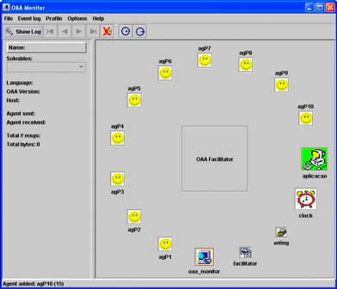
Implementation
Notes:
A collection of agents that work at a particular moment in the simulator:
ten participant agents
facilitator agent (responsible for the follow-up of all simulations)
the voting agent
the clock agent (OAA is not specially designed for simulation, for that reason it was necessary to introduce a clock agent to control the simulation)
the oaa monitor (i.e. an agent that belongs to the OAA platform, and is used to trace, debug and profile communication events for an OAA agent community)
the application agent (responsible for the communication between the community of agents and the simulator interface).

Slide 26
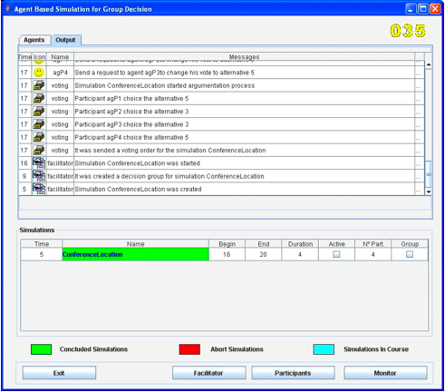
Arguments exchange
Notes:
An extract of the arguments exchanged by the participant agents. Once a simulation is accomplished, agents update the knowledge about the other agents’ profile (e.g. agent credibility).

Slide 27
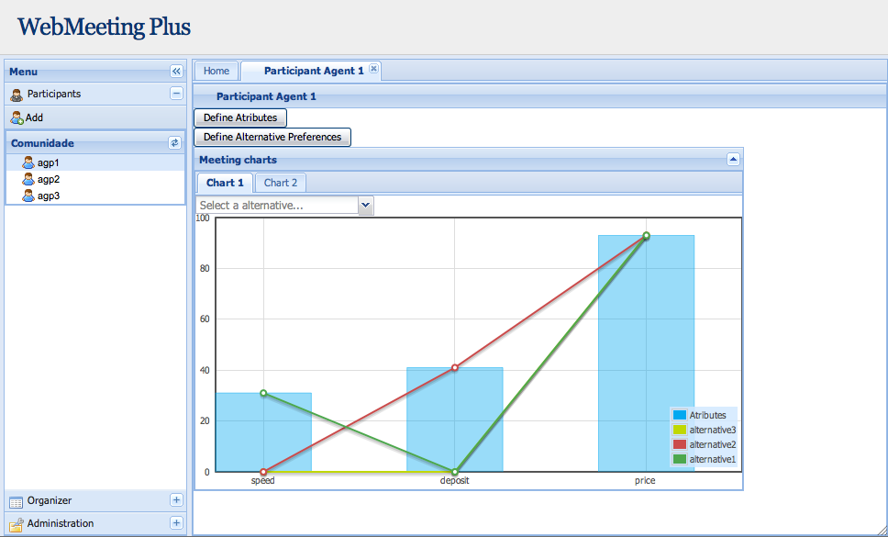
WebMeeting Plus
Notes:
The main screen of the system.

Slide 28
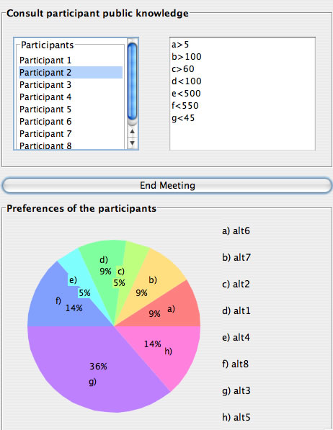
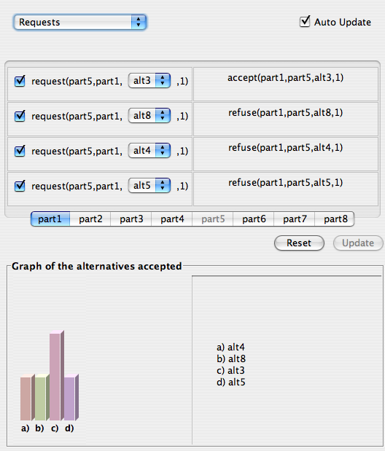
Organizer and Participant Window
Notes:
The left presents a window of the responsible of the meeting where it is possible to see, in the top, a list of all the participants in the meeting. The public profile of each one of the participants can be visualised by the responsible if he intends to do it.
In the bottom of the window it is presented a graphic with the trend of the meeting. For each alternative the characteristics can be visualised, as well as how many participants may support that alternative.
On the right there is a window of the participant where it is possible to see a table with all the requests made by a participant/agent of a meeting to all the other participants.
In the bottom it is possible to see a graphic that shows all the preferred alternatives of the participant. The graphic shows to the participant the trends and the chances of each alternative.

Slide 29
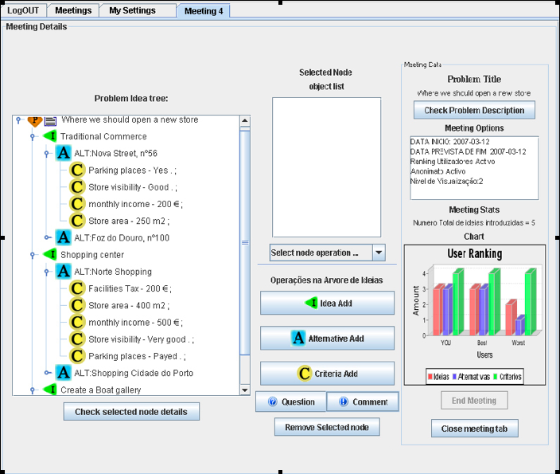
Meeting Desktop Panel
Notes:
The Meeting Desktop panel where it is possible to see the user ranking that consists of a three bar graphic representing the number of ideas introduced by the current user, the number of ideas from the worst and from the best one as well as the total number of ideas introduced.

Slide 30
Wrap Up
Systems are still too passive
Intelligent Decision Rooms should integrate AmI environments to:
interpreting the environment state
representing the information and knowledge associated with the environment
modeling, simulating and representing entities in the environment
planning decisions or actions
learning about the environment and associated aspects
interacting with humans
acting on the environment

