Slide 1
Privacy Sensitive Surveillance for Assisted Living – A Smart Camera Approach Sven Fleck & Wolfgang Straβer
Presented by Leland Holmquest
CS895: Software for Context-aware Multi-user Systems
Professor João Pedro Sousa
26 OCT 11

Slide 2
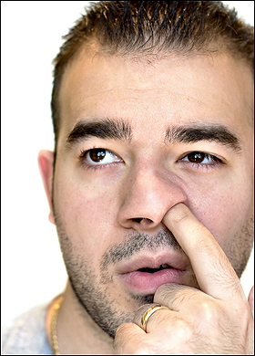
State of the Art:
IRAQI Intelligence

Slide 3
Outline
Introduction
Classification of AAL & Video Surveillance Systems
Related Work
Problem Statements
Proposed Smart System
Architecture
Visualization Decoupled
Conclusion

Slide 4
Introduction
Camera proliferation
Current architectures not scalable
Inefficient
Difficult to secure
Lack of privacy

Slide 5
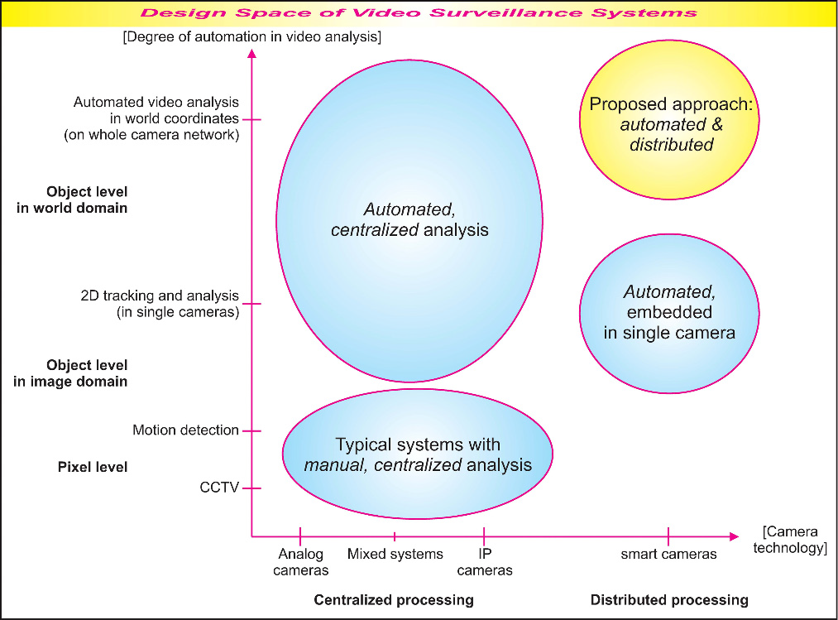
Classification
Manual vs. Automated
Centralized vs. Distributed
Notes:
AAL not actually defined nor classified in this section. Classified in 3.1.3 where it is explained that manual systems use devices worn by individuals and automated systems use visual and non-visual indications.

Slide 6
Related Work
Automated Surveillance Systems
All centralized server
Asserts this architecture inherently expensive (bandwidth) and prone to misuse
Privacy Respecting Surveillance
Masking
Assisted Living (manual vs. automated)
Smart Cameras

Slide 7
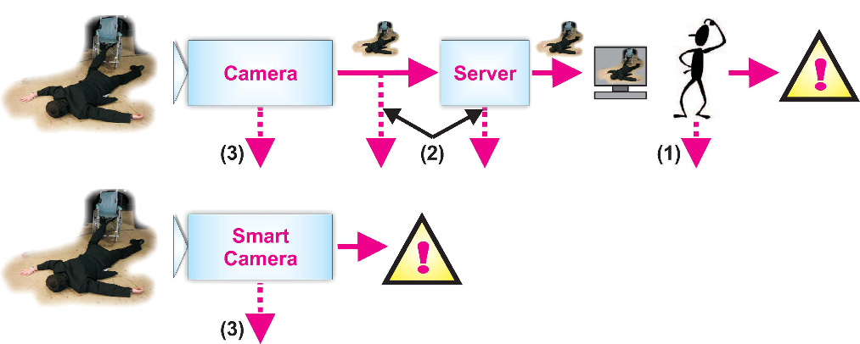
Problem Statements
Privacy – current systems do not address
Overstraining data – too much data, too difficult to monitor
Limited flexibility & expandability – bandwidth issues, central processing issues
Notes:
Asserts that even if encrypted, the data can be stolen – nothing to back this.

Slide 8
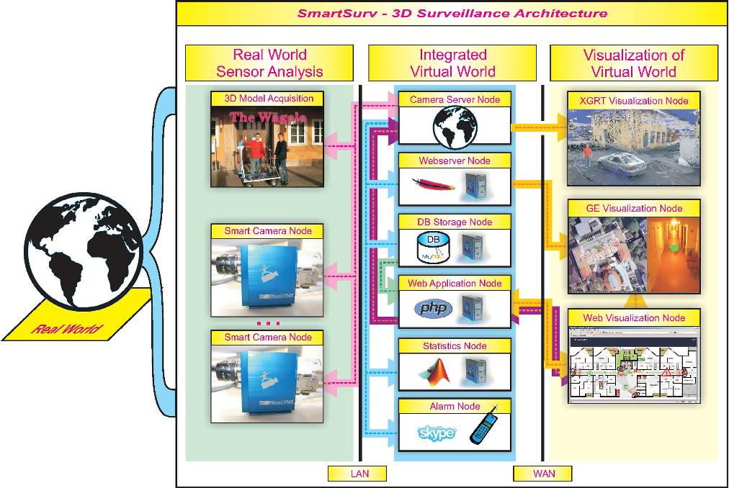
Propose Smart Camera Solution
Scene acquisition
Scene analysis
Virtual world
Integrated visualization
Notes:
A support vector machine (SVM) is a concept in statistics and computer science for a set of related supervised learning methods that analyze data and recognize patterns, used for classification and regression analysis. The standard SVM takes a set of input data and predicts, for each given input, which of two possible classes comprises the input, making the SVM a non-probabilistic binary linear classifier. Given a set of training examples, each marked as belonging to one of two categories, an SVM training algorithm builds a model that assigns new examples into one category or the other. An SVM model is a representation of the examples as points in space, mapped so that the examples of the separate categories are divided by a clear gap that is as wide as possible. New examples are then mapped into that same space and predicted to belong to a category based on which side of the gap they fall on.

Slide 9
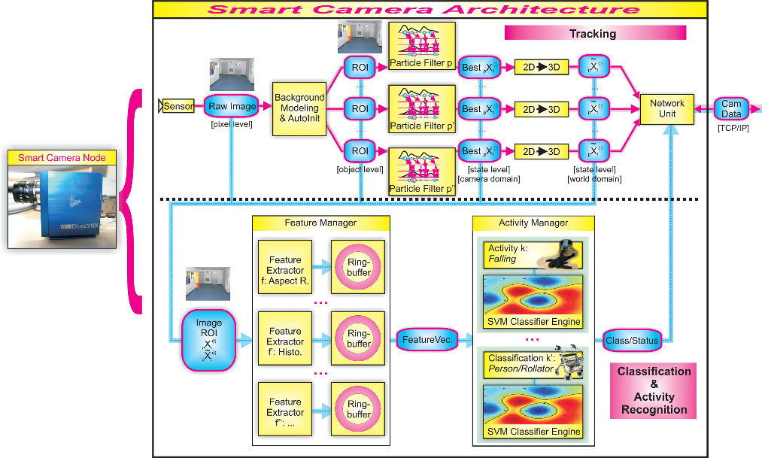
System Architecture

Slide 10
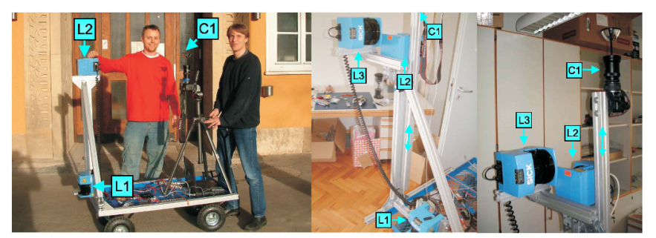
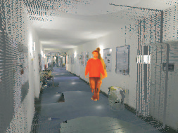
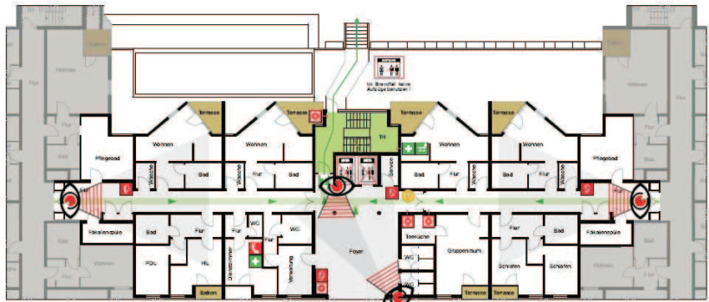
Visualization Decoupled
3D Visualization Node – XGRT
Google Earth
Web App

Slide 11
Conclusion
Privacy not currently addressed
Distributed and automated smart camera
Cameras use Support Vector Machines
Currently in the field and effective
Problem statements revisited
Privacy
Overstraining
Flexible and expandability

Slide 12
Questions?

