Slide 1
Smart Classroom: Bringing Pervasive Computing into Distance Learning
Paper by Shi, Qin, Suo, & Xiao Presented by Alan Kelly November 16, 2011
Notes:
Anecdotes from my Mason classes
Video with Gov. McDonnell

Slide 2
Currently Distance Education Systems…
Can’t capture traditional classroom experience
Focal point is dynamic as teachers move, gesture
Desktop-centric model assumes fixed users
Aren't scalable
Commercial videoconferencing systems used
Client/server model: central node with fixed capacity
Assume uniformity of student systems
Rigid network and device requirements defined
Slow systems: Quality does not degrade gracefully
Fast systems: Slowed to least common denominator

Slide 3
Smart Classroom Project
Integrated system for next-generation distance learning
Key Laboratory of Pervasive Computing, Tsinghua University

Slide 4
User Experience
Persons enter the classroom
Identified through facial and voice recognition
If identified as a lecturer, granted control over the classroom’s smart functions
Lecturer takes a badge with an embedded location sensor to allow motion-tracking
Everyone else identified as local students
Lecturer uses voice and gesture controls
Start lecture (turns on smart functionalities)
Load a particular courseware chapter, etc.

Slide 5
User Experience II
Course begins
Smart Cameraman Agent is activated to focus on the lecturer's current location
HTML-based multimedia courseware is projected on the Media Board
Lecturer can use gestures to perform "mouse" functions like highlighting, scrolling, adding images to the screen, etc.

Slide 6
User Experience III
Remote students are integrated
Lecturer can grant remote students the floor by gesture or voice command
Remote students can request the floor, their icon on the student board will twinkle
When the floor is granted to a specific remote student, his video and audio streams are synchronously played in the Classroom and to other remote students

Slide 7
Location Tracking
Objectives: Allow lecturer to roam freely, identify location of all potential speakers
Position tracked using lecturer’s badge transmitters and multiple receivers placed at known points around the room
Cicada
Time Difference of Arrival (TDOA) between radiofrequency (RF) and ultrasound signals
Position determined within 5cm

Slide 8
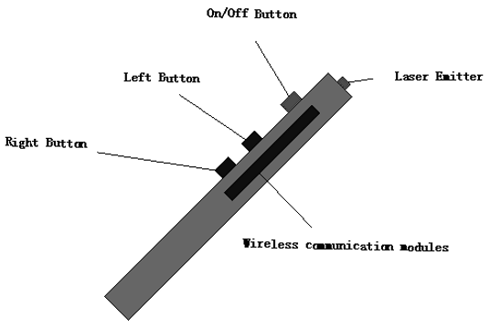
Direct Manipulation
Objective: Cursor control at a distance
CollabPointer
Laser pointer to position cursor
RF transmitter to register clicks
Multi-user support
Each CollabPointer broadcasts a unique id
Users are assigned levels of access priority

Slide 9
Speaker Tracking
Objectives: Avoid need for lecturer to carry or pass a microphone, provide focal point for cameras or other devices
Where is the speaker? Four microphone arrays on walls, TDOA provides location
Who’s speaking? All students given Cicada location badges so identity at that location can be determined

Slide 10
Context-Awareness
Situational contexts (e.g. instructor gestures or keywords) determine which feed(s) are shown to remote students
Ontology is developed using user, location, time, activity, service, environment, and platform variables to associate contexts with particular views

Slide 11
Scalability— Totally Ordered Reliable Multicast (TORM)
Hierarchical structure
In contrast to typical tree model, multiple top-level sources exist
Multicast within each tree is augmented by Unicast tunnels between top-level sources
Bandwidth differences are addressed by splitting users into homogeneous groups
Serialization algorithms ensure ordered message delivery through all members
Network congestion control scheme uses real-time network data to adapt

Slide 12
My Conclusions
Despite their well-publicized success, most distance education systems don't come close to mimicking a real-world classroom
Recent (and not-so-recent) innovations in smart spaces offer a wide range of options to improve this experience
Study is needed to determine if these experience improvements actually improve the successfulness of distance education

