Slide 1
The PERSONA Service Platform for AAL Spaces
Mohammad-Reza Tazari, Rancesco Furfari,
Juan-Pablo Lazaro Ramos, and Erina Ferro
Presented By:
Omar Nachawati

Slide 2
Presentation Outline
Introduction
Requirements Analysis
Related Work
PERSONA Architecture
Sensing the Environment
Challenges

Slide 3
Introduction
PERSONA Platform for Ambient Assisted Living
Supporting elderly and disabled people to live independently in their ‘preferred environment’
Scalable, open, standard, technological platform for AAL services, think: interoperability
21 partners from all over Europe – budget of 12€ million

Slide 4
Objectives
Social
Inclusion
Confidence,
Safety, and
Security
Daily Life
Activity
Support
Mobility

Slide 5
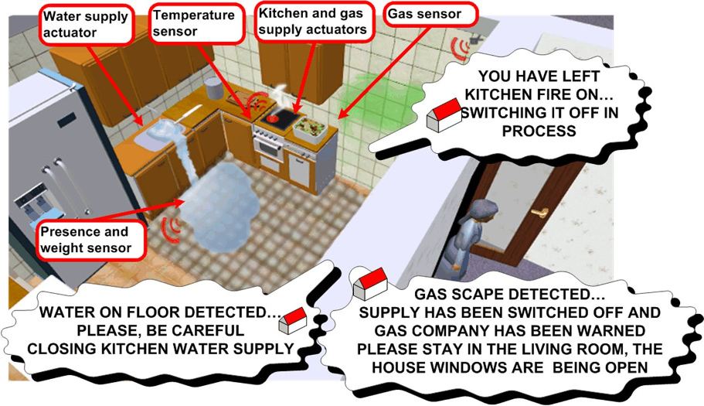
Motivation

Slide 6
Requirements Analysis
User Requirements
General Requirements
Effective replacement
Device ‘Invisibility’
User Interaction
Conformity with usability standards
Easy to learn
Adaptable
Consistent across different modalities
Privacy
Data Management
Technical Requirements
High-flexibility
Ad-hoc Networking Support
Multiple Messaging Patterns
Service Discovery + Binding
Service Composition + Orchestration
Personalization + Context Awareness
Identity management + QoS
Modular Design

Slide 7
Related Work
Objective: Avoid reinventing the wheel, while using latest technology
Total 30 related R&D projects gathered
6 projects evaluated, based on largest result impact
Results of evaluation showed that the combination of two projects could improve AmI systems: Amigo and SODAPOP

Slide 8
Amigo
Funded by the European Commission, spear-headed by Phillips Research
Provides a logical, SOA middleware that enables interoperability across many different components: home appliances, computers, TVs, and mobile devices
SOA middleware enables orchestration, discovery, and binding supported by ontologies for more intelligent automation

Slide 9
SODAPOP
Transducers
Transform/Aggregate input messages to output messages; connect to channels
Channels
Two kinds: event and RPC
Accept messages of a certain type; determine suitable receivers based on channel strategy
Channel Strategy: transparent to transducers
Coarse-grained self-organization based on data-flow partitioning
Fine-grained self-organization based on “pattern matching”
Reduces burden on transducer designers
Transparency minimizes misbehaved transducers

Slide 10
Comparison
SODAPOP
Message Brokering
Flexible, abstract middleware
Non-SOA based architecture
No support for ontology-based inference
By separating types of messages into different channels, modular specifications are allowed
Amigo
Object Brokering
Concrete middleware defines certain scenarios
SOA-based architecture
Support for ontology-based inference
No concept of separating types of messages into different channels

Slide 11
PERSONA Architecture
Open standard means faster adoptions (maybe)
Combines SOA-based Amigo architecture with SODAPOP bus-based architecture
Uses ontologies to support service discovery, match-making, and composition
Five architectural aspects:
Abstract Physical Architecture
Interoperability Framework
PERSONA Platform Services
Middleware
Ontological Modeling

Slide 12
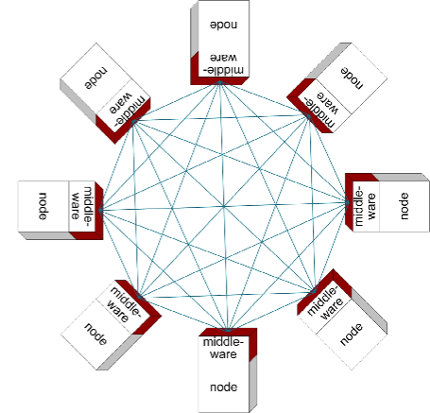
Abstract Physical Architecture
Provides a uniform view of the physical network, providing seamless integration of many different devices and network standards.
Distributed + Auto-Config
Supports the composition of many physical sensors into one logical sensor, such as a single posture sensor that itself is comprised of many physical accelerometer sensors.

Slide 13
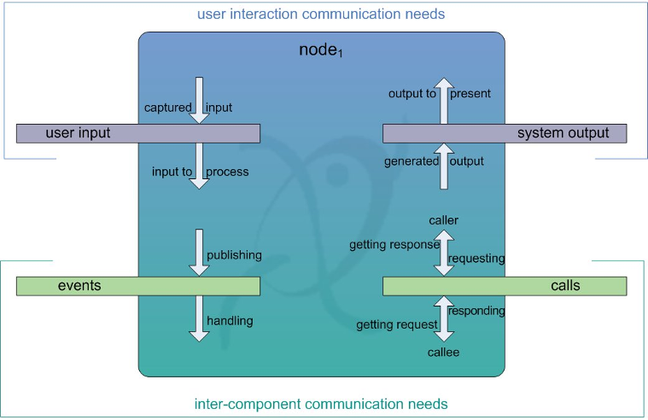
Interoperability Framework
Defines four SODAPOP-style channels (called buses) to better handle general types of communications:
EVENT
EVENT
EVENT
RPC

Slide 14
PERSONA Platform Services
Consists of core set of functions useful for many AAL scenarios, other functionality is added using the OSGi plug-in architecture:
Dialog Manager
Context History Entrepot (CHE)
Situation Reasoner (using RDF - SPARQL)
Service Orchestrator (composite services)
Profiling Component (customization)
Privacy-aware Identity&Security Manager (PISM)
AAL-Space Gateway (remoting)

Slide 15
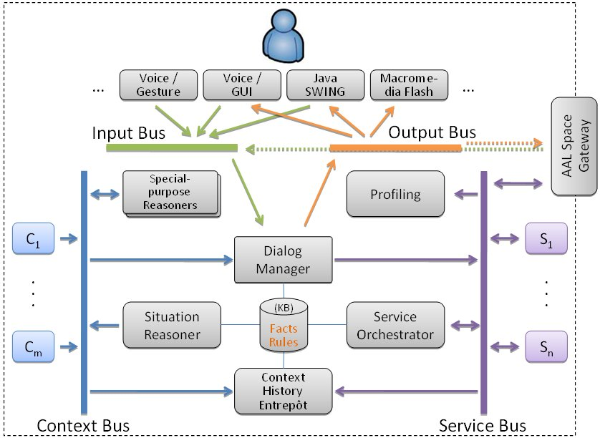
PERSONA Platform Services

Slide 16
Middleware
Set of OSGi modules organized into 3 layers, starting from the lowest level:
Abstract Connection Layer (ACL)
Provides P2P connectivity between participating nodes and supports multiple network and discovery protocols
SodaPop Layer
Organizes communication from the ACL based on message type, implements peer discovery
PERSONA-specific Layer
Provides communication to application level via four distinct buses: Input, Output, Context and Service.
Provides ontology-based service selection using OWL-S, effectively offering solutions to inferred-problems based on the context of the AAL environment, as shown in motivation.

Slide 17
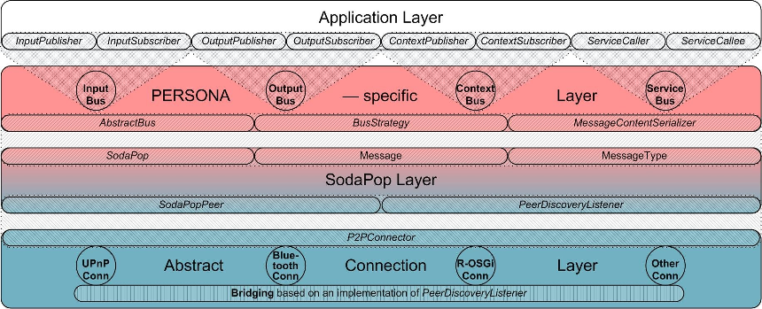
Middleware

Slide 18
Ontological Modeling
Adopts three elementary tools:
Semantic Web technology: RDF & OWL & SPARQL
Common ontology all participants share
A conceptual solution for seamless access to devices and sensors (SAIL, described in the next section)
Provides a Java class library to handle ontological resources
Provides OWL class expressions to filter event-based messages, possible expressions include: Enumeration, Intersection, Restriction, Union, Complement.
SPARQL used for filtering criteria by subscribers on the Service bus.

Slide 19
Wireless Sensing Networks
Wireless Sensor Network (WSN) Requirements:
R1: Integration of various sensor network technologies
R2: Sharing of communication medium by concurrent sensor applications
R3: Management of different applications on the same WSN
R4: Management of multiple instances of the same application
R5: Dynamic discovery of sensor applications
R6: Management of logical sensors
R7: Configuration and calibration of sensor applications

Slide 20
Sensing the Environment
Dealing with many different types of artifacts can be complicated. Artifacts include:
Stationary (themselves comprising of multiple logical sensors)
General purpose computers, Set-top-boxes, appliances
Portable
Medical devices, Smart-phones
Wearable
Garments equipped with sensors
Sensor Abstraction and Integration Layer (SAIL) provides a uniform view of sensors and is comprised of three layers built over OSGi framework:
Access
Abstraction
Integration

Slide 21
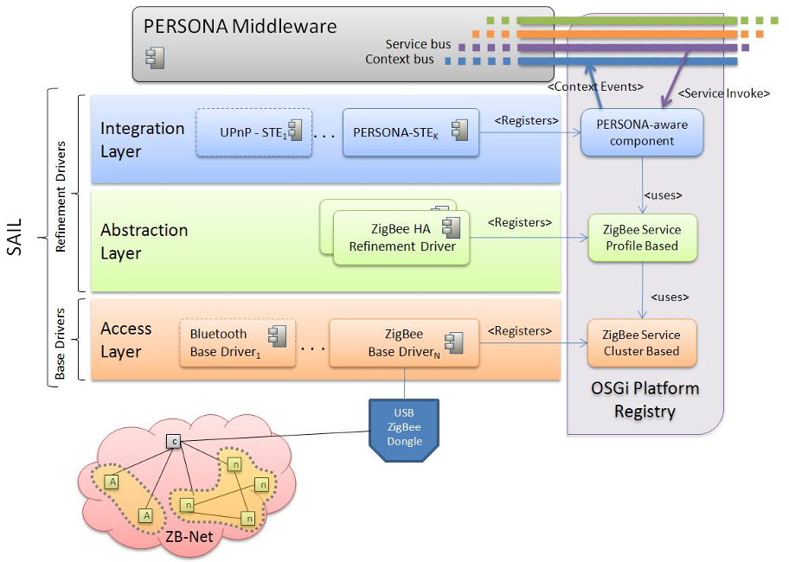
Sensing the Environment

Slide 22
Challenges
Scientific
Finding new ways to support independent living for elderly and disabled people
Technical
Develop new solutions to support flexible and seamless integration of AAL services
Psychological
Pleasantness
Improved Quality of Life
Economical
Affordability
Practicality
Sustainability

Slide 23
Questions?

