Slide 1
It is great that we automate our tests, but why are they so bad?
Jeff Offutt
George Mason University
Skövde University
TOCSYC Project
https://www.cs.gmu.edu/~offutt

Slide 2
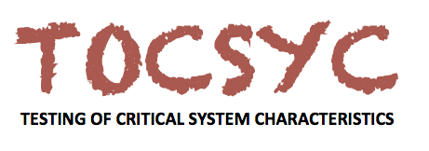
TOCSYC Testing of Critical System Characteristics
A distributed research environment

Slide 3
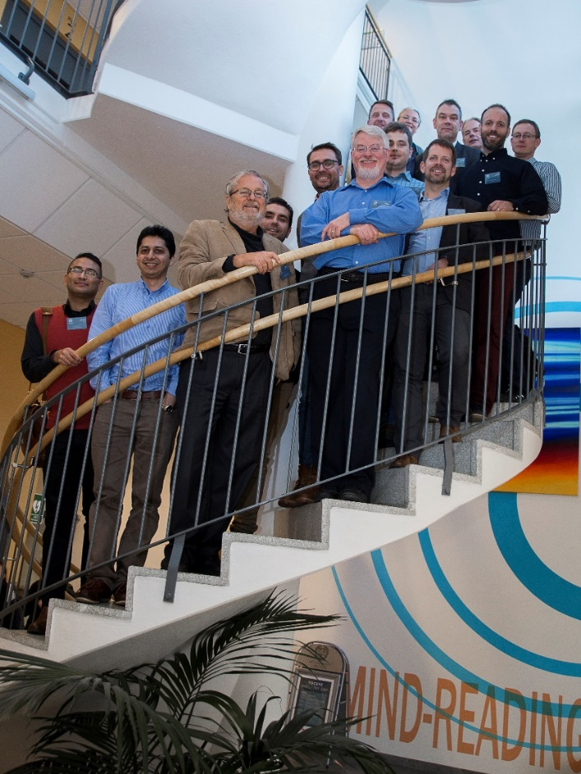
Who are we and what’s it all about?
5-year project ~30 MSEK
~15 senior funded researchers
And several contributing affiliate members
Our main goals
To develop feasible testing techniques for performance efficiency and robustness
To automate complex testing activities such as test case generation and test case prioritization
To determine cost effectiveness of different testing approaches

Slide 4
A strong collaborative research environment
A mix of expertise and approaches
Model-based testing
Mutation-based techniques
Search-based approaches
Static analysis techniques
Synergies between approaches explored
E.g., model-based mutation testing
200+ research papers produced by TOCSYC researchers since project started in 2013
Both TOCSYC results and results from our other projects

Slide 5
Background: Test Automation
Test case management
Source of tests
Commonly automated in practice
Test requirements generation
Test value generation
Test execution

Slide 6
Background: Model-Based Testing
Automate additional test generation steps
Test case management
Source of tests
Models, usually behavioral (e.g., UML statecharts)
This can be automated
Test requirements generation
Test value generation
Test execution

Slide 7
Model-Based Testing Process
Test criterion
Test requirements (subpaths)
Abstract tests (test paths)
Concrete tests
Test oracles
Model
Criterion
Test Requirements
Abstract Tests
Concrete Tests
Extra Info
Test Execution
Test Reports

Slide 8
Benefits of Model-Based Testing
Better tests : Find more failures
Lower cost : Fewer tests
Traceability : Direct connection to design and code elements
Early detection of requirements defects : Before coding
Software evolution : Changes reflected directly in tests
Less overlap : Each test evaluates something unique

Slide 9
Challenges of Test Automation
Controllability : Making sure we get our test values to the right places in the code
Revealability : Making sure our test oracles look in the right place to see the failures
Self-determination : Tests should be more self contained

Slide 10
Controllability: Mapping Problem
Transform abstract tests to concrete tests
First abstract test:
AddChoc, Coin, GetChoc, Coin, AddChoc
Nine edge coverage abstract tests use :
15 “AddChoc” transitions
16 “Coin” transitions
6 “getChoc” transitions
Testers often convert abstract to concrete tests by hand
This is expensive!
Solution?
Coin
[1, 3, 4, 1, 2, 4]
1
Coin
2
GetChoc
AddChoc
AddChoc
Coin
3
4
GetChoc
AddChoc
AddChoc / Coin
1: credit = 0 & #stock = 0
2: credit > 0 & #stock = 0
Automate the transformation
3: credit = 0 & #stock > 0
4: credit > 0 & #stock > 0

Slide 11
Model-Based Test Components
Test components
Test 1
Test 2
C1
C1
C1
C2
C2
C3
C3
Each abstract test component must be mapped to real code in concrete tests
Test 3
C4
C4
C4
many times
C5
C5
C5
C6
C6
C7
C7

Slide 12
Component-based vs. By Hand
Hand-based Generating Tests
Write tests by hand
Ensure that constraints in models were satisfied
Compile and run the tests
Component-based Test Generation
Import model and program into a tool
Create test component mappings by hand
Tool creates concrete tests to satisfy transition (edge) coverage
Empirical Evaluation
Faster
Fewer errors
Joint work with Dr. Nan Li

Slide 13
Challenges of Test Automation
Controllability : Making sure we get our test values to the right places in the code
Revealability : Making sure our test oracles look in the right place to see the failures
Self-determination : Tests should be more self contained

Slide 14
Test Oracle Problem
An automated test must check whether the behavior was correct
(assertions in Junit)
Q1: How much of the program state should be checked ?
(that is, which variables ? )
More checking adds more cost
Q2: How often should state be checked ?
Once at end of test ?
After every transition ?

Slide 15
Test Oracle Strategies
f requency
After each transition
Once at end of test
Requires analysis by tester
precision
NOS
null
(crash)
SIOS
state
invariant
(SI)
OS1
SI
member
objects
OS2
SI
returns
OS3
SI
objects
returns
OS5
SI
params
OS6
SI
objects
returns
params
Can be created from mappings
Free

Slide 16
Precision—% Faults Revealed
28,881,000 tests executed (12 OSes * 250 tests * 9627 faults)
More precise OSes are not always more effective

Slide 17
Frequency—% Faults Revealed
Checking after each transition vs. checking at the end of the test
Multiple checks is not significantly more effective

Slide 18
Test Oracle Strategy Findings
Crash testing (NOS) wastes much of testing effort
Penny wise, pound foolish
The most cost-effective choice is to check the state invariants once at the end of the tests (SIOS)
Only one check needed
Can be partially derived automatically from the model
Joint work with Dr. Nan Li

Slide 19
Challenges of Test Automation
Controllability : Making sure we get our test values to the right places in the code
Revealability : Making sure our test oracles look in the right place to see the failures
Self-determination : Tests should be more self contained

Slide 20
Old Style Tests
Values invented by humans
Scripts were pieces of paper with steps
Turn on computer
Type : “Run myProgram”
Enter name : “George P. Burdell”
Enter age : “-25”
Simple directions to humans
Slow!
Error prone!
Limited repeatability!
These tests are as dumb as single-cell organisms !!
Almost impossible to integrate criteria

Slide 21
Limitations
Single-cell tests are incompatible with
model-based testing

Slide 22
Modern Dumb Tests
Test values
Created by a mix of humans and test data generators
Satisfy well-documented goals, test criteria, or specialized domain needs
Integrated into automated test scripts (eg, JUnit)
Includes a small amount of brain power … these tests know what results to expect (eg, JUnit assertions)
Fast … repeatable …
These multi-cellular tests show the first signs of intelligence!

Slide 23
Multicellular Tests
But this test does not know …
Before values
Test Values
After values
Why is it there?
Expected results
When should it run?
When should it change?
When should it die?

Slide 24
Intelligent Tests
Intelligent tests
need
self-awareness
and
self-determination!

Slide 25
Intelligent Tests
Intelligent tests
need
self-awareness
and
self-determination!
Each test should encode traceability … what it covers
Tests should check what has changed, and rerun if necessary
Tests should alert tester when they no longer match the software
Tests should quietly go away when no longer needed

Slide 26
Summary
Test automation saves money
Model-based testing saves more money
Tests can be assembled from pieces
It matters what the oracle checks
Automated tests can be much better !
Jeff Offutt
https://www.cs.gmu.edu/~offutt

