Slide 1
The Model-Driven Test Design Process
Jeff Offutt
Professor, Software Engineering
George Mason University
Fairfax, VA USA
www.cs.gmu.edu/~offutt/
offutt@gmu.edu
Based on the book by
Paul Ammann & Jeff Offutt
www.cs.gmu.edu/~offutt/softwaretest/

Slide 2
Who Am I
PhD Georgia Institute of Technology, 1988
Professor at George Mason University since 1992
  Fairfax Virginia (near Washington DC)
  BS, MS, PhD in Software Engineering (also CS)
Lead the Software Engineering MS program
  Oldest and largest in USA
Editor-in-Chief of Wiley’s journal of Software Testing, Verification and Reliability (STVR)
Co-Founder of IEEE International Conference on Software Testing, Verification and Validation (ICST)
Co-Author of Introduction to Software Testing (Cambridge University Press)

Slide 3
Testing in the 21st Century
Software defines behavior
  network routers, finance, switching networks, other infrastructure
Today’s software market :
  is much bigger
  is more competitive
  has more users
Embedded Control Applications
  airplanes, air traffic control
  spaceships
  watches
  ovens
  remote controllers
Agile processes put increased pressure on testers
  Programmers must unit test – with no training, education or tools !
  Tests are key to functional requirements – but who builds those tests ?
Industry is going through a revolution in what testing means to the success of software products
  PDAs
  memory seats
  DVD players
  garage door openers
  cell phones

Slide 4
OUTLINE
Spectacular Software Failures
Why Test?
What Do We Do When We Test ?
  Test Activities and Model-Driven Testing
Changing Notions of Testing
Test Maturity Levels
Summary

Slide 5

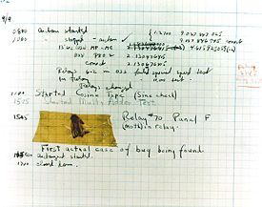
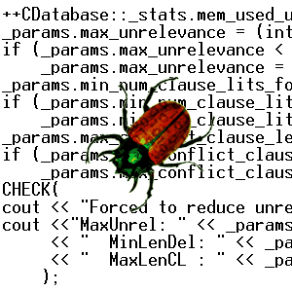

The First Bugs
Hopper’s
“bug” (moth
stuck in a
relay on an
early machine)
“an analyzing process must equally have been performed in order to furnish the Analytical Engine with the necessary operative data; and that herein may also lie a possible source of error. Granted that the actual mechanism is unerring in its processes, the cards may give it wrong orders. ” – Ada, Countess Lovelace (notes on Babbage’s Analytical Engine)
“It has been just so in all of my inventions. The first step is an intuition, and comes with a burst, then difficulties arise—this thing gives out and [it is] then that 'Bugs'—as such little faults and difficulties are called—show themselves and months of intense watching, study and labor are requisite. . .” – Thomas Edison

Slide 6
Costly Software Failures
NIST report, “The Economic Impacts of Inadequate Infrastructure for Software Testing” (2002)
  Inadequate software testing costs the US alone between $22 and $59 billion annually
  Better approaches could cut this amount in half
Huge losses due to web application failures
  Financial services : $6.5 million per hour (just in USA!)
  Credit card sales applications : $2.4 million per hour (in USA)
In Dec 2006, amazon.com’s BOGO offer turned into a double discount
2007 : Symantec says that most security vulnerabilities are due to faulty software
World-wide monetary loss due to poor software is staggering

Slide 7

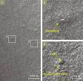

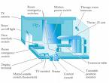
Spectacular Software Failures
NASA’s Mars lander: September 1999, crashed due to a units integration fault
Ariane 5:
exception-handling
bug : forced self
destruct on maiden
flight (64-bit to 16-bit
conversion: about
370 million $ lost)
Mars Polar
Lander crash
site?
Toyota brakes : Dozens dead, thousands of crashes
Major failures: Ariane 5 explosion, Mars Polar Lander, Intel’s Pentium FDIV bug
Poor testing of safety-critical software can cost lives :
  THERAC-25 radiation machine: 3 dead
THERAC-25 design
We need our software to be reliable
Testing is how we assess reliability

Slide 8
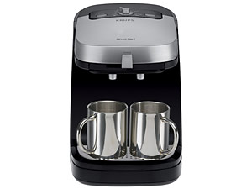

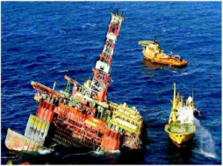
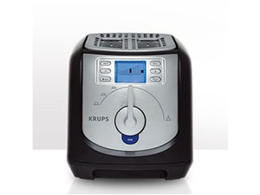

Software is a Skin that Surrounds Our Civilization
Quote due to Dr. Mark Harman

Slide 9
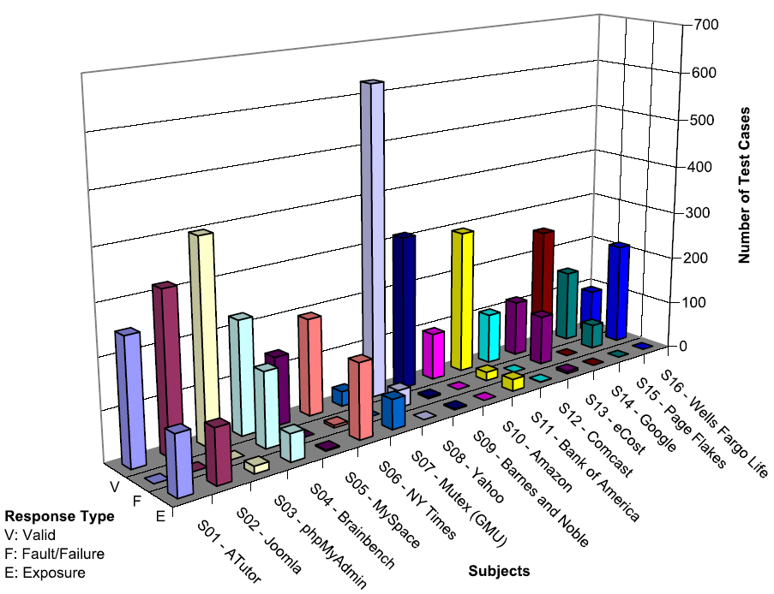
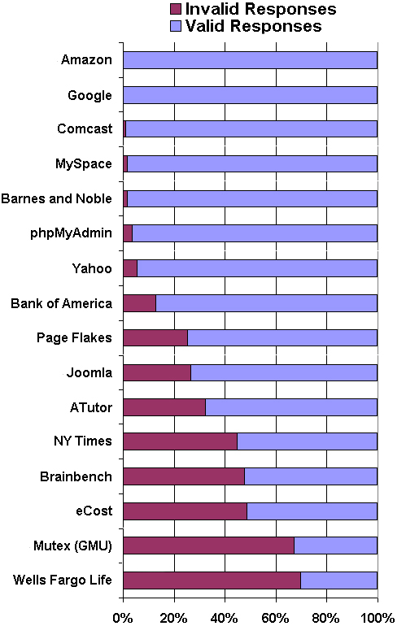
Bypass Testing Results
v
— Vasileios Papadimitriou. Masters thesis, Automating Bypass Testing for Web Applications, GMU 2006

Slide 10

Airbus 319 Safety Critical Software Control
Loss of autopilot
Loss of most flight deck lighting and intercom
Loss of both the commander’s and the co‑pilot’s primary flight and navigation displays !

Slide 11

Northeast Blackout of 2003
508 generating units and 256 power plants shut down
Affected 10 million people in Ontario, Canada
Affected 40 million people in 8 US states
Financial losses of
$6 Billion USD
The alarm system in the energy management system failed due to a software error and operators were not informed of the power overload in the system

Slide 12
What Does This Mean?
Software testing is getting more important

Slide 13
Testing in the 21st Century
More safety critical, real-time software
Embedded software is ubiquitous … check your pockets
Enterprise applications means bigger programs, more users
Paradoxically, free software increases our expectations !
Security is now all about software faults
  Secure software is reliable software
The web offers a new deployment platform
  Very competitive and very available to more users
  Web apps are distributed
  Web apps must be highly reliable
Industry desperately needs our inventions !

Slide 14
OUTLINE
Spectacular Software Failures
Why Test?
What Do We Do When We Test ?
  Test Activities and Model-Driven Testing
Changing Notions of Testing
Test Maturity Levels
Summary

Slide 15

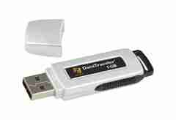
Here! Test This!
My first “professional” job
Big software program
MicroSteff – big
software system
for the mac
V.1.5.1 Jan/2007
Jan / 2010
Verdatim
DataLife
MF2-HD
1.44 MB
A stack of computer printouts—and no documentation

Slide 16
Cost of Testing
You’re going to spend at least half of your development budget on testing, whether you want to or not
In the real-world, testing is the principle post-design activity
Restricting early testing usually increases cost
Extensive hardware-software integration requires more testing

Slide 17
Why Test?
If you don’t know why you’re conducting each test, it won’t be very helpful
Written test objectives and requirements must be documented
What are your planned coverage levels?
How much testing is enough?
Common objectives – spend the budget …test until the ship-date …
  Sometimes called the “date criterion”

Slide 18
Why Test?
If you don’t start planning for each test when the functional requirements are formed, you’ll never know why you’re conducting the test
1980: “The software shall be easily maintainable”
Threshold reliability requirements?
What fact is each test trying to verify?
Requirements definition teams need testers!

Slide 19
Cost of Not Testing
Program Managers sometime say: “Testing is too expensive.”
Not testing is even more expensive
Planning for testing after development is prohibitively expensive
A test station for circuit boards costs half a million dollars …
Software test tools cost less than $10,000 !!!

Slide 20
Mismatch in Needs and Goals
Industry wants testing to be simple and easy
  Testers with no background in computing or math
Universities are graduating scientists
  Industry needs engineers
Testing needs to be done more rigorously
Agile processes put lots of demands on testing
  Programmers must unit test – with no training, education or tools !
  Tests are key components of functional requirements – but who builds those tests ?
Bottom line—lots of poor software

Slide 21
OUTLINE
Spectacular Software Failures
Why Test?
What Do We Do When We Test ?
  Test Activities and Model-Driven Testing
Changing Notions of Testing
Test Maturity Levels
Summary

Slide 22

Test Design in Context
Test Design is the process of designing input values that will effectively test software
Test design is one of several activities for testing software
  Most mathematical
  Most technically challenging
This process is based on my text book with Ammann, Introduction to Software Testing
http://www.cs.gmu.edu/~offutt/softwaretest/

Slide 23
Types of Test Activities
Testing can be broken up into four general types of activities
  Test Design
  Test Automation
  Test Execution
  Test Evaluation
Each type of activity requires different skills, background knowledge, education and training
No reasonable software development organization uses the same people for requirements, design, implementation, integration and configuration control
    1.a) Criteria-based
    1.b) Human-based
Why do test organizations still use the same people for all four test activities??
This clearly wastes resources

Slide 24
1. Test Design – (a) Criteria-Based
Design test values to satisfy coverage criteria or other engineering goal
This is the most technical job in software testing
Requires knowledge of :
  Discrete math
  Programming
  Testing
Requires much of a traditional CS degree
This is intellectually stimulating, rewarding, and challenging
Test design is analogous to software architecture on the development side
Using people who are not qualified to design tests is a sure way to get ineffective tests

Slide 25
1. Test Design – (b) Human-Based
Design test values based on domain knowledge of the program and human knowledge of testing
This is much harder than it may seem to developers
Criteria-based approaches can be blind to special situations
Requires knowledge of :
  Domain, testing, and user interfaces
Requires almost no traditional CS
  A background in the domain of the software is essential
  An empirical background is very helpful (biology, psychology, …)
  A logic background is very helpful (law, philosophy, math, …)
This is intellectually stimulating, rewarding, and challenging
  But not to typical CS majors – they want to solve problems and build things

Slide 26
2. Test Automation
Embed test values into executable scripts
This is slightly less technical
Requires knowledge of programming
  Fairly straightforward programming – small pieces and simple algorithms
Requires very little theory
Very boring for test designers
More creativity needed for embedded / RT software
Programming is out of reach for many domain experts
Who is responsible for determining and embedding the expected outputs ?
  Test designers may not always know the expected outputs
  Test evaluators need to get involved early to help with this

Slide 27
3. Test Execution
Run tests on the software and record the results
This is easy – and trivial if the tests are well automated
Requires basic computer skills
  Interns
  Employees with no technical background
Asking qualified test designers to execute tests is a sure way to convince them to look for a development job
If, for example, GUI tests are not well automated, this requires a lot of manual labor
Test executors have to be very careful and meticulous with bookkeeping

Slide 28
4. Test Evaluation
Evaluate results of testing, report to developers
This is much harder than it may seem
Requires knowledge of :
  Domain
  Testing
  User interfaces and psychology
Usually requires almost no traditional CS
  A background in the domain of the software is essential
  An empirical background is very helpful (biology, psychology, …)
  A logic background is very helpful (law, philosophy, math, …)
This is intellectually stimulating, rewarding, and challenging
  But not to typical CS majors – they want to solve problems and build things

Slide 29
Other Activities
Test management : Sets policy, organizes team, interfaces with development, chooses criteria, decides how much automation is needed, …
Test maintenance : Save tests for reuse as software evolves
  Requires cooperation of test designers and automators
  Deciding when to trim the test suite is partly policy and partly technical – and in general, very hard !
  Tests should be put in configuration control
Test documentation : All parties participate
  Each test must document “why” – criterion and test requirement satisfied or a rationale for human-designed tests
  Traceability throughout the process must be ensured
  Documentation must be kept in the automated tests

Slide 30
Summary of Test Activities
1a. | Design | Design test values to satisfy engineering goals
 | Criteria | Requires knowledge of discrete math, programming and testing
1b. | Design | Design test values from domain knowledge and intuition
 | Human | Requires knowledge of domain, UI, testing
2. | Automation | Embed test values into executable scripts
 |  | Requires knowledge of scripting
3. | Execution | Run tests on the software and record the results
 |  | Requires very little knowledge
4. | Evaluation | Evaluate results of testing, report to developers
 |  | Requires domain knowledge
These four general test activities are quite different
Using people inappropriately is wasteful

Slide 31
Organizing the Team
A mature test organization needs only one test designer to work with several test automators, executors and evaluators
Improved automation will reduce the number of test executors
  Theoretically to zero … but not in practice
Putting the wrong people on the wrong tasks leads to inefficiency, low job satisfaction and low job performance
  A qualified test designer will be bored with other tasks and look for a job in development
  A qualified test evaluator will not understand the benefits of test criteria
Test evaluators have the domain knowledge, so they must be free to add tests that “blind” engineering processes will not think of
The four test activities are quite different
Many test teams use the same people for ALL FOUR activities !!

Slide 32
Applying Test Activities
To use our people effectively
and to test efficiently
we need a process that
lets test designers
raise their level of abstraction
raise their level of abstraction
raise their level of abstraction

Slide 33
Using MDTD in Practice
This approach lets one test designer do the math
Then traditional testers and programmers can do their parts
  Find values
  Automate the tests
  Run the tests
  Evaluate the tests
  Just like in traditional engineering … an engineer constructs models with calculus, then gives direction to carpenters, electricians, technicians, …
Testers ain’t mathematicians !

Slide 34
Model-Driven Test Design
refined requirements / test specs
model / structure
test requirements
test requirements
DESIGN
ABSTRACTION
LEVEL
IMPLEMENTATION
ABSTRACTION
LEVEL
software artifact
input values
pass / fail
test results
test scripts
test cases

Slide 35
Model-Driven Test Design – Steps
criterion
refine
refined requirements / test specs
model / structure
test requirements
generate
analysis
test requirements
domain analysis
DESIGN
ABSTRACTION
LEVEL
IMPLEMENTATION
ABSTRACTION
LEVEL
software artifact
input values
feedback
evaluate
execute
automate
prefix
postfix
expected
pass / fail
test results
test scripts
test cases

Slide 36
MDTD – Activities
refined requirements / test specs
model / structure
test requirements
Test Design
DESIGN
ABSTRACTION
LEVEL
Raising our abstraction level makes
test design MUCH easier
IMPLEMENTATION
ABSTRACTION
LEVEL
software artifact
input values
Test Automation
pass / fail
test results
test scripts
test cases
Test Evaluation
Test Execution

Slide 37
Small Illustrative Example
Software Artifact : Java Method
/**
* Return index of node n at the
* first position it appears,
* -1 if it is not present
*/
public int indexOf (Node n)
{
for (int i=0; i < path.size(); i++)
if (path.get(i).equals(n))
return i;
return -1;
}
Control Flow Graph
1
i = 0
2
i < path.size()
3
if
5
4
return -1
return i

Slide 38
Example (2)
Support tool for graph coverage
http://www.cs.gmu.edu/~offutt/softwaretest/
Edges
1 2
2 3
3 2
3 4
2 5
Initial Node: 1
Final Nodes: 4, 5
6 requirements for Edge-Pair Coverage
1. [1, 2, 3]
2. [1, 2, 5]
3. [2, 3, 4]
4. [2, 3, 2]
5. [3, 2, 3]
6. [3, 2, 5]
Graph
Abstract version
1
2
3
Test Paths
[1, 2, 5]
[1, 2, 3, 2, 5]
[1, 2, 3, 2, 3, 4]
Find values …
5
4

Slide 39
OUTLINE
Spectacular Software Failures
Why Test?
What Do We Do When We Test ?
  Test Activities and Model-Driven Testing
Changing Notions of Testing
Test Maturity Levels
Summary

Slide 40
Changing Notions of Testing
Old view considered testing at each software development phase to be very different form other phases
  Unit, module, integration, system …
New view is in terms of structures and criteria
  Graphs, logical expressions, syntax, input space
Test design is largely the same at each phase
  Creating the model is different
  Choosing values and automating the tests is different

Slide 41
Old : Testing at Different Levels
Acceptance testing: Is the software acceptable to the user?
main Class P
System testing: Test the overall functionality of the system
Class A
Class B
Integration testing: Test how modules interact with each other
method mA1()
method mB1()
method mA2()
method mB2()
Module testing: Test each class, file, module or component
Unit testing: Test each unit (method) individually
This view obscures underlying similarities

Slide 42
New : Test Coverage Criteria
A tester’s job is simple :
Define a model of the software, then find ways to cover it
Test Requirements : Specific things that must be satisfied or covered during testing
Test Criterion : A collection of rules and a process that define test requirements
Testing researchers have defined hundreds of criteria, but they are all really just a few criteria on four types of structures …

Slide 43
Criteria Based on Structures
Structures : Four ways to model software
Graphs
Logical Expressions
(not X or not Y) and A and B
A: {0, 1, >1}
B: {600, 700, 800}
C: {swe, cs, isa, infs}
Input Domain Characterization
if (x > y)
z = x - y;
else
z = 2 * x;
Syntactic Structures

Slide 44
Source of Structures
These structures can be extracted from lots of software artifacts
  Graphs can be extracted from UML use cases, finite state machines, source code, …
  Logical expressions can be extracted from decisions in program source, guards on transitions, conditionals in use cases, …
This is not the same as “model-based testing,” which derives tests from a model that describes some aspects of the system under test
  The model usually describes part of the behavior
  The source is usually not considered a model

Slide 45
1. Graph Coverage – Structural
2
6
1
5
7
3
Node (Statement)
Cover every node
12567
1343567
Edge (Branch)
Cover every edge
12567
1343567
1357
Path
Cover every path
12567
1257
13567
1357
1343567
134357 …
This graph may represent
statements & branches
methods & calls
components & signals
states and transitions
4

Slide 46
1. Graph Coverage – Data Flow
def = {a , m}
def = {m}
2
use = {y}
6
def = {x, y}
use = {x}
use = {a}
use = {m}
1
5
7
use = {a}
use = {x}
def = {a}
3
Defs & Uses Pairs
(x, 1, (1,2)), (x, 1, (1,3))
(y, 1, 4), (y, 1, 6)
(a, 2, (5,6)), (a, 2, (5,7)), (a, 3, (5,6)), (a, 3, (5,7)),
(m, 2, 7), (m, 4, 7), (m, 6, 7)
All Defs
Every def used once
1, 2, 5, 6, 7
1, 2, 5, 7
1, 3, 4, 3, 5, 7
All Uses
Every def “reaches” every use
1, 2, 5, 6, 7
1, 2, 5, 7
1, 3, 5, 6, 7
1, 3, 5, 7
1, 3, 4, 3, 5,7
This graph contains:
defs: nodes & edges where variables get values
uses: nodes & edges where values are accessed
4
def = {m}
use = {y}

Slide 47
1. Graph - FSM Example
Memory Seats in a Lexus ES 300
Guard (safety constraint)
Trigger (input)
Driver 1
Configuration
[Ignition = off] | Button2
Driver 2
Configuration
[Ignition = off] | Button1
[Ignition = on] |
seatBack ()
[Ignition = on] |
seatBottom ()
New
Configuration
Driver 2
Ignition = off
[Ignition = on] |
lumbar ()
(to Modified)
[Ignition = on] |
sideMirrors ()
Ignition = off
[Ignition = on] | Reset AND Button2
New
Configuration
Driver 1
Modified
Configuration
[Ignition = on] | Reset AND Button1

Slide 48
2. Logical Expressions
( (a > b) or G ) and (x < y)
Transitions
Logical
Expressions
Program Decision Statements
Software Specifications

Slide 49
2. Logical Expressions
( (a > b) or G ) and (x < y)
Predicate Coverage : Each predicate must be true and false
  ( (a>b) or G ) and (x < y) = True, False
Clause Coverage : Each clause must be true and false
  (a > b) = True, False
  G = True, False
  (x < y) = True, False
Combinatorial Coverage : Various combinations of clauses
  Active Clause Coverage: Each clause must determine the predicate’s result

Slide 50
2. Logic – Active Clause Coverage
( (a > b) or G ) and (x < y)
1 T F T
2 F F T
With these values for G and (x<y), (a>b) determines the value of the predicate
3 F T T
4 F F T
duplicate
5 T T T
6 T T F

Slide 51
3. Input Domain Characterization
Describe the input domain of the software
  Identify inputs, parameters, or other categorization
  Partition each input into finite sets of representative values
  Choose combinations of values
System level
  Number of students { 0, 1, >1 }
  Level of course { 600, 700, 800 }
  Major { swe, cs, isa, infs }
Unit level
  Parameters F (int X, int Y)
  Possible values X: { <0, 0, 1, 2, >2 }, Y : { 10, 20, 30 }
  Tests
    F (-5, 10), F (0, 20), F (1, 30), F (2, 10), F (5, 20)

Slide 52
4. Syntactic Structures
Based on a grammar, or other syntactic definition
Primary example is mutation testing
  Induce small changes to the program: mutants
  Find tests that cause the mutant programs to fail: killing mutants
  Failure is defined as different output from the original program
  Check the output of useful tests on the original program
Example source and mutants
if (x > y)
Δ if (x >= y)
z = x - y;
Δ z = x + y;
Δ z = x – m;
else
z = 2 * x;
if (x > y)
z = x - y;
else
z = 2 * x;

Slide 53
Coverage Overview
Four Structures for Modeling Software
Graphs
Logic
Input Space
Syntax
Applied to
Applied to
Applied to
Source
FSMs
Specs
DNF
Source
Specs
Source
Models
Design
Use cases
Integ
Input

Slide 54
White-box and Black-box Testing
Black-box testing : Deriving tests from external descriptions of the software, including specifications, requirements, and design
White-box testing : Deriving tests from the source code internals of the software, specifically including branches, individual conditions, and statements
Model-based testing : Deriving tests from a model of the software (such as a UML diagram
MDTD makes these distinctions less important.
The more general question is: from what level of abstraction to we derive tests?

Slide 55
Two Ways to Use Test Criteria
Directly generate test values to satisfy the criterion often assumed by the research community most obvious way to use criteria very hard without automated tools
Generate test values externally and measure against the criterion usually favored by industry
  sometimes misleading
  if tests do not reach 100% coverage, what does that mean?
Test criteria are sometimes called metrics

Slide 56
Generators and Recognizers
Generator : A procedure that automatically generates values to satisfy a criterion
Recognizer : A procedure that decides whether a given set of test values satisfies a criterion
Both problems are provably undecidable for most criteria
It is possible to recognize whether test cases satisfy a criterion far more often than it is possible to generate tests that satisfy the criterion
Coverage analysis tools are quite plentiful

Slide 57
Test Coverage Criteria
Traditional software testing is expensive and labor-intensive
Formal coverage criteria are used to decide which test inputs to use
More likely that the tester will find problems
Greater assurance that the software is of high quality and reliability
A goal or stopping rule for testing
Criteria makes testing more efficient and effective
But how do we start to apply these ideas in practice?

Slide 58
OUTLINE
Spectacular Software Failures
Why Test?
What Do We Do When We Test ?
  Test Activities and Model-Driven Testing
Changing Notions of Testing
Test Maturity Levels
Summary

Slide 59
Testing Levels Based on Test Process Maturity
Level 0 : Testing and debugging are the same
Level 1 : Purpose of testing is to show correctness
Level 2 : Purpose of testing is to show that the software doesn’t work
Level 3 : Purpose of testing is to reduce the risk of using the software
Level 4 : Testing is a mental discipline that helps all IT professionals develop higher quality software

Slide 60
Level 0 Thinking
Testing is the same as debugging
Does not distinguish between incorrect behavior and mistakes in the program
Does not help develop software that is reliable or safe
This is what we teach undergraduate CS majors

Slide 61
Level 1 Thinking
Purpose is to show correctness
Correctness is impossible to achieve
What do we know if no failures?
  Good software or bad tests?
Test engineers have no:
  Strict goal
  Real stopping rule
  Formal test technique
  Test managers are powerless
This is what hardware engineers often expect

Slide 62
Level 2 Thinking
Purpose is to show failures
Looking for failures is a negative activity
Puts testers and developers into an adversarial relationship
What if there are no failures?
This describes most software companies.
How can we move to a team approach ??

Slide 63
Level 3 Thinking
Testing can only show the presence of failures
Whenever we use software, we have some risk
Risk may be small and consequences unimportant
Risk may be great and the consequences catastrophic
Testers & developers work together to reduce risk
This describes a few “enlightened” software companies

Slide 64
Level 4 Thinking
A mental discipline that increases quality
Testing is only one way to increase quality
Test engineers can become technical leaders of the project
Primary responsibility to measure and improve software quality
Their expertise should help the developers
This is how “traditional” engineering works

Slide 65
OUTLINE
Spectacular Software Failures
Why Test?
What Do We Do When We Test ?
  Test Activities and Model-Driven Testing
Changing Notions of Testing
Test Maturity Levels
Summary

Slide 66
Cost of Late Testing
Assume $1000 unit cost, per fault, 100 faults
$250K
$360K
$20K
$100K
$13K
$6K
Software Engineering Institute; Carnegie Mellon University; Handbook CMU/SEI-96-HB-002

Slide 67
How to Improve Testing ?
Testers need more and better software tools
Testers need to adopt practices and techniques that lead to more efficient and effective testing
  More education
  Different management organizational strategies
Testing / QA teams need more technical expertise
  Developer expertise has been increasing dramatically
Testing / QA teams need to specialize more
  This same trend happened for development in the 1990s

Slide 68
Four Roadblocks to Adoption
Lack of test education
Necessity to change process
Usability of tools
Weak and ineffective tools
Bill Gates says half of MS engineers are testers, programmers spend half their time testing
Number of UG CS programs in US that require testing ?
0
Number of MS CS programs in US that require testing ?
0
Number of UG testing classes in the US ?
~30
Adoption of many test techniques and tools require changes in development process
This is very expensive for most software companies
Many testing tools require the user to know the underlying theory to use them
Do we need to know how an internal combustion engine works to drive ?
Do we need to understand parsing and code generation to use a compiler ?
Most test tools don’t do much – but most users do not realize they could be better
Few tools solve the key technical problem – generating test values automatically

Slide 69
Needs From Researchers
Isolate : Invent processes and techniques that isolate the theory from most test practitioners
Disguise : Discover engineering techniques, standards and frameworks that disguise the theory
Embed : Theoretical ideas in tools
Experiment : Demonstrate economic value of criteria-based testing and ATDG (ROI)
  Which criteria should be used and when ?
  When does the extra effort pay off ?
Integrate high-end testing with development

Slide 70
Needs From Educators
Disguise theory from engineers in classes
Omit theory when it is not needed
Restructure curriculum to teach more than test design and theory
  Test automation
  Test evaluation
  Human-based testing
  Test-driven development

Slide 71
Changes in Practice
Reorganize test and QA teams to make effective use of individual abilities
  One math-head can support many testers
Retrain test and QA teams
  Use a process like MDTD
  Learn more testing concepts
Encourage researchers to embed and isolate
  We are very responsive to research grants
Get involved in curricular design efforts through industrial advisory boards

Slide 72
Future of Software Testing
Increased specialization in testing teams will lead to more efficient and effective testing
Testing and QA teams will have more technical expertise
Developers will have more knowledge about testing and motivation to test better
Agile processes put testing first—putting pressure on both testers and developers to test better
Testing and security are starting to merge
We will develop new ways to test connections within software-based systems

Slide 73
Advantages of Criteria-Based Test Design
Criteria maximize the “bang for the buck”
  Fewer tests that are more effective at finding faults
Comprehensive test set with minimal overlap
Traceability from software artifacts to tests
  The “why” for each test is answered
  Built-in support for regression testing
A “stopping rule” for testing—advance knowledge of how many tests are needed
Natural to automate

Slide 74
Criteria Summary
Many companies still use “monkey testing”
  A human sits at the keyboard, wiggles the mouse and bangs the keyboard
  No automation
  Minimal training required
Some companies automate human-designed tests
But companies that also use automation and criteria-based testing
Save money
Find more faults
Build better software

Slide 75
Contact
We are in the middle of a revolution in how software is tested
Research is finally meeting practice
Jeff Offutt
offutt@gmu.edu
http://cs.gmu.edu/~offutt/

