Slide 1
Fun facts about the cal() program
Paul Ammann, SWE 437
with thanks to Bob Kurtz

Slide 2
The cal() Example
cal() calculates the number of days between two dates in the same year
Chosen for its well-defined finite input space
A selective mutation tool (muJava) generates 173 mutants (AO Chapter 9)
28 are equivalent (hand analysis)
Input domain model and pairwise testing (AO Chapter 6) yields 90 tests with ACTS tool (NIST)

Slide 3
cal() code and variations
public static int cal(int month1, int day1, int month2, int day2, int year) {
int numDays;
if (month2 == month1)
numDays = day2 - day1;
else {
int daysIn[] = {0, 31, 0, 31, 30, 31, 30, 31, 31, 30, 31, 30, 31};
int m4 = year % 4;
int m100 = year % 100;
int m400 = year % 400;
if ((m4 != 0) || ((m100 == 0) && (m400 != 0)))
daysIn[2] = 28;
else
daysIn[2] = 29;
numDays = day2 + (daysIn[month1] - day1);
for (int i = month1 + 1; i <= month2-1; i++)
numDays = daysIn[i] + numDays;
}
return (numDays);
}
what about switching June and July?
31, 30
||
what about getting the logic wrong?
!=
what about boundary faults?

Slide 4
Subsumption: Which Mutants to Keep
Test set T
Tests that kill m_{j}
Tests that kill m_{k}
Tests that kill m_{i}
✔
✖
?
?
m_{i} → m_{j}
m_{i} → m_{k}

Slide 5
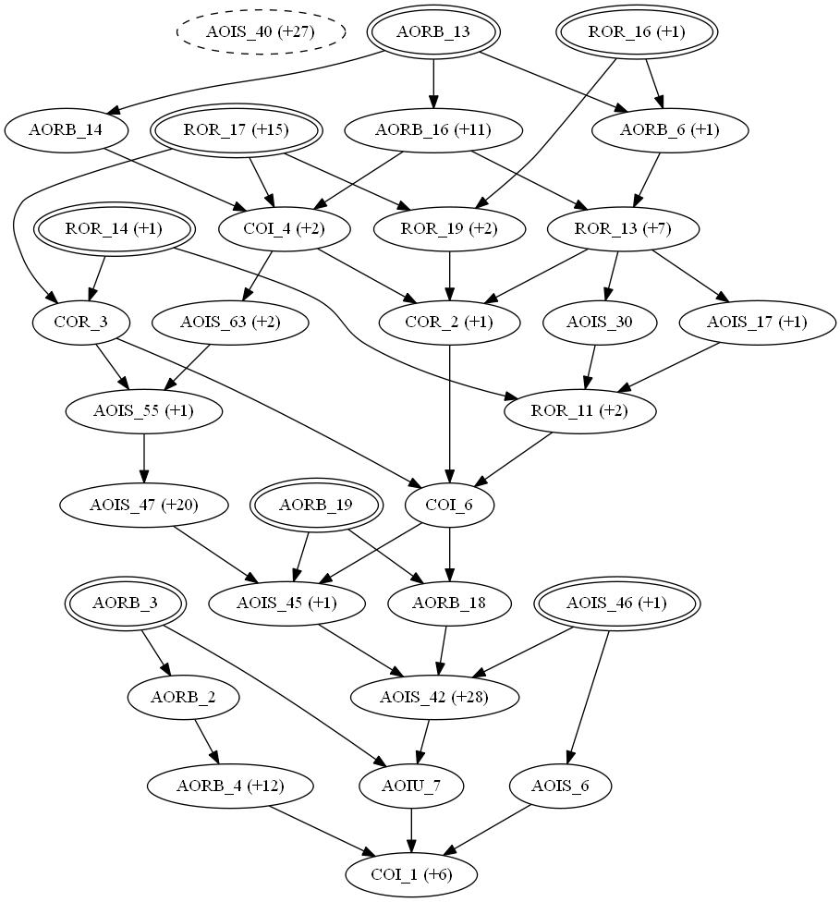
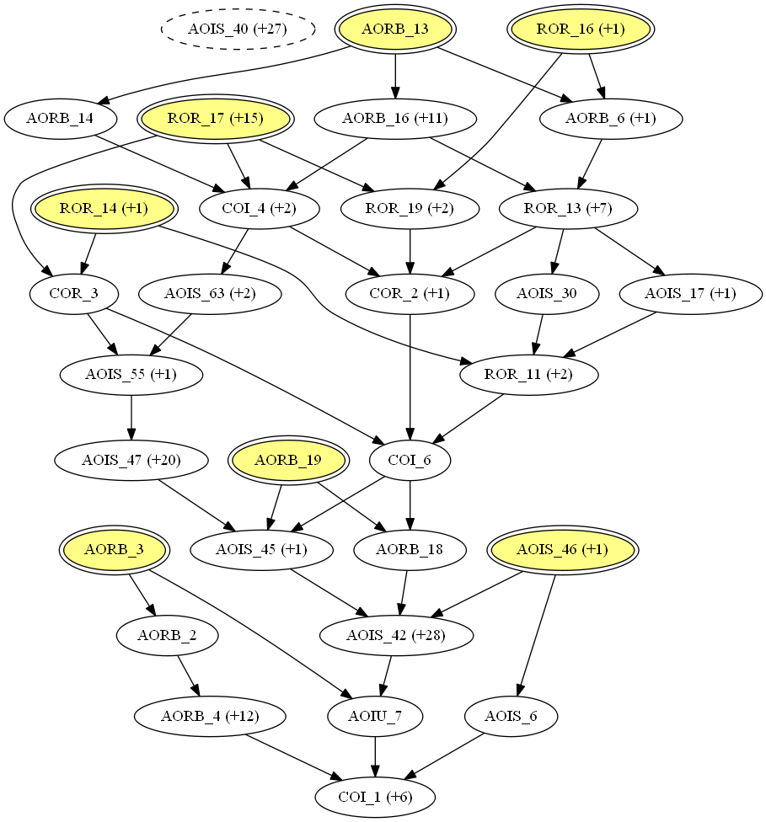
cal() Dynamic Subsumption
 | DMSG
Nodes | 30
Minimal Nodes | 7
Equiv | 28

Slide 6
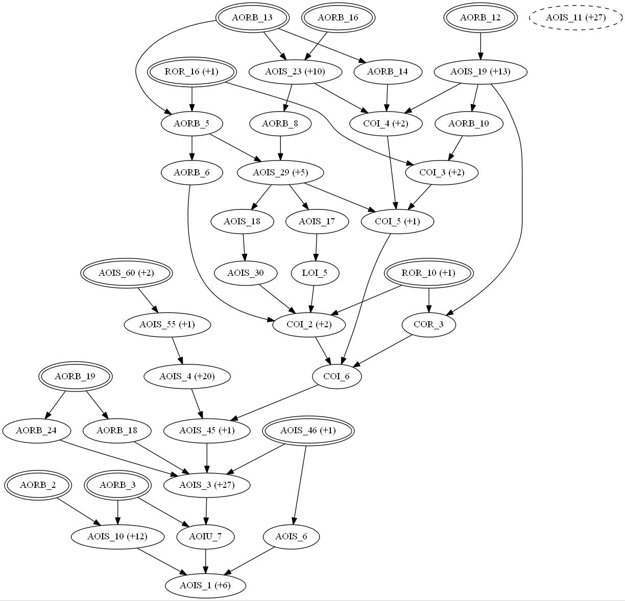
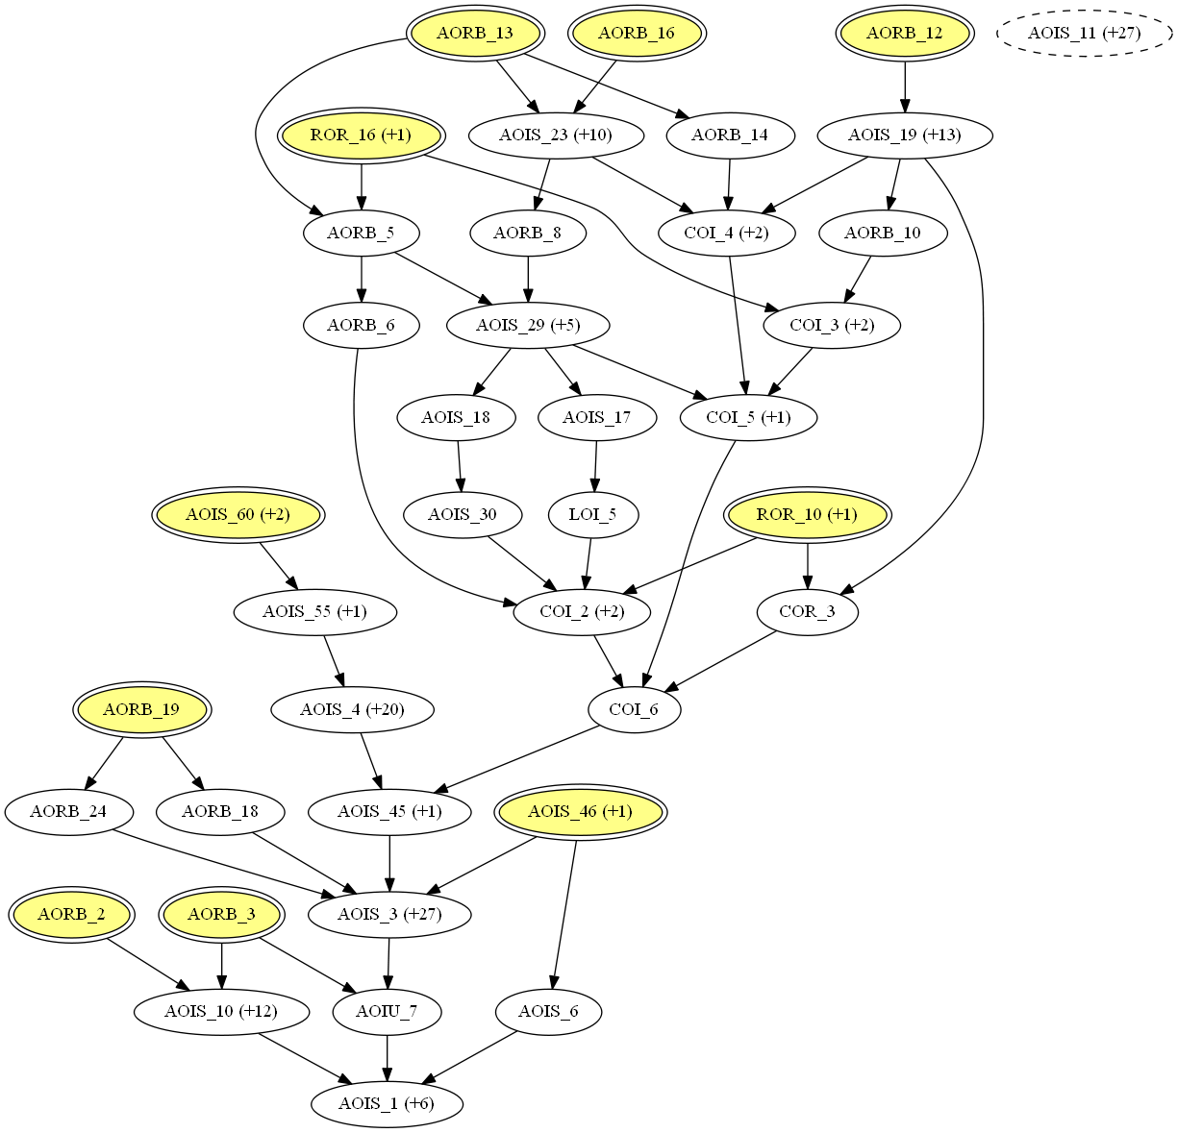
cal() True Subsumption
 | TMGS | DMSG
Nodes | 38 | 30
Minimal Nodes | 10 | 7*
Equiv | 28 | 28
* All are correct, but not fully distinguished

Slide 7
Takeaways for the 437 student
This week’s assignment was a warm-up
Simple programs can encode complex behavior
Surprising few tests can pin down behavior
Engineers need help finding these tests
What coverage criteria do! (AO Chapters 6-9)
ps – don’t stress out on the subsumption graphs given here– you won’t be tested on that

