Slide 1
An Industrial Application of Mutation Testing Lessons, Challenges, and Research Directions
Goran Petrovic, Marko Ivankovic, Bob Kurtz, Paul Ammann, René Just

Slide 2
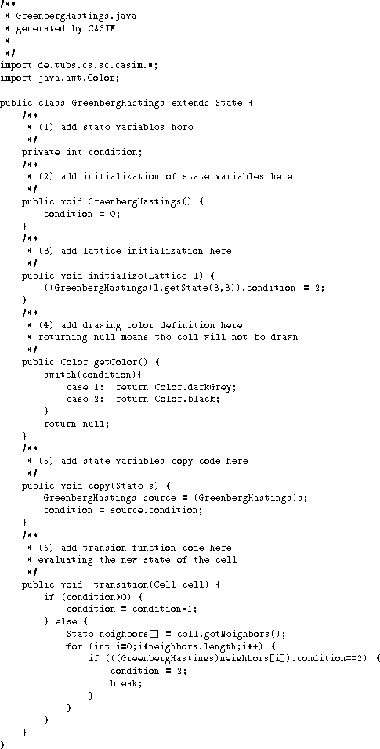
How to effectively test software?
???
Program
Tests

Slide 3
How to effectively test software?
???
Program
Tests
What to test?
How to test?
When to stop?
How effective are the tests?
What is missing?

Slide 4
Mutation testing
Mutation testing
Program
Tests

Slide 5
Mutation testing
Program
Mutants
Tests
Generating mutants is cheap
Executing tests on mutants is cheap(ish)
Writing tests is expensive

Slide 6
Mutation testing
Program
Mutants
Tests
Generating mutants is cheap
Executing tests on mutants is cheap(ish)
Writing tests is expensive
Engineers care about mutants that elicit effective tests!

Slide 7
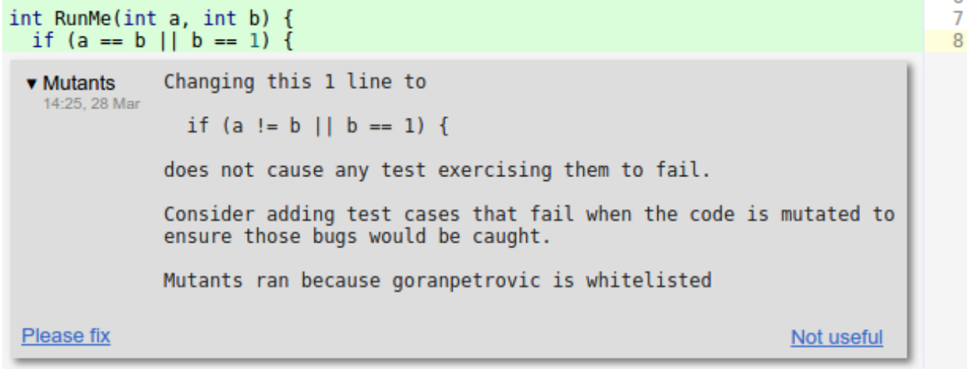
Mutation testing at Google
Petrovic and Ivankovic, ICSE (SEIP) 2018

Slide 8
Mutation testing at Google
Petrovic and Ivankovic, ICSE (SEIP) 2018

Slide 9
Status quo vs. this talk
Status quo
Killable mutants are good tests
Equivalent mutants are bad no tests
This talk
Killable vs. equivalent is too simplistic
Productive mutants elicit effective tests
Killable mutants can be unproductive
Equivalent mutants can be productive
The costs of unproductive mutants
Also in the paper
Mutation testing with productive mutants at Google

Slide 10
Status quo vs. this talk
Status quo
Killable mutants are good tests
Equivalent mutants are bad no tests
This talk
Killable vs. equivalent is too simplistic
Productive mutants elicit effective tests
Killable mutants can be unproductive
Equivalent mutants can be productive
The costs of unproductive mutants
Also in the paper
Mutation testing with productive mutants at Google
The notion of productive mutants is fuzzy!
A mutant is productive if it is
killable and elicits an effective test or
equivalent and advances code quality or knowledge

Slide 11
Killable vs. productive mutants
Original program
Mutant
public double getAvg(double[] nums) {
double sum = 0;
int len = nums.length;
for (int i = 0; i < len; ++i) {
sum = sum + nums[i];
}
return sum / len;
}
public double getAvg(double[] nums) {
double sum = 0;
int len = nums.length;
for (int i = 0; i < len; ++i) {
sum = sum * nums[i];
}
return sum / len;
}
The mutant is killable, but is it productive?

Slide 12
Killable vs. productive mutants
Original program
Mutant
public double getAvg(double[] nums) {
int len = nums.length;
double sum = 0;
double avg = 0;
for (int i = 0; i < len; ++i) {
avg = avg + (nums[i] / len);
sum = sum + nums[i];
}
return sum / len;
}
public double getAvg(double[] nums) {
int len = nums.length;
double sum = 0;
double avg = 0;
for (int i = 0; i < len; ++i) {
avg = avg * (nums[i] / len);
sum = sum + nums[i];
}
return sum / len;
}
The mutant is equivalent, but is it unproductive?

Slide 13
Killable vs. productive mutants
Original program
Mutant
...
Set cache = new HashSet(a * b);
...
...
Set cache = new HashSet(a + b);
...
The mutant is (maybe) killable, but is it productive?

Slide 14
Very few mutants are productive
Program
Mutants
Tests
A mutant is productive if it is:
killable and elicits an effective test or
equivalent and advances code quality or knowledge

Slide 15
Very few mutants are productive
Program
Mutants
Tests
A mutant is productive if it is:
killable and elicits an effective test or
equivalent and advances code quality or knowledge

Slide 16
Very few mutants are productive
Effective tests
Program
Mutants
Tests
A mutant is productive if it is:
killable and elicits an effective test or
equivalent and advances code quality or knowledge

Slide 17
The costs of unproductive mutants
Subjects
3 classes (Apache commons-lang)
3219 mutants
661 (20.5%) unkilled mutants
Goal
Develop a mutation adequate test suite
Label mutants as productive vs. unproductive

Slide 18
The costs of unproductive mutants: results

Slide 19
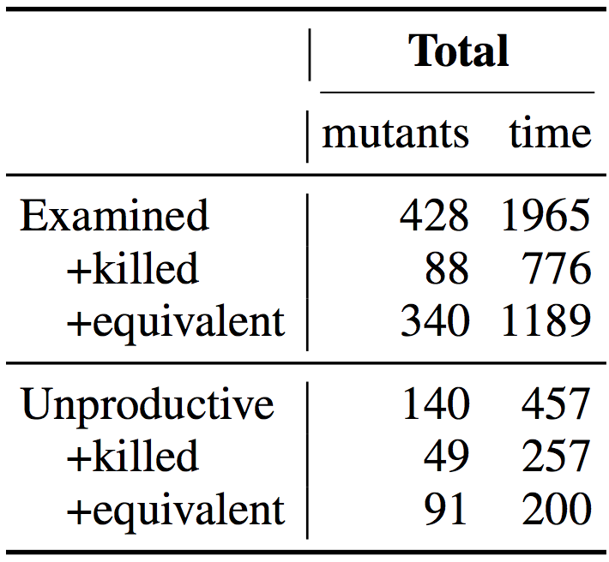
The costs of unproductive mutants: results
>32 hours for 428 mutants
33% of examined mutants are unproductive
Achieving mutation adequacy is hopeless!

Slide 20
The costs of unproductive mutants: results
8.8 minutes per mutant
3.5 minutes per mutant*
5.2 minutes per mutant
2.2 minutes per mutant*
*15 min per mutant on average (Schuler and Zeller, ICST 2010)

Slide 21
The costs of unproductive mutants: results
8.8 minutes per mutant
3.5 minutes per mutant*
5.2 minutes per mutant
2.2 minutes per mutant*
Unproductive mutants are expensive!

Slide 22
Problem: very few mutants are productive
Effective tests
Program
Mutants
Tests
A mutant is productive if it is:
killable and elicits an effective test or
equivalent and advances code quality or knowledge

Slide 23
Existing selection strategies
Effective tests
Program
Mutants
Tests
Existing selection strategies are no better than random*
Sample mutation operators
Sample mutants
*Gopinath et al., ICSE’16, *Kurtz et al., FSE’16

Slide 24
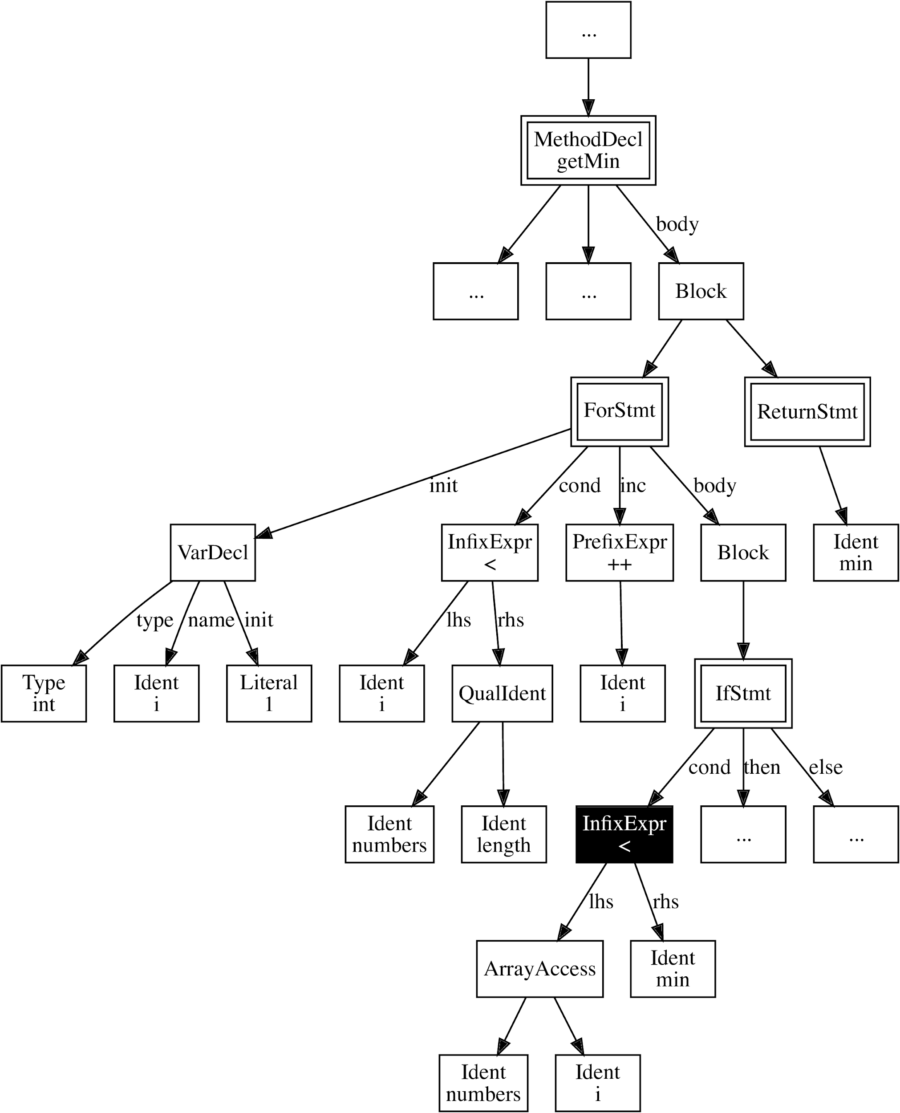
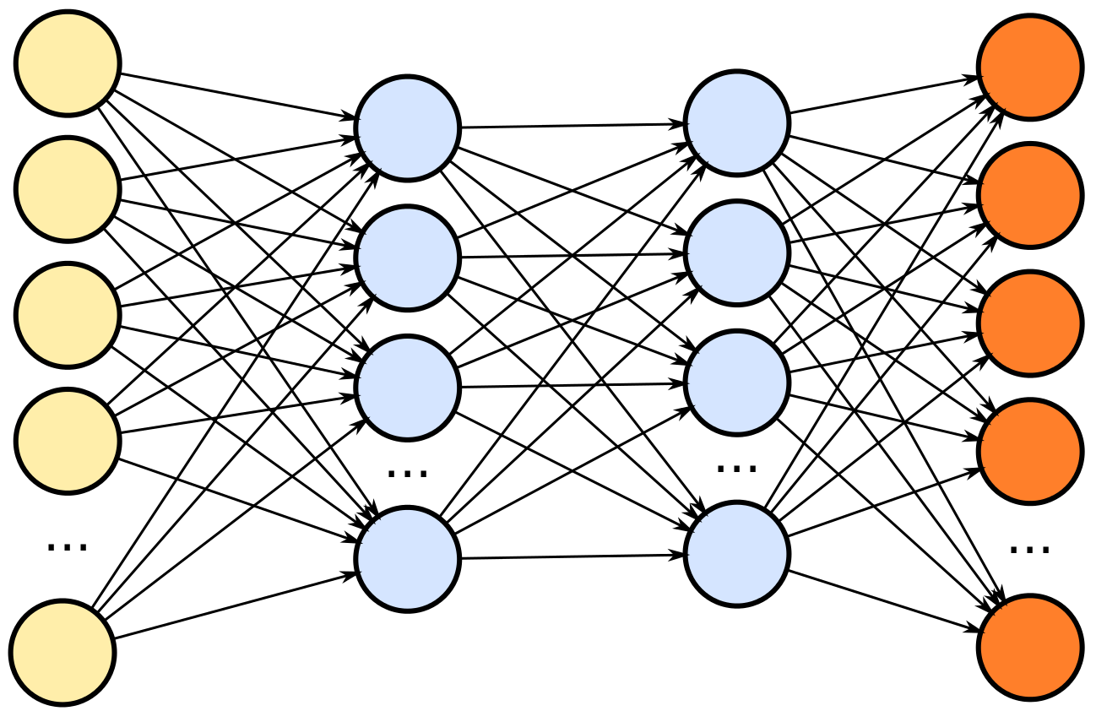
Future: predicting productive mutants
Effective tests
Program
Mutants
Tests

Slide 25
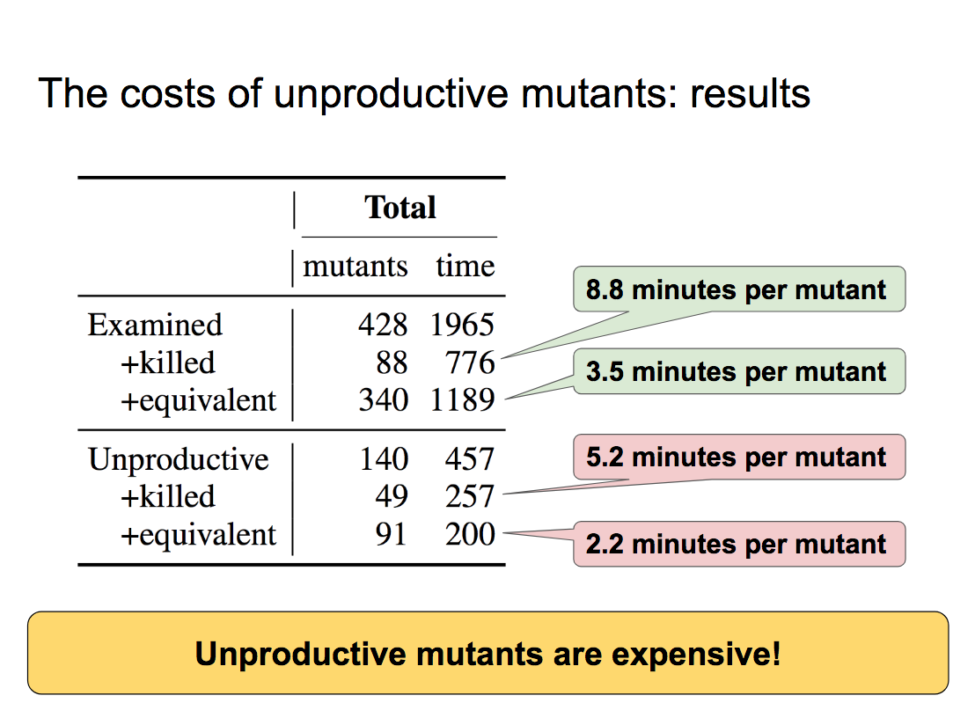
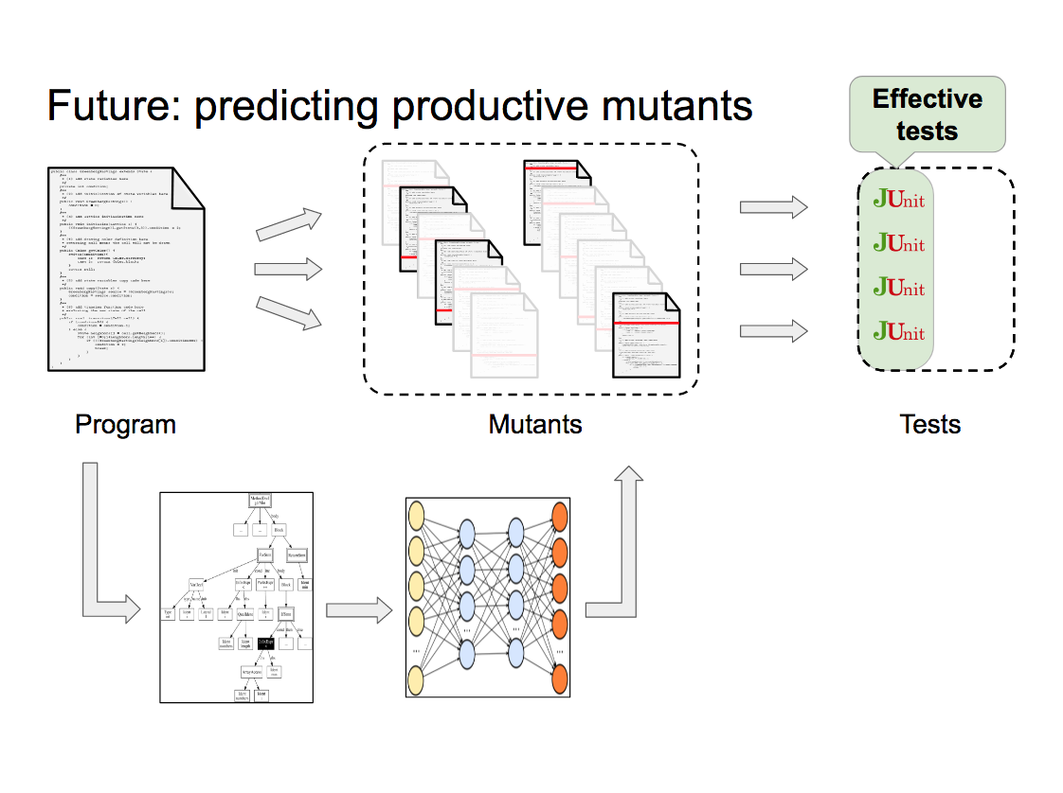
An Industrial Application of Mutation Testing

