Slide 1
Test Driven Lasse Koskela Chapter 2: Beginning TDD
Paul Ammann
http://cs.gmu.edu/~pammann/

Slide 2
Overview
From Requirements to Tests
Choosing the First Test
Breadth-first, Depth-first
Let’s Not Forget to Refactor
Adding a Bit of Error Handling
Loose Ends on the Test List
Experience is a hard teacher because she gives the test first, the lesson afterward.

Slide 3
From Requirements To Tests: Template System Example
Template System as Tasks
Template System as Tests
Write a regular expression for identifying variables from the template
Implement a template parser that uses the regex
Implement template engine that provides public API and uses parser internally
…
Template without any variables renders as is
Template with one variable is rendered with variable replace by value
Template with multiple variables is rendered with each variable replace by appropriate value
…
Which Approach Do You Find More Natural?

Slide 4
What Are Good Tests Made Of?
A Good Test Is Atomic
Keeps Things Focused
A Good Test Is Isolated
Doesn’t Depend On Other Tests
Lots of Other Desirable Properties Of Tests…

Slide 5
Programming By Intention
Given an Initial Set Of Tests
Pick One
Goal: Most Progress With Least Effort
Next, Write Test Code
Wait! Code Won’t Compile!
Simply Imagine Code Exists
Use Most Natural Expression For Call
Benefit of Programming By Intention
Focus on What We COULD Have
Instead of What We DO Have
Incremental API Design From The Client Perspective

Slide 6
Choosing The First Test
Some Detailed Requirements:
System replaces variable placeholders like ${firstname} in template with values provided at runtime
Attempt to send template with undefined variables raises error
System ignores variables that aren’t in the template
Some Corresponding Tests
Evaluating template “Hello, ${name}” with value Reader results in “Hello, Reader”
Evaluating “${greeting}, ${name}” with “Hi” and “Reader” results in “Hi, Reader”
Evaluating “Hello, ${name}” with “name” undefined raises MissingValueError

Slide 7
Writing First Failing Test
Evaluating template “Hello, ${name}” with value Reader results in “Hello, Reader”
Listings 2.1, 2.2, 2.3
public class TestTemplate {
@Test
public void oneVariable() throws Exception {
Template template = new Template(“Hello, ${name}”);
template.set(“name”, “Reader”);
assertEquals(“Hello, Reader”, template.evaluate());
}
}
DO Try This At Home

Slide 8
Code To Make Compiler Happy
public class Template {
public Template (String templateText) {
}
public void set (String variable, String value) {
}
public String evaluate() {
return null;
}
}
The Test Fails, Of Course, On This Code (Listing 2.4 = 2.5)
Let’s Run It And Make Sure We Get A RED Bar
We’re At The RED part of RED-GREEN-REFACTOR

Slide 9
Making The First Test Pass
public class Template {
public Template (String templateText) {
}
public void set (String variable, String value) {
}
public String evaluate() {
return “Hello, Reader”; // Couldn’t get easier than this!
}
}
We’re Looking For The Green Bar – Listing 2.6
We Know This Code Will Change Later – That’s Fine
Three Dimensions To Push Out Code: variable, value, template

Slide 10
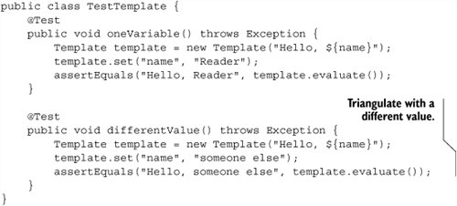
Another Test
Purpose of 2nd Test (Listing 2.7) is to Drive Out Hard Coding of Variable’s Value
Koskela Refers To Technique as Triangulation

Slide 11
Another Test
Revised Code (Listing 2.8) on Page 57
public class Template {
private String variableValue;
public Template(String templateText) {
}
public void set(String variable, String value) {
this.variableValue = value;
}
public String evaluate() {
return "Hello, " + variableValue;
}
}

Slide 12
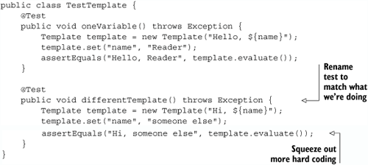
Another Test
Note Revisions To Junit in Listing 2.9

Slide 13
Breadth-First, Depth-First
What To Do With a “Hard” Red Bar?
Issue is What To Fake Vs. What To Build
“Faking” Is An Accepted Part Of TDD
Really, It Means “Deferring A Design Decision”
Depth First Means Supply Detailed Functionality
Breadth First Means Covering End-To-End Functionality (Even If Some Is Faked)

Slide 14
Handling Variables as Variables: Listing 2.10
public class Template {
private String variableValue;
private String templateText;
public Template(String templateText) {
this.templateText = templateText;
}
public void set(String variable, String value) {
this.variableValue = value;
}
public String evaluate() {
return templateText.replaceAll("\\$\\{name\\}", variableValue);
}
}

Slide 15
Multiple Variables
Test (page 60)
@Test
public void multipleVariables() throws Exception {
Template template = new Template("${one}, ${two}, ${three}");
template.set("one", "1");
template.set("two", "2");
template.set("three", "3");
assertEquals("1, 2, 3", template.evaluate());
}

Slide 16
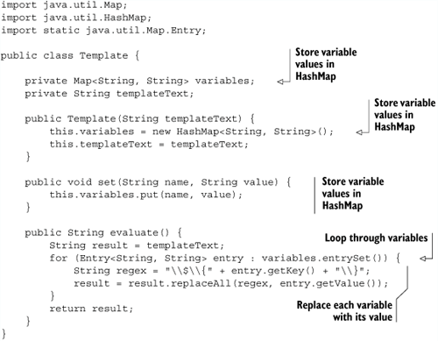
Multiple Variables: Solution (2.11)

Slide 17
Special Test Case
Special Case Test page 62
This test passes for free!
@Test
public void unknownVariablesAreIgnored() throws Exception {
Template template = new Template("Hello, ${name}");
template.set("name", "Reader");
template.set("doesnotexist", "Hi");
assertEquals("Hello, Reader", template.evaluate());
}

Slide 18
Let’s Not Forget To Refactor
Refactoring Applies To
Code, and
Test Code
Compare Listing 2.12 with Refactored Listing 2.13
Note Use of Fixtures

Slide 19
Listing 2.12: Ugly
@Test public void oneVariable() throws Exception {
Template template = new Template("Hello, ${name}");
template.set("name", "Reader");
assertEquals("Hello, Reader", template.evaluate());
}
@Test public void differentTemplate() throws Exception {
template = new Template("Hi, ${name}");
template.set("name", "someone else");
assertEquals("Hi, someone else", template.evaluate());
}
@Test public void multipleVariables() throws Exception {
Template template = new Template("${one}, ${two}, ${three}");
template.set("one", "1");
template.set("two", "2");
template.set("three", "3");
assertEquals("1, 2, 3", template.evaluate());
}
@Test public void unknownVariablesAreIgnored() throws Exception {
Template template = new Template("Hello, ${name}");
template.set("name", "Reader");
template.set("doesnotexist", "Hi");
assertEquals("Hello, Reader", template.evaluate());
}

Slide 20
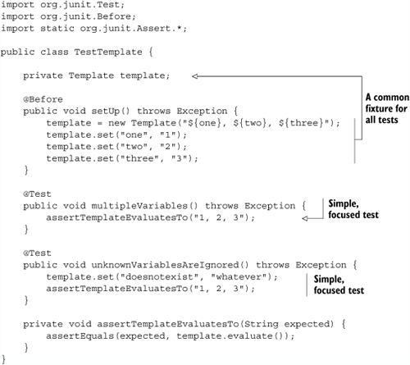
Listing 2.13: Test Code is Still Code!

Slide 21
Adding A Bit Of Error Handling
Adding Exception Test Listing 2.14
Note Different Approaches To Testing Exceptions
try/catch block with fail() vs. @Test(expected= …)
Note Home Grown Exception
Generally not recommended
@Test
public void missingValueRaisesException() throws Exception {
try {
new Template("${foo}").evaluate();
fail("evaluate() should throw an exception if "
+ "a variable was left without a value!");
} catch (MissingValueException expected) {
}
}

Slide 22
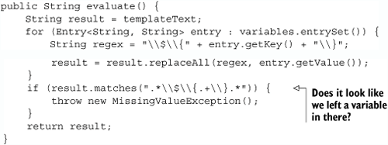
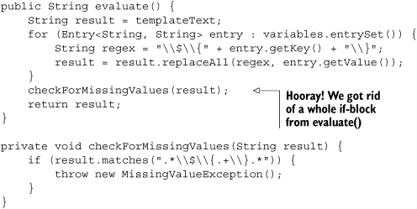
Corresponding Code: Listings 2.15, 2:16

Slide 23
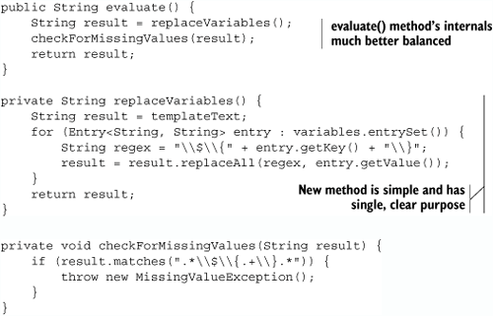
More Refactoring: Listing 2:17

Slide 24
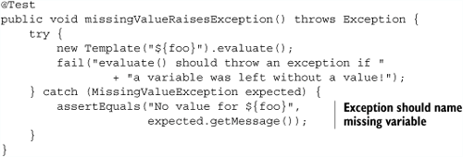
Exceptions With Diagnostics: Listing 2:18
import java.util.regex.Pattern;
import java.util.regex.Matcher;
private void checkForMissingValues(String result) {
Matcher m = Pattern.compile("\\$\\{.+\\}").matcher(result);
if (m.find()) {
throw new MissingValueException("No value for " + m.group());
}
}

Slide 25
Loose Ends On The Test List
Performance? Add a Test
Listing 2.19 (not shown in slides)
Finally, A Test That Dooms Current Implementation
@Test
public void variablesGetProcessedJustOnce() throws Exception {
template.set("one", "${one}");
template.set("two", "${three}");
template.set("three", "${two}");
assertTemplateEvaluatesTo("${one}, ${three}, ${two}");
}
Next Chapter Addresses This “Major” Change
Notion of “Spikes”
So Far, “Easy” TDD

