Slide 1
Architecture-Based Runtime Software Evolution
Peyman Oreizy,
Nenad Medvidovic &
Richard N. Taylor

Slide 2
Publication
ICSE, Proceedings of the 20th International Conference on Software Engineering, 1998
2008, named that conference's Most Influential Paper ten years later

Slide 3
Influence—citations

Slide 4
Citations continued
Paper’s influence is felt at GMU, and is cited in works by:
Gomaa
Malek
Menascé

Slide 5
Introduction
Continuous Availability is a critical requirement
Runtime evolution can mitigate costs and risks associated with downtime
OS’s, Distributed Object Technologies and Programming Languages support runtime modification, however…

Slide 6
Shortcomings
Existing technologies do not ensure
Consistency
Correctness
Desired properties of runtime change
These shortcomings still exist, according to the class text (p.540)

Slide 7
Change Management
Principle aspect of runtime system evolution
Helps identify what must be changed
Provides context for reasoning about, specifying and implementing change
Controls change to preserve system integrity
CM mitigates risks introduced by change

Slide 8
Architecture based approach
(Following on the work of Perry & Wolf, and Shaw & Garlan)
Unique elements:
Explicit architectural model, deployed with system
Preservation of explicit software connectors in system implementation
Imperative language for modifying architectures
Prototype tool to support above (ArchStudio)

Slide 9
Aspects of Change Management
Change Application Policy
Controls how change is applied to a running system.
Change Scope
Extent to which change affects parts of a system
Separation of Concerns
The degree to which functional issues are distinguished from change issues
Level of Abstraction
Complexity of information that must be managed

Slide 10
Reasons for Change
Changes to System Requirements (functional)
Changes to Implementation (From the text, p526)
Corrective Change (bug fixing)
Changes to non-functional requirements (security, performance, scale, etc)
Changes to operational environment

Slide 11
Previous Approaches to change
Gupta, et al
Statement & procedure level modeling
Peterson, et al
Module level modeling
Gorlick, et al
Data flow based modeling (Weaves)
Kramer and Magee
Structural based approach to changing system configuration (of bidirectional comm. links)

Slide 12
Benefits to CM at Architectural Level
Engineers use the architecture as a tool to describe, reason about and understand overall system behavior
OTS components can be used if component internals are unrestricted
Policy & Scope decisions are naturally encapsulated within connectors
Architect controls change application policy and scope

Slide 13
Types of Change
Runtime Component Addition
Must not assume that system is in initial state
Must discover the current system state and synchronize its state with the system state.
Runtime Component Removal
May be the result of recent additions (i.e. new behavior)
Requirements are application specific

Slide 14
Types of Change continued
Runtime Component Replacement
May be the combination of an addition and removal
The state of the original component must be transferred to the new component
Both components must not be simultaneously active
Simplified when components lack state, or if state loss can be tolerated

Slide 15
Types of Change continued
Runtime Reconfiguration
Structural reconfiguration
Recombining existing functionality to modify overall system behavior

Slide 16
Enabling Runtime Change
Components
Each must provide a minimal amount of functional behavior:
Dynamically loadable
to support runtime addition and removal
Able to alter their connector bindings
to support runtime reconfiguration
Typically reusable code libraries that “wrap” the components

Slide 17
Enabling Runtime Change continued
Connectors
Must remain discrete entities in the implementation
Must provide a mechanism for adding and modifying component bindings
Play a significant role in Change Management

Slide 18
ArchStudio
Implements the Architecture-based approach to software evolution, with
Explicit Architectural Model, available at runtime
Runtime changes are described in terms of the architectural model
Using discrete operations for adding, removing and replacing components and connectors, or changing architectural topology,
Using facilities for querying the model and using the results

Slide 19
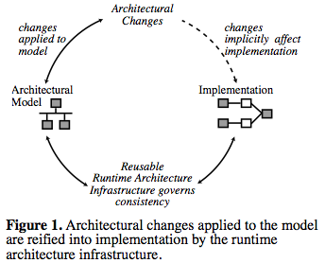
Conceptual Model

Slide 20
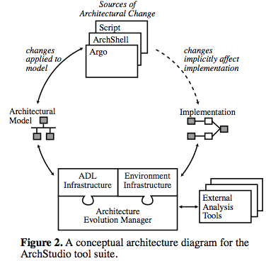
Model as Implemented in ArchStudio

Slide 21
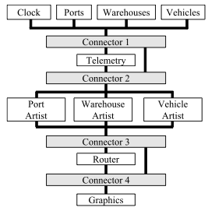
Original Architecture

Slide 22
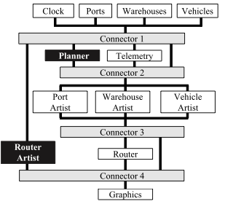
Modified Architecture

Slide 23
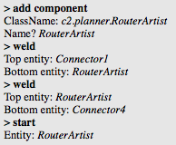
ArchShell Command example

Slide 24
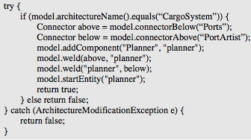
Extension Wizard Script example

Slide 25
Conclusion
Authors make a compelling case for an architectural approach to change, and CM
Contributions
Incorporation of an explicitly deployed architectural model
Preservation of explicit software connectors in the system
Imperative language for modifying architecture

Slide 26
What is ArchStudio 4 ? (from website)
A Software and Systems Development Environment
Two Roles
As a modeling environment
For modeling, visualizing and applying software and system architectures
As a meta-modeling environment
Allowing stakeholders to extend the environment to better suit their own needs

Slide 27
ArchStudio as a Modeling Environment
Documenting principal design decisions
Specifying architectural type consistency
Capturing architectural changes over time
Architecture models are stored and manipulated in xADL (open, XML-based).

Slide 28
ArchStudio as a Modeling Environment
Architecture Visualization
Use multiple interacting editors to develop and visualize architecture description
Architecture checking and analysis
Run suites of tests to check for consistency and correctness
Architecture Application
Tie architectures to implemented systems

Slide 29
ArchStudio for Meta-Modeling
Extensible Notation (xADL)
Representation format is modular and can be extended with standard XML schemas to capture new data or more detail
Extensible Visualization (Archipelago)
Visual editor has an extensible plug-in mechanism for adding editing support for new language modules.

Slide 30
ArchStudio for Meta-Modeling
Extensible Analysis
Users can write tests in the Schematron constraint language
Users can integrate new analysis engines
Extensible Application
Users can bind their architectures to the flexible Myx framework, or use their own

Slide 31
ArchStudio is Built in ArchStudio!
The Archstudio environment is built and maintained using its own tools
ArchStudio’s architecture is modeled in ArchStudio
Each time it starts, it is parsing its own architecture description and instantiating that description
Changes to the model are reflected in the implementation

