Slide 1


Self-Architecting Software SYstems (SASSY) from QoS-Annotated Activity Models
Sam Malek
Naeem Esfahani
Daniel A. Menascé
João P. Sousa
Hassan Gomaa
May 19th 2009
ICSE Workshop on Principles of Engineering Service Oriented Software Systems
Supported by the

Slide 2
Outline
Motivation
Research Objective
SASSY Framework
A Taste of SASSY
  Activity-Oriented Language
  Architecture Generation
  Methodology
Future Work

Slide 3
Emerging SOA-Enabled Pervasive Systems
We are witnessing the emergence of a new breed of software systems
Driven by the proliferation of smart spaces, portable devices, and advances in wireless network connectivity
Enabled by service-oriented architectures
  Autonomy: decoupling of service providers from consumers
  Flexibility: dynamically discovering and binding to services
  Standards: alleviating interoperability and integration challenges

Slide 4



Key Characteristics
Smart emergency response system
  Smart buildings with sensors
  Smart fire stations that monitor the sensors and dispatch fire engines
  Smart fire engines wirelessly connected to the rest of the system
  Smart hospitals monitoring the situation and dispatch ambulances
Innately dynamic and unpredictable
Functional requirements are often not completely known at design-time, and may change at run-time

Slide 5
Challenges
Software engineers need to rethink the way they compose such software systems
  Existing techniques rely on human reasoning and manual intervention
There is a pressing need for
  Rapid composition of software systems at run-time based on the users’ changing needs
  Autonomous adaptation of the software system at run-time to satisfy the system’s functional and QoS requirements

Slide 6
Outline
Motivation
Research Objective
SASSY Framework
A Taste of SASSY
  Activity-Oriented Language
  Architecture Generation
  Methodology
Future Work

Slide 7
State of the Art
Self-Adaptive Software: Software that is designed to automatically change its functionality (capabilities) at runtime
  3-layer model from Imperial
  ArchStudio from UCI
  Rainbow from CMU
What is known: in the absence of explicit architectural model, the engineer is left to reason about adaptation from memory or from source code
  Not feasible!
Architecture should serve as the primary focus of reasoning
  Underlying assumption: software requirements are known at design time
Key question: how can we design self-adaptive software in pervasive settings, where the system’s requirements are not completely know at design-time?

Slide 8
SASSY: Self-Architecting Software SYstems
Pushes the envelope
  From self-adaptive software → self-architecting software
Doman expert, instead of a software engineer, specifies the functional and QoS requirements in an activity-oriented modeling language
SASSY automatically constructs an optimal architectural model and the corresponding software system that satisfies the user’s requirements

Slide 9
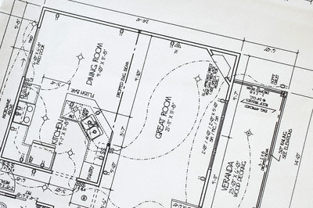

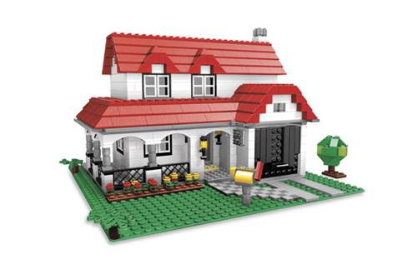
Somewhat Similar to Lego

Slide 10
Fiction or Reality: Key Assumptions
Focus on service-oriented systems
Reliance on a domain ontology
  Provides precise definition of domain concepts, including activities and services
  Terminology that is commonly understood by domain experts
Informed users that are trained in the requirements modeling language

Slide 11
Outline
Motivation
Research Objective
SASSY Framework
A Taste of SASSY
  Activity-Oriented Language
  Architecture Generation
  Methodology
Future Work

Slide 12
SASSY Framework

Slide 13
Outline
Motivation
Research Objective
SASSY Framework
A Taste of SASSY
  Activity-Oriented Language
  Architecture Generation
  Methodology
Future Work

Slide 14
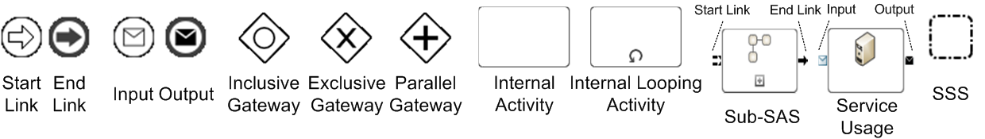
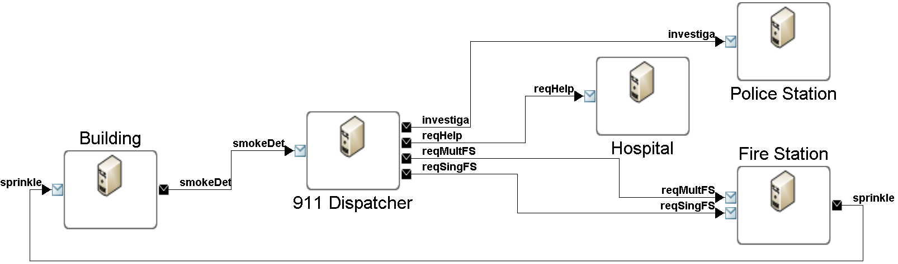
Service Activity Schemas (SAS)
A small emergency response system modeled in SAS
This shows the high-level requirements for the system
The notion of coordinator is implicit

Slide 15
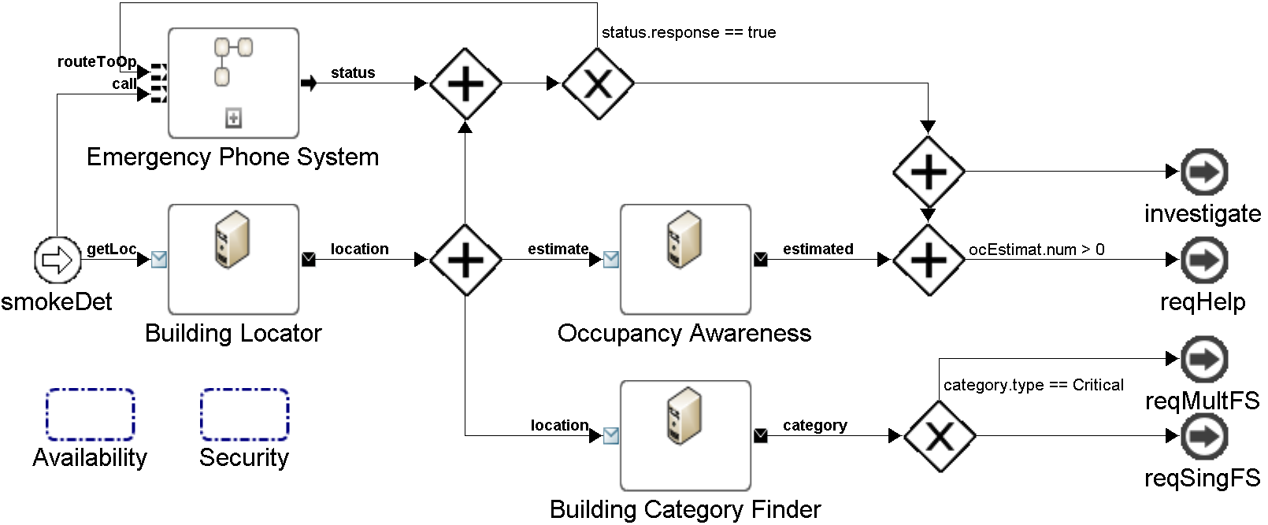
Internal Details of 911 Dispatcher

Slide 16
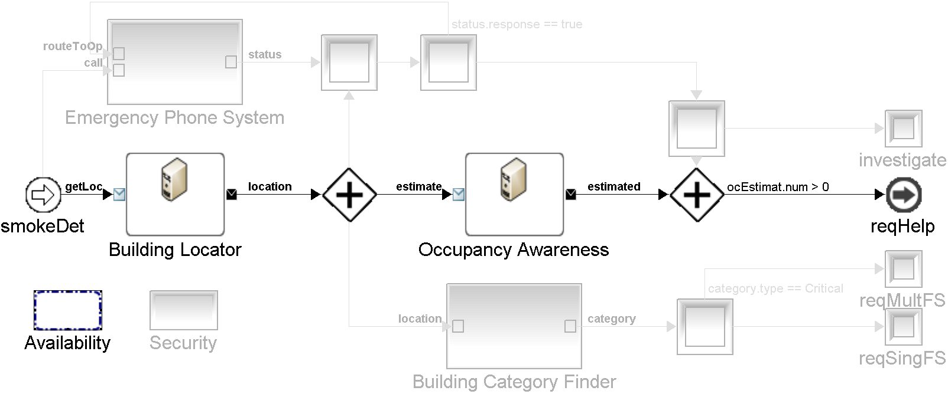
Modeling the QoS Requirements

Slide 17
Self-Architect the Base Architecture
Identify the service providers satisfying the functional requirements
(Near-) Optimally select the best providers with respect to QoS

Slide 18
Self-Architect the Enhanced Architecture
If the QoS requirements cannot be satisfied using existing providers, apply QoS patterns
  In this example, we apply the replication and mediator patterns

Slide 19
Self-Architect Coordinator’s Behavior

Slide 20
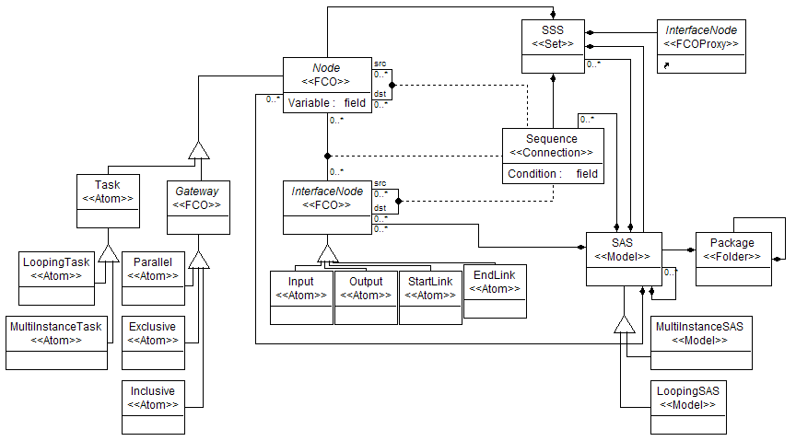
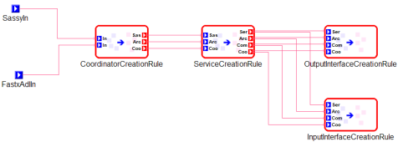
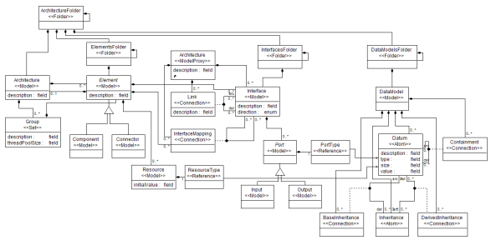
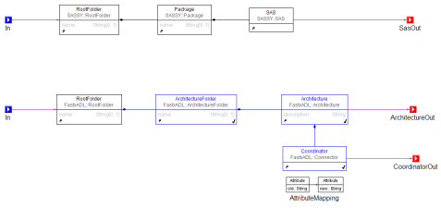
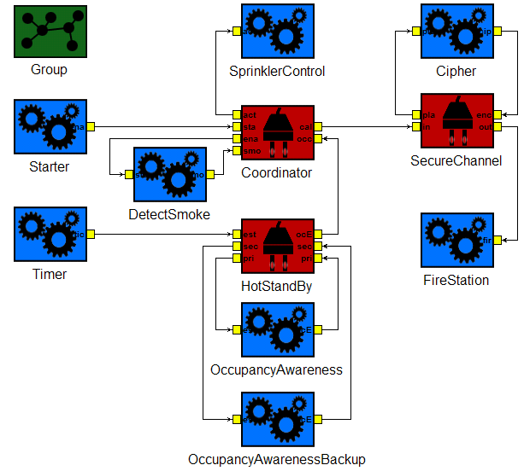
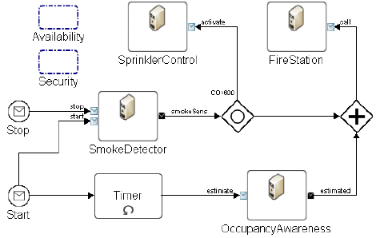
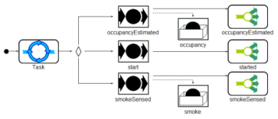
Architecture Generation using GReAT
Refers to
Refers to
SAS Meta-model
Architecture
Meta-model
Model Transformation
Specification in GReAT
Transformation Modeling
Transformation Executions
SAS to Architecture
Model Transformer
Input
Transforms
GReAT Engine
SAS Model
Architecture
Model

Slide 21
Outline
Motivation
Research Objective
SASSY Framework
A Taste of SASSY
Future Work

Slide 22

Ongoing Research & Future Work
Developing a repository of QoS patterns
Fully automating application of patterns
Utility function elicitation
Optimal architecture selection
Adaptation and evolution infrastructure

Slide 23
Questions

