Slide 1
RESISTing Reliability Degradation through Proactive Reconfiguration By Deshan Cooray
CS 795 – Spring 2010

Slide 2
Motivation
“Software Systems are increasingly Situated in dynamic, mission critical settings
Operational profile is dynamic, and depends on;
Type of user input, or features or services being invoked
Characteristics of the physical environment
System’s configuration is dynamic throughout its lifetime
E.g.: Changes in the number and type of software components (and devices) in the system, and their organization structure
Other contextual properties
E.g.: Resource limitations such as battery power and network bandwidth
Typical in mobile embedded systems
This dynamic nature, in turn, affects the QoS of a system

Slide 3
Motivation (Cont…)
Deployment time analysis of reliability is insufficient
System’s reliability (and other quality attributes) actually depends on its runtime characteristics
Thus a system needs to adapt at runtime to improve its QoS
Reactive systems adapt after the system’s capability has degraded
That’s not good enough
Thus a system needs to adapt proactively in order to maintain its effectiveness throughout its mission

Slide 4
Motivation (Cont…)
Software Systems are increasingly Situated in dynamic, mission critical settings
A system is mission critical if the loss of capability leads to a reduction in mission effectiveness
E.g.: Unmanned space mission, or a firefighting robot
But software failures occur during system’s execution, either due to
Previously unknown defects that get manifested due to the dynamic nature of the operational profile
Propagation of unhandled faults to non-faulty components
E.g.: OS faults
Hardware malfunction, which in turn result in software faults
E.g.: Hardware damage while the robot extinguishes a fire
Failure of required resources
E.g.: Network bandwidth fluctuations etc.

Slide 5
Challenges
Need to effectively estimate system reliability at runtime
Requires efficient, fine-grain reliability analysis
Proactive reconfiguration requires estimation of the system’s future reliability
Estimating the future operational profile is required
Need to determine the optimally reliable architecture at runtime
Requires analyzing effects of adaptation on Reliability, and other QoS attributes

Slide 6
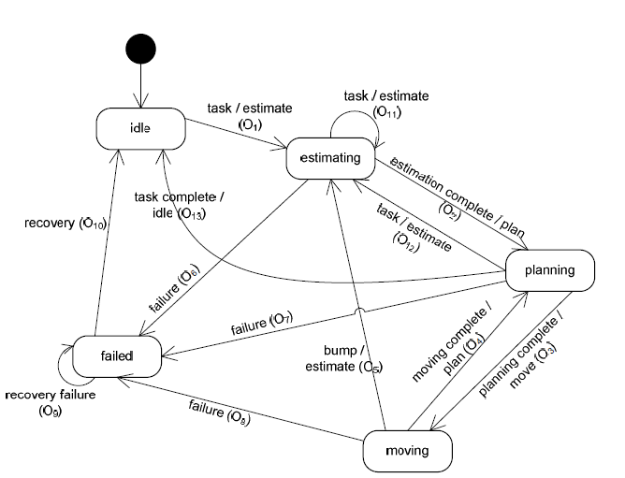
Example
Robot controller’s behavior model

Slide 7
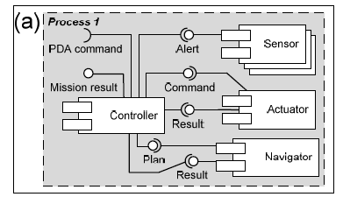
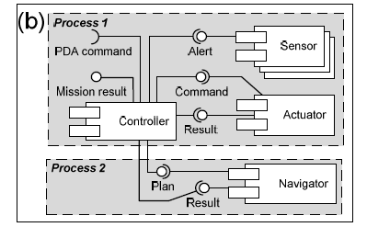
Example
Lets consider two alternative deployment architectures for the Robot Subsystem
Terminal faults of the Navigator can propagate to all other components
Less reliable, more efficient
Terminal faults of the Navigator are contained within process 2, preventing propagation
More reliable, less efficient

Slide 8
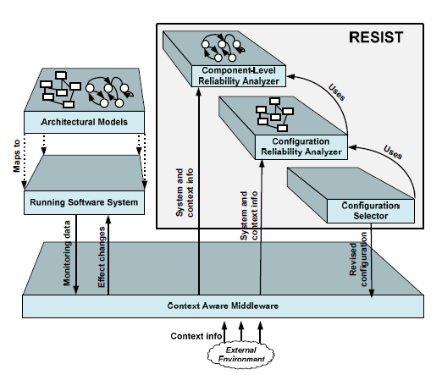
RESIST Framework
Context-aware middleware to provide support for;
Monitoring internal and external properties
Failures, Service requests etc
Network fluctuations, battery power etc
Adaptation of the software
Changes is the structure of software
Contextual properties
Location etc

Slide 9
Component Reliability
Upfront static reliability prediction offers little help
Due to the dynamic operational context
Therefore runtime reliability analysis is required
Can be estimated stochastically using a Discrete Time Markov Chain (DTMC)
Set of States S = {S₁, S₂, ..., S_{N}}
Transition matrix A = {a_{ij}}, where a_{ij} is the probability of transitioning from state S_{i} to state S_{j}
How to derive transition Matrix A?

Slide 10
Component Reliability (Cont…)
Use Hidden Markov Models (HMMs) to estimate transition matrix A
Observations from the system are used to derive the model
An HMM is defined as follows
Set of States S = {S₁, S₂, ..., S_{N}}
Transition matrix A = {a_{ij}}, where a_{ij} is the probability of transitioning from state S_{i} to state S_{j}
Set of observations O = {O₁, O₂, ..., O_{M}}
Observation matrix E = {e_{ij}}, where e_{ij} is the probability of observing event O_{k} in state S_{i}

Slide 11
Component Reliability (Cont…)
Robot controller’s behavior model

Slide 12
Component Reliability (Cont…)
Given the sequences of observations, use the Baum-Welch algorithm to train transition matrix A
States S = {idle, estimating, planning, moving, failed}
The steady state vector obtained from A represents the probability of being in any of the states given the system operates over time;
Reliability is computed as the probability of not being in a state

Slide 13
Component Reliability (Cont…)
Component Reliability Prediction
We consider a set of contextual parameters monitored by the runtime infrastructure
C= {C₁,…,C_{x}}
Revise transition matrix A using a context specific function quantifying the impact of contextual change on the transition probability.
When adjusting a’_{kj} the cumulative probability of that row must be equal to 1:

Slide 14
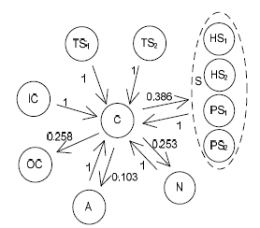
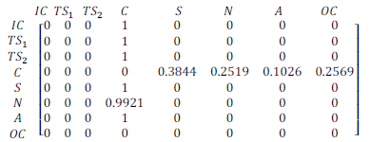
Configuration Reliability
System Reliability Calculation
Map components and their interactions to a DTMC, where a state is one or more components in concurrent execution

Slide 15
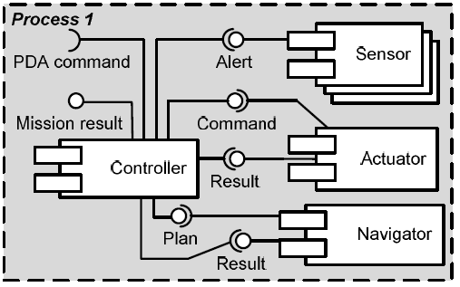
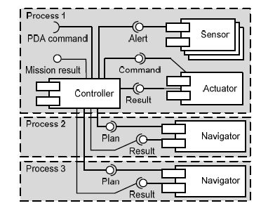
Configuration Reliability (Cont…)
Effects of adaptation on Reliability
Changing the Architectural Style
E.g.: Replicating components

Slide 16
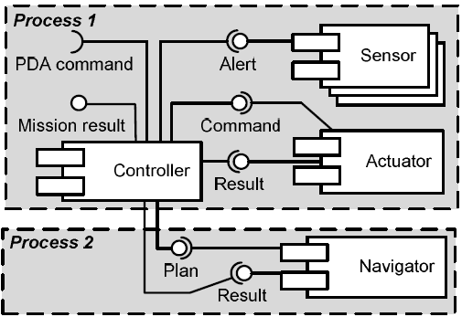
Configuration Reliability (Cont…)
Effects of adaptation on Reliability
Changing the Deployment Architecture
E.g.: Re-allocating components to processes

Slide 17
Configuration Selection
Optimal architecture should be determined by considering quality trade-offs
E.g.: Reliability vs Efficiency
Objective is to find configuration C* given the current configuration C, such that;
Where U_{q} is a utility function indicating the engineer’s preferences for the quality attribute q, and where;

Slide 18
Configuration Selection
Assume the following;
P = number of processes
C = number of components
N = number of replicas
This implies that there are
O(P^{C}) ways of allocating software components to OS processes
E.g.: with 3 components, and 2 processes, 8 possible configurations
O(N^{C}) ways of replicating components
E.g.: with 3 components and with up to 2 replicas for each, 8 possible configurations
Therefore, O((NxP)^{C})possible configurations

Slide 19
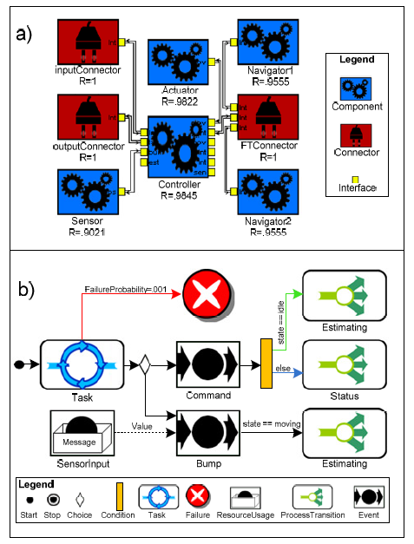
Implementation
XTEAM for maintaining
structural, behavioral and
reliability models
PRISM-MW as the
context-aware middleware
MATLAB as computational
environment

Slide 20
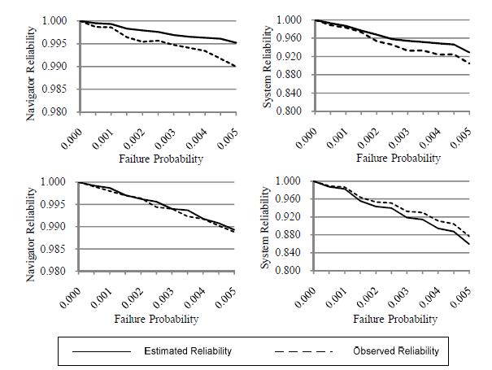
Evaluation
Effectiveness of Reliability Analysis
Estimated vs Observed reliability
Top - N and C as separate processes
Bottom - N and C sharing a process

Slide 21
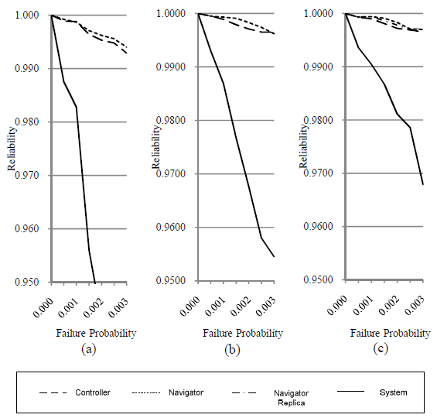
Evaluation (Cont…)
Effectiveness of architectural reconfiguration
N and C sharing the a process
N and C separated
N replicated

Slide 22
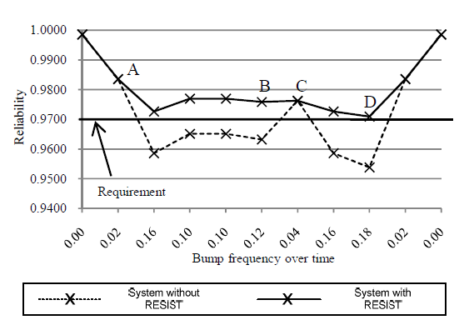
Evaluation (Cont…)
Comparison of the system with and without RESIST

Slide 23
Evaluation (Cont…)
Execution time of reliability analysis

