Slide 1
432 Invitation System
(Instructions …..)
Event name:
Date:
Time:
Location:
Description:
Attend
Not Attend
Cancel
Submit

Slide 2
432 Invitation System
(Instructions …..)
Event name:
Date:
Time:
Do you want to attend?
Location:
Description:
Yes
No
Attend
Not Attend
Cancel
Submit

Slide 3
Revenue tasks vs Excise tasks
Problem (what to achieve)
Complete SWE 432, understand and be able to design and implement usable web applications
Revenue tasks
Studying, reading materials, writing programs, …
Excise tasks
Debugging, installing VPN, setting up tomcat, …
Taking final exam ??

Slide 4
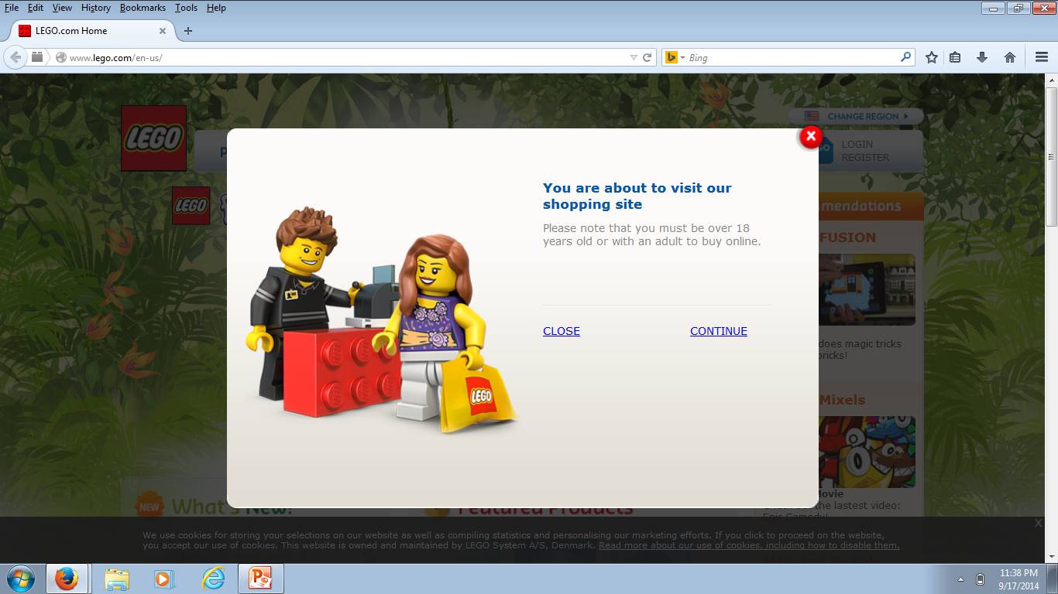
Do you want to attend?
Yes
No

Slide 5
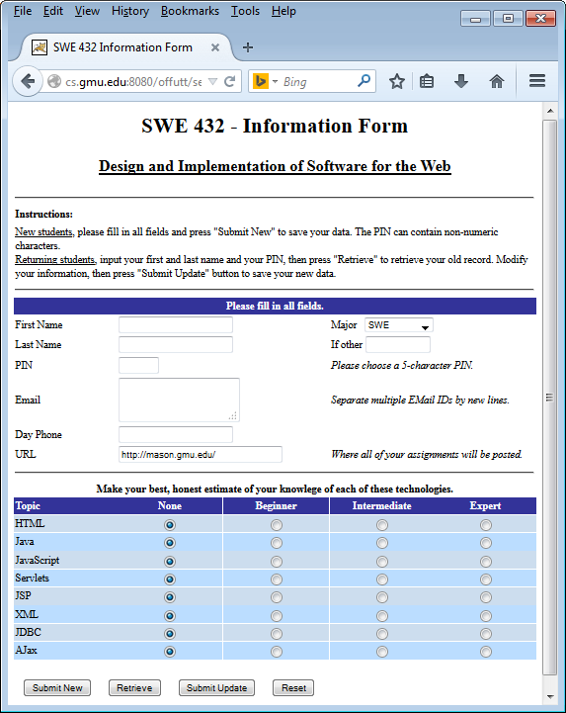
Navigation and menus
Links
Clickable /unclickable items
Page layout
Text and images
URL design
Search
UI flow
Users’ mental model
Revenue/excise tasks
Dialog boxes
Error messages
Feedback
Browser compatibility
…
Time to learn
Speed of performance
Avoiding user errors
Retention over time
Subjective satisfaction

Slide 6
Attend
Not Attend
Attend
Not Attend
Attend
Attend
Not Attend
Not Attend
Submit
Submit

Slide 7
432 Invitation System
(Instructions …..)
Event name:
Date:
Time:
Location:
Description:
Attend
Not Attend
Submit
432 Invitation System
(Instructions …..)
Event name:
Date:
Time:
Location:
Description:
Attend
Not Attend
Submit

