Slide 1
Game Physics – Part IV Moving to 3D
Dan Fleck

Slide 2
Moving to 3D
To move into 3D we need to determine equivalent equations for our 2D quantities
position
velocity
orientation
angular velocity

Slide 3
Linear Kinematics
This is the easy part – in 3D, the linear kinematics equations are the same, just with one extra dimension.
Position vectors now are = X,Y,Z
NewPosition_{xyz} = OldPosition_{xyz} + h*Velocity_{xyz}
NewVelocity = OldVelocity + h*AccelerationCM
Onward to orientation… aka the hard part!

Slide 4
Orientation in 3D
In 2D orientation was simply a single scalar = angle
In 3D it is much more complicated
In 3D there are 3 angular DoF (+3 positional DoF = 6 DoF you commonly see)
So we need at least 3 numbers to represent an orientation in 3D
It’s been proven that 3 numbers (minimal parameterization) mathematically sucks!
Lets see why…
The problem

Slide 5
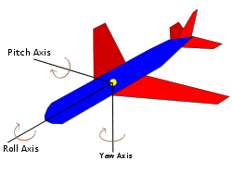
Euler Angles
Roll, Pitch, Yaw – This is what DarkGDK implements (as X,Y,Z rotations)
To define a location, the angle order matters. X=20, Y=5, Z=15 if applied
XYZ is different than YZX, etc…
In DarkGDK you can set ZYX rotation using dbSetObjectRotationZYX

Slide 6
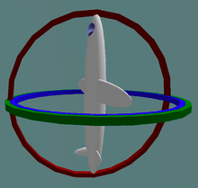
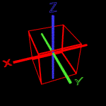
Euler Rotations
Using Euler angles to interpolate changes between two orientations
Suffer from Gimbal Lock
If two of the axis are aligned, you lose a degree of freedom. From this configuration you can only rotate in two DoF.
And discontinuities
When interpolating between two orientations, discontinuous angles (“jumps”) can result

Slide 7
Rotation Matrix
Rotation matrices represent orientations by a 3x3 Matrix.
3x3 leads to 9 DoF, but we know that reality is 3 DoF… thus we need other constraints
To be a rotation matrix, A, must be
special – not a reflection (not changing a left-handed coordinate system to a right-handed one)
orthogonal - means A*A^{T} = 1
These constraints mean
rows are unit length (3 constraints)
rows are all right angles (orthogonal) to each other (3 constraints)
Total DoF = 9 – 6 = 3 ☺

Slide 8
Rotation Matrices
Any matrix that is special orthogonal is a rotation matrix
To rotate a vector: A*V = V’
To combine rotations A*B=N
rotating first by A then B is the same as just multiplying by N
Not commutative!
A*B ≠ B*A

Slide 9
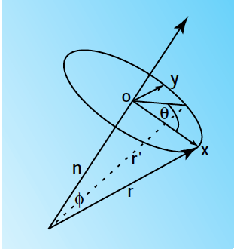
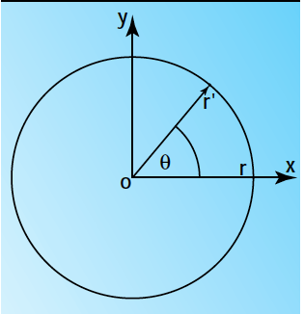
Axis – Angle Representation
Any vector rotation can be defined as a single rotation around an arbitrary unit vector axis
In picture 2: Angle is θ, axis is unit vector n (pointing into the page)
Picking a specific axis will allow rotation between any two configurations

Slide 10
Angular Velocity
To compute the angular velocity of the a point “r”.
We can treat r as rotating in 2D because it’s in a single plain. Thus, the speed of rotation is:
The direction of the velocity must be perpendicular to both r and n (n is the axis pointing into the screen)
What gives something perpendicular to two vectors? cross product!

Slide 11
Angular Velocity
So in 2D the angular velocity was given by the dot product
In 3D the angular velocity is given by the cross product of
Note: this equation is an instantaneous equation. It assumes r is constant which is only true for an instant because the axis of rotation changes
This equation shows the angular velocity (ω) differentiating a vector (r) to get the slope (or small change) in r

Slide 12
Angular Velocity
So, to “differentiate” the orientation matrix to find the change in orientation we need to differentiate the columns of the matrix (which are the orthogonal unit vectors of the axis in the oriented frame)
How? cross product of the angular velocity with every column
Similarly, to figure out change in orientation (A): we can just use

Slide 13
Angular Velocity
This will differentiate each column of the orientation matrix to get the instantaneous change in orientation
Procedure
Using forces and torques to compute angular velocity (ω).
Apply tilde operator to get skew-symmetric matrix
Compute new orientation:
Note: you need to recompute every frame, because angular velocity is instantaneous (valid only once).

Slide 14
Angular momentum of a point
In 2D this was done by a scalar from the perp-dot-product
In 3D we use an axis to describe the plane of rotation.
If A is the CM and B is the point on the body
p_{B}=linear momentum of the point B
L_{AB} is a vector that is the “normal” to the plane of rotation.
The magnitude of L_{AB} measures the amount of momentum perpendicular to r_{AB}

Slide 15
Total Angular Momentum
The derivative of momentum is the torque (just as in 2D) .
Without proof (just trust me):
Total angular momentum is thus:

Slide 16
Total Angular Momentum
Substitute and pull m out →
Flip order (changes sign)
Use tilde operator to change cross product to multiplication
Because ω is constant over the body. I_{A} is the inertia of the body. In 3D though, the inertia I_{A} is a matrix, thus called the inertia tensor.

Slide 17
Total Angular Momentum
The inertia tensor though depends on r which are positions in the world space (thus they change as the body moves). Meaning I_{A} is not a constant we can calculate once and be done!
Assuming we know I_{A,} we can solve for angular velocity ω as

Slide 18
The Inertia Tensor
Our problem is that I_{A} changes as the body rotates because it uses world-space vectors (r). This is because we computed it using world space vectors.
We can compute it instead using vectors relative to the body. Where “bar” means body-space coordinates.
The body space inertia tensor is constant, thus can be precomputed. Additionally, it’s inverse can also be precomputed.

Slide 19
The Inertia Tensor
However, to use this equation, we still need it in “world coordinates”.
We need a matrix I that acts on world-space vectors, like matrix I-bar acts on body space vectors. A similarity transform can do this. Given a rotation matrix A
A transform like this can transform from one coordinate space (body) to another (world). So applying the body tensor to a vector in body-space is the same as applying the world tensor to a vector in world-space

Slide 20
Inertia Tensors
Compute by integrating the mass over a 3D shape to get the inertia of the body. However, for any non-trivial shape this is hard.
For this course you can use tables of tensors for common shapes. For a box and sphere:
Box sides 2a, 2b, 2c:
X = (b2 + c2) / 3
Y = (a2 + c2) / 3
Z = (a2 + b2) / 3
Sphere with radius r:
X = Y = Z = 2 * r² / 5

Slide 21
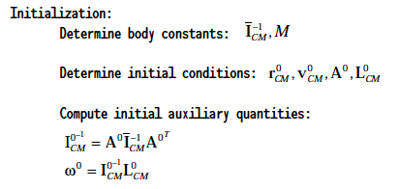
Putting it all together

Slide 22
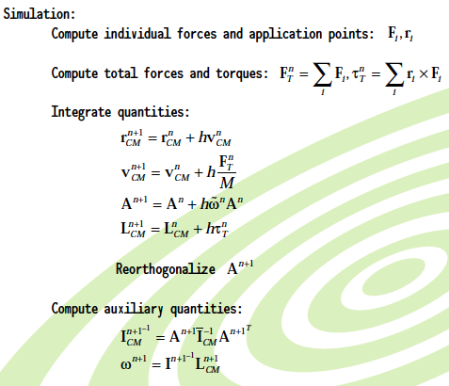
Due to numerical errors in integration, A will drift from a correct rotation matrix.

Slide 23
Using the values
Finally, using the simulation values update your object.
Applying A as orientation is just multipling all the vertices by the A.
Vertices (V) are the vertices of your object
V_{n} = A*V₀ (note: you always start with the original orientation)

Slide 24
Collisions
Collision detection is a challenging problem we’re not going over here
You still need location of collision, and velocities of the colliding objects.
Given those, the magnitude of the collision impulse (J) is given as:

Slide 25
Re-orthogonalizing a matrix
X = col1(A)
Y = col2(A)
Z = col3(A)
X.normalize(); // magnitude to one
Z = Cross(X,Y).normalize();
Y = Cross(Z,X).normalize();
// Reform matrix
A = [X, Y,Z];

Slide 26
Summary
While we have gone through a lot of information, there is still much more to creating fast, efficient, production engines.
You should understand the general concepts of
derivatives: position → velocity → acceleration
integration: acceleration → velocity → position
In 2D how Forces are used to derive linear quantities
acceleration, velocity, position
In 2D how Torque is used to derive angular quantities
momentum, angular velocity, rotation
In 3D how rotation can be represented as a matrix, and how that matrix is used

Slide 27
References
These slides are mainly based on Chris Hecker’s articles in Game Developer’s Magazine (1997).
The specific PDFs (part 1-4) are available at: http://chrishecker.com/Rigid_Body_Dynamics
Additional references from:
http://en.wikipedia.org/wiki/Euler_method
Graham Morgan’s slides (unpublished)
en.wikipedia.org/wiki/Aircraft_principal_axes
http://www.gamedev.net/community/forums/topic.asp?topic_id=57001
http://www.anticz.com/images/SiteImages/gimbal.gif

