Slide 1
Game Physics – Part II
Dan Fleck

Slide 2
Linear Dynamics Recap
Change in position (displacement) over time is velocity
Change in velocity over time is acceleration
Sum up the forces acting on the body at the center of mass to get current acceleration
To get new velocity and position, use your current acceleration, velocity, position and numerical integration over some small time step (h)

Slide 3
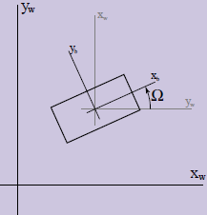
Angular Effects
Omega (Ω) is the orientation or angle of our rigid body
Change in Ω over time is angular velocity ( ω ) lower-case omega.
Change in angular velocity (ω) over time is angular acceleration

Slide 4
Finding angular acceleration α
If we know α we can differentiate it to find angular velocity and then again to find orientation. (Similar to finding linear acceleration a).
Finding α
Under linear motion (without rotation), all points move at the same velocity, however when the body is also rotating the velocity of every point is different.

Slide 5
Linear Velocity of a Point from Angular Velocity
v^{B} = velocity of point B
r^{OB} = vector from O to B
means take the perpendicular of that vector (rotate by 90° counterclockwise)

Slide 6
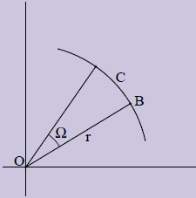
Proof
Displacement of point B rotating around the origin is C, by definition of radians:
Velocity is the time derivative of displacement
Thus the magnitude is correct
Intuitively the direction of velocity is tangent to the radius, which is perpendicular to the radius.

Slide 7
Total Velocity
The general case of the velocity of a point that is rotating and translating is given by Chasles’ theorem which states:
Thus, we can compute the velocity of any point on a body by knowing the linear velocity of the body’s origin (i.e. center of mass) and the velocity generated by rotation

Slide 8
Angular Momentum
Now lets find angular momentum
Linear momentum is defined for a point, angular momentum must be defined by using a reference point. The angular momentum of point B as seen by point A is L^{AB}
So this equation says the angular momentum of point B looking from A is the dot product of the perpendicularized radius vector and the linear momentum of the point (p^{B})
Operation is called the perp-dot product

Slide 9
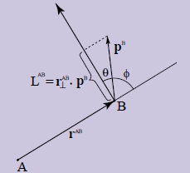
Angular Momentum
If you have a point B you want to find the component of the linear momentum that is in the “angular rotation” direction as seen from A.
Dot product projects one vector onto another

Slide 10
Torque at a single point
Force’s angular equivalent is Torque ( τ )
Thus, torque at a point is related to F at a point by the perp-dot product with the radius vector

Slide 11
Total Angular Momentum
The total angular momentum of the body around point A denoted as L^{AT} is
To get the total angular momentum, sum up the momentum at each point (where momentum is mass*velocity)

Slide 12
Total Angular Momentum
Combining these equations
Yields
Substitution
Factor out angular velocity (same at all points), pull mass out of dot product
Dot product of vector with itself, just square of magnitude
Define moment of inertia for the body as I^{A}. Which is constant for a body and can be computed ahead of time.

Slide 13
Moment of Inertia I
Moment of inertia I^{A} is the sum of the squared distances of all points from point A scaled by the mass of the points
Think of it as “how hard it is to rotate the object around point A”
A
A
Harder – higher moment of inertia
Easier – lower moment of inertia

Slide 14
Total Torque
Finally, if we know torque we can get angular acceleration
Thus, knowing the total torque (τ) and moment of inertia (I^{A}), we can divide to get angular acceleration (α)
From angular acceleration we can get angular velocity and then orientation

Slide 15
Summary
Compute CM and moment of inertia at the CM (i.e. I^{CM})
Set initial values (position, orientation, velocity, etc…)
Compute linear acceleration
For each force, compute the induced torque and add it to the total torque
Divide total torque by I^{CM} to get angular acceleration
Numerically integrate linear and angular acceleration to update position, linear velocity, orientation, angular velocity
Redraw object

Slide 16
ImpulseTorqueForce.cpp

Slide 17
ImpulseTorqueForce.cpp (cont)

Slide 18
Player.cpp (create the force)
Force is in same direction ship is facing, but offset to the left

Slide 19
Player.cpp
Using force and torque, update other quantities

Slide 20
Player.cpp (UpdatePlayer continues)

Slide 21
References
These slides are mainly based on Chris Hecker’s articles in Game Developer’s Magazine (1997).
The specific PDFs (part 1-4) are available at: http://chrishecker.com/Rigid_Body_Dynamics
Additional references from:
http://en.wikipedia.org/wiki/Euler_method
Graham Morgan’s slides (unpublished)

