Slide 1
Game Physics – Part III Collisions
Dan Fleck

Slide 2
Current Status
We understand how forces affect linear velocity
We understand how forces affect angular velocity
We can calculate change in velocity, position, angular velocity and orientation based on the sum of forces (and moment of inertia/center of mass)

Slide 3
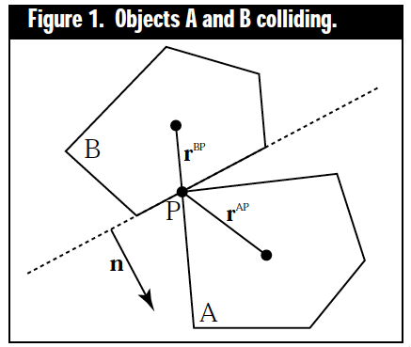
What’s Missing
Collisions – when two bodies hit each other, what are the resulting forces?
What are the resulting changes in velocity/accelerations
P = point of collision (P resides on both A and B)
rBP and rAP are the vectors from the center of mass to P
vAP and vBP are velocities of P on the two bodies. Wait, are these the same at the time of collision?

Slide 4
Collision Equations
Relative velocity (closing velocity)
How much of the velocity is in the direction of the collision?
If the collision normal is known, then we want the velocity of the collision in normal direction

Slide 5
Normal Velocity Equations
(Eq. 2)
Three cases:
If the equation is positive, then A is moving in the direction of the normal, thus object moving away
If the equation is negative, then A is moving in the opposite of normal (thus colliding)
If the equation is 0 objects are touching, but not colliding

Slide 6
Processing a collision
To change velocities in previous weeks we have added forces. Will that work now?
Previous process: apply force → changes acceleration → changes velocity → changes position.
All of this is done through integration over time
In real life this works. However in our simulation the change in velocity should be essentially instantaneous. Otherwise the non-rigid bodies will interpenetrate
To accomplish a discontinuity in velocity (instantaneous change) we need to introduce an Impulse force

Slide 7
Impulse Force
An impulse force can change the velocity of an object immediately
It’s like a very large force integrated over a very very short time.
This is an approximation needed because we are assuming rigid bodies to simplify our work
So we will apply an impulse force at the collision point in the opposite normal direction to achieve this change.
But what is the magnitude of that force?

Slide 8
Impulse Force Magnitude
Newton’s Law of Restitution for Instantaneous Collisions with No Friction
Instantaneous = no other forces are considered during the collision (like gravity or drag, etc…)
Coefficient of restitution = e or ε(lowercase epsilon) = a scalar value to model compression and restitution of impacting bodies
e says how much of the energy is dissipated during collision
e=1.0 is like a superball
e=0.0 is a like lump of mud
Outgoing relative velocity
Incoming relative
velocity

Slide 9
Impulse Force Magnitude
We will now define J as the magnitude of the impulse force needed to change the velocity.
Newton’s 3rd Law of equal and opposite reactions, says that if the force experienced by object A is jn then the force experienced by B is –jn
Thus, knowing the magnitude of the forces ( j ) we can write velocity equations for A and B:
Eq 4a and b assume bodies A and B cannot rotate

Slide 10
Quick derivation
Remember F = ma, so a=F/m.
In this case “F” is jn, so a is jn/M for the entire body
Then we are just updating the velocity as we did before:
v2 = v1 + (h*a) where h is a small time step

Slide 11
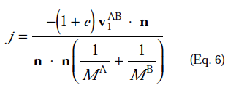
Solving for j (magnitude of force)
Substitute
Plug eqn 4 into equation above and distribute dot prod
Solve for j, with substitution from Eq. 2.

Slide 12
Impulse Force Magnitude (w/o Rotation)
j is the magnitude of the impulse (assuming no rotation)
At the time of collision we know all parameters of j
Using j and equation 4 we can solve for the new velocities of objects A and B after collision.

Slide 13
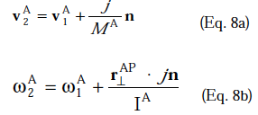
Spinning
Now lets add the ability to rotate to our body
Velocity of a rotating point P (from previous lecture). We need two things though
Linear and angular velocities under a force ( jn )
These equations show how the impulse force jn will modify the pre-collision velocities into post-collision velocities.
Solve for j using lots of algebra, much in the same way we solved for j before.

Slide 14
Completion
Now, using j and equations 8a and 8b we can solve for the new linear and rotational velocity of body A.
Similarly, use –j and 8a and 8b for body B

Slide 15
Collision Handling
Determine if objects are colliding
Determine collision point P
Determine collision normal n
Determine relative velocity v^{AB}
Solve for J (see previous slide)
Solve for new linear and angular velocities (see previous slide)
However, there are problems with this…

Slide 16
Determine if objects are colliding
--- Fast moving object can interpenetrate
B
B
A
A
Time t=1
Time t=2
This happens because from time 2 to 3 the objects moved to far.
Option 1: discover this, and try time 2.5. If still interpenetrating try 2.25, etc… (Hecker’s option)
Option 2: store previous non-interpenetrating configuration and move back to it, and then apply force (Fleck option … easier, but doesn’t work as well ☹ )
B
A
Time t=3

Slide 17
Determine collision point P
B
B
A
A
Easy vertex edge collision
“Manifold” collision – edge to edge – our equations cannot handle
B
Solution:
Manifold – assume one point hit and use it. Not perfect, but looks “ok”
Vertex-Vertex – pick one edge as the collision edge and treat as vertex-edge
A
Vertex – Vertex
What is the “normal”?

Slide 18
Multiple Colliding Entities
Our code does not handle multiple colliding entities
Nor multiple points colliding at the same time on two entities (concave shapes could do this)
Solution: Read more, learn more, use more robust solutions to solve these problems

Slide 19
Challenges with DarkGDK
Collision point not given
Collision normal not given
What can we do?

Slide 20
Challenges with DarkGDK
Add collision points all over perimeter (not seen in the game)
Pros? Cons?
Pros: Easy to detect collision
Cons: Hard to detect normal, lots of “sprites” to manage

Slide 21
Challenges with DarkGDK
Add collision lines all over perimeter (not seen in the game)
Pros? Cons?
Pros: Line intersection to detection collision and point of intersection. How to detect “normal”?
Cons: More sprites to manage, but not as many as points solution

Slide 22
To the code
Perimeter – stores the list of lines that form the perimeter of a shape.
Detect collisions among lines using line-line intersection
Determine normal by
Determine min distance to end of segment from collision point
Pick the other line as the “edge” to find normal
Compute normal
Main.cpp, processCollision
Player->processCollision

Slide 23
References
These slides are mainly based on Chris Hecker’s articles in Game Developer’s Magazine (1997).
The specific PDFs (part 1-4) are available at: http://chrishecker.com/Rigid_Body_Dynamics
Additional references from:
http://en.wikipedia.org/wiki/Euler_method
Graham Morgan’s slides (unpublished)

