Slide 1
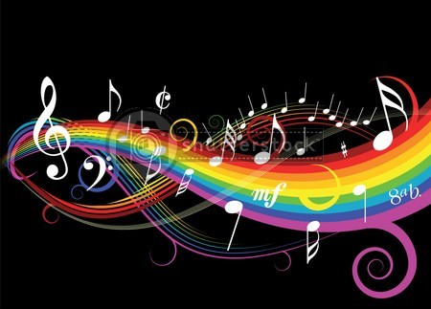
Music and sound in Video Games
Jonathan Crowe

Slide 2
Overview
What sets video game music apart
How the music and sounds are played
History of video game music and sounds
Current video game music and sounds
Comparison: then and now
Design choices
The future of music and sounds in video games
Examples

Slide 3
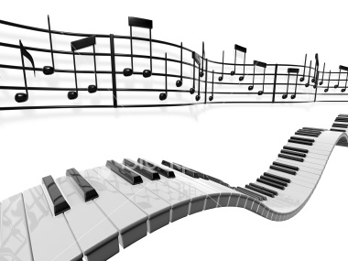
What makes it different?
Original music
Public domain songs
Orchestra music created for game
Popular songs by known artists

Slide 4
How is it played?
Ways to play sound:
Cassettes, records
Computer chip to convert between digital and analog, then output the analog as sound
Chips, but with sound samples
Pre-record then stream music
Current most popular method is to pre-record then stream
Best quality
Can use any pre-recorded music

Slide 5
History
Mostly started with digital to analog conversion chips (1970s-80s)
Programmers had to make digital representations of the analog notes to be played
Only a few tones available
Atari 2600 capable of playing 2 tones at a time
Some Exidy games had digitized sounds
In the 1980s, the price of technology started to decrease, and silicon chips were improved
Motorola 68000 CPU
Yamaha YM
ColecoVision

Slide 6
History, continued
Nintendo Entertainment System
Capable of five tones/channels
One of the five channels was capable of PCM sampled sound (although it was simple)
PCM mostly just used as substitute for percussion
Sometimes used for sound bites
Consoles at the time used a combination of:
Creating tones to act as instruments
Using a “noise channel” for percussion

Slide 7
History, continued
Commodore Amiga
Sampling used
Four independent digital-analog converters
Used pre-recorded sound waves, not just “beeps”
Program freely distributed, called Sound Tracker
Used MOD files
Made creating sound files much simpler
Super Nintendo Entertainment System
New Sony chip for sound
Eight channels of sound
Full stereo sound

Slide 8
History, continued
PlayStation
Used a CD-ROM drive
Up to 24 channels of sound
Sound was equal to CD quality
Pre-recorded and streaming music
Music can be recorded with any kinds of instruments
Tracks had to be mastered
CDs made sure that the files could fit and be played back with high quality
Method used in current generation

Slide 9
History, continued: Important Composers
Nobuo Uematsu – Final Fantasy
Kōji Kondō – Super Mario Bros., The Legend of Zelda
Kōichi Sugiyama – Dragon Quest
Hirokazu Tanaka – Metroid

Slide 10
Today
Dolby Digital – Xbox 360
Dolby TrueHD – PlayStation 3
DTS-HD – PlayStation 3
Dolby Pro Logic II – Wii
SoundBlaster – PC

Slide 11
Then and Now
Advances in surround sound
Advances in HD quality (Blu-ray)
Change from digitized sound samples to streaming pre-recorded sounds and music
As old as Dragon’s Lair – 1983
PC sound cards improved in 1989 to handle streaming audio, but not taken advantage of until 1992
PlayStation in 1994 had streaming audio capabilities

Slide 12
Design Choices
Streaming audio
Audio sequences
Pros:
Unlimited quality of pre-recorded audio
Unlimited types of instruments, no limit to how many of each
Cons:
Larger file size
No dynamic shifts
Pros:
Dynamic shifts for different types of gameplay
Smaller file size
Cons:
Limited to number of “synthesized voices”
Cannot use pre-recorded songs
Lower sound quality

Slide 13
Future
Not much improvement in technology
Contracting composers and popular artists
Game music outside of games
Popular in Japan already
Coming to West
Buying soundtracks to games
PLAY!

Slide 14
Examples
Super Mario Bros. Theme
Legend of Zelda Theme
Metroid Theme
Final Fantasy Theme
Doom Theme Song
Duke Nukem 3D Theme
Mortal Kombat II Theme
Halo Theme
The Elder Scrolls IV: Oblivion Theme

Slide 15
Works Cited
http://www.wikipedia.org
http://www.play-symphony.com
http://www.vgmusic.com
http://www.youtube.com

