Slide 1
Ciphers
Dan Fleck
CS 469: Security Engineering
1
1
1
These slides are modified with permission from Bill Young (Univ of Texas)

Slide 2
What is Good Encryption?
The following are suggested as tests of worth for current cryptographic practice:
is based on sound mathematics;
has been analyzed by competent experts and found to be sound;
has stood the test of time.
2
2
2

Slide 3
Breakable Encryption
An encryption algorithm is called breakable if, given enough time and data, an analyst can recover the plaintext.
Most encryption algorithms are breakable since the analyst can try all keys systematically. Being breakable doesn’t mean that it’s feasible to break.
The analyst must be able to recognize success. For that reason, having plaintext/ciphertext pairs available is often required.
3
3
3

Slide 4
Strong Encryption
A cryptosystem is strong if there is no analytic approach that is substantially faster than brute force—i.e., trying all of the keys one by one. Most strong algorithms are still breakable.
The larger the keyspace, the longer to ﬁnd the key by search. How do you compute the size of the keyspace?
Many ciphers use a n-bit string as key. Given a small number of plaintext/ciphertext pairs encrypted under key K, K can be recovered by exhaustive search in an expected time on the order of 2^{n−1} operations. Why?
4
4
4

Slide 5
Building Blocks of Ciphers
The simplest building blocks of encryption are:
substitution: in which each symbol is exchanged for another (not necessarily uniformly), and
transposition: in which the order of symbols is rearranged.
It might seem that these are too naive to be eﬀective. But almost all modern commercial symmetric ciphers use some combination of substitution and transposition for encryption.
5
5
5

Slide 6
Confusion and Diﬀusion
Two things an encryption step can provide are:
Confusion: transforming information in plaintext so that an interceptor cannot readily extract it.
Diﬀusion: spreading the information from a region of plaintext widely over the ciphertext.
Substitution tends to be good at confusion; transposition tends to be good at diﬀusion.
40
7
6

Slide 7
Lessons
An encryption algorithm is breakable if a systematic process will permit extracting the message.
It is strong if there is not better attack that brute force.
Most symmetric encryption algorithms use some combination of substitution and transposition to accomplish both confusion and diﬀusion.
6
6
7

Slide 8
Substitution Ciphers
A substitution cipher is one in which each symbol of the plaintext is exchanged for another symbol.
If this is done uniformly this is called a monoalphabetic cipher or simple substitution cipher.
If diﬀerent substitutions are made depending on where in the plaintext the symbol occurs, this is called a polyalphabetic substitution.
7
8
8

Slide 9
Simple Substitution
A simple substitution cipher is an injection (1-1 mapping) of the alphabet into itself or another alphabet. What is the key?
A simple substitution is breakable; we could try all k! mappings from the plaintext to ciphertext alphabets. That’s usually not necessary.
Redundancies in the plaintext (letter frequencies, digrams, etc.) are reﬂected in the ciphertext.
Not all substitution ciphers are simple substitution ciphers.
8
9
9

Slide 10
Caesar Cipher
The Caesar Cipher is a monoalphabetic cipher in which each letter is replaced in the encryption by another letter a ﬁxed “distance” away in the alphabet.
For example, A is replaced by C, B by D, ..., Y by A, Z by B, etc. What is the key?
What is the size of the keyspace?
9
10
10

Slide 11
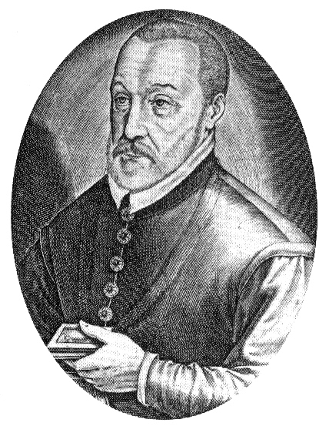
Vigenère Cipher
The Vigenère Cipher is an example of a polyalphabetic cipher, sometimes called a running key cipher because the key is another text.
Start with a key string: “monitors to go to the bathroom” and a plaintext to encrypt: “four score and seven years ago.” Align the two texts, possibly removing spaces:
plaintext: fours corea ndsev enyea rsago
key: monit orsto gotot hebat hroom
ciphertext: rcizl qfkxo trlso lrzet yjoua
Then use the letter pairs to look up an encryption in a table
(called a Vigenère Tableau or tabula recta).
What is the corresponding decryption algorithm?
10
11
11

Slide 12
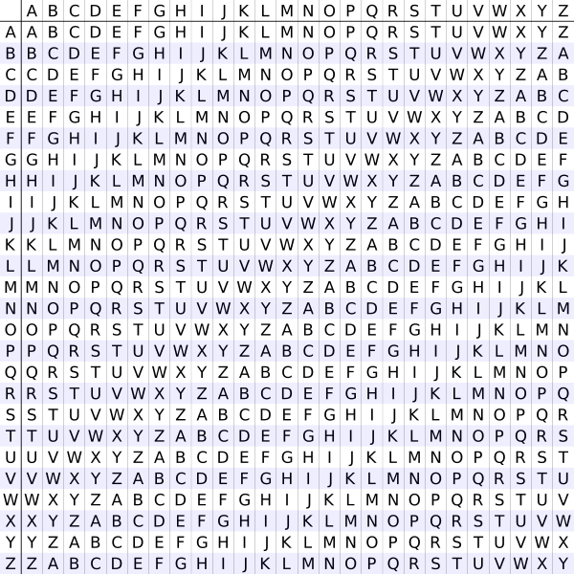
Vigenère Tableau
11
12
12

Slide 13
Cryptanalysis on Vigenère Cipher
The Vigenère Cipher selects one of twenty-six diﬀerent Caesar Ciphers, depending upon the corresponding letter in the key.
Running key ciphers are susceptible to statistical analysis. Both key and plaintext are English language strings and so have the entropy characteristics of English. In particular, the letters A, E, O, T, N, I make up approximately 50% of English text. Thus, at approximately 25% of indices, these can be expected to coincide.
This is an example of a regularity in the ciphertext that would not be expected merely from chance.
12
13
13

Slide 14
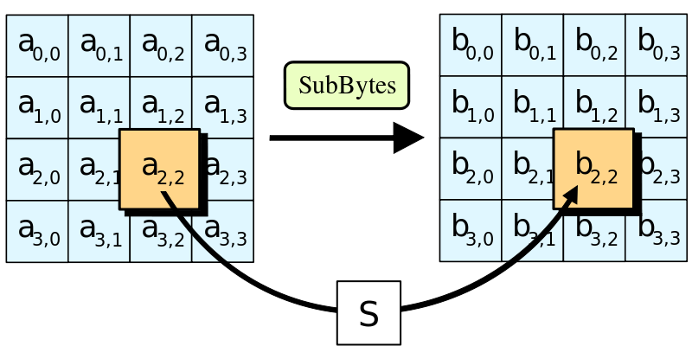
AES Substitution Step
Substitution need not only apply to symbols in a text.
The Advanced Encryption Standard (AES) contains a substitution step; each byte in a 16-byte array is replaced with a corresponding entry from a ﬁxed 8-bit lookup table.
13
14
14

Slide 15
Lessons
Substitution is one of the building blocks of encryption.
Simple substitution means replacing symbols uniformly by others. The Caesar Cipher and our pirate example are instances.
Polyalphabetic substitution means that the substitution varies according to the position in the text. The Vigenère Cipher is an example.
14
15
15

Slide 16
Thought Experiment: Using Information
Question 1: Suppose you know that “xyy” encodes a string in the English alphabet (26 letters) using a substitution cipher. How many decryptions are possible?
Answer 1: 26³ = 17576
Question 2: Add the information that it’s a simple substitution cipher.
Answer 2: 26 × 25 = 650. (Reduce search space by a factor of 27.)
Question 3: Add that you know the plaintext is an English word:
Answer 3: around 40. (Reduce original search space by a factor of 439.)
15
16
16

Slide 17
Perfect Ciphers
A perfect cipher would be one for which no reduction of the search space is gained from knowing:
the encryption algorithm, and
the ciphertext.
The attacker’s uncertainty (the likelihood of guessing the plaintext) of the message is exactly the same whether or not she has access to the ciphertext.
Do you think a perfect cipher is possible?
16
17
17

Slide 18
A Perfect Cipher: One Time Pad
A one-time pad, invented by Miller (1882) and independently by Vernam and Mauborgne (1917), is a theoretically perfect cipher.
The idea is to use a key that is the same length as the plaintext, and to use it only once. The key is XOR’d with the plaintext.
Example: Given a 15-bit binary message:
plaintext: 10110010111001
key: 11010001010100
ciphertext: 01100011101101
Notice the space of plaintexts, ciphertexts, and keys are all the same: 15-bit binary strings.
17
18
18

Slide 19
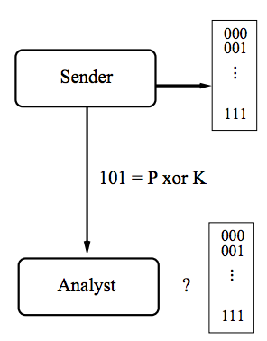
One Time Pad
Why is the one-time pad perfect? Consider the space of three-bit messages.
Suppose the attacker intercepts the ciphertext (“101”) and knows that a one-time pad is in use.
Every possible plaintext could be the pre-image of that ciphertext under a plausible key. Therefore, no reduction of the search space is possible.
Why does it matter that the key be random?
18
19
19

Slide 20
Key Distribution
The main problem with the one-time pad is practical, rather than theoretical.
Given the need to communicate securely, how do the sender and receiver agree on a secret (key) that they can use in the algorithm.
If sender and receiver already have a secure channel, why do they need the key?
If they don’t, how do they distribute the key securely?
This is the key distribution problem.
19
20
20

Slide 21
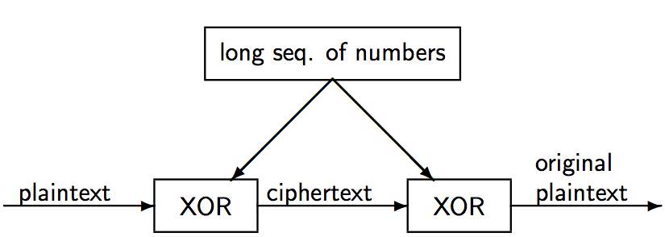
Vernam Cipher
The Vernam cipher is a type of one-time pad suitable for use on computers.
20
21
21

Slide 22
One Time Pad Approximation
Approximate the one-time pad using a PRNG to generate a key.
Another computer running the same random number generator function can produce the key from the seed. This works well because a pseudorandom sequence may have a very long period.
It is susceptible to compromise by someone who knows the algorithm and the seed.
21
22
22

Slide 23
Lessons
The cryptanalytic task is to reduce the uncertainty in the message (plaintext) using all available information.
A perfect cipher would be one in which no reduction of the search space is possible, even given access to the ciphertext and algorithm.
The one-time pad is a theoretically perfect encryption algorithm. However, it requires as much key material as there is plaintext, and suﬀers from the key distribution problem.
An approximation suitable for computers uses a PRNG to generate a seed.
22
23
23

Slide 24
Transposition Ciphers
Dan Fleck
CS 469: Security Engineering
23
24
24
These slides are modified with permission from Bill Young (Univ of Texas)

Slide 25
Transposition Ciphers
A transposition cipher hides information by reordering the symbols in a message. The goal of transposition is diﬀusion.
Example: Columnar transposition involves writing the plaintext characters in a number of ﬁxed length rows such as the following:
c₁ c₂ c₃ c₄ c₅
c₆ c₇ c₈ c₉ c₁₀
c₁₁ c₁₂ etc.
Form the ciphertext by reading down the columns: c₁c₆c₁₁c₂ . . ..
If the message length is not a multiple of the number of columns, pad the ﬁnal row with any character.
24
25
25

Slide 26
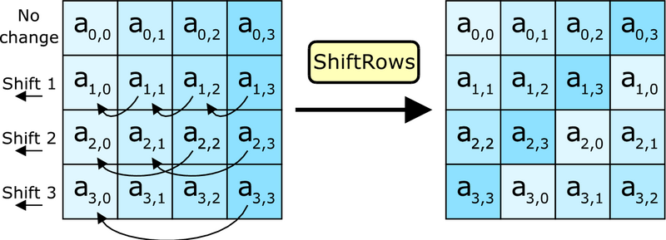
AES Transposition Step
Transposition need not only apply to symbols in a text.
The Advanced Encryption Standard (AES) contains a transposition step that reorders the bytes in a 16-byte array
25
26
26

Slide 27
Cryptanalysis of Transpositions
Question: Given a text you believe to be the encryption of a text by transposition. How could you increase your conﬁdence that that’s the case?
Answer: Since transposition reorders characters, but doesn’t replace them, the original characters still occur in the result. Letter frequencies are preserved in the ciphertext, but the frequencies of digrams, trigrams, etc. are not.
In a columnar transposition with rows of length n, adjacent characters in the plaintext are c₁ and c_{n+1}, c₂ and c_{n+2}, etc. Hypothesize a distance of n and try a decryption; if it fail, try a distance of n + 1, etc.
26
27
27

Slide 28
Combinations of Approaches
Substitutions and transpositions can be regarded as building blocks for encryption. Many important commercial algorithms use combinations of these.
A combination of two or more ciphers is called a product cipher or cascade cipher:
E₂(E₁(P, k₁), k₂)
A combination is not necessarily stronger than either cipher individually. It may even be weaker.
27
28
28

Slide 29
Lessons
Transposition is another important building block for encryption.
Because it preserves the symbols of a text, transposition preserves letter frequencies but not digrams, trigrams, etc.
A product cipher is the combination of two or more encryption steps.
28
29
29

Slide 30
Symmetric vs. Asymmetric Systems
Dan Fleck
CS 469: Security Engineering
29
30
30
These slides are modified with permission from Bill Young (Univ of Texas)

Slide 31
Symmetric vs. Asymmetric Systems
Recall that there are two basic types of encryption:
symmetric algorithms: (also called “secret key”) use the same key for both encryption and decryption
asymmetric algorithms: (also called “public key”) use diﬀerent keys for encryption and decryption.
For any encryption approach, there are two major challenges:
Key distribution: how do we convey keys to those who need them to establish secure communication.
Key management: given a large number of keys, how do we preserve their safety and make them available as needed.
30
31
31

Slide 32
Asymmetric Encryption Primer
In asymmetric or public key encryption, diﬀerent keys are used for encryption and decryption.
Each subject S has a publicly disclosed key K_{S} (“S’s public key”) that anyone can use to encrypt, and a privately held key K⁻¹ _{S}
(“S’s private key”). The relationship is:
Anyone wishing to send a message M conﬁdentially to S sends Only the holder of K⁻¹_{S} can decrypt this message.
Asymmetric encryption largely solves the key distribution problem.
Why?
31
32
32

Slide 33
Characteristics of Keys
Typically, in a symmetric encryption system keys are:
randomly generated k-bit strings,
simple to generate,
have no special properties.
In a public key system, keys:
have special structure (e.g., are large primes), and
are expensive to generate.
Key sizes are not comparable between the two approaches. A 128-bit symmetric key may be equivalent in strength to a 3000-bit public key.
32
33
33

Slide 34
Lessons
Using symmetric encryption, security requires that each pair of users share a secret key.
In an asymmetric system, each user has a public/private key pair.
Keys in the two approaches have very diﬀerent characteristics and are not directly comparable.
33
34
34

Slide 35
Stream and Block Encryption
Dan Fleck
CS 469: Security Engineering
34
35
35
These slides are modified with permission from Bill Young (Univ of Texas)

Slide 36
Stream and Block Ciphers
An important distinction in symmetric cryptographic algorithms is between stream and block ciphers.
Stream ciphers convert one symbol of plaintext directly into a symbol of ciphertext.
Block ciphers encrypt a group of plaintext symbols as one block.
Simple substitution is an example of a stream cipher. Columnar transposition is a block cipher.
Most modern symmetric encryption algorithms are block ciphers. Block sizes vary (64 bits for DES, 128 bits for AES, etc.).
35
36
36

Slide 37
Stream Encryption
Advantages:
Speed of transformation: algorithms are linear in time and constant in space.
Low error propagation: an error in encrypting one symbol likely will not aﬀect subsequent symbols.
Disadvantages:
Low diﬀusion: all information of a plaintext symbol is contained in a single ciphertext symbol.
Susceptibility to insertions/ modiﬁcations: an active interceptor who breaks the algorithm might insert spurious text that looks authentic.
36
37
37

Slide 38
Block Encryption
Advantages:
High diﬀusion: information from one plaintext symbol is diﬀused into several ciphertext symbols.
Immunity to tampering: diﬃcult to insert symbols without detection.
Disadvantages:
Slowness of encryption: an entire block must be accumulated before encryption / decryption can begin.
Error propagation: An error in one symbol may corrupt the entire block.
37
38
38

Slide 39
Lessons
An important distinction is between stream and block ciphers.
Each has distinct strengths and weaknesses.
38
39
39

Slide 40
Material following this slide will not be covered, but could be interesting ☺
39
40
40

Slide 41
Confusion and Diﬀusion
Two things an encryption step can provide are:
Confusion: transforming information in plaintext so that an interceptor cannot readily extract it.
Diﬀusion: spreading the information from a region of plaintext widely over the ciphertext.
Substitution tends to be good at confusion; transposition tends to be good at diﬀusion.
40
41
41

Slide 42
Attacking Encryption
Attacks on an encryption algorithm are classiﬁed according to what information is available to the attacker.
Ciphertext-only: attacker has only encrypted text
Known plaintext: attacker has some ciphertext/plaintext pairs.
Chosen plaintext: attacker can cause messages of his choosing to be encrypted.
Adaptive chosen plaintext: chosen plaintext attack adjusted according to earlier results.
Chosen ciphertext: attacker can decrypt selected ciphertext.
41
42
42

Slide 43
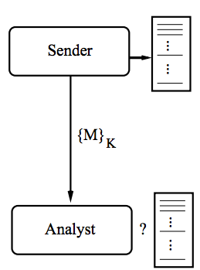
Breaking a Cipher
A cryptanalyst’s task is extracting the correct decryption from the space of possible decryptions, given limited information.
How much can she glean from the ciphertext and the circumstances to reduce the search space?
42
43
43

Slide 44
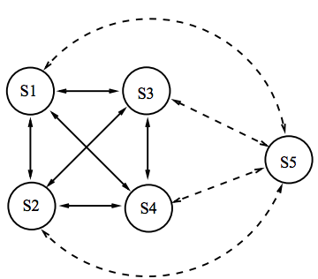
How Many Keys: Symmetric Encryption
Given a symmetric system with n users, how many keys are needed for pairwise secure communication?
Each time a new user is added to the system, it needs to share a new key with each previous user. Thus, for n users, we have
1 + 2 + . . . + (n − 1) = n(n − 1)/2 keys.
This is O(n²) keys.
43
44
44

Slide 45
How Many Keys: Asymmetric Encryption
Given an asymmetric system of n users, how many keys are needed for pairwise secure communication?
Each time a new user is added to the system, it needs only a public key and a private key.
Thus, for n users, we have 2n keys, which is O(n).
Depending on the algorithm, each user may need separate pairs for conﬁdentiality and signing, i.e., 4n keys, which is still O(n).
44
45
45

Slide 46
Malleability
An encryption algorithm is said to be malleable if transformations on the ciphertext produce meaningful changes in the plaintext.
That is, given a plaintext P and the corresponding ciphertext C = E(P), it is possible to generate C₁ = f (C) so that D(C₁) = P₁ = f′(P)
with arbitrary, but known, functions f and f′.
Most modern block-structured ciphers are non-malleable.
45
46
46

