Slide 1
Cryptographic Protocols
Dan Fleck
CS 469: Security Engineering
These slides are modified with permission from Bill Young (Univ of Texas)

Slide 2
Thought Experiment
Consider the following scenario:
Your friend Ivan lives in a repressive country where the police spy on everything and open all the mail.
You need to send a valuable object to Ivan.
You have a strongbox with a hasp big enough for several locks, but no lock to which Ivan also has a key.
How can you get the item to Ivan securely?

Slide 3
A Possible Answer
You might take the following sequence of steps:
Put the item into the box, attach your lock to the hasp, and mail the box to Ivan.
Ivan adds his own lock and mails the box back to you.
You remove your lock and mail the box back to him. He now removes his lock and opens the box.
The procedure just described could be regarded as a protocol—a structured dialog intended to accomplish some communication-related goal.

Slide 4
What’s This Got to do with Computing?
What goal: To send some content conﬁdentially in the context of a hostile or untrustworthy environment, when the two parties don’t already share a secret/key.
You could implement the “same” protocol to send a message conﬁdentially across the Internet. Here,
the valuable thing is the contents of a secret message;
the locks are applications of some cryptographic algorithm with appropriate cryptographic keys.
But for this to work in the computing world there’s a particular feature that the ciphers have to satisfy. Can you see what it is?

Slide 5
What is the Property?
Imagine that instead of putting another lock on the hasp, Ivan puts your lockbox inside another locked box. The protocol no longer works; you can’t reach inside his box to take oﬀ your lock in step 3.
On-line, you’d have to be able to “reach inside” his encryption to undo yours. One way this would be true is if the ciphers commute.
Most encryption algorithms don’t have this property. But one that does is: exclusive or (XOR) your message with a randomly
generated string (key) of the same length.

Slide 6
So Here’s the Protocol
Let K_{a} be a random string generated by A, and K_{b} be a random string generated by B, both K_{a} and K_{b} of the same length as M.
In step 3, the two applications of K_{a} “cancel out,” leaving (M ⊕ K_{b}), which B can easily decrypt with his own key K_{b}.

Slide 7
Whoops!
This is eﬀectively using the one-time pad, so should be very strong. Right?
Even though the one-time pad is a theoretically unbreakable cipher, there’s a good reason it’s called “one-time.” Our protocol is fundamentally ﬂawed. Can you see why?
An eavesdropper who stores the three messages can XOR combinations of them to extract any of M, K_{a}, and K_{b}. Verify this for yourself.

Slide 8
Lessons
Cryptographic protocols accomplish security-related functions via a structured exchange of messages.
They are very important to security on the Internet.
They are diﬃcult to design and easy to get wrong in subtle ways.

Slide 9
Some Deﬁnitions
Almost everything that occurs on the Internet occurs via a protocol.
Deﬁnition: A protocol is a structured dialogue among two or more parties in a distributed context controlling the syntax, semantics, and synchronization of communication, and designed to accomplish a communication-related function.
Deﬁnition: A cryptographic protocol is a protocol using cryptographic mechanisms to accomplish some security-related function.

Slide 10
Possible Goals
Among the goals of cryptographic protocols are the following:
Unicity: secret shared by exactly two parties
Integrity: message arrived unmodiﬁed
Authenticity: message claim of origin is true
Conﬁdentiality: message contents are inaccessible to an eavesdropper
Non-repudiation of origin: sender can’t deny sending
Non-repudiation of receipt: receiver can’t deny receiving

Slide 11
Cryptographic Protocols Fundamentals
All cryptographic protocols share the following characteristics:
several principals are exchanging messages;
they are attempting to accomplish some security-related function;
they are operating in a hostile and insecure environment.
The protocol must be robust and reliable in the face of a determined attacker.

Slide 12
Cryptographic Protocols Fundamentals
A protocol involves a sequence of message exchanges of the form:
meaning that principal A sends to principal B the message M.
Because of the distributed nature of the system and the possibility of malicious actors, there is typically no guarantee that B receives the message, or is even expecting the message.

Slide 13
A Protocol Example
Consider the following simple protocol:
Informal goal: A shares with B a secret key K, and each party is authenticated to the other.
What are the assumptions? Precisely what are the goals? Are they satisﬁed? How can you be sure?
However, this protocol is fatally ﬂawed. Can you see how?

Slide 14
Lessons
Protocols are structured exchanges of messages at the very heart of distributed communication.
Cryptographic protocols use cryptography to accomplish security-related functions.
Protocols operate in a hostile environment, so cannot assume that messages are delivered.

Slide 15
Cryptographic Protocols
A protocol involves a sequence of message exchanges of the form:
meaning that principal A sends to principal B the message M.
There’s a “temporal” aspect to protocols. Until and unless B receives the message, he can’t respond to it.
In general, B won’t be expecting the message unless he has already participated in earlier steps of the protocol.

Slide 16
Taking an Abstract View
There is a lot involved in making a protocol work, particularly at the implementation level.
We’ll ignore issues like:
What are the mechanisms of message transmission?
How does a principal know when decryption has succeeded?
How can you reliably parse a message of multiple components?
If a message contains the name of a principal, what is the form of that name?
How are public keys maintained and distributed?
Those are all important issues, but we want to look at protocols abstractly.

Slide 17
Protocol Questions
An analysis of any protocol attempts to answer the following types of questions:
What are the goals of the protocol?
What does the protocol actually achieve?
Does it achieve its stated objective?
Does it include unnecessary steps or messages?
What assumptions are made?
Does it encrypt items that could be sent in the clear?
Is it susceptible to attack? What would an attack look like?

Slide 18
Lessons
We want to look at protocols abstractly and ignore issues at the implementation level.
A standard set of questions can be asked of any cryptographic protocol.

Slide 19
Needham-Schroeder
Dan Fleck
CS 469: Security Engineering
These slides are modified with permission from Bill Young (Univ of Texas)

Slide 20
Needham-Schroeder Protocol
Many existing protocols are derived from one proposed by Needham and Schroeder (1978), including the widely used
Kerberos authentication protocol suite.
N-S is a shared-key authentication protocol designed to generate and propagate a session key, i.e., a shared key for subsequent symmetrically encrypted communication.
Note that there is no public key infrastructure in place.

Slide 21
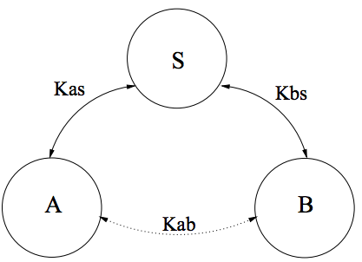
Assumptions of Needham-Schroeder
There are three principals: A and B, two principals desiring mutual communication, and S, a trusted key server.
It is assumed that A and B already have secure symmetric communication with S using keys K_{as} and K_{bs} , respectively.

Slide 22
Nonces and Timestamps
N-S uses nonces (short for “numbers used once”), randomly generated values included in messages.
If a nonce is generated and sent by A in one step and returned by B in a later step, A knows that B’s message is fresh and not a replay from an earlier exchange.
Note that a nonce is not a timestamp. The only assumption is that it has not been used in any earlier interchange, with high probability.

Slide 23
Needham-Schroeder
Two questions to ask of any step in any protocol:
What is the sender trying to say with this message?
What is the receiver entitled to believe after receiving the message?
Here N_{a} and N_{b} are nonces

Slide 24
Lessons
Needham-Schroeder is a shared-key authentication protocol that has been very important historically.
It illustrates:
the overall structure of protocols;
that some principals may have special roles to play;
the usefulness of nonces.

Slide 25
Attacks on Protocols
Recall our earlier list of things to ask about a protocol.
Are both authentication and secrecy assured?
Is it possible to impersonate one or more of the parties?
Is it possible to interject messages from an earlier exchange (replay attack)?
What tools can an attacker deploy?
If any key is compromised, what are the consequences?

Slide 26
Flaws in Needham-Schroeder
Denning and Sacco pointed out that the compromise of a session key has bad consequences. An intruder can reuse an old session key and pass it oﬀ as a new one as though it were fresh.
Suppose C has cracked K_{ab} from last week’s run of the protocol, and has squirreled away message 3 from that session:
B will believe it is talking to A

Slide 27
Flaws in Needham-Schroeder
Problem: Message 3 is not protected by nonces. There is no way for B to know if the K_{ab} it receives is current. An intruder has unlimited time to crack an old session key and reuse it as if it were fresh.
Example Attack: an employee runs the ﬁrst few steps of the protocol multiple times, gathering up tickets for each diﬀerent server B in the system. If he’s ﬁred, he can still log onto all of the company’s servers.

Slide 28
Flaws in Needham-Schroeder
Bauer, et al. pointed out that if key K_{as} were compromised, anyone could impersonate A and establish communication with any other party.
These ﬂaws persisted for almost 10 years before they were discovered.

Slide 29
Is it Fair?
The “attacks” discovered by Denning and Sacco and by Bauer, et al. ask what happens if a key is broken.
Is it fair to ask that question? Isn’t a presumption of any cryptographic protocol that the encryption is strong?
How might you address these ﬂaws if you were the protocol designer?

Slide 30
Lessons
Researchers have pointed out ﬂaws in the N-S protocol.
They illustrate how hard it is to make a protocol secure

Slide 31
Attacks on Cryptographic Protocols
Dan Fleck
CS 469: Security Engineering
These slides are modified with permission from Bill Young (Univ of Texas)

Slide 32
Attacks
A diﬃcult aspect of analyzing cryptographic protocols is answering the question: What constitutes an attack?
Are both authentication and secrecy assured?
Is it possible to impersonate one or more of the parties?
Is it possible to interject messages from an earlier exchange (replay attack)?
What tools can an attacker deploy?
*If any key is compromised, what are the consequences?
Is the last question really fair?
Some protocols have been in use for years before someone noted a signiﬁcant vulnerability.

Slide 33
Attacks on Protocols
This is a partial list of attacks on protocols:
Known-key attack: attacker gains some keys used previously and uses this info in some malicious fashion.
Replay: attacker records messages and replays them at a later time.
Impersonation: attacker assumes the identity of one of the legitimate parties in a network.
Man-in-the-Middle: attacker interposes himself between two parties and pretends to each to be the other.
Interleaving attack: attacker injects spurious messages into a protocol run to disrupt or subvert it.

Slide 34
Attackers
The designer of a protocol should assume that an attacker can access all of the traﬃc and interject his own messages into the ﬂow.
Can the attackers messages be arbitrary? Why not? What restrictions do we impose on the attacker?
The protocol should be robust in the face of such a determined and resourceful attacker.

Slide 35
Important Point About Protocols
Due to the distributed nature of the system, protocols are highly asynchronous.
A party to a protocol won’t know anything about the current run of the protocol except the messages it has received and sent.
Except for the initiator, other parties will not even know that they are participating until they receive their ﬁrst message.
Each message sent must be of a form the recipient can identify
and respond to.

Slide 36
Lessons
One of the hardest things about analyzing a protocol is understanding what an attacker might do.
The distributed nature of the system means that no-one but the initiator knows the protocol is running until they receive their ﬁrst message.
Consequently, each message must be clear enough so that the recipient can interpret it and respond appropriately.

Slide 37
Otway-Rees
Dan Fleck
CS 469: Security Engineering
These slides are modified with permission from Bill Young (Univ of Texas)

Slide 38
Otway-Rees
Another very important and much studied protocol is the Otway-Rees protocol. Below is one of several variants.
Here M is a session identiﬁer; N_{a} and N_{b} are nonces.
What are the assumptions? What seems to be the goal? What might the principals believe after each step?

Slide 39
Attack on Otway-Rees
A malicious intruder can arrange for A and B to end up with diﬀerent keys.
After step 3, B has received K_{ab}.
An intruder then intercepts the fourth message.
The intruder resends message 2, so S generates a new key K’_{ab} , sent to B.
The intruder intercepts this message too, but sends to A :
A has K′_{ab} , while B has K_{ab}.
Another problem: although the server tells B that A used a nonce, B doesn’t know if this was a replay of an old message

Slide 40
A Flawed Protocol
Recall the following protocol, introduced previously.
Suppose an attacker C obtains the message (step 1): . Then, C initiates a new run of the protocol with B:
The message that B sends back is:
allowing C to extract the original K.

Slide 41
Lessons
Otway-Rees is another important protocol historically.
Like Needham-Schroeder it illustrates how diﬃcult it is to build a secure cryptographic protocol.
This is also illustrated by our simple public key protocol.

Slide 42
Protocol Verification
Dan Fleck
CS 469: Security Engineering
These slides are modified with permission from Bill Young (Univ of Texas)

Slide 43
Veriﬁcation of Cryptographic Protocols
Protocols can be notoriously diﬃcult to get correct. Flaws have been discovered in protocols published many years before.
It would be nice to be able to reason formally about protocol correctness.
How do you characterize what a “spy” can do? We should at least assume that:
the spy can see all messages sent;
can compose messages from anything visible to it;
can interject messages into the ﬂow.

Slide 44
Verification
There are several major approaches to the veriﬁcation problem:
Belief logics allow reasoning about what principals within the protocol should be able to infer from the messages they see. Allows abstract proofs, but may miss some important ﬂaws.
State exploration methods (model checking) treat a protocol as a ﬁnite state system and conduct an exhaustive search checking that all reachable states are safe.
General-purpose theorem proving uses induction over potential traces of protocol execution.
We’re only going to cover belief logics

Slide 45
Belief Logics
A belief logic is a formal system for reasoning about beliefs. Any logic consists of a set of logical operators and rules of inference.
One trick is taking a sequence of message exchanges and generating a collection of belief statements.
You have to postulate some reasonable initial assumptions about the state of knowledge/belief of the principals.

Slide 46
Lessons
Protocols are crucial to the Internet; it would be great to get them right.
Reasoning rigorously about protocols requires some way of formalizing their behavior and properties.
Belief logics is such an approach.

Slide 47
BAN Logic
Dan Fleck
CS 469: Security Engineering
These slides are modified with permission from Bill Young (Univ of Texas)

Slide 48
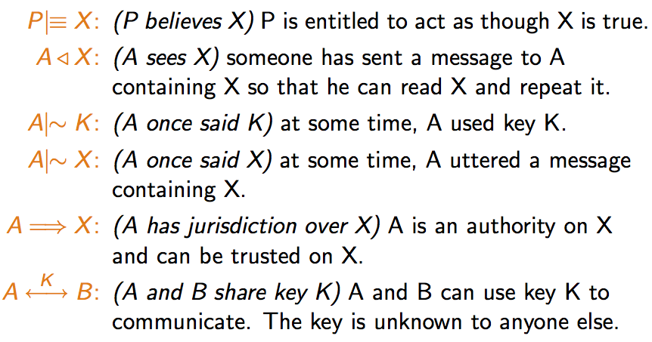
Belief Logics: BAN
The BAN (Burrows, Abadi, and Needham) logic is a modal logic of belief. It has several modal operators including:

Slide 49
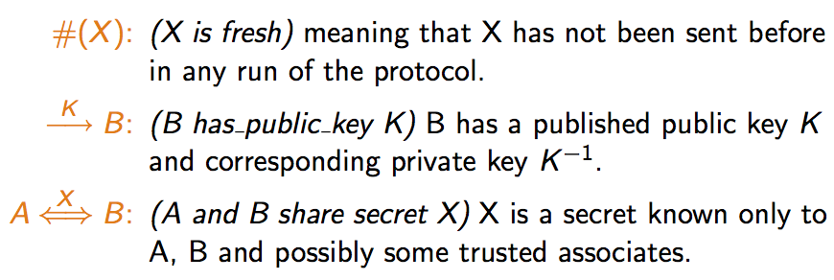
BAN Operators Continued

Slide 50
Belief Logics: Rules
There are numerous rules of inference for manipulating the protocol to generate a set of beliefs. For example,
Message meaning: If A believes (A share(K) B) and A sees {X}_{K} then A believes(B said X).

Slide 51
Belief Logics: Rules
Nonce veriﬁcation: If A believes X is fresh and A believes B once said X, then A believes B believes X.
Jurisdiction: If A believes B has jurisdiction over X and A believes B believes X, then A believes X.

Slide 52
BAN Logic: Idealization
To get from protocol steps to logical inferences, we have a process called idealization. This attempts to turn the message sent into its intended semantics. For example, given the protocol step:
If B knows the key K_{bs} , this tells us that K_{ab} is a key to communicate with A. An idealized version is:
One purpose of idealization is to omit parts of the message that do not contribute to the beliefs of the recipients. In BAN all plaintext is omitted since it can be forged.
Idealization of the protocol is not deﬁned unambiguously. It depends on the interpretation of the meaning of some steps.

Slide 53
Lessons
The BAN logic has been an important tool for reasoning about protocols.
It is a modal logic of belief with 10 primitives and a number of inference rules.

Slide 54
BAN Logic: Needham-Schroeder
Dan Fleck
CS 469: Security Engineering
These slides are modified with permission from Bill Young (Univ of Texas)

Slide 55
Needham-Schroeder: Idealization
Recall the Needham-Schroeder protocol:
Needham-Schroeder is idealized as follows:

Slide 56
BAN Logic: Assumptions

Slide 57
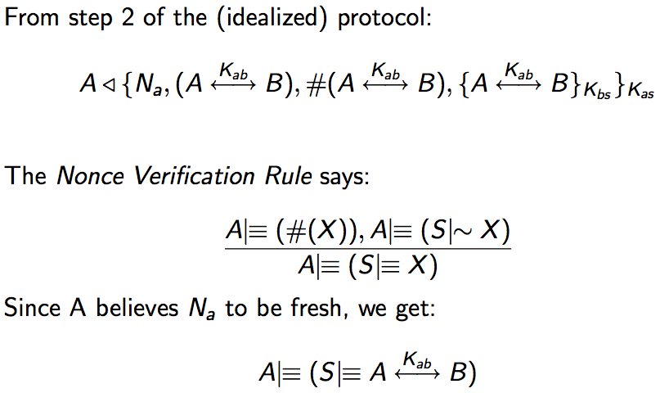
BAN Logic: Analyzing the Protocol

Slide 58
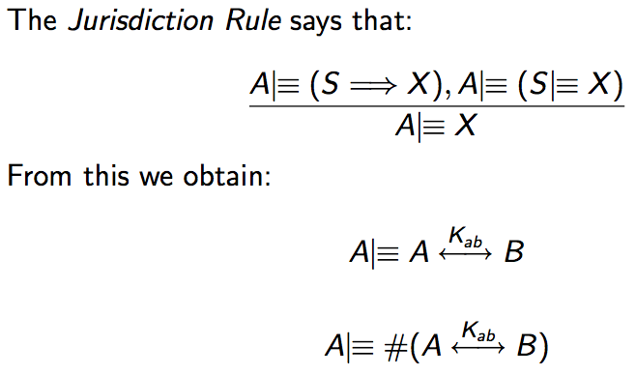
BAN Logic: Analyzing the Protocol

Slide 59
BAN Logic: Analyzing the Protocol

Slide 60
BAN Logic: Analyzing the Protocol
Since A has also seen the part of the message encrypted under B’s key, he can send it to B. B decrypts the message and obtains:
meaning that B believes that S once sent the key.
At this point, we need the ﬁnal dubious assumption:
With it, we can get:

Slide 61
BAN Logic: Analyzing the Protocol
From the last two messages, we can infer the following. How?
These are the point of the protocol. The proof exhibits some assumptions that were not apparent.

Slide 62
Lessons
Use of a logic like BAN shows what is provable and also what must be assumed.
Using BAN eﬀectively requires a lot of practice and insight into the protocol.

