Slide 1
Anatomy of Attack: Code Red
Dan Fleck
CS 469: Security Engineering
1
These slides are modified with permission from Bill Young (Univ of Texas)

Slide 2
DoS Case Study: CodeRed
On June 18, 2001 eEye publicized a buﬀer-overﬂow vulnerability in Microsoft’s IIS webservers: inadequate bounds checking on some input buﬀers allows system-level execution of code.
On July 12, 2001, the CodeRed virus began attacking unpatched machines. It works as follows:
If date is between 1st and 19th of the month, generate a random list of IP addresses and attempt to infect those machines.
On 20th to 28th of the month, launch a DoS ﬂooding attack on www1.whitehouse.gov.
The worm also defaces some webpages with the words “Hacked by Chinese.”
2

Slide 3
CodeRed
On July 13, 2001, investigators from eEye Digital Security worked overnight to analyze the worm. They called it “CodeRed” because of the CodeRed Mountain Dew they were drinking and because of the “Hacked by Chinese” message.
The worm uses a static seed in its random number generator and thus generates identical lists of IP addresses on each infected machine.
Each infected machine probed the same list of machines, so the worm spread slowly.
The IP address for www1.whitehouse.gov was changed so the DoS attack failed.
3

Slide 4
CodeRed Analysis
Because of ﬂaws in the design, especially the static seed, CodeRed did very little damage.
The CodeRed worm is memory resident. A machine can be disinfected by simply rebooting it.
Once-rebooted, the machine remains vulnerable to repeat infection, likely since each newly infected machine probes the same list of IP addresses.
4

Slide 5
CodeRed Version 2
On July 19, 2001 a variant began to circulate that was identical but uses a random seed in the random number generator.
This had a major impact: more than 359,000 machines were infected with CodeRed (version 2) in just fourteen hours.
Version 2 had a much greater impact on global infrastructure due to the sheer volume of hosts infected and probes sent to infect new hosts.
Wreaked havoc on some additional devices with web interfaces: routers, switches, DSL modems, and printers. They either crashed or rebooted when an infected machine attempted to send them a copy of the worm.
5

Slide 6
Lessons
CodeRed is a classic computer worm, but contained several severe ﬂaws.
The CodeRed author quickly exploited a vulnerability and quickly adapted his code in the light of ﬂaws.
6

Slide 7
CodeRedII
On August 4, 2001, an entirely new worm began to exploit the buﬀer-overﬂow vulnerability in Microsoft’s IIS webservers.
The code contains the string “CodeRedII” which became the name.
When the worm infects a new host, it ﬁrst determines if the system has already been infected.
If not, the worm initiates its propagation mechanism, sets up a “backdoor” into the infected machine, becomes dormant for a day, and then reboots the machine.
Begins a process of propagating itself (follows).
7

Slide 8
CodeRedII Propagation
Launches 300 or 600 threads in propogation attempt.
CodeRedII generates a random IP address and then applies a mask to produce the addresses to probe.
1/8th of the time, probes a completely random IP address.
1/2 of the time, probes a machine in the same /8 (new IP address has same ﬁrst 8 bits).
3/8ths of the time, probes a machine on the same /16 (same ﬁrst 16 bits).
Avoids probing addresses in 224.0.0.0/8 (multicast) and 127.0.0.0/8 (loopback).
Machines on the same network or subnet are likely to be running similar software
8

Slide 9
Danger of CodeRedII
Unlike CodeRed, CodeRedII neither defaces web pages on infected machines nor launches a Denial-of-Service attack.
Also unlike CodeRed, CodeRedII is not memory resident, so rebooting an infected machine does not eliminate CodeRedII.
Installs a mechanism for remote, root-level access to the infected machine. This backdoor allows any code to be executed, so the machines could be used as zombies for future attacks
9

Slide 10
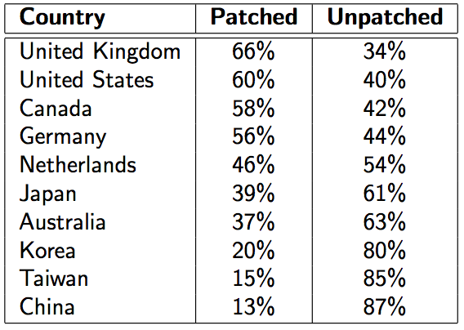
Rates of Response
Studies showed that the rate of patching vulnerable machines varied widely. The attack began on July 19; on Aug. 14 the following statistics were estimated:
A large number of machines remained vulnerable to the same or similar attack.
10

Slide 11
Install Patches
[A report from Verizon Business] covering 500 forensic investigations, involving 230 million compromised customer records, found that nine out of 10 breaches attributed to hacking attacks took advantage of a vulnerability for which a ﬁx was available at least six months prior to the attack.
11

Slide 12
Lessons
CodeRedII is a diﬀerent worm, exploiting the same vulnerability as CodeRed.
Uses a much more sophisticated propogation strategy.
Users often don’t patch machines, leaving a population of vulnerable hosts.
12

