Slide 1
transAD: A Content Based Anomaly Detector
Sharath Hiremagalore
Advisor: Dr. Angelos Stavrou
October 23, 2013

Slide 2
Intrusion Detection Systems
Secure code – Vulnerabilities are just waiting to be discovered
Attackers come up with new attacks all the time.
A single line of defense to prevent malicious activity is insufficient

Slide 3
Intrusion Detection Systems
Adds one more line of defense to prevent attackers from getting away easily
What is an Intrusion Detection System (IDS) supposed to detect?
Activity that deviates from the normal behavior – Anomaly detection
Execution of code that results in break-ins – Misuse detection
Activity involving privileged software that is inconsistent with respect to a policy/ specification - Specification based Detection
- D. Denning

Slide 4
Types of IDS
Host Based IDS
Installed locally on machines
Monitoring local user activity
Monitoring execution of system programs
Monitoring local system logs
Network IDS
Sensors are installed at strategic locations on the network
Monitor changes in traffic pattern/ connection requests
Monitor Users’ network activity – Deep Packet inspection

Slide 5
Types of IDS
Signature Based IDS
Compares incoming packets with known signatures
E.g. Snort, Bro, Suricata, etc.
Anomaly Detection Systems
Learns the normal behavior of the system
Generates Alerts on packets that are different from the normal behavior

Slide 6
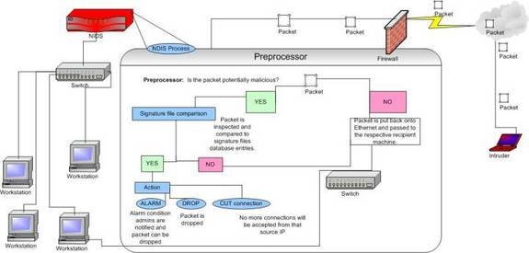
Network Intrusion Detection Systems
Source: http://www.windowssecurity.com/

Slide 7
Network Intrusion Detection Systems
Current Standard is Signature Based Systems
Problems:
“Zero-day” attacks
Polymorphic attacks
Botnets – Inexpensive re-usable IP addresses for attackers
Notes:
Current Signature based systems – Fail to identify zero-day, polymorphic attacks.
IP Blacklists do not work.
Current AD sensor – High FPR
Elaborate on high FPR. The current state of the art. FPR and how does this prevent deployment in production systems.
Elaborate on Labeling training data.

Slide 8
Anomaly Detection
Anomaly Detection (AD) Systems are capable of identifying “Zero Day” Attacks
Problems:
High False Positive Rates
Labeled training data
Our Focus:
Web applications are popular targets
Notes:
Current Signature based systems – Fail to identify zero-day, polymorphic attacks.
IP Blacklists do not work.
Current AD sensor – High FPR
Elaborate on high FPR. The current state of the art. FPR and how does this prevent deployment in production systems.
Elaborate on Labeling training data.

Slide 9
transAD & STAND
transAD
TPR 90.17%
FPR 0.17%
STAND
TPR 88.75%
FPR 0.51%
Relative improvement in FPR 66.67% (Actual: 0.0034)
Relative improvement in TPR 1.6% (Actual: 0.0142)
Notes:
Example of a specific day... In October where STAND has higher FPs than transAD FPs

Slide 10
Attacks Detected by transAD
Type of Attack | HTTP GET Request
Buffer Overflow | /?slide=kashdan?slide=pawloski?slide=ascoli?slide=shukla?slide=kabbani?slide=ascoli?slide=proteomics?slide=shukla?slide=shukla
Remote File Inclusion | //forum/adminLogin.php?config[forum installed]= http://www.steelcitygray.com/auction/uploaded/golput/ID-RFI.txt??
Directory Traversal | /resources/index.php?con=/../../../../../../../../etc/passwd
Code Injection | //resources-template.php?id=38-999.9+union+select+0
Script Attacks | /.well-known/autoconfig/mail/config-v1.1.xml? emailaddress=********%40*********.***.***
Notes:
How is the traffic collected. Where were these attacks seen.

Slide 11
transAD - Outline
Transduction Confidence Machines based Anomaly Detector
Completely unsupervised
Builds a baseline representing normal traffic
Ensemble of AD sensors
Notes:
TCM k-NN can not be directly used here because of very high FP rate.

Slide 12
Transduction based Anomaly Detection
Compares how test packet fits with respect to the baseline
A “Strangeness” function is used for comparing the test packet
The sum of K-Nearest Neighbors distances is used as a measure of Strangeness

Slide 13
Hash Distance
Notes:
Add the computation of distance for this example.

Slide 14
Hash Distance
In the above example:
One n-gram ‘bcd’ matches
The larger string has 5 n-grams
Distance is 0.8
Notes:
Add the computation of distance for this example.

Slide 15
Request Normalization
Different GET requests may have the same underlying semantics
Improves discrimination between normal and attack packets
Notes:
Add text to say why this is necessary.

Slide 16
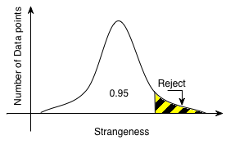
Transduction based Anomaly Detection
Hypothesis testing is used to decide if a packet is an Anomaly
Null Hypothesis: The test point fits well in the baseline
Several confidence levels were tested and 95% was chosen

Slide 17
Micro-model Ensemble
Packets captured into epochs of time called “Micro-models”
Micro-model contain a sample of normal traffic
Micro-models could potentially contain attacks
Notes:
Explain what an ensemble is.
How many micro-models are present in an ensemble.

Slide 18
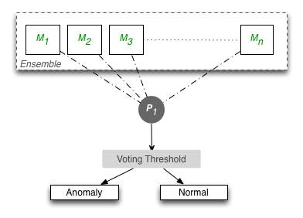
Sanitization
Removes potential attacks from the micro-models
Generally attacks are short lived and poison a few micro-models
Packets that have been voted as an anomaly by the ensemble are excluded from the micro-models
Several voting thresholds were tested and 2/3 majority voting chosen
Notes:
Mention Transduction here.

Slide 19
Model Drift
Overtime the services in the network change
Old micro-models become stale resulting in more False Positives
Old models are discarded and new models inducted into the ensemble.

Slide 20
Experimental Setup
Two data sets with traffic to www.gmu.edu
Two weeks of data
No synthetic traffic
IRB approved
Run offline faster than real time
Alerts generated were manually labeled
Over 10,000 alerts labeled
 | Number of GET Requests | Number of GET Requests with Arguments
Data Set 1 | 25 million | 445,000
Data Set 2 | 19 million | 717,000
Notes:
Data set 1: 25 Million GET. 445K GET with args. Data set 2: 19 million GET. 717K GET with args.
Add this details to the slide.

Slide 21
Parameter Evaluation – Micro-model duration
Magnified portion of the ROC curve for different micro-model duration
Notes:
Detail proper transition describing the parameters used by transAD.

Slide 22
transAD Parameters
Parameters | Value
Number of Nearest Neighbors (k) | 3
Micro-model Duration | 4 hours
N-gram Size | 6
Relative n-gram Position Matching | 10
Confidence Level | 95%
Voting Threshold | 2/3 Majority
Ensemble Size | 25
Drift Parameter | 1
Notes:
Add disclaimer for kNN. The algorithm is not sensitive to changes in the value of ‘k’.

Slide 23
Alerts per day for transAD and STAND
transAD
STAND

Slide 24
Questions?
Thank You

