Slide 1
Analytical Thinking: Assessments and Assertions
Dan Fleck
(adapted from slides originally from Jeff Offutt)
http://www.cs.gmu.edu/~dfleck/
SWE 632
User Interface Design and Development

Slide 2
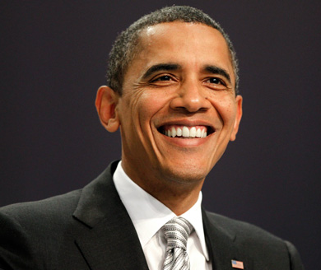
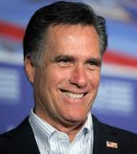
Assessments
Judging or determining some quality about a person or situation
He is a good teacher
She is a good student
He is a good husband
She is a good researcher
He is an effective manager
He is quite tall
I will be the best President!

Slide 3
Assertions
Statements that can be either True or False; the validity is observable
His exams cover all the material
She always reads the material before class
She has all As
He always considers her feelings
She has published more than 40 papers
Her papers are referenced hundreds of times
The results of her research are being put into practice
His employees always achieve their goals
His employees give him above-average reviews
He is 180 cm tall
“My stomach hurts”
- Assertion or not?

Slide 4
Preparation for Action
An assessment is often made as a preparation for action
Accepting a job
Giving a promotion
Making a recommendation
Working on a project
Taking a class
Voting for a candidate
Buying a car
People generally must accept the assessment before they will take action.

Slide 5
Grounding
An assessment is well grounded if the assertions adequately support the assessment
What do you do you when you have no grounding?
Campaigns seem to make it up ☺! http://factcheck.org/

Slide 6
Detective Exercise
Detectives must make assessments and judgments based on solid evidence/assertions.
Exercise: You are a detective. Write down a description of the scene, and try to only use assertions.
We will then read them and decide if they are assertions or assessments.
(Idea from: Assertions and Assessments, P.J.Denning, 2004)

Slide 7
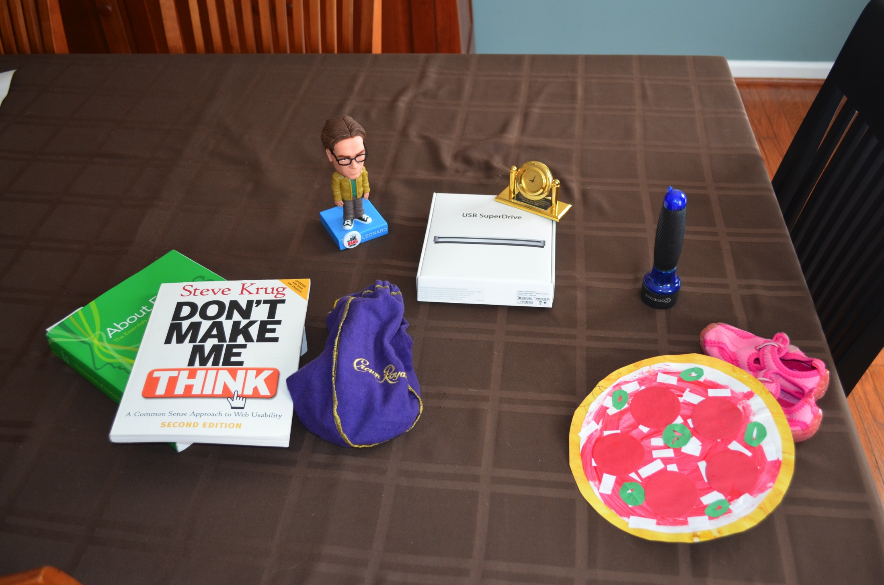
Detective Exercise: Scene

Slide 8
Standards
The standards for whether a set of assertions adequately support the assessment varies and are determined by the community
Reasons that a set of assertions do not meet the standards for supporting an assessment:
not enough assertions
incorrect assertion
different standards

Slide 9
Levels of Competence: Performance
Beginner
No knowledge or skills
Novice
Understands rules or process
Competent
Usually does what is expected
Proficient
Others admire performance and sets a new standard for others
Virtuoso
Widely admired and inspirational, helps others rise to new heights of excellence
Master
Superior performance at a level that most could never reach

Slide 10
Levels of Competence: Grades
A Superior demonstration of knowledge
A- Excellent demonstration of knowledge
B+ Understands most material
B Performs as expected, understands most material, some problems
C Significant lapses in knowledge, mostly adequate
F Inadequate, most material not learned

Slide 11
Speaking about yourself
It’s very hard… but required in job interviews, public speaking, politics, dating ☺, …
“I am competent at X”.
Speak for no more than 2 minutes to the class to get them to accept your claim.
Audience: Listen, listen for grounding, assertions and assessments.
(Idea from: Assertions and Assessments, P.J.Denning, 2004)

Slide 12
Summary—Usability Evaluations
Every statement in the usability evaluations should be an assertion
These should lead to assessments:
Is the UI User Appropriate ?
Is the UI good enough ?
Watch in the world for assessments that are ungrounded, or insufficiently grounded. Question them.

