Slide 1
Don’t Make Me Think (the slides) Dan Fleck SWE 632 http://cs.gmu.edu/~dfleck/
These are based on the excellent book “Don’t Make Me Think” from Steve Krug…. Go out and buy it!

Slide 2
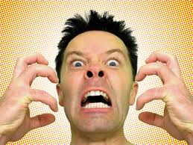
Usability
“Making sure that something works well: that the average person can use the thing without getting hopelessly frustrated” – Steve Krug

Slide 3
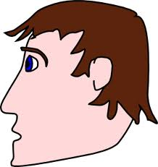
Rule 1: Don’t Make Me Think
< OBVIOUS REQUIRES THOUGHT >
Got it!
Huh? Uncertain..

Slide 4
Rule 1: Don’t Make Me Think
< OBVIOUS REQUIRES THOUGHT >
Click it!
I guess I can click that.
Quick thought.
Can I click that?
Results
Results
Results

Slide 5
How People Use the Web
Pages are scanned – not read!
We don’t make optimal choices – we pick the first reasonable option. What’s the cost of an error?
We muddle through – if something works, we don’t look for an alternative.
Many people (my mom included) type URLs for sites they want to visit into Google Search box – everytime
Design for people flying by a billboard, not reading a novel

Slide 6
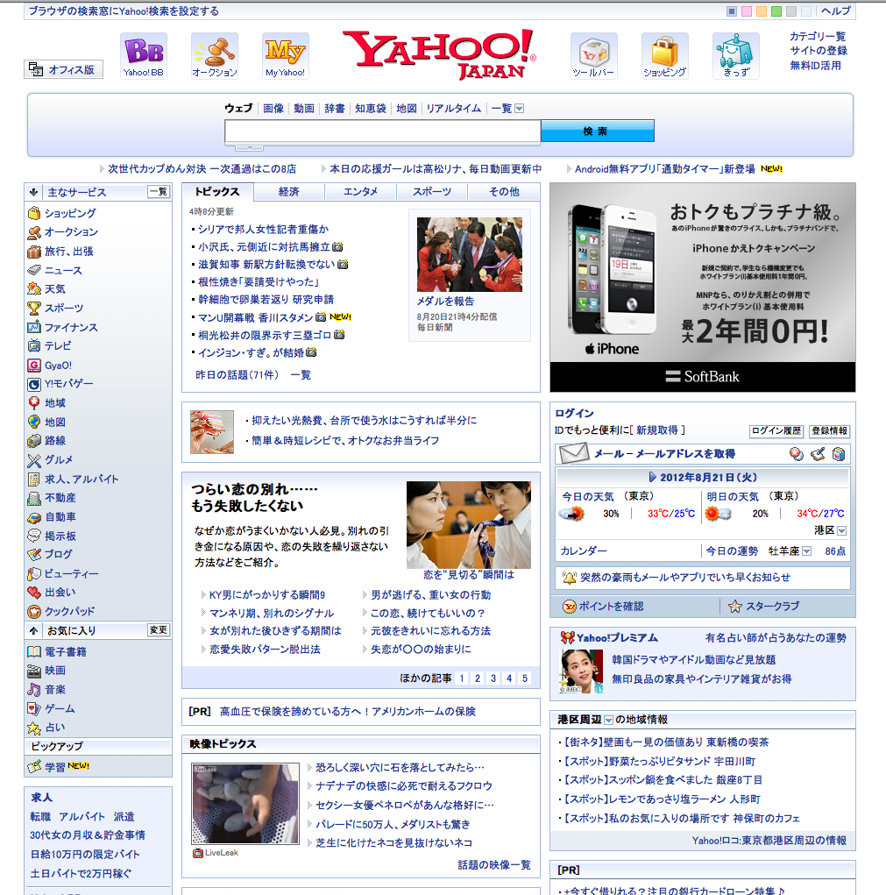
Conventions work – use them!
Can you identify parts of this page?

Slide 7
Omit needless words!
Reduces noise on the page
Makes content more prominent
Makes pages shorter, making scanning easier

Slide 8
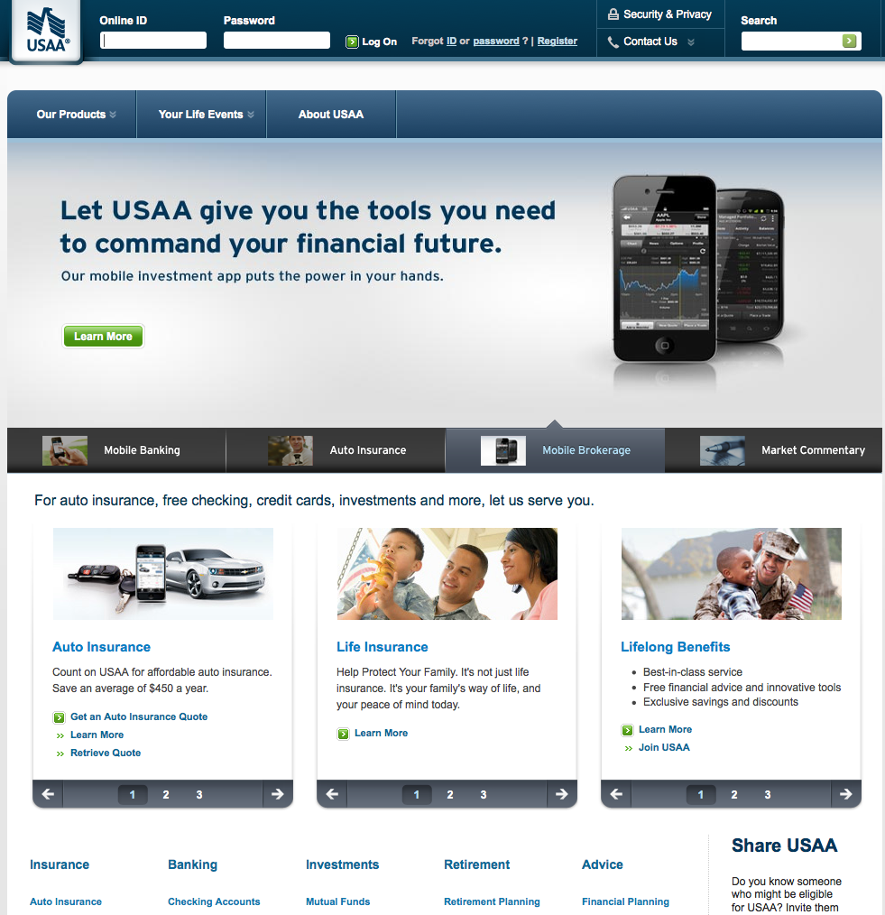
What can I omit?

Slide 9
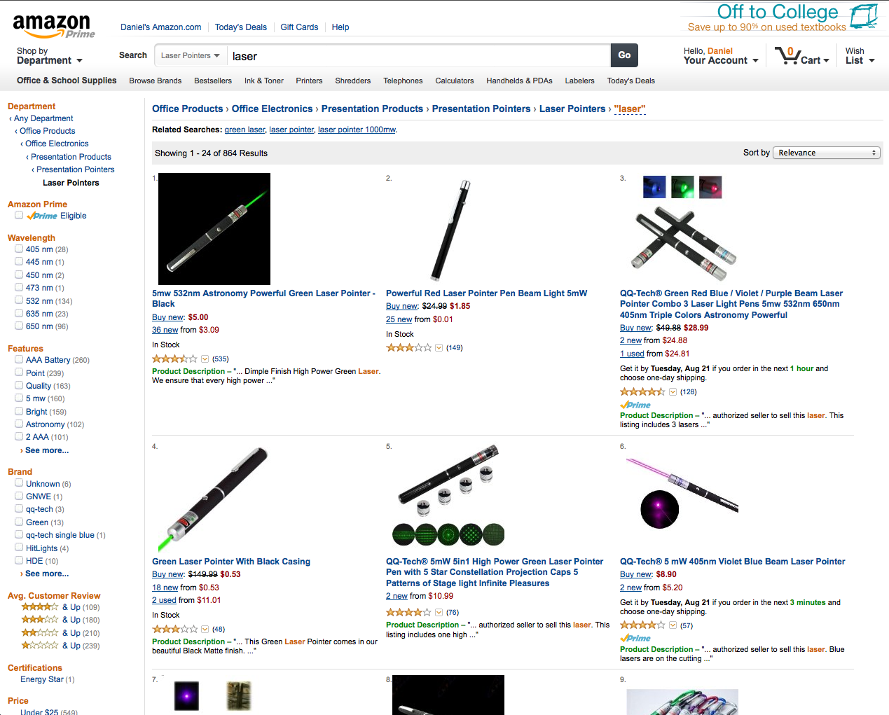
Navigation: The Trunk Test
Site organization is what brings people back. If you can’t find things, you use the site less.
Common anchors
Site ID
Breadcrumbs (where
Am I?)
Common tools

Slide 10
Navigation: The Trunk Test
You’ve been kidnapped by the mafia, thrown in a trunk and dumped onto a random webpage on a website (you know, by Google or someone like that)
What site is this? (Site ID)
What page am I on (Page name)
What are the major sections of this site? (Sections)
What are my options at this level? (Local navigation)
Where am I in the scheme of things? (“You are here indicators”)
How can I search?
Lets try it!
Pick a site… click into it a few pages from the homepage
Answer the questions above

Slide 11
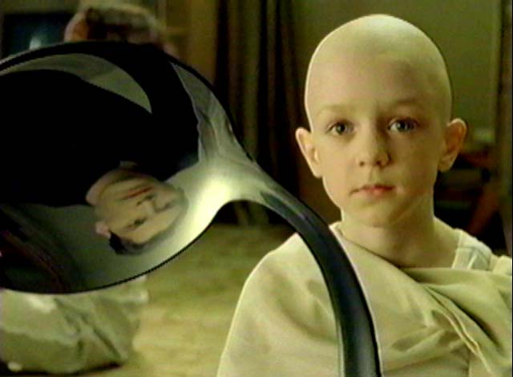
Arguments
Everybody likes __________________
Designer – visually interesting sites
Developer – lots of cool features
CEO – I want Pizazz!
Business development – cross-brand marketing!
There is no spoon!
There is no general right answer!

Slide 12
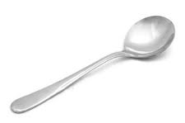
The General Right Answer ☺
The general right answer (wait, what the heck?!?)
Wrong: Do most people like pull down menus?
Right: Do people like this pull down menu, on this site, in this context?
How do you know?
Usability Testing!
That’s the next book! “Rocket Surgery Made Easy”

Slide 13
Common Courtesy
The Reservoir of Goodwill
Everyone has one, and it’s full when we enter a site.
Every bad, confusing thing depletes it
Good, reassuring things can refill it
Idiosyncratic: Some people’s are bigger than others
Situational: If I’m in a hurry, or busy, or upset… smaller
Sometimes a single mistake can empty it: Forcing me to register before I decided to buy anything. I’m done!

Slide 14
Things that lower reservoirs
Hiding information I want
Punishing me for not doing things your way
Asking me for info you don’t really need
Shucking and jiving me.
“Your call is important to us”
Putting sizzle in my way
Your site looks amateurish

Slide 15
Things that fill up reservoirs
Know the main things people want on your site, and make them obvious and easy
Tell me what I want to know
Save me steps wherever you can
Put effort into it
Know what questions I’m likely to have, and answer them
Provide me with creature comforts. Printer friendly pages
Make it easy to recover from errors
When in doubt, apologize.

Slide 16
In Summary
Work hard to not make me think, and I’ll be happy!
☺

