Slide 1
The Importance of Error Messages (and other feedback messages) In the User Interface
Dan Fleck
(adapted slides from Jeff Offutt)
http://www.cs.gmu.edu/~dfleck
SWE 632
User Interface Design and Development
“The needs of both people and machines can be
reconciled; users will respond more efficiently and
intelligently if they receive meaningful feedback.”
− B. Dwyer, CACM, Sept. 1981

Slide 2
Philosophies
People remember more about when bad things happen than when good things happen
Lets talk about bicycle riders…
Error messages should not be (just) pointers to manuals

Slide 3
Bad Error Messages Cost $!
Error: This page is too big to be shown completely
What did it mean?
Why were users seeing it?
How could they get rid of it?
Customers called/emailed hundreds of times
Customer support costs for this error: $50,000
From: http://writersua.com/articles/message/index.html

Slide 4
Four General Ideas
Must be specific
Must use constructive guidance and positive tone
Must be in a user-centered style
Must use appropriate physical format

Slide 5
(1) Be Specific
A message that has to be explained has failed
Users should not have to read a message twice
Messages should be concise
Messages should be brief, informative, and in the users’ vocabulary

Slide 6
(1) Be Specific
A useful message should state:
What error has been detected
Which input field contains the error
and most importantly …
What corrective action to take

Slide 7
(1) Be Specific
Examples
Non-specific
Specific
Invalid input
The id number must be 5 numeric digits
Invalid date
Format: MM/DD/YY
SYNTAX ERROR
Unmatched left parenthesis
Illegal entry
Type first letter: Send, Read, or Drop
Error accessing
http://www.cs.gmu.edu:
SOCKET: Connection
refused
www.cs.gmu.edu is busy, try again later

Slide 8
(1) Be Specific
A note on beeping ...
Beeps are non-specific, and can be embarrassing and annoying

Slide 9
(2) Give Constructive Guidance in a Positive Tone
Meaningful messages
Positive tone
Not incriminating
Blame system, not users
State what should be there, not what should not

Slide 10
(2) Give Constructive Guidance in a Positive Tone
Examples
Non-constructive
Constructive
Illegal year!
The year must be between 1975 and 1995.
Your id # has characters!
The id # must be numeric. Please re-enter.
Part Code not numeric.
Part Code must be 3 numeric digits.

Slide 11
(2) Give Constructive Guidance in a Positive Tone
Do not use hostile terminology:
Fatal error
Run aborted
Catastrophic error
Illegal error
Invalid
Bad

Slide 12
(3) Use a User-Centered Style
Users should feel that they are in control
Messages should be :
In the user’s vocabulary
Courteous
Not Imperative

Slide 13
(3) Use a User-centered Style
Examples
Non-user-centered
User-centered
ENTER DATA.
Ready for command:
Ready!
Your turn :

Slide 14
(4) Use an Appropriate Physical Format
Messages should be neat, consistent, and readable
Mostly mixed case (upper and lower)
All upper-case only for brief, serious warnings
Message placement should not interfere
Include white space around messages
Input and message on same screen
Highlight erroneous data fields

Slide 15
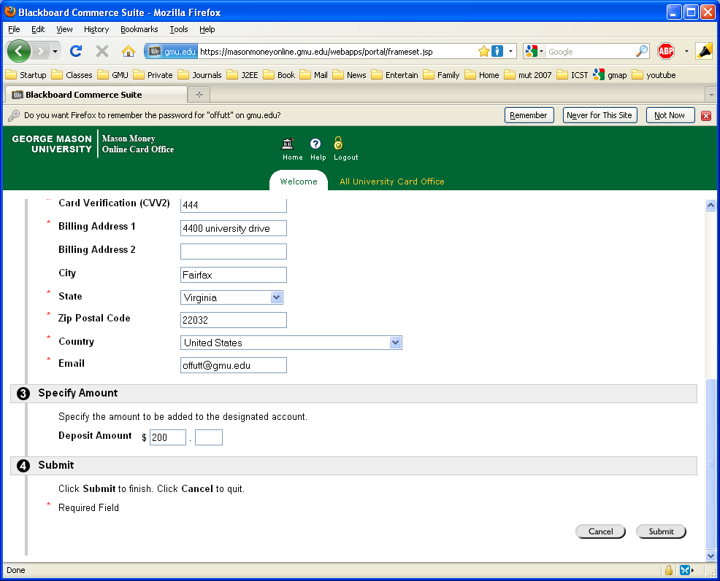
Example

Slide 16
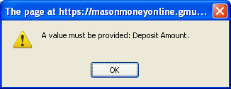
Example
I did!
Maybe I need 50 cents …
50

Slide 17
Example
Must enter 2 zeros (other values not allowed)
00
50

Slide 18
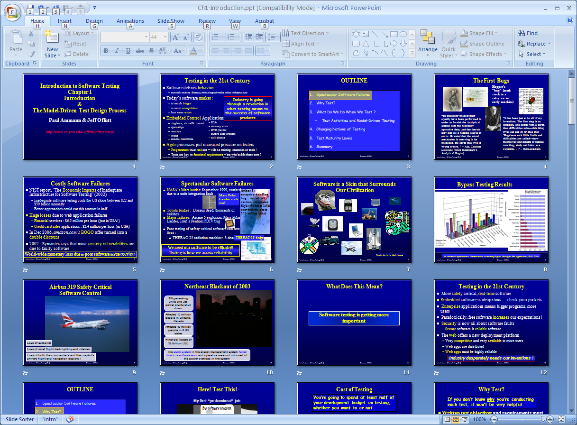
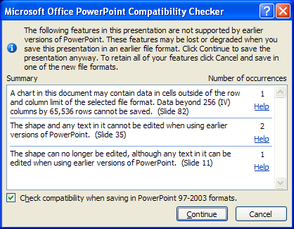
Example
This modal dialog box will not allow me to see the message (with crucial info!) while editing the slides. I have to respond before editing.

Slide 19
Examples
! HT ACCESS: Error accessing “http://www.cs.gmu.edu/offutt.html”: “HTTP: File/directory does not exist”
The requested web page /offutt.html was not found on http:// ...
!PrintMonitor is currently printing “Doc 1: Bad Examples” from “WordPerfect 2.1”. If PrintMonitor quits now, “Doc 1: Bad Examples" will be printed when the system is restarted with MultiFinder. Do you want to finish printing before PrintMonitor quits? (Windows 95)
Currently printing. If shutdown occurs now, the document will not be printed until MS Word restarts. You can still delay shutdown until the document finishes printing.
Wait and shutdown after printing:
Shutdown now and cancel printing:

Slide 20
Another Example
http://www.inwarehouse.se/ : Microsoft OLE DB Provider for ODBC Drivers error '80004005'
[Microsoft][ODBC SQL Server Driver][SQL Server]Your transaction (process ID #85) was deadlocked with another process and has been chosen as the deadlock victim. Rerun your transaction.
/script/webkatalogen/pb.asp, line 221
Internal failure, please try again.

Slide 21
More Examples
Bus error, core dumped (Unix)
Access through a nil pointer in function GetNext()
Terminating thread, due to a stack overflow problem. A VxD, possibly recently installed, has consumed too much stack space. Increase the setting of MinSPs in SYSTEM.INI or remove recently installed VxDs. There are currently 5 SPs allocated. (Windows 2000)
???

Slide 22
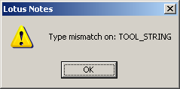
Yet Another Example
From Lotus notes
What does that mean ???

Slide 23
A Confusing Example
This webpage has a redirect loop.
The webpage at
https://property.onesite.realpage.com/system/onlinepayments/default.asp
has resulted in too many redirects. Clearing your cookies for this site may fix the problem. If not, it is possibly a server configuration issue and not a problem with your computer.
Here are some suggestions:
Reload this web page later.
Learn more about this problem.
More information on this error
Below is the original error message
Error 310 (net::ERR_TOO_MANY_REDIRECTS): There were too many redirects.

Slide 24
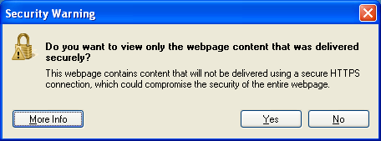
Another Confusing Example
The wording of this message makes it hard to know how to answer
“to view only” ?
If I want to let it show me everything, should I answer “Yes” or “No”?
This message can only be understood by someone who got an A in a logic class …

Slide 25
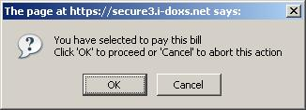
Yet Another Example
From an online bill payment system
Is it legal to “abort” in this state?

Slide 26
A Commonly Occurring Example
Most browsers give a warning before submitting POST data for the second time
Avoid duplicate submissions and updates
Avoid duplicate purchases
Users should be very careful before overriding this hesitation
However … how many users understand “POSTDATA”?

Slide 27
Last (Negative) Example
Program Error: WINWORD.exe has generated errors and will be closed by Windows. You will need to restart this program. An error log is being created. (Word 2000)
A colleague got this message, intermittently, for several months before diagnosing the problem
It occurred when starting MS Word (and PowerPoint) … sometimes … and they immediately exited
Restarting the computer did not work
Took computer to the support center, but they couldn’t get the problem to repeat
The actual problem ???
The default printer is a network printer and is currently unavailable. Word is continuing, but you will not be able to print.

Slide 28
An Outstanding Example
ERROR 403 - Forbidden
The server understood the request, but is refusing to fulfill it.
Authorization will not help and the request SHOULD NOT be
repeated. This status code is commonly used when the server does
not wish to reveal exactly why the request has been refused, or
when no other response is applicable.
Having trouble? Maybe one of these links will help you find what
you are looking for: Hardware, Software, Solutions, Storage
Systems Products.
Search:

Slide 29
An Interesting Example
Command: Mail To: fred
Subject:
No subject – Continue with message? (y/n) n ___
Interesting escape
A reminder that we should use subject lines
Intrusive or protection?

Slide 30
Your turn – Groups 1-6!
http://www.instructionaldesign.org/bad_error_messages.html
What is wrong? (Be specific… use our four criteria)
Must be specific
Must use constructive guidance and positive tone
Must be in a user-centered style
Must use appropriate physical format
2. Fix it!
3. Go to the next slides and answer the example
for your group number (1-6 also)

Slide 31
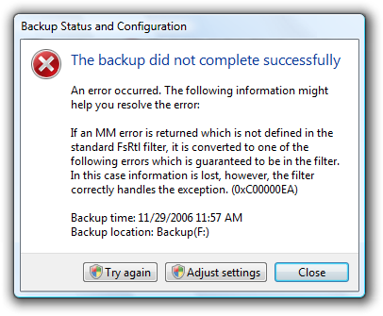
Exercise 1
From: http://msdn.microsoft.com/en-us/library/windows/desktop/aa511267.aspx#codes

Slide 32
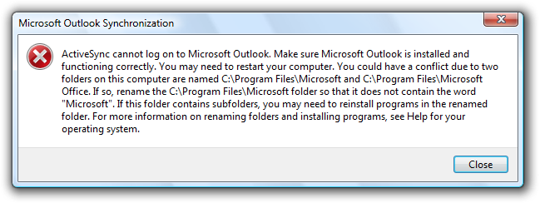
Exercise 2
From: http://msdn.microsoft.com/en-us/library/windows/desktop/aa511267.aspx#codes

Slide 33
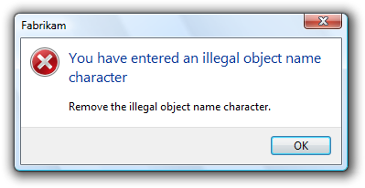
Exercise 3
From: http://msdn.microsoft.com/en-us/library/windows/desktop/aa511267.aspx#codes

Slide 34
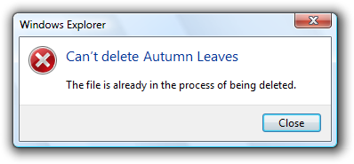
Exercise 4
From: http://msdn.microsoft.com/en-us/library/windows/desktop/aa511267.aspx#codes

Slide 35
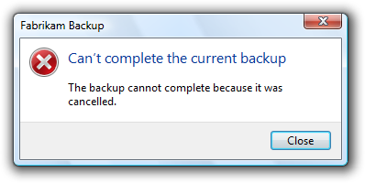
Exercise 5
From: http://msdn.microsoft.com/en-us/library/windows/desktop/aa511267.aspx#codes

Slide 36
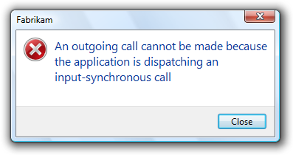
Exercise 6
From: http://msdn.microsoft.com/en-us/library/windows/desktop/aa511267.aspx#codes

Slide 37
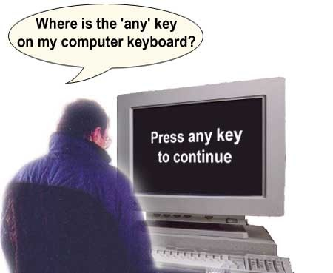
A Stupid Example

Slide 38
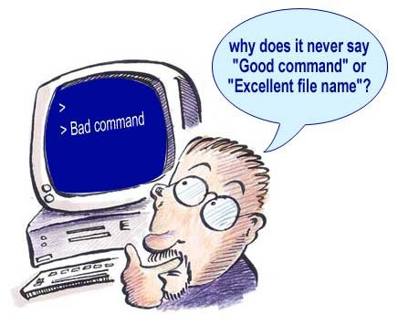
Another Stupid Example

Slide 39
If Error Messages Were Haikus
Yesterday it worked
Today it is not working
Windows is like that
Wind catches lily
Scatt’ring petals to the wind:
segmentation fault
Three things are certain:
Death, taxes, and lost data.
Guess which has occurred.
A file that big?
It might be very useful.
But now it is gone.
Windows NT crashed.
I am the Blue Screen of Death.
No one hears your screams.
Errors have occurred.
We won’t tell you where or why.
Lazy programmers.

Slide 40
Client- or Server-side Checking?
Typically uses javascript
Does not require “round-trip” to server
Can check immediately
JS is interpreted (slow!)
JS has limited abilities to:
Format error message
Redraw screen
Diagnose problem
Access back-end data
JS is quite error-prone
Typically uses Java (or C#)
Requires “round-trip” to server
Check is after “go” button
Java is very fast
Java is very powerful :
Arbitrary message formatting
Can create a new screen
Exception-handling mechanism
Can access database !
Java programs are much more reliable
Users can “bypass” client-side checking

Slide 41
Client- or Server-side Checking?
Server-side checking with Java has many advantages
Only client-side advantage is speed :
Advantage disappears when JS gets complicated (interpreted!)
Other advantages of server-side outweigh speed of client-side by a lot
Modern web sites are moving to doing all of their checking on the server side
A compromise uses Ajax
Checking can be done on the server
But without the user explicitly sending a request

Slide 42
Philosophy of Designing for Errors
Think of the user’s point of view
Assume every mistake will occur
Make every action reversible
Use syntactic constraints as much as possible
Selection vs. typing
Make the results of actions obvious
If possible, make them obvious before actions are committed

Slide 43
Summary
Good Error Messages:
Increase speed of use
Increase subjective satisfaction
Reduce repeat errors

