Slide 1
Some Golden Rules of Interaction Design
Dan Fleck
http://www.cs.gmu.edu/~dfleck/
(adapted from Jeff Offutt’s slides)
SWE 632
User Interface Design and Development

Slide 2
Modes of Interaction (Types of Interfaces)
Menu (selection)
Form fill (selection)
Command language
Natural language
Direct manipulation – GUI, WUI

Slide 3
Eight “Golden” Principles for Dialogue Designers
Valid for any type of interface
Consistency
Design in, then evaluate
Changes break consistency …
Shortcuts
Users must be able to find them
Feedback
Not just error messages
Yield Closure
Have a clearly defined end-point in the interaction

Slide 4
Eight “Golden” Principles
Error Handling
Clearly tell me what was wrong
Only make me redo the part that was wrong
Undo
If the operation cannot be “undone,” use hesitation
Put the user in charge
Inexperienced users may be intimidated when the software makes decisions
Experienced users want to control the flow
Reduce the STM load

Slide 5
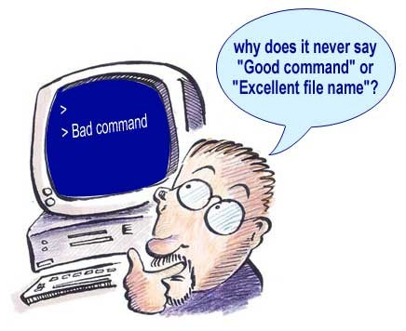
Eight “Golden” Principles
Design for the USER
First
Last
Then test it

Slide 6
Preventing Errors
People often make mistakes
Faster computers can increase errors
Prevention strategies :
Flow : Users make fewer mistakes when the flow through the UI makes sense
Education : Better error messages can reduce errors

Slide 7
Software Seatbelts
The software can prevent the user from making dangerous choices
If the dangerous choice must be available, allow it with a hesitation (“are you sure?”)
Exiting editors with changed, unsaved text
Should not hesitate if unchanged!
rm *.o … rm * .o
rm –i *.o forces hesitation (alias rm “rm –i”)
Do not put choices on menus that should not be used
http://gmailblog.blogspot.com/2008/10/new-in-labs-stop-sending-mail-you-later.html

Slide 8
Simplifying Displays Five Objectives
Consistency
Format, terminology, abbrevs, titles
Easier to repair than to build in!
Efficient assimilation
Neat columns
Left justification of characters
Right justify integers
Spacing, etc

Slide 9
Simplifying Displays Five Objectives
Reduce memory load
Do not cross screens
No long sequences of interaction
Input should look like output
Put dashes in phone numbers and credit card numbers
Allow output displays to be flexible

Slide 10
Highlighting
Highlighting can appear in many ways :
bold
marking
size
font
CAPITALIZE
inverse video
blinking
color
audio
BE GENTLE!! HIGHLIGHTING ALWAYS LOOKS STRONGER TO THE USER THAN TO THE DESIGNER!!!

Slide 11
Rules for Data Entry
Be consistent !
Minimize user inputs
Single character choices
Reduce device switching (keyboard – mouse)
No redundancy (addresses …)
Minimize memory load
Make data entry similar to data display
Be flexible : Again [YN] (N)?

Slide 12
Summary
All an interface designer has to do is
Be polite
Be considerate
Be clear

