Slide 1
Designing Good Behavior
Dan Fleck
(adapted from original slides by Jeff Offutt)
http://www.cs.gmu.edu/~dfleck
SWE 632
User Interface Design and Development
Cooper, Ch 12

Slide 2
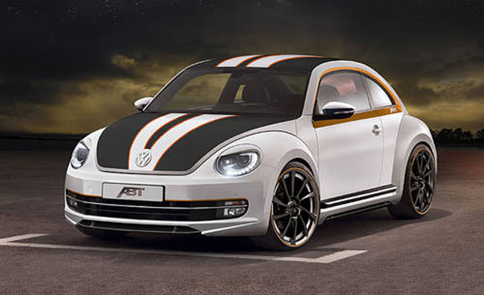
Ch 12 : Designing Good Behavior
People respond to computer user interfaces as if they are sentient beings
We should make our software considerate, likeable, supportive
Core question: What does the human need ?

Slide 3
Ch 12 : Designing Good Behavior
People should think, computers should work
This is not hard …
But being considerate takes more time than being inconsiderate
Inconsiderate people think they are being efficient …but many of their colleagues think they’re self-centered, curt, and cryptic
Remember that the software is there to help the user, not the other way around

Slide 4
Take an interest
Why, thank you!
Remember things about the users
Considerate people ask what you like once, then remember
PPT never remembers my print preferences or my file saving preferences
Notes:
Other examples are form fill ins everywhere

Slide 5
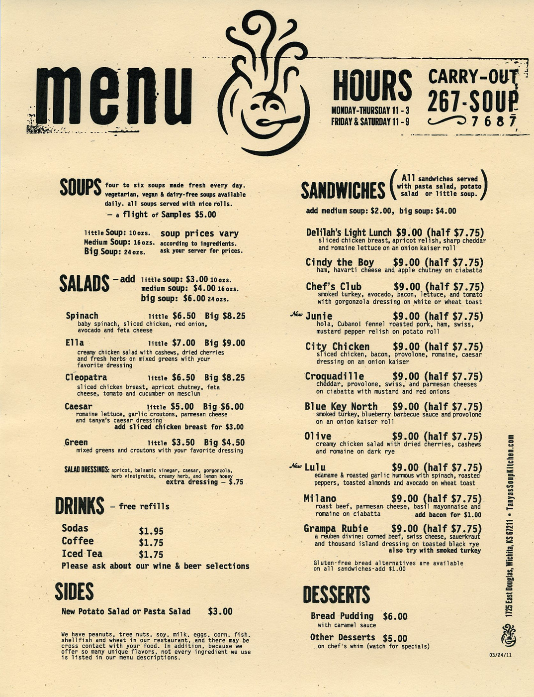
Considerate products are deferential
Give users choices, not orders
Never judge users – don’t tell users they’re wrong, the software doesn’t understand
If you submit without a phone number, we won’t be able to call you back. Would you like to continue anyway?

Slide 6
Considerate products are forthcoming
Give users related information that might help them
Printing could also tell us:
The print queue is full …
The color is out
There are 50 other documents ahead of yours, how about trying Printer_X2 which is free?
Suggest possible words on misspellings …

Slide 7
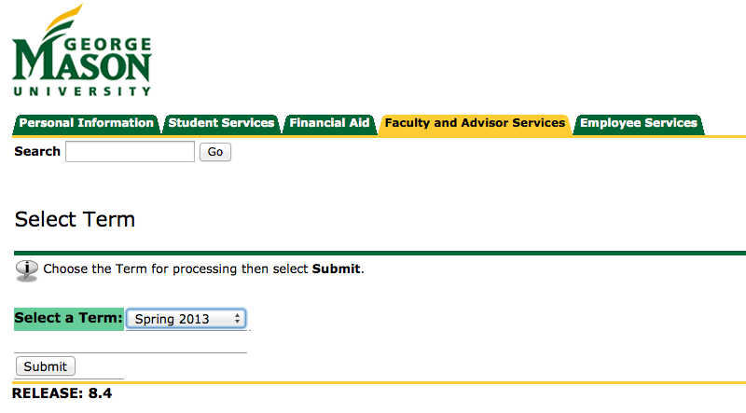
Considerate products use common sense
Put controls in logical places
Hesitate on stupidity: Are you sure you want to send a check for 29 cents?
A considerate program would never think I want my class roster for the next semester
This is the default!

Slide 8
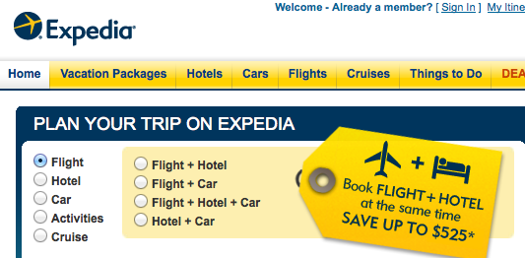
Considerate products anticipate human needs
Considerate products anticipate human needs
Operating systems “pre-fetch” sectors that are near the last sector we read … why don’t web browsers do the same ?
FasterFox does this now!
Good “human” choices

Slide 9
Considerate products are conscientious
Consider the broader goal
If I ask you to make me a sandwich. What else?
Put it on a plate and bring it to me.
Wash the dishes
Wash, dry, and put them away.
When copying a file with the same name – should let me merge, show me the differences, rename the old file, or simply overwrite
When printing color ppt to a black-and-white printer, should automatically change to “pure black and white”

Slide 10
Considerate products don’t burden you with their personal problems
A receptionist at the dentist’s office who complains about her schedule to customers is very annoying
Software should not :
Tell us it successfully saved …
Whine about a full recycle bin …
Tell us it cannot render some weird fonts …
Just do it !

Slide 11
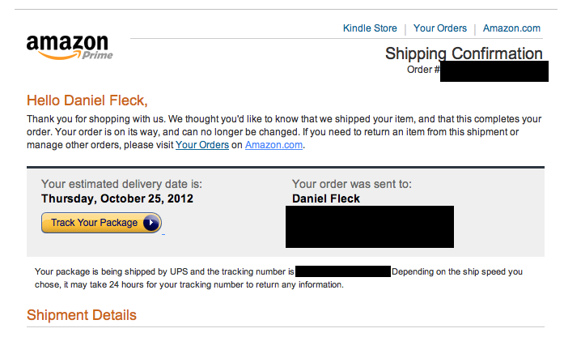
Considerate products keep us informed
Tell users about what matters to the users
What can I do next ?
How do I complete my order ?
How do I quit ?
How can I change something later ?

Slide 12
Considerate products are perceptive
If I check my roster in the morning, then I log into the system that afternoon, shouldn’t it automatically tell me if anybody added or dropped the class since my last check ?
If I resize adobe reader to use the full height of my screen and be just wide enough to fit a document … shouldn’t it create the window with that size next time ?
When I print with “Adobe PDF” in PPT, I always choose “Handouts”, “Pure Black and White” and “Slides per page” = 2 ... PPT should notice and remember

Slide 13
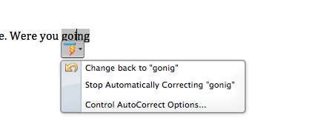
Considerate products are self-confident
“are you sure ?” just gets in the way … on the other hand, the software should provide an “undelete”
MS Word is confident to auto-correct… but lets you go back if you want.

Slide 14
Considerate products don’t ask a lot of questions
Give users choices, not questions
Don’t offer choices nobody ever wants
Don’t offer choices whose consequences are not clear
“are you sure you want to quit? (yes, no, cancel)”
What does cancel do !!!!
About once a week I shut down my computer and go to bed … the next morning when I look at my computer I find a dialog box “something is still open, should I shut down?” … when I say “yes”, then it shuts down, wasting time as well as electricity
See next slide for an inconsiderate question…

Slide 15
An Inconsiderate Question
Uhmmmm …. I didn’t change anything …
All I did was print !
Did I accidentally change something else ?
Why are you bothering me ?
Are you stupid or am I ?
What does “Cancel” do ?
Mommy ! Help !

Slide 16
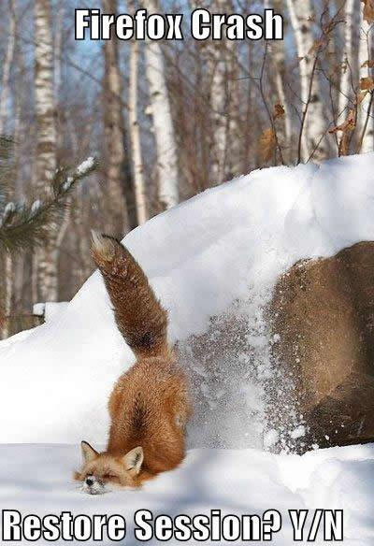
Considerate products fail gracefully
When you fail, apologize and try to fix it (kindergarten lesson …)
Don’t throw away data when crashing …
If I fill out 10 form fields and get one wrong, keep the data from the other 9

Slide 17
Considerate products know when to bend the rules
To reimburse a visitor for a trip, we have to create a banner record
We have to have a G-number
To get a G-number, we need a social security number !
The automated system is stupid enough to check that the SSN is valid ...
Allow users to complete part of the process today and come back later to finish
Binary logic : yes/no, true/false, done/not done
Trinary logic : yes/no/maybe, true/false/possibly, done/not done/started …
In real life, we never get the rules right
We need some way to allow for when the rules don’t quite fit
Manual systems are always “fudgeable” by humans… computerized aren’t (yet)!

Slide 18
Considerate products take responsibility
Software should understand hardware devices and deal with them
When my printer runs out of paper, my computer tells me “could not print” … so I fill the printer up and print again … then the printer finishes my first print and happily prints my second copy!
The web interface on my router constantly is dead. I have to reboot almost every time I want to access it.
Updated 3rd party firmware would allow me to automatically reboot – they need to be “good” to be used, OEM doesn’t I guess.

Slide 19
Designing Smart Products
This section makes some interesting general points, but few specific actionable suggestions ( research agenda? )
Smart products take care of users
They don’t behave intelligently
Smart products are proactive, not just reactive
Most computers spend > 90% of their time doing … nothing
Use the time to look for files the user might need
Cooper spends several paragraphs complaining that computers don’t use spare cycles to help the users, but does not offer any other concrete suggestions
Smart products have a memory : A way to track and use actions that users take over multiple sessions
Remember previous preferences and choices
“Dynamic defaults” resets defaults based on the user’s past history
It’s easier for programmers to let the UI ask the user what to do each time – it’s easier for users if the UI remembers

Slide 20
Designing Smart Products
Task coherence : Our goals and how we achieve them is usually similar from day to day
Similar usage patterns in software
Often the same document, or documents in the same directory
Why should I tell Word to full justify paragraphs … every time ?
Why should my phone keep asking “did you say …” when I say “yes” … every time ?
Applications should remember how big they were and where they were on-screen
If a user goes through the same sequence of commands several times – the application should automatically create a macro
What should a program remember ? EVERYTHING !
Disk space is now not a problem for saving information – save everything !
My TA emails me the grade spreadsheet at least once a week and I put it in the same place every time … yet every time, my mail client asks me where to put it … can you imagine an assistant acting that stupidly ?

Slide 21
Designing Smart Products
Software should automatically keep track of old versions
Change management algorithms were developed THIRTY YEARS AGO !
I’ve been using sccs / rcs / cvs since 1982
Why doesn’t Word keep track of old versions automatically ?
Why can’t I compare the contents of two Word documents, line by line ?
Software should keep track of the undo stack between sessions
Office products throw away the undo stack when we save
Very 1995 “memory is scarce” thinking …
Data fields should remember the values entered in previous sessions
Modern browsers have started doing this

Slide 22
Summary : Five Powerful Ideas
Posture of UIs (Ch 9)
Flow through the UIs (Ch 10)
Overhead of UI interaction (excise) (Ch 11)
Navigation among windows, panes, tools and information (Ch 11)
Considerate user interfaces (Ch 12)
Remember to think about the users and you’ll be fine

