Slide 1
Introduction & Overview
Dan Fleck
(Slides adapted from Jeff Offutt’s slides)
http://cs.gmu.edu/~dfleck/
SWE 632
User Interface Design and Development
Cooper, Ch. 1

Slide 2
SWE 632 Overview
Working title
Why we hate computers
And what we can do about them
In mature engineering fields, customers choose products they can use without help
Can I drive the car without extra training?
Can I use this web application without being taught?
Can I program my DVR without the manual?
Can I use my stopwatch without help?

Slide 3
What Will You Learn in This Class?
How to break down the essential characteristics of usable software from an analytical viewpoint
Engineering principles for designing and building software interfaces that are
Fast to learn
Speedy to use
Avoid user errors
Lets evaluate something in this classroom
How to recognize and articulate the difference between “this program sucks” and “I can improve this program by changing X,Y and Z”
Life-long habits for engineering usable products

Slide 4
What is This Class?
Psychology human factors ?
NOT
(Psychology)
Graphics ?
NOT
(CS)
GUI Programming ?
NOT
(Skills)
A design class ?
YES
Some of all of those:
Psychology serves as the theoretical foundations
Graphics provides the mechanism (how, but not what to do)
GUI programming works at a lower level than ours

Slide 5
A Design Class
Engineers tend to focus on functionality
Exciting features are worthless if users cannot figure out how to use them!
VCR programming : impossible with old interfaces easy with new ones
Cell phones : do you know how to use all of the features on your cell phone?
What about your washing machine?

Slide 6
User Friendly
The term “user friendly” is over-used and under-defined
What is “friendly” to one person may be trite, tedious, or confusing to another
“User appropriate” is more accurate …
But we need to know something about the user!
We must design the interface to accomplish the users’ goals!

Slide 7
UIs and Communication
This class is largely about communication
It is not all written, but
There is a large vocabulary for the class
Communication between software and people
If you are a good communicator, this class will not be hard

Slide 8
Design of UIs: The Problem
Inside-out design: Develop a system, then add the interface
Managers
Programmers
QA
Designers
Look & Feel
Initiate
Build
Test
Ship
Traditional CS is frequently inside out

Slide 9
Design of UIs: A solution
Outside-in design: Develop the interface, then build the system to support it
Managers
Designers
specs
Programmers
code
QA
product
bug
report
input
Design
feasibility
feedback
Initiate
Build
Test
Ship
Users
Users

Slide 10
Design of UIs:
Inside-out design: Develop a system, then add the interface
Outside-in design: Develop the interface, then build the system to support it
When decisions are made, either the developer must conform to the user, or the user must conform to the developer.

Slide 11
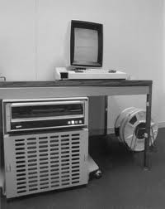
Origins: Graphical UIs how did it all start?
In1963, Ivan Sutherland submits PhD work at MIT proposing the Sketchpad software, for which he got the 1988 Turing Award
Sketchpad revolutionized navigation by treating the screen as a navigable window rather than the sequential command lines
http://www.youtube.com/watch?v=495nCzxM9PI
In the early 1970s, Xerox Parc introduced the Xerox Star
windows, icons, buttons, mouse, pop-up menus…
In 1983 Apple Lisa is first commercial PC ($9,995) to use GUI
quickly followed by the Macintosh (1984, $2,495)
…and MS Windows 1.0 in 1985
Xerox Star
what is going on?

Slide 12
Enter: Cognitive Psychology – 7± 2 Rule
In 1956 George Miller finds that the human short term memory (STM) can hold about 7(2) chunks of information
That’s all we can concentrate on !
Phone numbers – 7 digits!
Books (parts, chapters, sections, paragraphs, ideas)
Lectures
Software
Items on a menu
Options on a command line
Procedures in a module
Types / variables / constants

Slide 13
Cognitive Psychology – 7± 2 Rule
When we get more than about 7 items, we get confused
This is closely related to complexity
We handle complexity by
Chunking (psychology term)
Abstraction or grouping (CS / Math term)
A usable interface must help the users handle complexity by chunking choices into groups

Slide 14
Cognitive Psychology – 7± 2 Rule: Example!
Can you memorize this: 19004685865
“Chunks” : 19-00-46-85-865
Better chunks (familiar): 1-900-468-5865
Even fewer chunks: 1-900-GOT-JUNK

Slide 15
Cognitive Psychology – 7± 2 Rule: Example!
later work on complex and dynamic content estimates about half of that
web usability guidelines recommend 2 to 3 chunks
remember 2 to 3 items from one screen to the next
2 to 3 clicks to get to the user’s goal…
A usable interface must help the users handle complexity by chunking choices (into groups of less than about 7 (simple things) or 3 (complex things)

Slide 16
Simplicity is Hard
“It takes three weeks to prepare a good ad lib speech” – Mark Twain
Anyone can make something confusing
It takes talent, diligence, knowledge and skills to make things simple
User interfaces should be simple!

Slide 17
Shneiderman’s Measurable Criteria
Time to learn
Speed of performance
Rate of user errors
Retention of skills
Subjective satisfaction
Numerically
Before designing, decide what is acceptable for each of these!!

Slide 18
1. Time to Learn
How long it takes to learn how to use an interface
With complicated interfaces, learning happens in “plateaus”
Plateau 3
More tasks, more choices, or more speed
additional
commands
Plateau 2
More tasks, more choices, or more speed
additional
commands
Plateau 1
Ability to complete at least one simple task
initial
set of
commands

Slide 19
2. Speed of Performance
Speed of user interface, NOT software
Number of characters to type, buttons to press, mouse-clicks, mouse movements, …
Speed of performance often directly conflicts with time to learn
That is, faster systems are often harder to learn
Unix vs. Windows
Command lines vs. GUIs
Table saws vs. hack saws
Why?

Slide 20
3. Rate of User Errors
A UI can be designed so as to make user mistakes more or less likely
Compare C++ with Java
Affected by factors such as :
Consistency
Instructions
Logical arrangement of screens
Importance depends on criticality of software

Slide 21
4. Retention of Skills
We quickly forget how to use some user interfaces, but remember others for life
Z vs. algebra
Airplanes vs. bicycles
Affected by how closely the syntax of the operations match our understanding
If learning is very very fast, retention may be less important

Slide 22
5. Subjective Satisfaction
How comfortable the users are with the software
The other criteria are very analytical, objective, and measurable
SS captures other issues that are more specific to individual taste and background
Often subjective
A little harder to measure
The $300 Million Button:
http://www.uie.com/articles/three_hund_million_button

Slide 23
Shneiderman’s Measurable Criteria
Time to learn
Speed of performance
Rate of user errors
Retention of skills
Subjective satisfaction
Lets try it: evaluate www.ted.com
We will spend most of our time on the first three Learn, Speed, and Errors

Slide 24
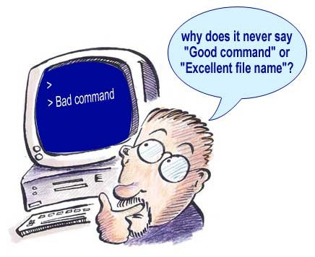
Good Command

Slide 25
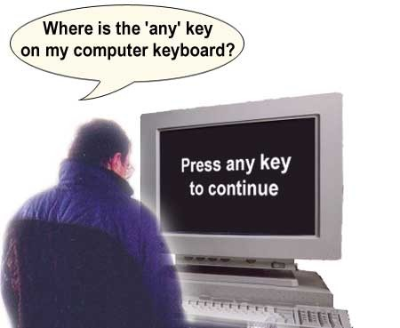
Any Key

Slide 26
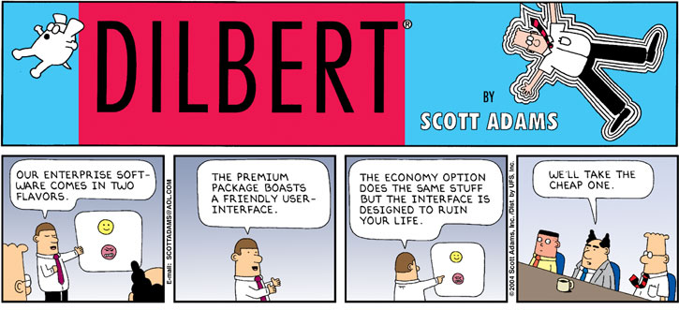
A Favorite Dilbert
patriot web

Slide 27
Yahoo! Craziness
Question : How can I print a receipt?
Answer: Thank you for writing to Yahoo! Travel concerning your receipt request. We are committed to provide quick and efficient service and will be glad to assist you.
Additionally, you may also choose to print your receipt online. Please follow the instructions provided below:
Retrieve your reservation online
Click on the link ‘Email a friend’
A different page will be displayed which will have a radio button ‘View/ Print Receipt’
Click on this button and print your receipt for this reservation.
We appreciate your association with us and look forward to being of assistance to you in the future.
Yahoo! Travel/Travelocity Customer Support
Email a friend

Slide 28
Read It and Weep
From Sharp Electronics manual for a home fax machine
TEXT: “The Remote Transfer Passcode can be used in Extension Telephone Function. To transfer a fax call from an extension phone to the UX-170 for reception. This function, the call is transferred to the UX-170 by pressing the passcode number and * key at the extension telephone. The passcode is a one-digit number, selected from 0 to 9. To change the Passcode, redo the entry operation. To check the Passcode, print-out and refer to the Program List (see p. 76). If an incorrect number is entered during the procedure, press the * key and repeat entire procedure.”
TRANSLATION: If you can understand and remember this for more than 10 minutes, you can become president of Sharp Electronics.

Slide 29
Summary of Important Concepts
Goals for the class
Design for the user
“User friendly” is a meaningless term
Usability and communication
Origins of usability
7 ± 2 rule
Five criteria :
Learn, Speed, Errors, Skills, SS

