Slide 1
Mental Models
Dan Fleck
(slides adapted from Jeff Offutt & Joao Sousa)
http://www.cs.gmu.edu/~dfleck/
SWE 632
User Interface Design and Development
Cooper, Ch 2

Slide 2
Models for Interfaces
mental
  users’ perception of reality
interface
representation/manifestation
  how the UI designer represents
  the implementation to the user
implementation
  how a machine, virtual or otherwise,
  is actually built

Slide 3
Example: driving a car
mental
  push the gas pedal, the car goes faster
  turn the wheel, the car turns
representation/manifestation
  steering wheel, speed selector
  pedals for gas and breaks, speedometer…
implementation
  more gas -> stronger explosions -> more RPMs
  transmission transforms RPMs into tire spins
  at variable rates and in different directions
  steering wheel activates hydraulic
  servo-system that controls angle of tires

Slide 4
Stationary Bicycles at the Gym
A Hill
Resistance
on a hill
Resistance
Picture on the bike screen

Slide 5
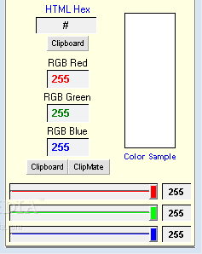
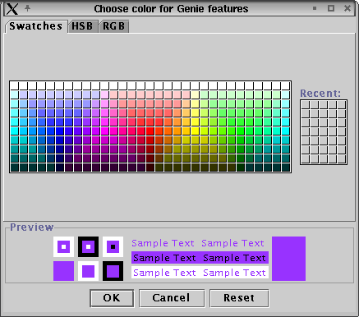
Software Example: Color Chooser
Follows (many) users’
mental models
Follows implementation
model

Slide 6
Manifest Model
The manifest model is more significant in software than in other engineering artifacts
Hiding the complexity about how software works internally is a key benefit of computers! Example:
  Implementation : Network protocols
  Manifest : Local disk
  Mental : Files

Slide 7
User Interfaces
Telephones : I want to call Mom, not 1-606-XXX-XXXX
Compile : I want to Run my program, not compile, link, run
File Manager : Dragging a file from window to window is:
  Move on disk
  Copy from disk to disk
Max OSX disk eject: Drag disk to trashcan
Is this good or bad? Does it correspond to the mental model or the implementation model?
Interfaces should conform to the user’s mental model

Slide 8
Does this match your mental
model or implementation model?

Slide 9
Mechanical → Information Age
As we move from physical to software, mechanical representations remain
  Tab key on your typewriter moved to your computer ☺
  Reigns from your saddle used to guide your car ☹
Enhance the physical, when moving
  Address books can sort in various ways, can represent items in a table, has “search”
Be aware: blindly following mechanical age representations may limit your ideas and innovations!

Slide 10
Typical Paging Calendar
Feb
Jan
Sun | Mon | Tue | Wed | Thu | Fri | Sat
31 | 1 | 2 | 3 | 4 | 5 | 6
7 | 8 | 9 | 10 | 11 | 12 | 13
14 | 15 | 16 | 17 | 18 | 19 | 20
21 | 22 | 23 | 24 | 25 | 26 | 27
28 | 1 | 2 | 3 | 4 | 5 | 6
Sun | Mon | Tue | Wed | Thu | Fri | Sat
27 | 28 | 29 | 30 | 31 | 1 | 2
3 | 4 | 5 | 6 | 7 | 8 | 9
10 | 11 | 12 | 13 | 14 | 15 | 16
17 | 18 | 19 | 20 | 21 | 22 | 23
24 | 25 | 26 | 27 | 28 | 29 | 30
This makes perfect sense … for a paper calendar

Slide 11
Scrolling Calendar
Sun | Mon | Tue | Wed | Thu | Fri | Sat
17 | 18 | 19 | 20 | 21 | 22 | 23
24 | 25 | 26 | 27 | 28 | 29 | 30
31 | Feb 1 | 2 | 3 | 4 | 5 | 6
7 | 8 | 9 | 10 | 11 | 12 | 13
14 | 15 | 16 | 17 | 18 | 19 | 20
scroll
This is closer to the user’s mental model

Slide 12
How did things improve?
Books (physical to online/e-readers?
Phone calls to Skype calls?
What else can we improve?

Slide 13
UIs and Mental Models
Predicting storms
  Does the prediction “30% chance of snow” mean
    It will snow in 3 of 10 locations in the area
    Less snow than if 50% chance, but more than if 10%
    On 3 days out of 10 with these “weather conditions,” it has snowed in the past
Dice
  If I roll a 6 five times in a row, what is the probability that my next roll will be a 6 ?

Slide 14
Mental Model Summary
Engineers are very comfortable thinking in terms of the implementation model
Users are not
Manifest models that follow users’ mental models help users learn and use software effectively

