Slide 1
Menu Design Guidelines
Dan Fleck
(slides adapted from Jeff Offutt)
SWE 632
User Interface Design and Development
Cooper, Ch. 22

Slide 2
Broad Purposes of Interaction
App-specific dialogue
pay the electric bill
set the home’s security system to let the dog sitter come in at 1pm
set print options
Know/find something
read the news
best Korean restaurant in town
where to pay the electric bill
analyze data
Enter data
e.g. enter customer no. and credit card data
Others?
these kinds of interaction may appear separately or together in some combination

Slide 3
Several dialogue styles
 | pros | cons
menu selection | recognize rather than remember shortens learning structures decision making, dialogues and error feedback | menu explosion screen real estate may slow experienced users
command language | flexible and powerful fast for experienced users | remember rather than recognize harder to design dialogues (chains of commands) harder to provide feedback & targeted error messages
natural language | best for untrained users best flexibility and power | hard to manage context ambiguous complex, high-cost development

Slide 4
Several dialogue styles
 | pros | cons
form fill | simplifies data entry modest training easy to provide contextual help | screen real estate may be burdensome on users layout is critical for clarity
direct manipulation | presents task concepts visually recognize rather than remember good retention encourages exploration easier to avoid/recognize errors | may be hard to design & program may become complex to use for all but simple cases

Slide 5
Menus are Effective When
Users will have little or no training
Intermittent users
Users are not familiar with terminology
Users need help making decisions

Slide 6
Why use menus?
Menus are best used to learn available commands, remind intermittent users on syntax
Frequent users will use
Butcons (or ribbon bar)
Keyboard shortcuts
Direct manipulation
Menus are for LEARNING and REMINDING!

Slide 7
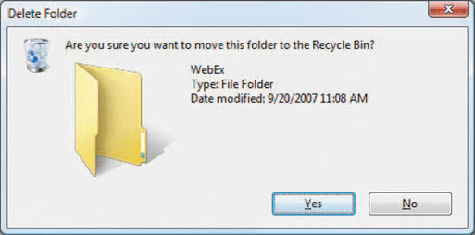
Design Considerations
Title
Phrasing of items
Sequence of items
Default buttons
Accelerators (short-cuts)
How to select
Help?

Slide 8
Types of Menus
Binary
Multiple-item
Extended
Pop-up
Permanent
Multiple selection
Linear sequence
Tree structure
Single Menus
Multiple

Slide 9
1. Binary Menus
One of two choices can be made (Yes or No)
Do you want another transaction (Y,N)?
Brief
Concise
But not descriptive …
You may:
Make another transaction
Quit and have your card returned
Type 1 or 2: ___
Why be descriptive? Pros/Cons?
More space
Just as fast
Instructions clear
Results are clear
Uses conversational dialogue, not stilted formalism

Slide 10
2. Multiple-Item Menus
Only one item can be chosen
Do you want to:
Withdraw ⇒
Deposit ⇒
Check Balance ⇒
Quit ⇒
Touch the button by your choice.

Slide 11
3. Extended Menus
One menu spanning two or more screens
Title
Screen 1 of 2
1. _
2. _
3. _
4. _
Press the number of your choice or N for Next screen. Then Press RETURN
Title
Screen 2 of 2
5. _
6. _
7. _
Press the number of your choice or P for Previous screen. Then Press RETURN
Titles must match
Screen numbering must be consistent
Choice labels must be unique across screens
3 screens is a lot, 4 is too many

Slide 12
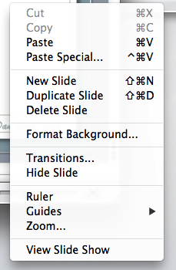
4. Pop-Up Menus (and Pull-Down)
Menus that appear for one selection, then disappear
Must use highlighting to select
Text must be short and concise
If it needs a lot of text, don’t use a pop-up!
Right-click menu

Slide 13
5. Permanent
Pop-up menus that remain on the screen
May be automatic or requested by the user
Contains very common choices
Use very little text
Must use highlighting of selection
Much like pop-up
Guidelines
What are the disadvantages?
GIMP Toolbox

Slide 14
6. Multiple Selection
Set List Files Options
X Emphasize directories and executables
Show long format
Show “hidden” files
X Sort by modification time
Show group owner
Choose as many options as you wish.
List Files
More than one choice can be made at a time
Requires a “Go” button
Pros/Cons

Slide 15
7. Linear Sequence (e.g. wizards)
The entire sequence is one task - separated into several steps
One decision at a time
Often used to implement options
Print
STEP 1: Choose Printer
STEP 2: Choose Spacing
STEP 3: Choose Numbering
1. Main office
1. Single
1. No numbering
2. Laboratory
2. Double
2. Full numbering
3. Secure room
3. One and half
3. Every 5 lines
Effective for novice users performing simple tasks
Very tedious for experts or repeated tasks
Pros/Cons

Slide 16
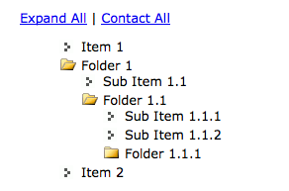
8. Tree Structure (1)
A hierarchy of menus and submenus
4 to 8 items per level
No more than 3 or 4 levels
Use familiar and distinct terminology
Choice must be title of sub-menu
Guidelines
Fast if natural and comprehensive
Lose users if too deep
Pros/Cons
Expanding tree-menus keep full context

Slide 17
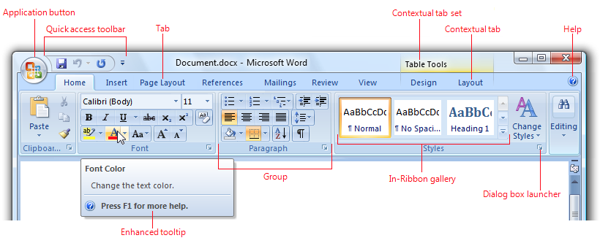
9. Ribbon Bar
Combines menus and toolbars
Speed of use of toolbar (with butcons)
Visibility of menus
From: http://msdn.microsoft.com/en-us/library/windows/desktop/cc872782.aspx

Slide 18
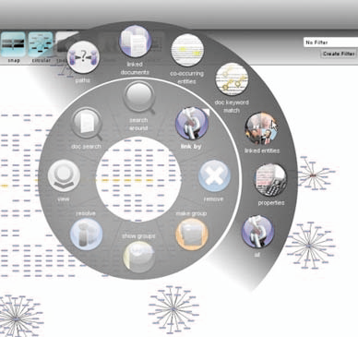
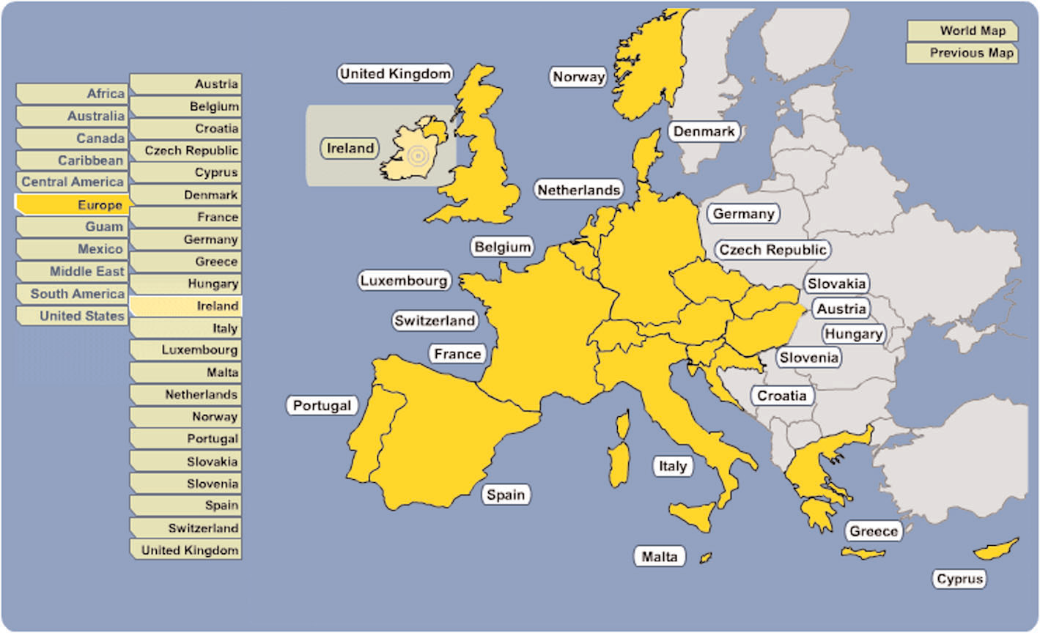
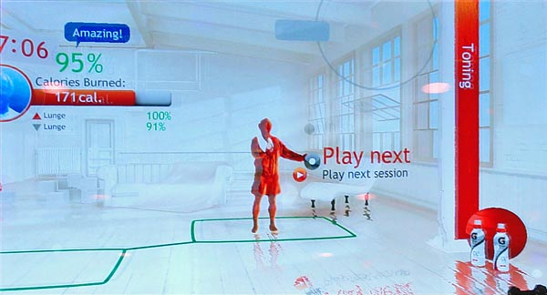
Many other menu types
Pie menus
Audio menus
(Car GPS)
Small devices
(smart phones)
Graphical menus
Gesture menus (Kinect)

Slide 19
Exercise
Most ATMs use a linear sequence of multiple-item menus
Re-design the menu system using some other type
Ribbon bar
Tree structure
Pull-downs
Etc… anything you want.
A key guideline: design around user goals/tasks they want to accomplish.

Slide 20
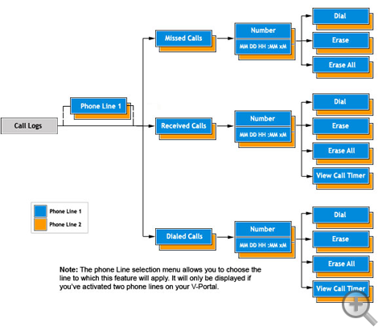
Menu Maps
Needed for Tree-Structured multiple menus
Offline documentation of menus
Anyone have one posted on their wall or monitor?
On-screen
Reference (main/option3/option4)
Site Map
Part of Vonage Menu Map

Slide 21
Order Of Menu Items
Chronological (time)
Numeric
Physical properties
Alphabetic
Grouping of related items
Frequently used first (most common strategy)
“Important” items first (exit)

Slide 22
Adaptive Menus
An adaptive menu changes to adapt to the user’s habits
Reorders the menu choices
Infrequently used items put in a “background” menu
(as in MS Office 2000, 2003)
Risky
Can be confusing
Multiple users on the same computer
Users must have some control
Many users hate it
(Old) empirical evidence was not positive
Newer systems get the advantages without the disadvantages… how?

Slide 23
Speeding Through Menus (Shortcuts)
Increase # of items per menu
Typeahead
If no returns, it’s natural
Concatenation of characters yields one operation
Menu names
Each menu has a name that can be used
Short-cut keys to open / navigate menus
http://iboughtamac.com/2007/01/13/useful-keyboard-shortcuts-in-os-x/
Menu Macros
User assigns a name to a choice

Slide 24
Menu Screen Design Hints (1)
Title – alone, top middle or top left
Escape labeled – how to get out
No irrelevant info
Mixed upper & lower case
Legibility
Instructions at top
How to enter command
Few options (about 7)
“Return” not an entry command or special key
No strange symbols
Number from 1 (we measure from 0, number from 1)

Slide 25
Menu Screen Design Hints (2)
Verify selection with highlighting before committing
Titles & selections same text !
Same titles in documentation
Text brief, descriptive and consistent grammatical style
Consistent layout
Take screen size into account
Offer help !!
Left justify items
Instructions should be consistent
Error messages in the same location
Menu status always in the same place

Slide 26
Phrasing of Menu Choices
Words should be familiar to users!
All screens must be consistent
Every word/option must be distinct
Phrases must be concise
Use the keyword first
Bad example
Much clearer!
Travel Menu
See all the details
Watch the country side
Long voyages
Travel Menu
Walking tours
Bike Tours
Cruises

Slide 27
Selecting Choices (no mouse)
Numbers
easy to read
more than 10 requires two keys
Help, Back are different values
Letters
sequential or mnemonic
not as easy to remember
Mixed
number for choices
H, B, M for Help, Back, Main
Cursor Motion
easier to learn … but more keystrokes
no type-ahead
dependent on hardware

Slide 28
Speed of Use vs. Social Amenities
“Please”, “do you wish”, “If you want” can be eliminated to improve speed of use
Questions can be implicit, not explicit
Please select the criteria for Flagship report: ___
or …
Flagship report criteria: ___

Slide 29
Example – Simplifying a Menu
Please enter report number or name: _ _ _ _ _
If entering name, also enter category: _ _ _
(Enter category for level 2 reports only)
Create a report
Delete a report
Modify a report
Modify several reports
option: ___
FLAGSHIP REPORT MAINTENANCE
Create
Delete
Modify
Maintenance Options: _
Report Number or Name: _ _ _ _ _
Report Category (L2): _ _ _

Slide 30
Customization
As users’ syntactic knowledge increases, they develop preferences for UI behavior
Successful UIs allow users to customize aspects of the behavior
UI designers must:
Define aspects of the behavior that users will want to customize
Design techniques to customize the UI
Present the customization to the users in usable ways

Slide 31
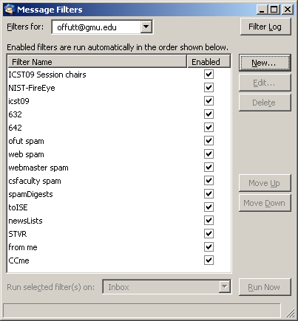
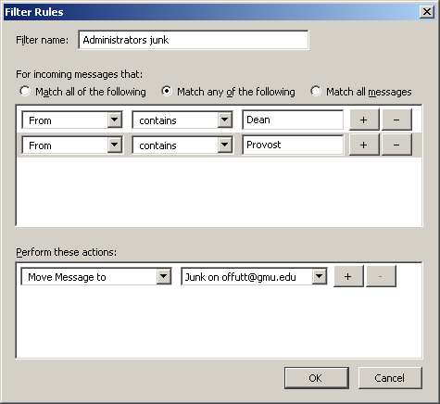
Thunderbird – Message Filters

Slide 32
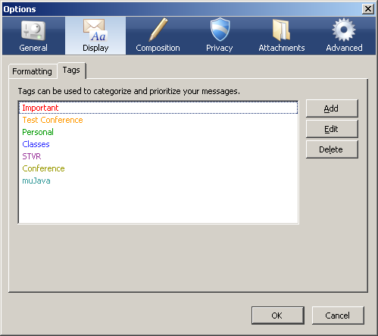
Thunderbird – Tagging Messages

Slide 33
Data Entry with Menus: Form Fill
Appropriate when many fields of data must be entered:
Full complement of information is visible to user.
Display resembles familiar paper forms. (easy to learn)
Few instructions are required for many types of entries. (easy to learn)
Users must be familiar with:
Keyboards
Use of TAB key or mouse to move the cursor
Error correction methods
Field-label meanings
Permissible field contents
Use of the ENTER and/or RETURN key.

Slide 34
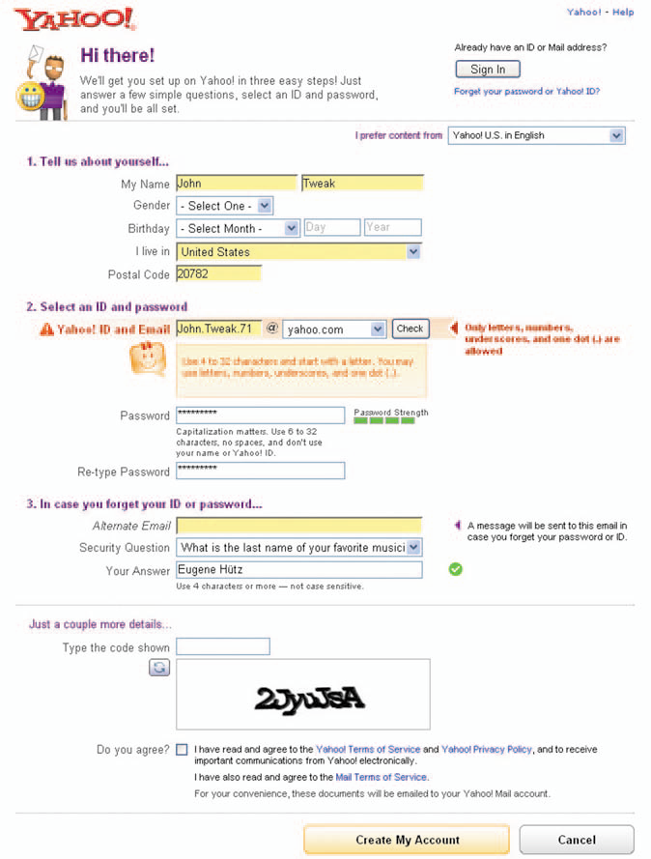
Form Fill Guidelines (1)
Title should be descriptive
Concise, clear instructions – user’s vocabulary
Logical grouping of fields
Plenty of white space
Familiar field labels
(from user’s vocabulary, not developer’s)
Consistent terminology
Consistent abbreviations and abbreviation strategy
Convenient cursor movement
(PF4 is not convenient if I don’t have that key on my keyboard)

Slide 35
Form Fill Guidelines (2)
Error correction for characters and fields
(Only make me change what I got wrong!)
Polite, clear messages for unacceptable values
Mark optional fields clearly
Don’t make the users enter the same data twice
Use sensible defaults when appropriate
How do I commit ?
MINIMIZE TYPING
Minimize keyboard/mouse moving

Slide 36
Form Fill – Columns
Left justify alphabetic
Right justify numbers on display
Line up decimals
Don’t make users enter leftmost zeros!

Slide 37
Design for Common Data
Telephone ( _ _ _ ) _ _ _ - _ _ _ _
Social Security: _ _ _ - _ _ - _ _ _ _
Times: _ _ : _ _ P M
Dates: MM / DD / YY
Money: $ _ _ _ . 00
Address: Street _________
Box or number _____
State _________
Zip _ _ _ _ _
Name: First __________
Middle Initial: _
Last: _______
Allow for all sorts
Some people use middle name

Slide 38
Summary
Simpler is always better
Menus are for intermittent users
Moderate to high task-semantic knowledge
Limited syntactic knowledge
They need reminding – speed is secondary
Menus help them explore and learn new capabilities
It is crucial to minimize hand-to-mouse movements
Help users type less
Good defaults in forms
“Dynamic defaults” – filled in from another field
Selection is always better than typing (when possible)

