Slide 1
The Story of Prego
By Dan Fleck
inspired by TED talk from Malcolm Gladwell
http://www.ted.com/talks/malcolm_gladwell_on_spaghetti_sauce.html

Slide 2
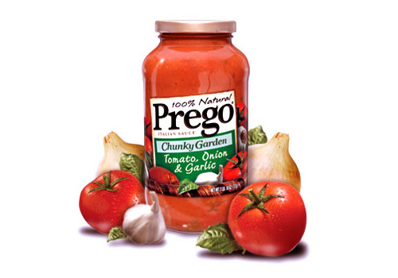
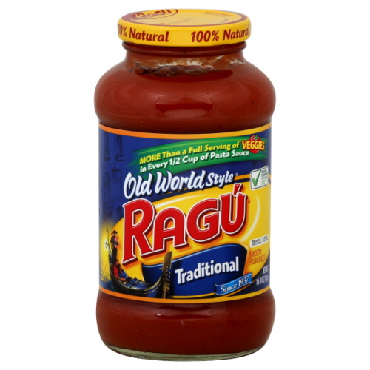
Prego versus Ragu
1980s… Ragu was winning….

Slide 3
Marketing (in the 1980s)
Focus groups: What do you like?
Search for the universal answer (like physics)

Slide 4
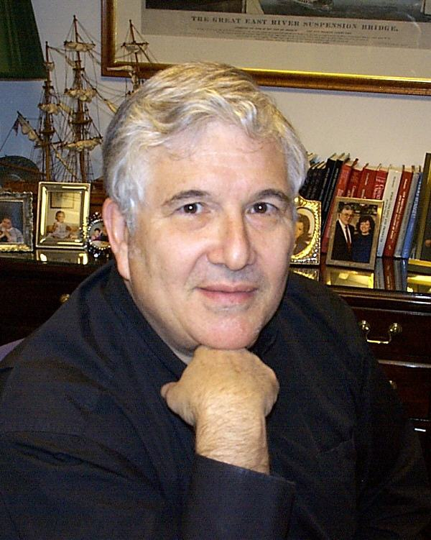
Enter Howard Moskowitz
Harvard trained pyschophysicst
Prego asked him to find out how to beat Ragu
Spent months in TASTE tests with pasta sauce of all possible variable (tart, sweetness, spiciness, chunkiness, etc…)

Slide 5
The Answer
What is the best sauce overall?
GROUPING (Market Segmentation)
1/3 like regular
1/3 of the people like spicy
1/3 like chunky
…. But in 1980 NO ONE made a chunky sauce (because that’s not what was authentic in Italy)

Slide 6
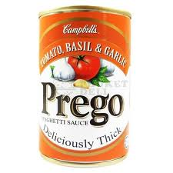
Enter: Prego Thick and Chunky
Prego creates a line of Thick and Chunky sauces
Over the next 10 years they make $600m from this line

Slide 7
Lessons for S/W
Create Thick and Chunky Interfaces ?
Requirements
People can’t say what they want – iterate/prototype
People can’t tell you what they do – ethnographic studies
UI
Different users need different UIs… don’t search for universal!

