Slide 1
Visual Interface Design
Dan Fleck
(adapted from original slides by Jeff Offutt)
http://www.cs.gmu.edu/~dfleck/
SWE 632
User Interface Design and Development
Cooper, Ch 14

Slide 2
Ch 14 : Visual Interface Design
Visual elements are “words” in the language that computers use to communicate with users
Visual elements are powerful communication devices, but very difficult to design well !
Requires lots of skills :
Computing
Communication
Knowledge of language
Graphical design
Don’t expect to find all those skills in one person !!

Slide 3
Use of Visual Elements
Visually show what – Textually show which
Is it a button
Or text field?
Which button should I press?
Graphic design is too much to teach in this course
Some knowledge of visual interface design is necessary to GUI designers

Slide 4
Visual Interface Suggestions Overview
Use visual properties to distinguish and organize elements
Contrast
Similarity
Layering
Provide structure and flow
Imagery (icons/graphics) that is cohesive and consistent
Integrate style and functions
Avoid too many visual elements

Slide 5
Visual Hierarchy
Determine hierarchy of actions based on importance to the user’s goals
Use hue, saturation, value, size, and position to distinguish levels in the hierarchy
Be conservative (emphasis always looks louder to a user than to the designer)
Group related items
Spatially – put them near each other
Visually – use the same properties for each (even when not grouped spatially)

Slide 6
Contrast and Layering
Contrast helps users
Distinguish among active interfaces elements
Distinguish among passive elements
Don’t include contrast that is not meaningful
Active, or manipulable, controls should stand out clearly
Layering : Putting visual elements on top of other elements

Slide 7
Provide Visual Structure and Flow
GUI organization
Visual elements in groups (PPT: icons in toolbars and screen)
Groups organized into panes (PPT: several panes)
Panes organized into screens or pages (PPT: each page in file)
Line things up
Align labels with each other: left justify
Line sets of controls up
Line up controls even across different panes
Follow a grid structure (GUI development tool should help)
The flow should support the user’s mental model
Western flow: (left → right, top → bottom)

Slide 8
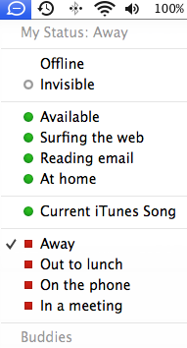
Clutter
Clutter uses up mental energy
Both in messy rooms and in messy UIs
Avoid complicated visual elements
Smaller and simpler is usually better
Leverage: A visual element that has multiple purposes
An icon that indicates type and that can be opened

Slide 9
Imagery
Icons are part of a language that communicate information to users
Function or active icons :
Represent both action and object
Metaphors may mean different things to different users
Don’t make icons too detailed
Reuse icons in different parts of the interface
Elements that behave differently should look different
Communication is more important than beauty!

Slide 10
Visual Information Design
Tufte : Good visual design is “clear thinking made visible”
Two problems for information design :
It is hard to display multidimensional information on a screen
Screens cannot show as much information as paper
Do you think this is still true?

Slide 11
Seven Grand Principles of Information Design
Enforce visual comparisons
Show causality
Show multiple variables
Integrate text, graphics, and data into one display
Ensure the quality, relevance and integrity of the content
Show things adjacently in space, not stacked in time
Do not de-quantify quantifiable data

Slide 12
1. Enforce Visual Comparisons
Users should be able to compare variables visually, not just textually
Related variables
Trends
Before and after scenarios
2000 | 58
2001 | 55
2002 | 31
2003 | 168
2004 | 134
2005 | 142
2006 | 179
2007 | 155
2008 | 165
2009 | 171
SWE Student Enrollment

Slide 13
2. Show Causality
Show relationships between cause and effect
Three mile Island (1979)
A valve was open that needed to be closed
Red indicated closed, green indicated open
The operator saw green, thought “okay,” and didn’t close the valve for several crucial seconds …
Current control stations show a picture of the valve
Challenger disaster (1986)
O-rings failed, causing the shuttle to blow up on launch
O-rings failed because of a deep freeze
Better charts could have clarified the causality of temperature and O-ring failures

Slide 14
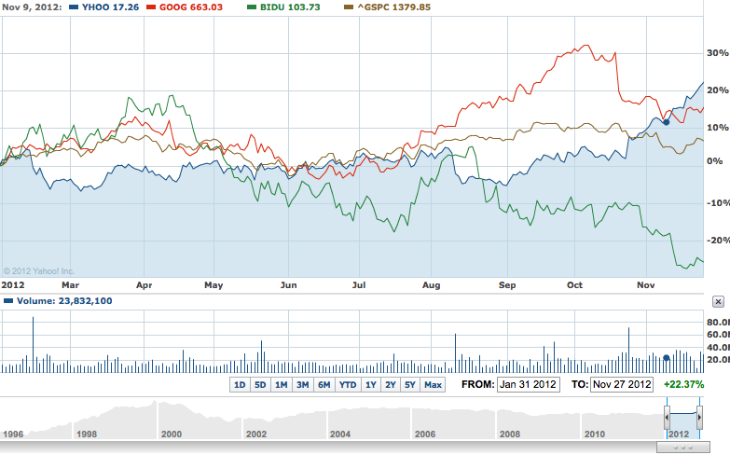
3. Show Multiple Variables
Show all related variables simultaneously.
Users should be able to hide some of the variables

Slide 15
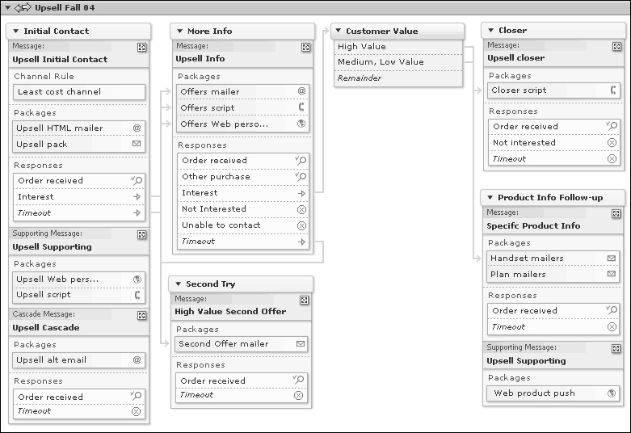
4. Integrate Text, Graphics, and Data
Pictures give an overview, but text and data give precision
Simply sticking both on-screen isn’t enough, because users may have a hard time connecting them

Slide 16
5. Ensure Quality, Relevance and Integrity
Don’t show data just because it’s available
Consider the users’ goals
Display information or data only if it supports those goals
Incorrect or unneeded data :
Slows users down
Damages their trust
Increases errors on the part of users

Slide 17
6. Show Things Adjacently in Space
Feb 1: Project assigned
Feb 15: Statement of intent
Feb 22: User Profile
Feb 1: Project assigned
Mar 1: Interface Goals
Feb 15: Statement of intent
Feb 22: User Profile
Mar 1: Interface Goals
Mar 22: Techno Demo
Mar 29: Screen Designs
Apr 19: Projects - Demos
May 3: Projects–non-Demos
Mar 22: Techno Demo
Mar 29: Screen Designs
Apr 19: Projects - Demos
May 3: Projects–non-Demos

Slide 18
7. Do Not De-quantify Quantifiable Data
Charts are good, but the numbers need to be available
poor
OK
better

Slide 19
Visual Element Summary
A visual interface must be
based on visual patterns

