Slide 1
ISA 562
Information Security, Theory and Practice.

Slide 2
What is computer security?
At it’s essence, it is an arms race!
Adversaries find vulnerabilities, and attack them.
Security experts find vulnerabilities and develop countermeasures.
Security managers try to deploy countermeasures, trace attacks, and recover from them.
Efforts to formalize the field
Build theoretical models and formal analysis of systems.
Efforts to at least organize the field
Categorize attack types, countermeasure types, etc.

Slide 3
C.I.A.
Confidentiality
Integrity
Availability

Slide 4
C.I.A.
Confidentiality: Preventing unauthorized access to the information.
Encryption
Access Control
User Authentication / identification
Physical security
Integrity
Availability

Slide 5
C.I.A.
Confidentiality
Integrity: ensuring that data is unaltered
Backups
Checksums
Error correcting codes
Message authentication and digital signatures
Availability
Notes:
Integrity: mention metadata, e.g. timestamps

Slide 6
C.I.A.
Confidentiality
Integrity
Availability: accessible when needed by those that are authorized
Physical protection from attacks and nature.
Redundancy of storage, servers, etc.
Notes:
Give example of credit card blacklists

Slide 7
A.A.A.A.
Assurance
Authenticity
Anonymity
Accountability

Slide 8
A.A.A.A.
Assurance: guarantee that the system provides the properties it has been trusted to provide.
Policies about how the system can be used by various users
Permissions of various users
Protection of the system through some security mechanism. Might include legal means, reputation, …
Not just about data, but also resources.
Authenticity
Anonymity
Accountability

Slide 9
A.A.A.A.
Assurance
Authenticity: a method for verifying that policies and permissions are genuine.
In other words: non-repudiation. People can’t go back on their word.
Solved by using digital signatures, which also provide integrity.
Anonymity
Accountability

Slide 10
A.A.A.A.
Assurance
Authenticity
Anonymity: certain records or actions cannot be attributed to a particular individual.
Aggregation and noise. (Differential privacy)
Mixing
Proxies, such as ToR
Accountability
Notes:
To provide authenticity and confidentiality, we need mechanism for proving our identity.
These open us to attack as well, as our identity become linked across the Internet.

Slide 11
A.A.A.A.
Assurance
Authenticity
Anonymity
Accountability: actions of an entity are traceable.
Non-repudiation of actions.
Supports after-action recovery and legal action.

Slide 12
C.I.A. Examples
Not all attacks have the same impact.
Both student grades, and student enrollment are regulated by FERPA. An attack revealing either would be an attack on confidentiality, but, clearly grade information is more sensitive than enrollment.
Medical data is an asset with a high requirement for integrity. Lives could be at stake if someone changes the information. Bus schedules have a medium requirement.
Availability: a system for tracking the current location of police officers in a large city would have high need for availability. My course website has a low need.

Slide 13
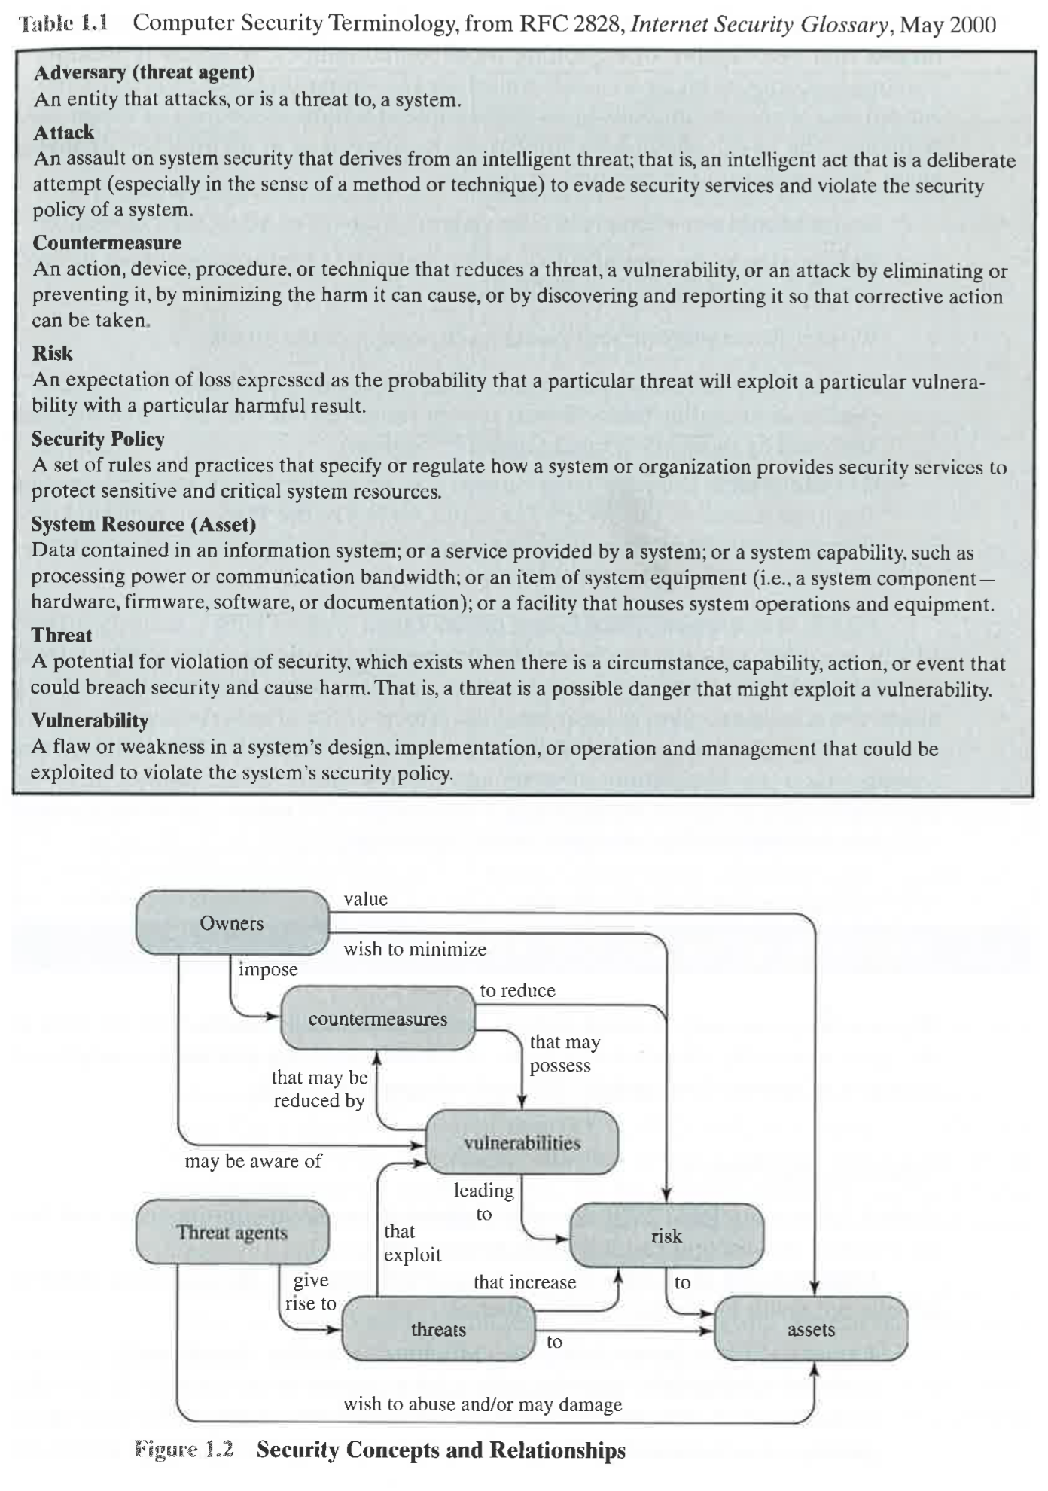
Terminology
Source: Computer Security, Principles and Practice. William Stallings, Lawrie Brown

Slide 14
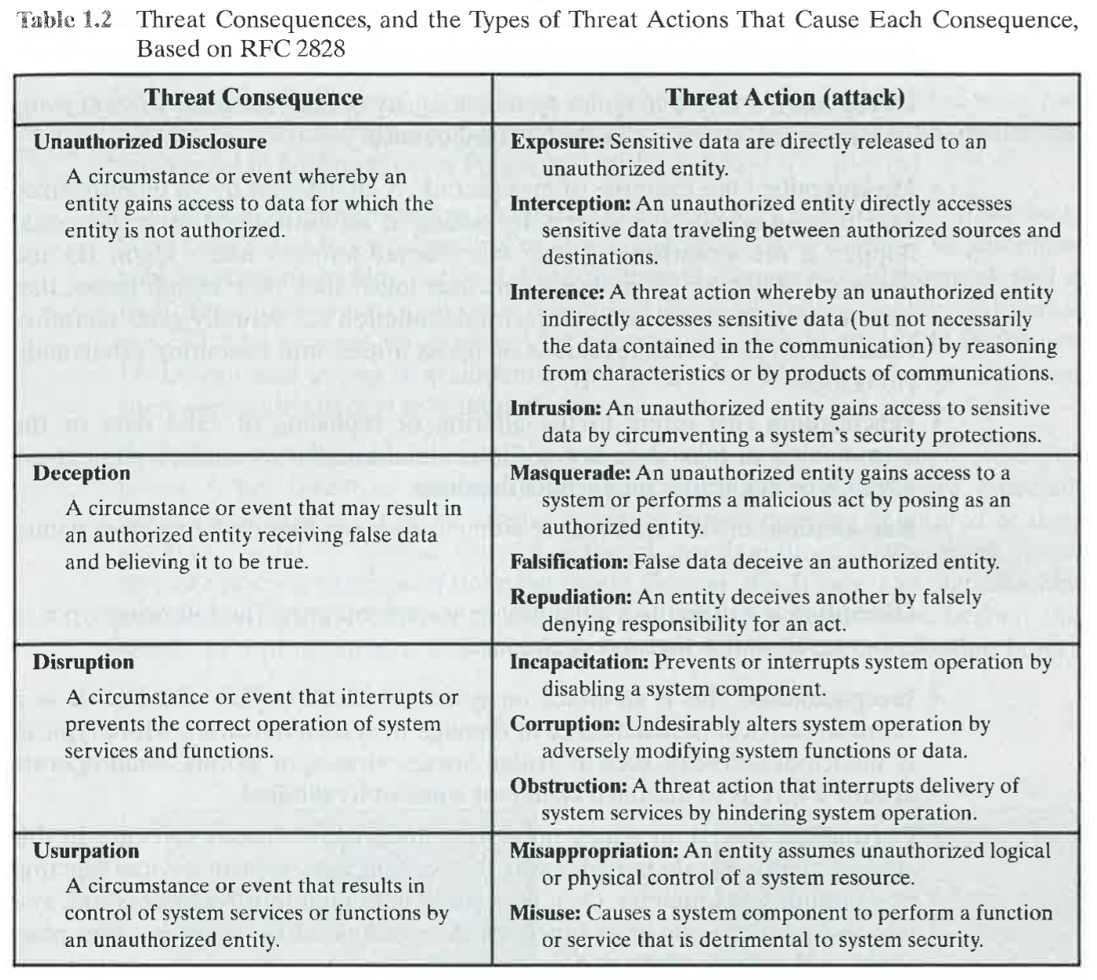
Attacks and consequences
Source: Computer Security, Principles and Practice. William Stallings, Lawrie Brown

Slide 15
Assets
Hardware
Software
Data
Communication lines and networks

Slide 16
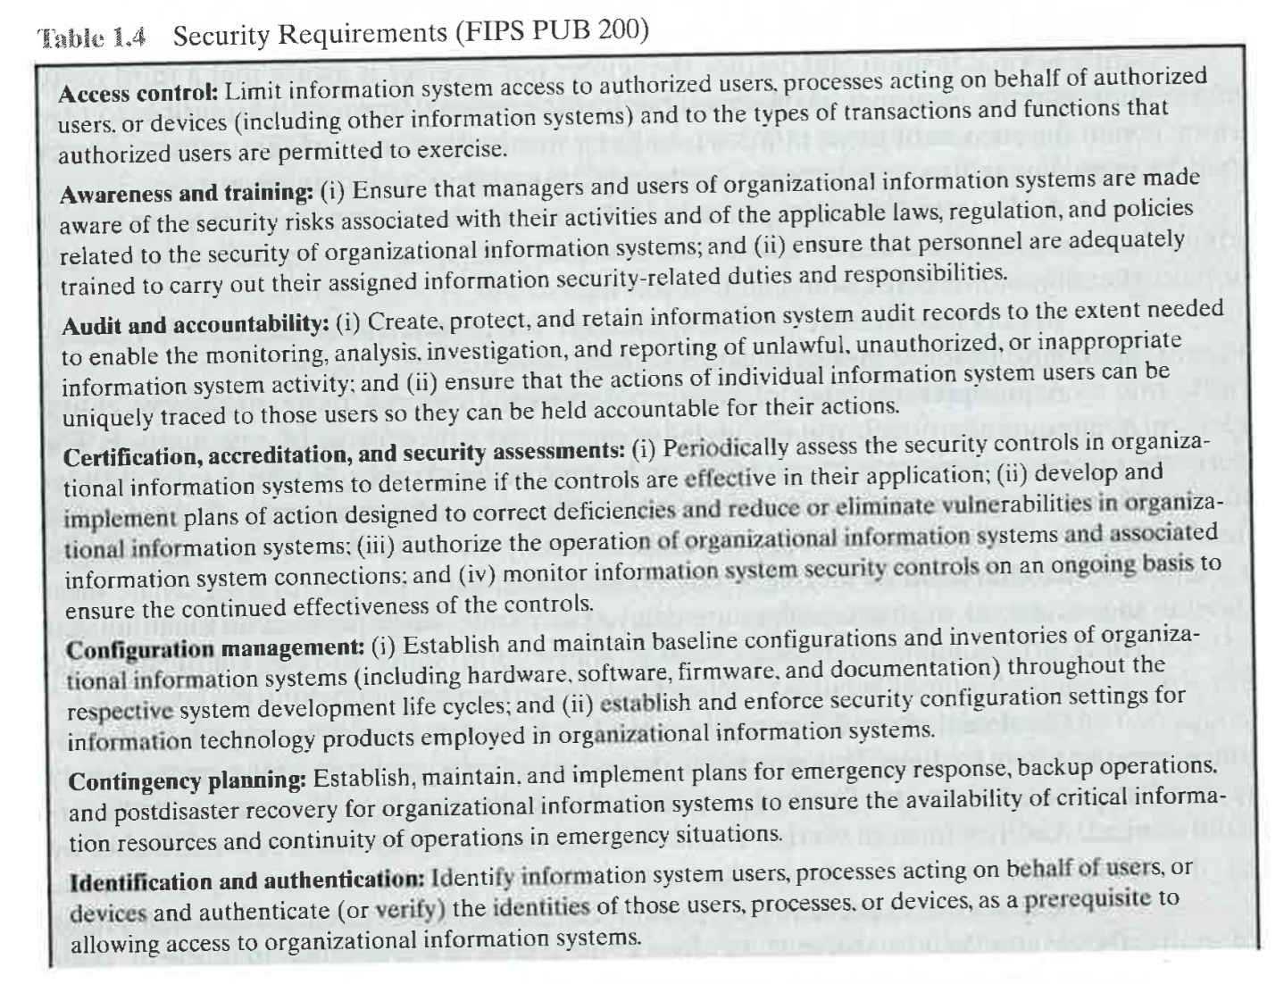
Countermeasures
Source: Computer Security, Principles and Practice. William Stallings, Lawrie Brown

Slide 17
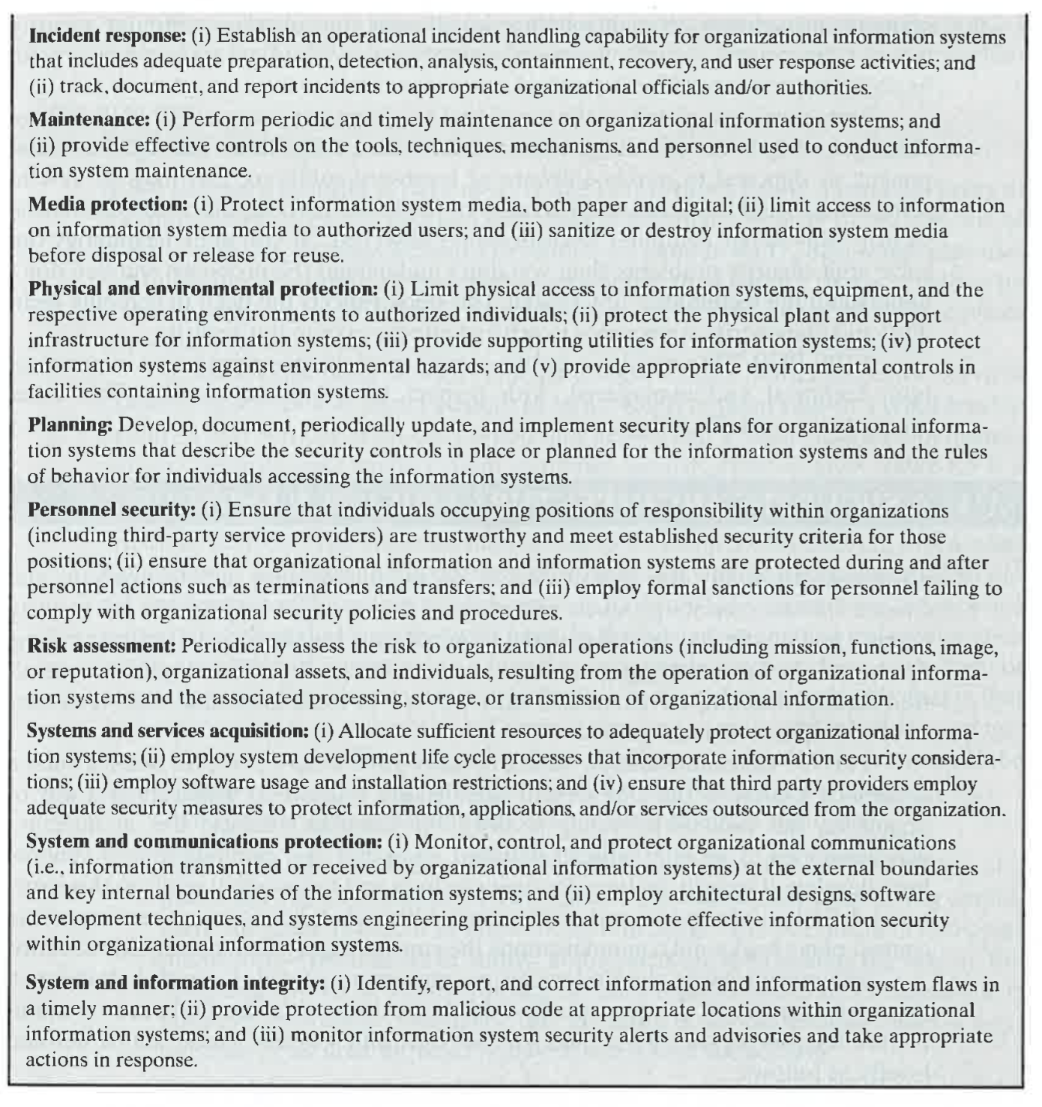
Countermeasures
Source: Computer Security, Principles and Practice. William Stallings, Lawrie Brown

Slide 18
Overall strategy
Security Policy
Value of assets
Vulnerabilities of the system
Potential threats and likelihood of attacks
Ease of use vs. security gains.
Cost of security vs. cost of failure and recovery.
Source: Computer Security, Principles and Practice. William Stallings, Lawrie Brown

Slide 19
Overall strategy
Security Implementation
Prevention
Detection
Response
Recovery
Source: Computer Security, Principles and Practice. William Stallings, Lawrie Brown

Slide 20
Overall strategy
Assurance and Evaluation
How sure are we that the system meets the policy requirements?
Assurance is a degree of confidence. Quantifying and evaluating it formally is nearly impossible.
Evaluation through testing, possibly using some formal or technical means, and also through human attempts at penetration.
Source: Computer Security, Principles and Practice. William Stallings, Lawrie Brown

