Slide 1
CS451Real-time Rendering Pipeline
Jyh-Ming Lien
Department of Computer SCience
George Mason University
Based on Tomas Akenine-Möller’s lecture note

Slide 2
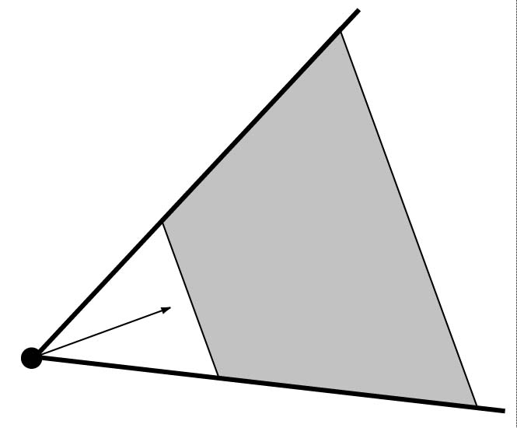
You say that you render a ”3D scene”, but what does it mean?
First of all, to take a picture, it takes a camera
Decides what should end up in the final image
Create image of geometry inside gray region
Used by OpenGL, DirectX, ray tracing, etc.
far
dir
near
Point
camera
fov (angle)

Slide 3
You say that you render a ”3D scene”, but what does it mean?
A 3D scene includes:
Geometry (triangles, lines, points, and more)
A triangle consists of 3 vertices
A vertex is 3D position, and may
Material properties of geometry
Light sources
Textures (images to glue onto the geometry)
Let us take a look at OBJ format
include normals, texture coordinates and more

Slide 4
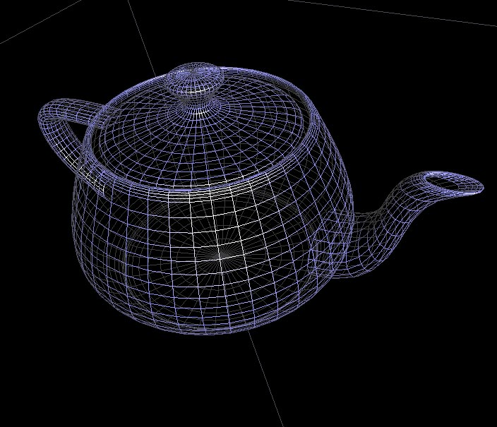
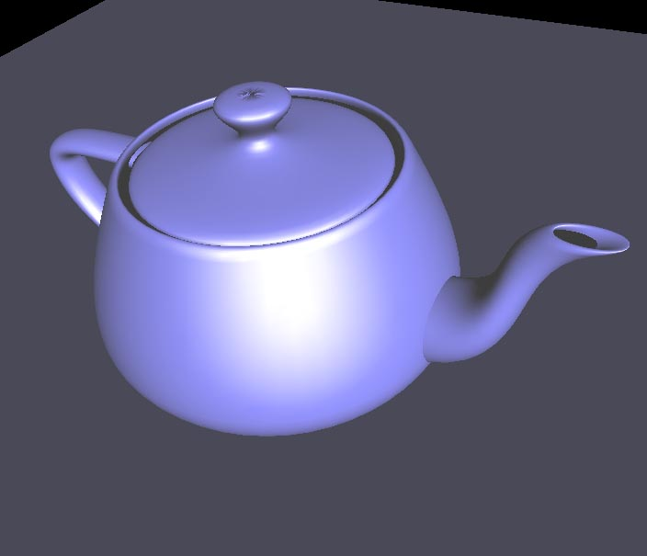
Rendering Primitives
Use graphics hardware (GPU) for real time computation…
These GPUs can render points, lines, triangles very efficiently
A surface is thus an approximation by a number of such primitives

Slide 5
Fixed-Function Pipeline
From chapter 2 in the RTR book
The pipeline is the ”engine” that creates images from 3D scenes
Three conceptual stages of the pipeline:
Application (executed on the CPU)
Geometry
Rasterizer
3D
scene
Application
Geometry
Rasterizer
Image
input
Game
CAD/Maya
GIS
Transformation matrices
(World, View, Projection)
Textures / Color
Lighting information
output

Slide 6
Back to the pipeline: The APPLICATION stage
Application
Geometry
Rasterizer
Executed on the CPU
Means that the programmer decides what happens here
Examples:
Collision detection
Speed-up techniques
Animation
Most important task: send rendering primitives (e.g. triangles) to the graphics hardware

Slide 7
The GEOMETRY stage
Application
Geometry
Rasterizer
Task: ”geometrical” operations on the input data (e.g. triangles)
Allows:
Move objects (matrix multiplication)
Move the camera (matrix multiplication)
Compute lighting at vertices of triangle
Project onto screen (3D to 2D matrix multiplication)
Clipping (remove triangles outside the screen)
Map to window

Slide 8
Animate objects and camera
Application
Application
Geometry
Geometry
Rasterizer
Rasterizer
Can animate in many different ways with 4x4 matrices
Example:
Before displaying a torus on screen, a matrix that represents a rotation can be applied. The result is that the torus is rotated.
Same thing with camera (this is possible since motion is relative)

Slide 9
The RASTERIZER stage
Application
Geometry
Rasterizer
Main task: take output from GEOMETRY and turn into visible pixels on screen
add textures and various other per-pixel operations
And visibility is resolved here: sorts the primitives in the z-direction

Slide 10
Rewind! Let’s take a closer look
The programmer ”sends” down primtives to be rendered through the pipeline (using API calls)
The geometry stage does per-vertex operations
The rasterizer stage does per-pixel operations
Next, scrutinize geometry and rasterizer

Slide 11
GEOMETRY stage in more detail
Application
Application
Geometry
Geometry
Rasterizer
Rasterizer
The model transform
Originally, an object is in model space
Move, orient, and transform geometrical objects into world space
Ex: a sphere is defined with origin at (0,0,0) with radius 1
Translate, rotate, scale to make it appear elsewhere
Done per vertex with a 4x4 matrix multiplication
How does the matrix look like? Can it be any 4x4 matrix?

Slide 12
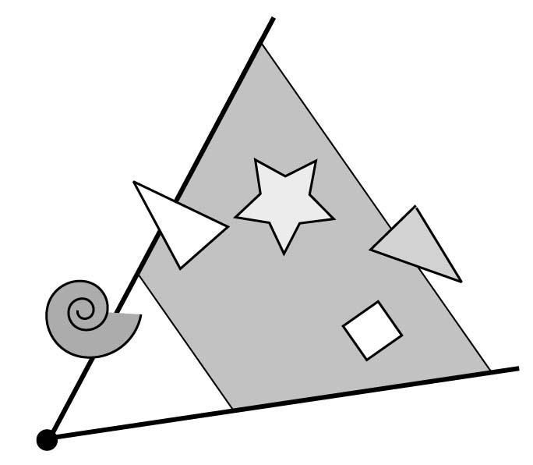
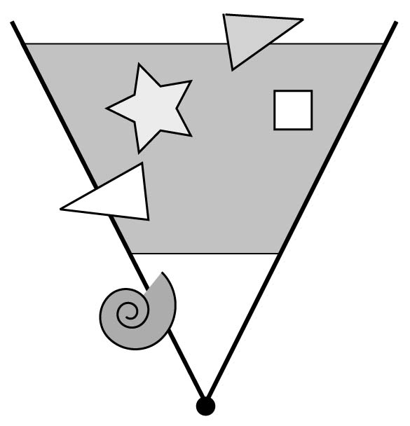
The view transform
Application
Application
Geometry
Geometry
Rasterizer
Rasterizer
You can move the camera in the same manner
But apply inverse transform to objects, so that camera looks down negative z-axis (as in OpenGL)
z
x

Slide 13
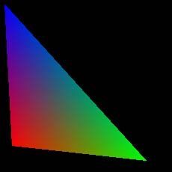
Lighting
Application
Application
Geometry
Geometry
Rasterizer
Rasterizer
Compute lighting at vertices
white
light
Rasterizer
blue
Geometry
white
white
red
green
mimics how light in nature behaves
uses empirical models, hacks, and some real theory
Much more about this in later lectures

Slide 14
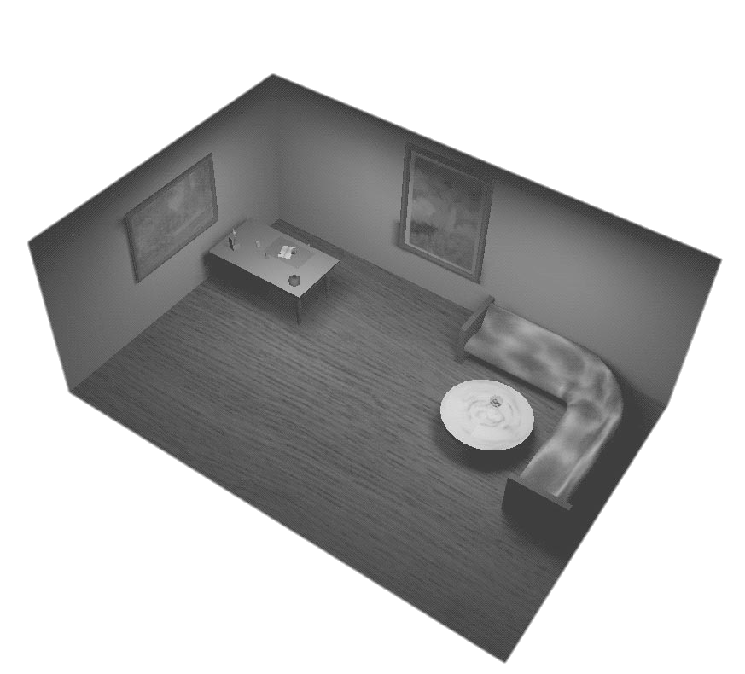
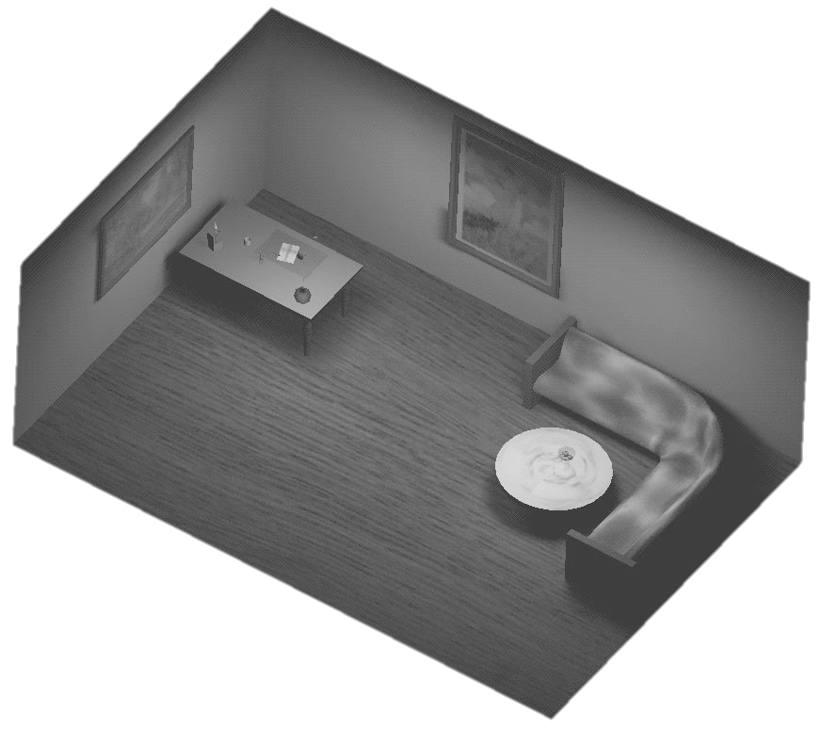
Projection
Application
Application
Geometry
Geometry
Rasterizer
Rasterizer
Two major ways to do it
Orthogonal (useful in fewer applications)
Perspective (most often used)
Mimics how humans perceive the world, i.e., objects’ apparent size decreases with distance
Orthogonal
Perspective

Slide 15
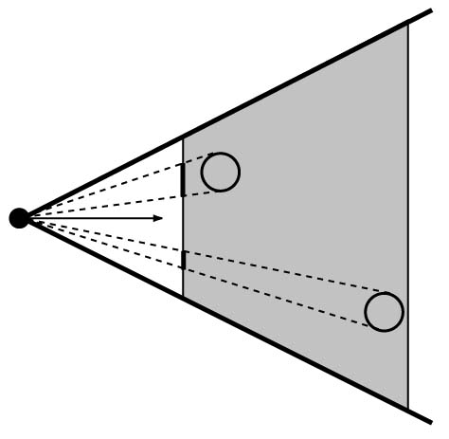
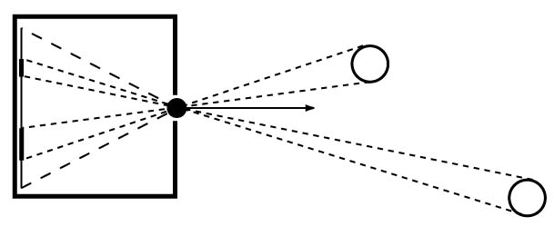
Projection
Application
Application
Geometry
Geometry
Rasterizer
Rasterizer
Also done with a matrix multiplication
Pinhole camera (left), analog used in CG (right)
rendered
image
Frustum
film
Pinhole camera
CG camera

Slide 16
Clipping and Screen Mapping
Application
Application
Geometry
Geometry
Rasterizer
Rasterizer
Square (cube) after projection
Clip primitives to square
Screen mapping, scales and translates square so that it ends up in a rendering window
These screen space coordinates together with Z (depth) are sent to the rasterizer stage

Slide 17
Summary
Application
Application
Geometry
Geometry
Rasterizer
Rasterizer
model space
world space
world space
camera space
clip
map to screen
projection
image space
compute lighting

Slide 18
The RASTERIZER in more detail
Application
Geometry
Rasterizer
Scan-conversion
Find out which pixels are inside the primitive
Texturing
Put images on triangles
Interpolation over triangle
Z-buffering
Make sure that what is visible from the camera really is displayed
Double buffering
And more…

Slide 19
Scan conversion
Application
Application
Geometry
Geometry
Rasterizer
Rasterizer
Triangle vertices from GEOMETRY is input
Find pixels inside the triangle
Or on a line, or on a point
Do per-pixel operations on these pixels:
Interpolation
Texturing
Z-buffering
And more…

Slide 20
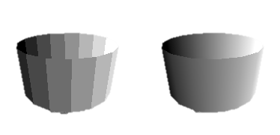
Interpolation
Application
Geometry
Rasterizer
Interpolate colors over the triangle
Called Gouraud interpolation
blue
red
green
flat
Gouraud

Slide 21
Texturing
Application
Geometry
Rasterizer
texturing is like gluing images onto geometrical object
+
=
Uses and other applications
More realism
Bump mapping
Pseudo reflections
Light mapping
... many others
Bump mapping

Slide 22
Z-buffering
The graphics hardware is pretty stupid
It ”just” draws triangles
However, a triangle that is covered by a more closely located triangle should not be visible
Assume two equally large tris at different depths
incorrect
correct
Triangle 1
near
Triangle 2
far
Draw 1 then 2
Draw 2 then 1

Slide 23
Z-buffering
Application
Geometry
Rasterizer
Would be nice to avoid sorting…
The Z-buffer (aka depth buffer) solves this
Idea:
Store z value (depth) at each pixel
When scan-converting a triangle, compute z at each pixel on triangle
Compare triangle’s z to Z-buffer z-value
If triangle’s z is smaller, then replace Z-buffer and color buffer
Else do nothing
Can render in any order (if no blending is involved)

Slide 24
Double buffering
Application
Geometry
Rasterizer
The monitor displays one image at a time
So if we render the next image to screen, then rendered primitives pop up
And even worse, we often clear the screen before generating a new image
A better solution is ”double buffering”

Slide 25
Double buffering
Application
Geometry
Rasterizer
Use two buffers: one front and one back
The front buffer is displayed
The back buffer is rendered to
When new image has been created in back buffer, swap front and back

Slide 26
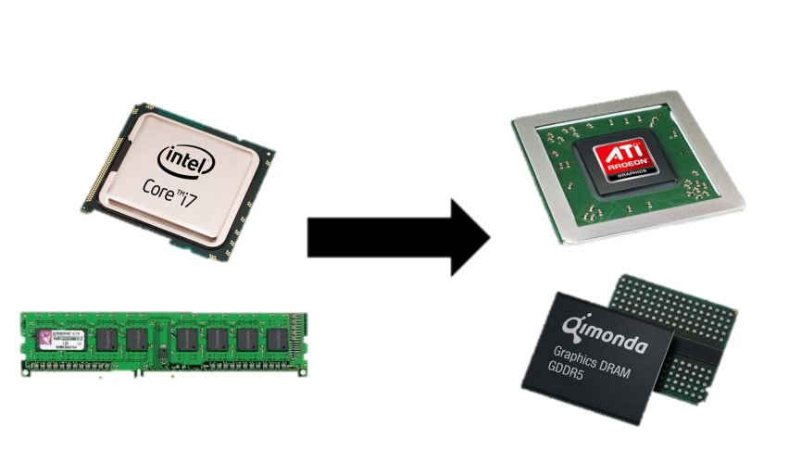
Programmable pipeline
Application
Geometry
Rasterizer
Programmable shading has become a hot topic
Vertex shaders
Pixel shaders
Adds more control and much more possibilities for the programmer
bus
HARDWARE
Application
Geometry
Rasterizer
CPU
Very general
Command GPU
GPU
Highly specialized
e.g, vector calculations
Highly parallelized
Vertex shader
program
Pixel shader
program
More to come when we talk about shaders!!

