Slide 1
CS451 Ambient Occlusion
Jyh-Ming Lien
Department of Computer SCience
George Mason University
Most materials are from “Reaistic Ray Tracing” by Shirley and Morley

Slide 2
BRDF
BRDF (bidirectional reflectance distribution function)
A 4D function $ρ(k_{i},k_{o})$ where $k_{i}$ and $k_{o}$ are points on the hemisphere
$ρ(k_{i},k_{o})$ defines the reflectance of all possible incoming and outgoing directions
For ideal diffuse surface Lambertian $ρ(k_{i},k_{o})$ is a constant

Slide 3
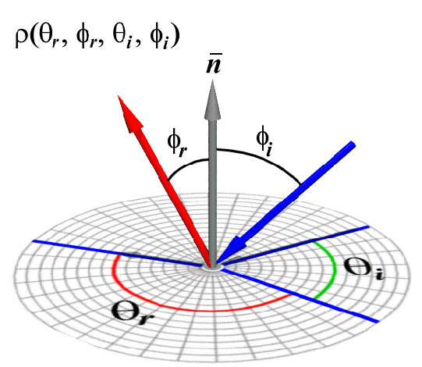
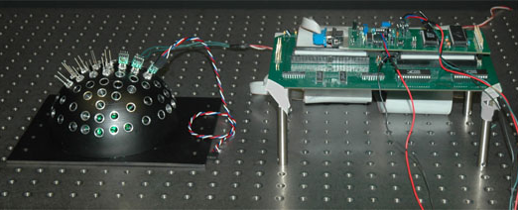
BRDF
BRDF $ρ(k_{i},k_{o})$
BRDF Measurement Device
Ben-Ezra et al. CVPR08

Slide 4
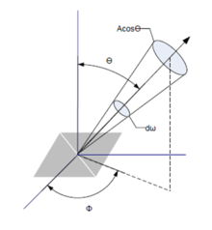
Radiance
How much light hits a point $x$ from a given direction
Imagine a truncated cone placed around the point $x$
Solid angle, steradiance, between $0$ and $4π$
The truncated cone can tilt around the hemisphere centered at $x$
radiance $L=\frac{ΔΦ}{∆ω\cos{θ}}$ has unit $J$/$sec$/$m^{2}$/$nm$/$steradiance$
Important: Radiance is invariant to the distance to light
Finally, the irradiance $Φ$ at $x$ from all directions is
$Φ=\int_{ω}{L\left(ω\right)\cos{θ}}dω=\int_{φ=0}^{2π}{\int_{θ=0}^{\frac{π}{2}}{L(φ,θ)\cos{θ}\sin{θ}{dθ}dφ}}$

Slide 5
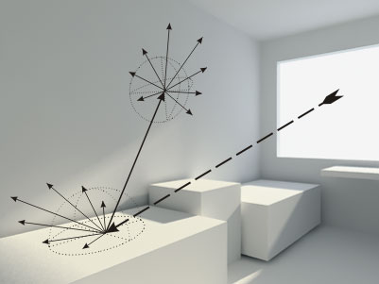
Path Tracing
What do we do with all these?
Think about path tracing
A photon comes out from a light source
With certain wave length, direction, and energy
Hit a surface in direction $k_{i}$
Leaves the surface in direction $k_{o}$
$ρ(k_{i},k_{o})$ is applied to determine the new properties of the photon
The photon continues to hit surfaces until it hits the film (near camera plane)
http://blender3d.cz/others/tnt/

Slide 6
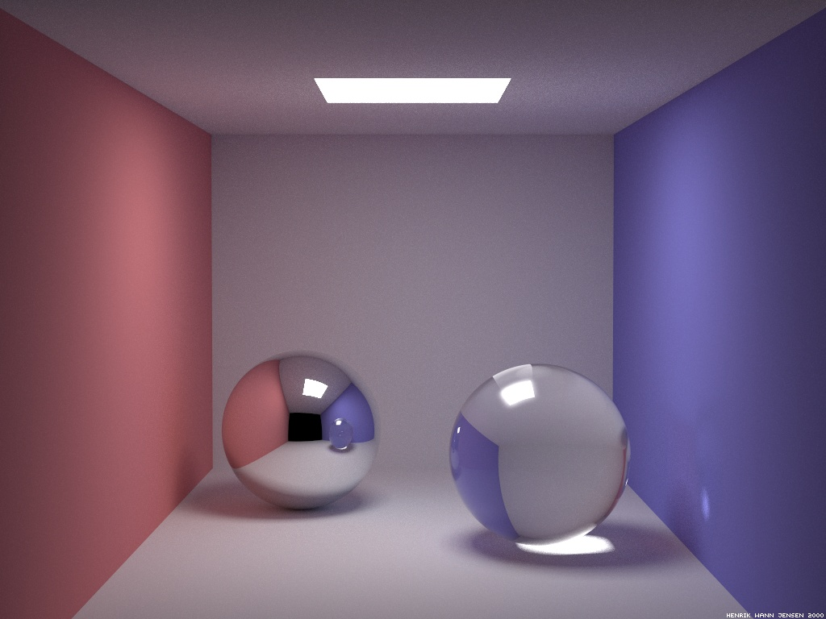
Path Tracing
What is the difference between your ray tracing and this path traced image?
http://www.thepolygoners.com/tutorials/GIIntro/GIIntro.htm

Slide 7
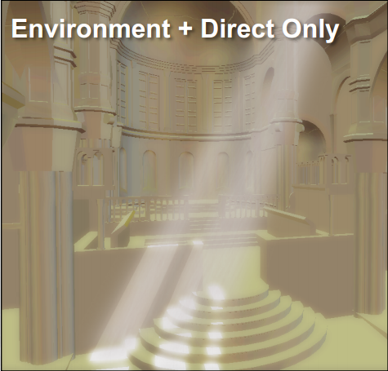
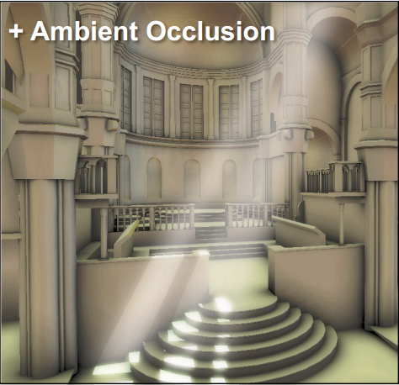
Ambient Occlusion
So far, our ambient term is merely a constant
Ambient occlusion is a global illumination method that allows us better estimate the ambient term
Render objects as if place them in a cloudy day

Slide 8
Basic idea of Ambient Occlusion
Less occluded
More occluded

Slide 9
Ambient Occlusion
Formulation
Ambient = $\frac{1}{π}\int{L(ω)⋅V⋅\left(ω⋅n\right)dω}$
Recall that$L(ω)$ is radiance from the direction of $ω$
$L(ω)$ is usually assumed to be a constant
$V$ is an indicator function
0 if the steradiance $ω$ is blocked
1 otherwise
$$n$$
$$ω$$
$$x$$

Slide 10
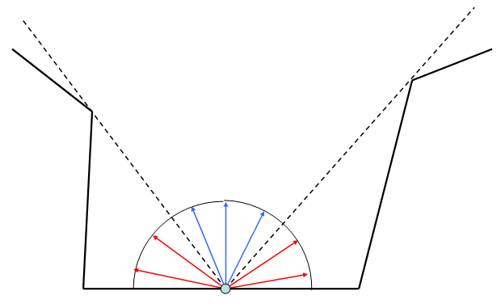
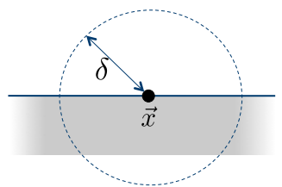
Ambient Occlusion
Approximate using ray tracing
Shoot $N$ rays in the open direction
Detect if a ray can see the sky
Occlusion is then $\frac{n}{N}$ if $n$ rays are blocked
Practically, we should define a range $δ$ as the influence range
If the ray hits something in the ball of radius $δ$ then the ray is blocked
Otherwise the ray is free
nonoccluded
rays
occluded rays

Slide 11
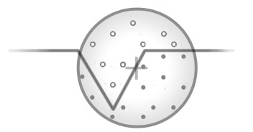
Variants of AO Approximations
Ray traced AO
Crytek SSAO (used in Crysis)
Use fragment shader per-pixel depth information
Sample in sphere around the given point
Project each sample to screen space to get the coordinates into the depth buffer
If the sample is behind the depth in the buffer, it contributes to the occlusion factor
http://john-chapman-graphics.blogspot.com/2013/01/ssao-tutorial.html

Slide 12
Screen-Space Ambient Occlusion (SSAO)

Slide 13
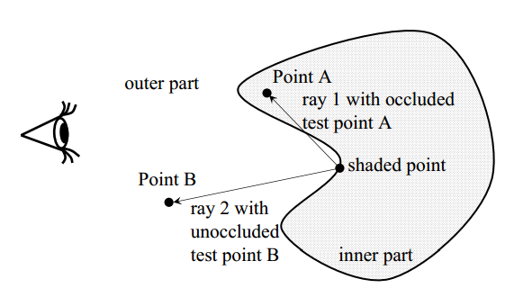
Variants of AO Approximations
Volumetric AO
measures how big portion of the tangent sphere of the surface belongs to the set of occluded points
Fastest screen-space method
Replacing ray tracing by contain-ment tests

Slide 14
Volumetric Ambient Occlusion

Slide 15
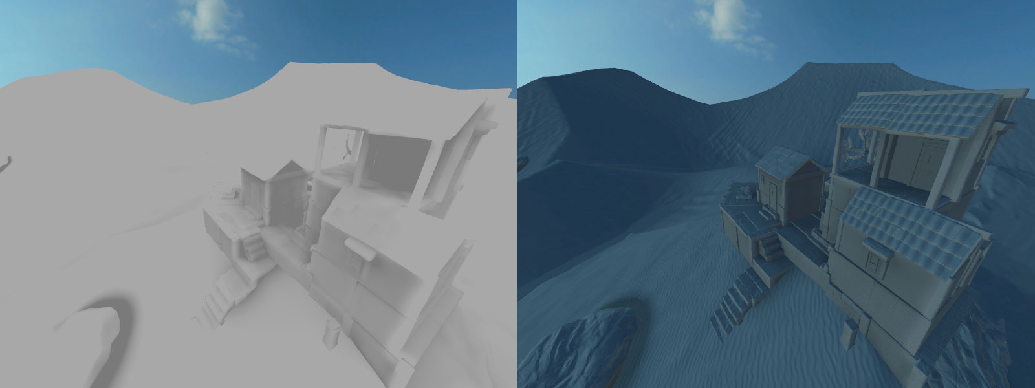
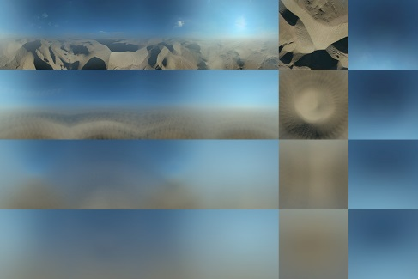
Variants of AO Approximations
Image-based ambient light
Using cube-map, environment map, etc, to determine $L(ω)$
By David Rosen
Blur image to reduce alias

Slide 16
Conclusion
We briefly introduced BRDF
We go over the basic ideas of ambient occlusion
There are many variants for ambient occlusion approximation
Ray tracing (slow but most realistic)
Image-space ambient occlusion (fast but has artifacts)
ambient occlusion with cube map
….

