Slide 1
Modern Day Shape Fabrication

Slide 2
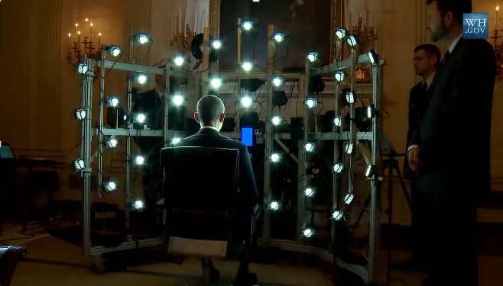
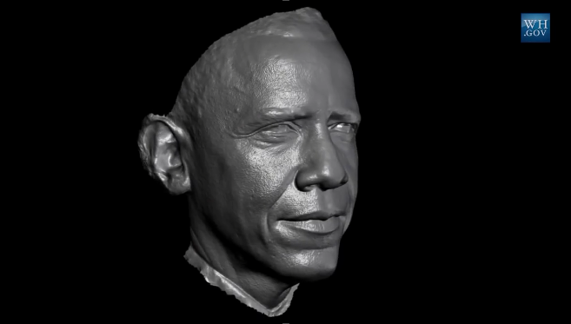
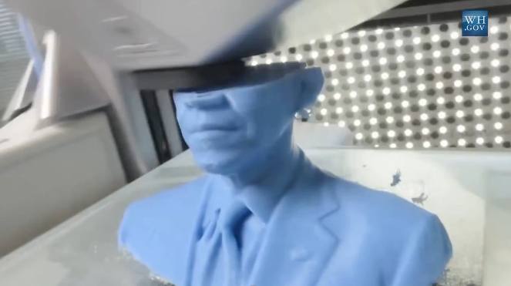
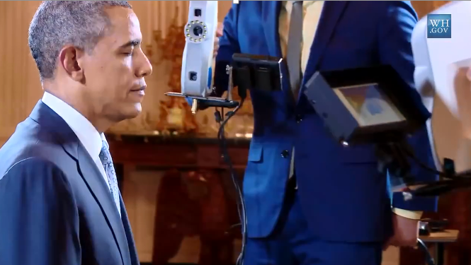
Main Steps in Digital Fabrication
Geometry processing
remove noise, fill holes
Fabrication
printing, sculpting
Shape acquisition
laser, structured light, sound

Slide 4
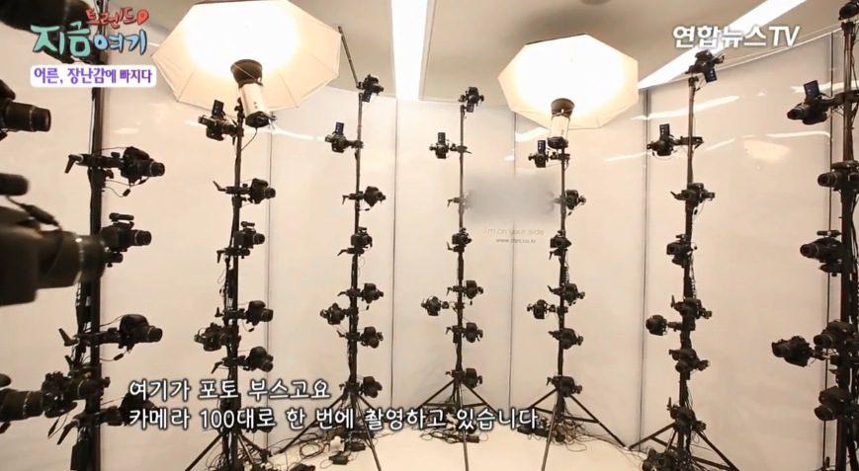
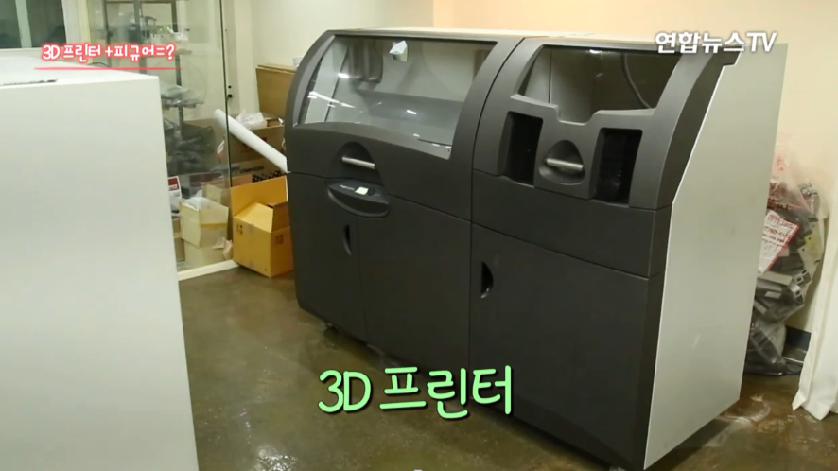
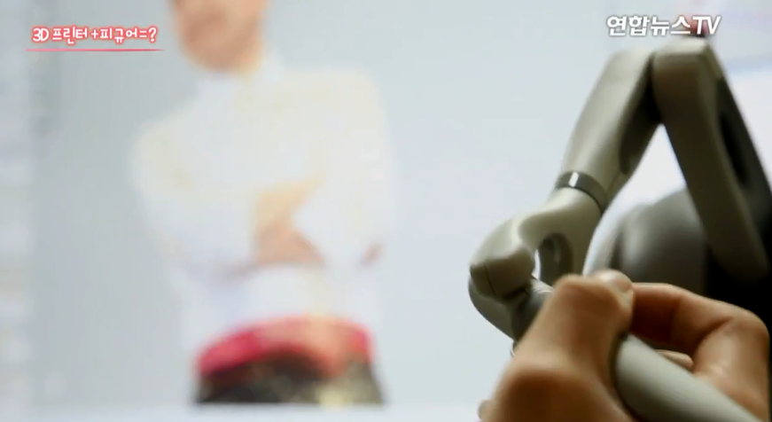
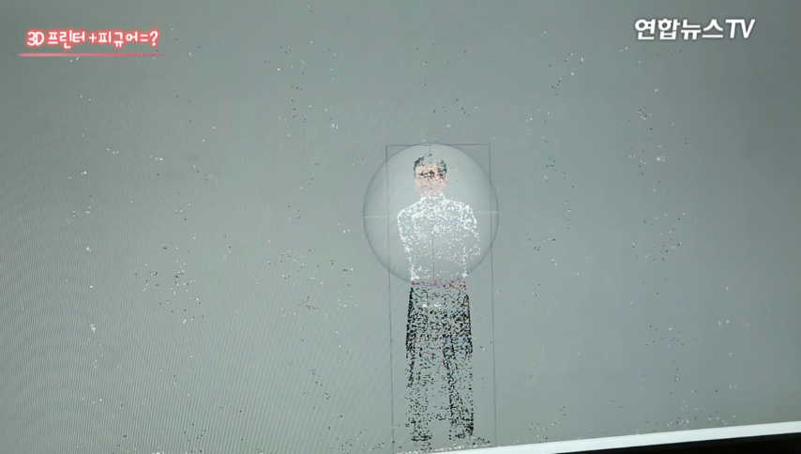
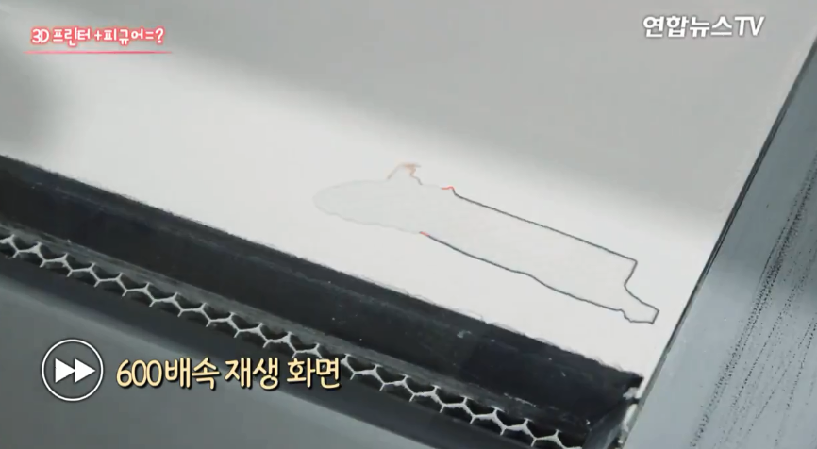
Main Steps in Digital Fabrication
Geometry processing
remove noise, fill holes
Shape acquisition
100 cameras
Fabrication
printing

Slide 5
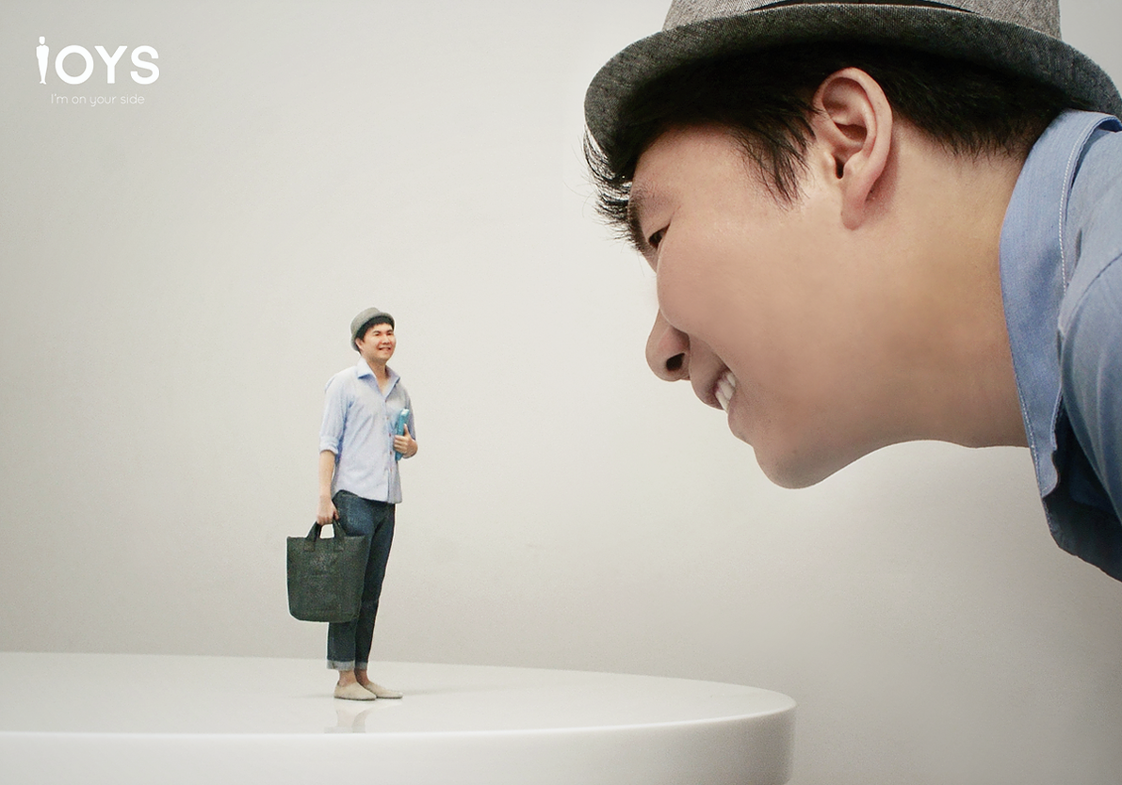
Too expensive
Too small (10~20cm)
http://www.ioys.co.kr/

Slide 6
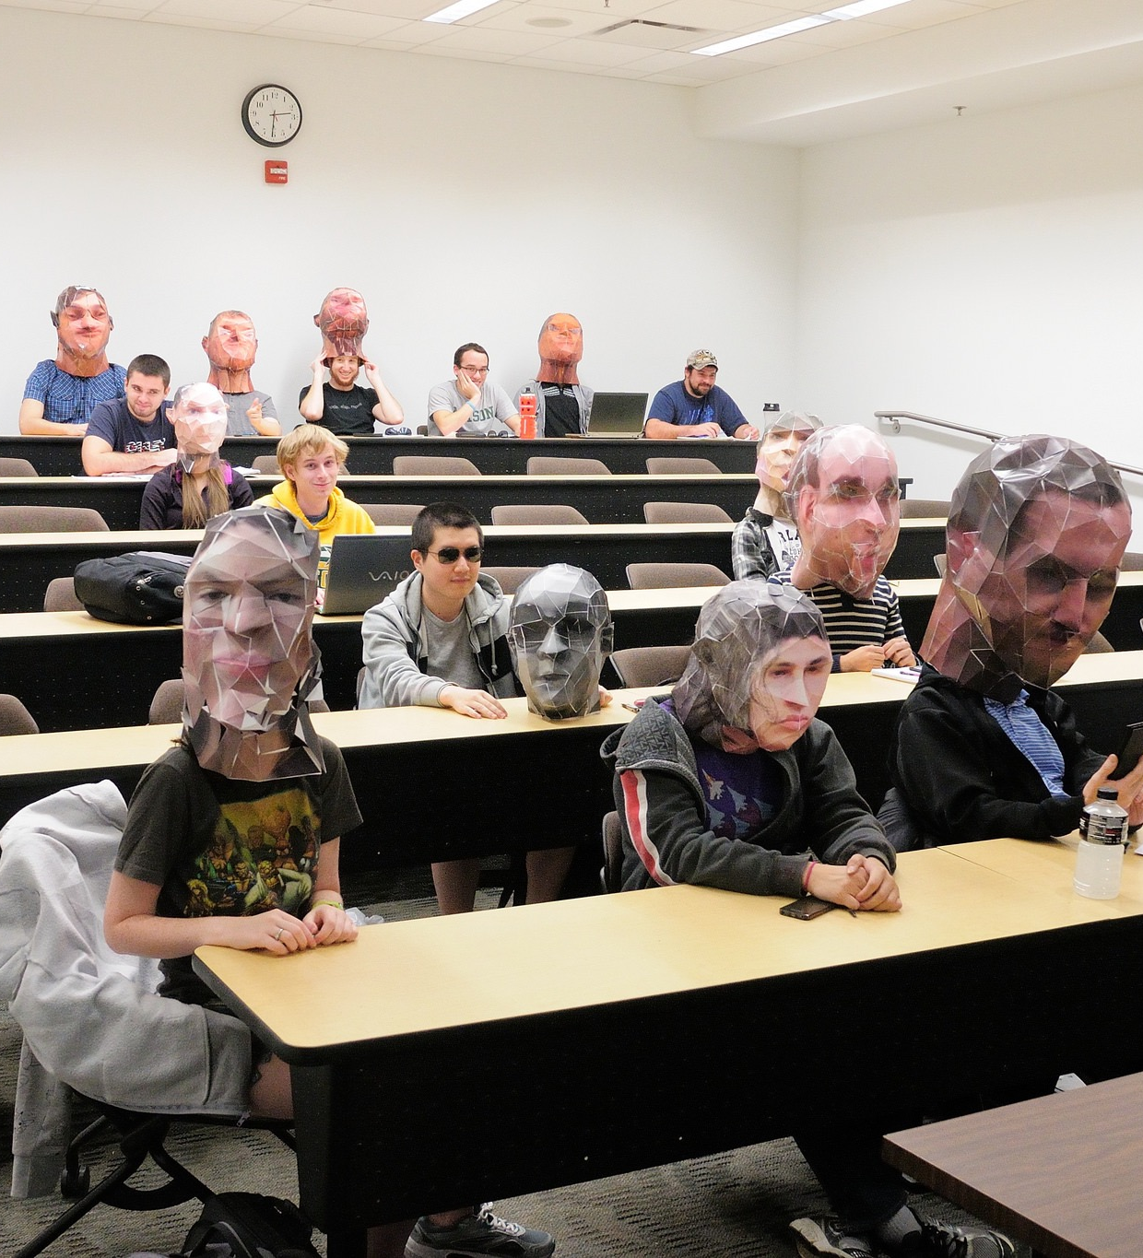
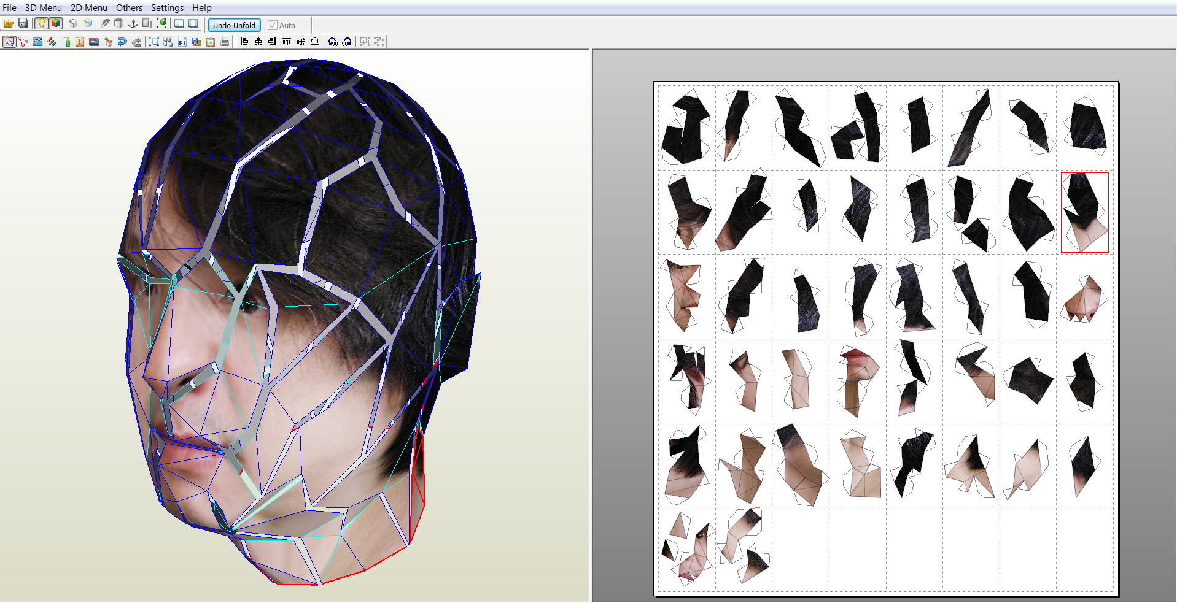
A Poor man’s Personal Fabrication
Personalized paper craft @ George Mason University

Slide 7
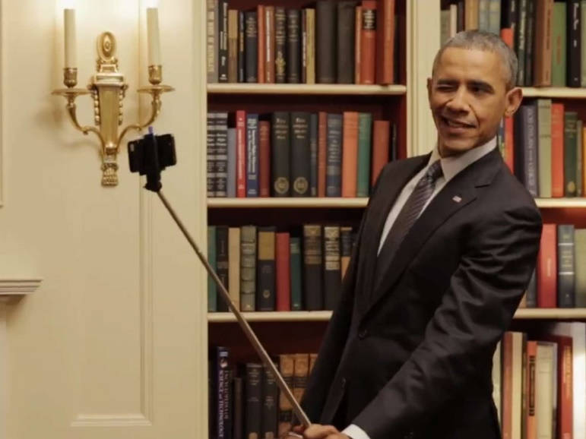
Make Your Own Personal Sculpture
Tools needed
digital camera (with GPS)
a computer
Paper (card stock)
2D printer (color)
Scissors (laser cutter)
Glue (hot glue gun)
Advantages
Very cheap
Can be made a big as you like
Have a chance to take many many selfies
Take as many selfies as possible

