Slide 1

Model-Driven Test Design
Jeff Offutt
Professor, Software Engineering
George Mason University
Fairfax, VA USA
www.cs.gmu.edu/~offutt/
offutt@gmu.edu

Slide 2
OUTLINE
Consequences of Poor Testing
Why is Testing Done so Poorly
Model-Driven Test Design
How to Improve Testing
Software Testing is Changing
We are in the middle of a revolution in how software is tested
Research is finally meeting practice

Slide 3



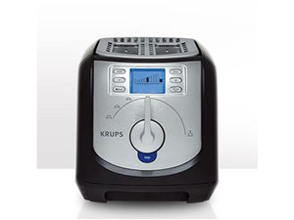

Software is a Skin that
Surrounds Our Civilization
Quote due to Dr. Mark Harman

Slide 4
Testing in the 21st Century
We are going through a time of change
Software defines behavior
  network routers, finance, switching networks, other infrastructure
Today’s software market :
  is much bigger
  is more competitive
  has more users
Embedded Control Applications
  airplanes, air traffic control
  spaceships
  watches
  ovens
  remote controllers
Agile processes put increased pressure on testers
Industry is going through a revolution in what testing means to the success of software products
  PDAs
  memory seats
  DVD players
  garage door openers
  cell phones

Slide 5

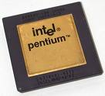
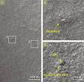
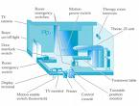
Why Does Testing Matter?
NIST report, “The Economic Impacts of Inadequate Infrastructure for Software Testing” (2002)
  Inadequate software testing costs the US alone between $22 and $59 billion annually
  Better approaches could cut this amount in half
Major failures: Ariane 5 explosion, Mars Polar Lander, Intel’s Pentium FDIV bug
Insufficient testing of safety-critical software can cost lives:
  THERAC-25 radiation machine: 3 dead
We need software to be reliable
  Testing is usually how we ascertain reliability
Ariane 5:
exception-handling
bug : forced self
destruct on maiden
flight (64-bit to 16-bit
conversion: about
370 million $ lost)
Mars Polar
Lander crash
site?
THERAC-25 design

Slide 6

Airbus 319 Software Malfunction
Loss of autopilot
Loss of most flight deck lighting and intercom
Loss of both the commander’s and the co‑pilot’s primary flight and navigation displays

Slide 7

NorthAm 2003 Northeast Blackout
508 generating units and 256 power plants shut down
Affected 10 million people in Ontario, Canada
Affected 40 million people in 8 US states
Financial losses of
$6 Billion USD
The alarm system in the energy management system failed due to a software error and operators were not informed of the power overload in the system

Slide 8

Failures in Production Software
NASA’s Mars lander, September 1999, crashed due to a units integration fault—over $50 million US !
Huge losses due to web application failures
  Financial services : $6.5 million per hour
  Credit card sales applications : $2.4 million per hour
In Dec 2006, amazon.com’s BOGO offer turned into a double discount
2007 : Symantec says that most security vulnerabilities are due to faulty software
Stronger testing could solve most of these problems
World-wide monetary loss due to poor software is staggering
Thanks to Dr. Sreedevi Sampath

Slide 9
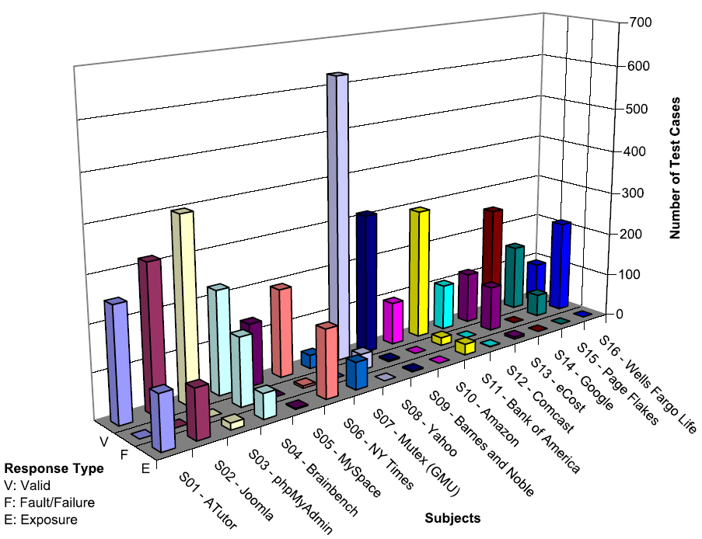
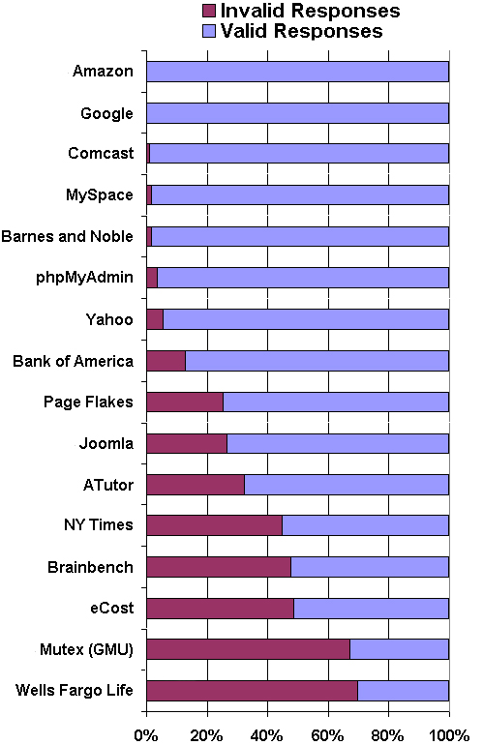
Web Application Problems
v
— Vasileios Papadimitriou. Masters thesis, Automating Bypass Testing for Web Applications, GMU 2006

Slide 10
Testing in the 21st Century
More safety critical, real-time software
Enterprise applications means bigger programs, more users
Embedded software is ubiquitous … check your pockets
Paradoxically, free software increases our expectations !
Security is now all about software faults
  Secure software is reliable software
The web offers a new deployment platform
  Very competitive and very available to more users
  Web apps are distributed
  Web apps must be highly reliable
Industry desperately needs researchers’ inventions !

Slide 11
OUTLINE
Consequences of Poor Testing
Why is Testing Done so Poorly
Model-Driven Test Design
How to Improve Testing
Software Testing is Changing

Slide 12
Software Testing—Academic View
1970s and 1980s : Academics looked almost exclusively at unit testing
  Meanwhile industry & government focused almost exclusively on system testing
1990s : Some academics looked at system testing, some at integration testing
  Growth of OO put complexity in the interconnections
2000s : Academics trying to move our rich collection of ideas into practice
  Reliability requirements in industry & government are increasing exponentially

Slide 13
Academics and Practitioners
Academics focus on coverage criteria with strong bases in theory—quantitative techniques
  Industry has focused on human-driven, domain-knowledge based, qualitative techniques
Practitioners said “criteria-based coverage is too expensive”
  Academics said “human-based testing is more expensive and ineffective”
Practice is going through a revolution in what testing means to the success of software products

Slide 14
How to Improve Testing ?
We need more and better software tools
  A stunning increase in available tools in the last 10 years!
We need to adopt practices and techniques that lead to more efficient and effective testing
  More education
  Different management organizational strategies
Testing / QA teams need to specialize more
  This same trend happened for development in the 1990s
Testing / QA teams need more technical expertise
  Developer expertise has been increasing dramatically

Slide 15
OUTLINE
Consequences of Poor Testing
Why is Testing Done so Poorly
Model-Driven Test Design
How to Improve Testing
Software Testing is Changing

Slide 16

Test Design in Context
Test Design is the process of designing input values that will effectively test software
Test design is one of several activities for testing software
  Most mathematical
  Most technically challenging
This process is based on my text book with Ammann, Introduction to Software Testing
http://www.cs.gmu.edu/~offutt/softwaretest/

Slide 17
Types of Test Activities
Testing can be broken up into four general types of activities
  Test Design
  Test Automation
  Test Execution
  Test Evaluation
Each type of activity requires different skills, background knowledge, education and training
No reasonable software development organization uses the same people for requirements, design, implementation, integration and configuration control
    1.a) Criteria-based
    1.b) Human-based
Why do test organizations still use the same people for all four test activities??
This clearly wastes resources

Slide 18
1. Test Design – (a) Criteria-Based
Design test values to satisfy coverage criteria or other engineering goal
This is the most technical job in software testing
Requires knowledge of :
  Discrete math, Programming, Testing
Requires much of a traditional CS degree
This is intellectually stimulating, rewarding, and challenging
Test design is analogous to software architecture on the development side
Using people who are not qualified to design tests is a sure way to get ineffective tests

Slide 19
1. Test Design – (b) Human-Based
Design test values based on domain knowledge of the program and human knowledge of testing
This is much harder than it may seem to developers
Criteria-based approaches can be blind to special situations
Requires knowledge of :
  Domain, testing, and user interfaces
Requires almost no traditional CS
  A background in the domain of the software is essential
  An empirical background is very helpful (biology, psychology, …)
  A logic background is very helpful (law, philosophy, math, …)
This is intellectually stimulating, rewarding, and challenging
  But not to typical CS majors – they want to solve problems and build things

Slide 20
2. Test Automation
Embed test values into executable scripts
This is slightly less technical
Requires knowledge of programming
  Fairly straightforward programming – small pieces and simple algorithms
Requires very little theory
Very boring for test designers
Programming is out of reach for many domain experts
Who is responsible for determining and embedding the expected outputs ?
  Test designers may not always know the expected outputs
  Test evaluators need to get involved early to help with this

Slide 21
3. Test Execution
Run tests on the software and record the results
This is easy –trivial if the tests are well automated
Requires basic computer skills
  Interns
  Employees with no technical background
Asking qualified test designers to execute tests is a sure way to convince them to look for a development job
If, for example, GUI tests are not well automated, this requires a lot of manual labor
Test executors have to be very careful and meticulous with bookkeeping

Slide 22
4. Test Evaluation
Evaluate results of testing, report to developers
This is much harder than it may seem
Requires knowledge of :
  Domain
  Testing
  User interfaces and psychology
Usually requires almost no traditional CS
  A background in the domain of the software is essential
  An empirical background is very helpful (biology, psychology, …)
  A logic background is very helpful (law, philosophy, math, …)
This is intellectually stimulating, rewarding, and challenging
  But not to typical CS majors – they want to solve problems and build things

Slide 23
Summary of Test Activities
1a. | Design | Design test values to satisfy engineering goals
 | Criteria | Requires knowledge of discrete math, programming and testing
1b. | Design | Design test values from domain knowledge and intuition
 | Human | Requires knowledge of domain, UI, testing
2. | Automation | Embed test values into executable scripts
 |  | Requires knowledge of scripting
3. | Execution | Run tests on the software and record the results
 |  | Requires very little knowledge
4. | Evaluation | Evaluate results of testing, report to developers
 |  | Requires domain knowledge
These four general test activities are quite different
It is a poor use of resources to use people inappropriately
Most test teams use the same people for ALL FOUR activities !!

Slide 24
Other Testing Activities
Test management : Sets policy, organizes team, interfaces with development, chooses criteria, decides how much automation is needed, …
Test maintenance : Tests must be saved for reuse as software evolves
  Requires cooperation between test designers and automators
  Deciding when to trim the test suite is partly policy and partly technical – and in general, very hard !
  Tests should be put in configuration control
Test documentation : All parties participate
  Each test must document “why” – criterion and test requirement satisfied or a rationale for human-designed tests
  Traceability throughout the process must be ensured
  Documentation must be kept in the automated tests

Slide 25
Number of Personnel
A mature test organization only needs one test designer to work with several test automators, executors and evaluators
Improved automation will reduce the number of test executors
  Theoretically to zero … but not in practice
Putting the wrong people on the wrong tasks leads to inefficiency, low job satisfaction and low job performance
  A qualified test designer will be bored with other tasks and look for a job in development
  A qualified test evaluator will not understand the benefits of test criteria
Test evaluators have the domain knowledge, so they must be free to add tests that “blind” engineering processes will not think of

Slide 26
Applying Test Activities
To use our people effectively
and to test efficiently
we need a process that
lets test designers
raise their level of abstraction

Slide 27
Model-Driven Test Design – Steps
criterion
refine
refined requirements / test specs
model / structure
test requirements
mathematical analysis
generate
test requirements
domain analysis
DESIGN
ABSTRACTION
LEVEL
IMPLEMENTATION
ABSTRACTION
LEVEL
software artifacts
input values
feedback
evaluate
execute
automate
prefix
postfix
expected
pass / fail
test results
test scripts
test cases

Slide 28
MDTD – Activities
refined requirements / test specs
Here
be
math
model / structure
test requirements
Test Design
Test Design
DESIGN
ABSTRACTION
LEVEL
Raising our abstraction level makes
test design MUCH easier
IMPLEMENTATION
ABSTRACTION
LEVEL
software artifact
input values
Test Automation
pass / fail
test results
test scripts
test cases
Test Evaluation
Test Execution

Slide 29
Using MDTD in Practice
This approach lets one test designer do the math
Then traditional testers and programmers can do their parts
  Find values
  Automate the tests
  Run the tests
  Evaluate the tests
Testers ain’t mathematicians !

Slide 30
OUTLINE
Consequences of Poor Testing
Why is Testing Done so Poorly
Model-Driven Test Design
How to Improve Testing
Software Testing is Changing

Slide 31
Mismatch in Needs and Goals
Industry & contractors want simple and easy testing
  Testers with no background in computing or math
Universities are graduating scientists
  Industry needs engineers
Testing needs to be done more rigorously
Agile processes put lots of demands on testing
  Programmers have to do unit testing – with no training, education or tools !
  Tests are key components of functional requirements – but who builds those tests ?
Bottom line result—lots of poor software

Slide 32
How to Improve Testing ?
Testers need more and better software tools
Testers need to adopt practices and techniques that lead to more efficient and effective testing
  More education
  Different management organizational strategies
Testing / QA teams need more technical expertise
  Developer expertise has been increasing dramatically
Testing / QA teams need to specialize more
  This same trend happened for development in the 1990s

Slide 33
Four Roadblocks to Adoption
Lack of test education
Necessity to change process
Usability of tools
Weak and ineffective tools
Bill Gates says half of MS engineers are testers, programmers spend half their time testing
Number of UG CS programs in US that require testing ?
0
Number of MS CS programs in US that require testing ?
0
~20
Number of UG testing classes in the US ?
Adoption of many test techniques and tools require changes in development process
This is very expensive for most software companies
Many testing tools require the user to know the underlying theory to use them
Do we need to understand an internal combustion engine to drive ?
Do we need to understand parsing and code generation to use a compiler ?
Most test tools don’t do much – but most users do not realize they could be better
Few tools solve the key technical problem – generating test values automatically

Slide 34
OUTLINE
Consequences of Poor Testing
Why is Testing Done so Poorly
Model-Driven Test Design
How to Improve Testing
Software Testing is Changing

Slide 35
Needs From Researchers
Isolate : Invent processes and techniques that isolate the theory from most test practitioners
Disguise : Discover engineering techniques, standards and frameworks that disguise the theory
Embed : theoretical ideas in tools
Experiment : Demonstrate economic value of criteria-based testing and ATDG
  Which criteria should be used and when ?
  When does the extra effort pay off ?
Integrate high-end testing with development

Slide 36
Needs From Educators
Disguise theory from engineers in classes
Omit theory when it is not needed
Restructure curriculum to teach more than test design and theory
  Test automation
  Test evaluation
  Human-based testing
  Test-driven development

Slide 37
Changes in Practice
Reorganize test and QA teams to make effective use of individual abilities
  One math-head can support many testers
Retrain test and QA teams
  Use a process like MDTD
  Learn more of the concepts in testing
Encourage researchers to embed and isolate
  We are very responsive to research grants
Get involved in curricular design efforts through industrial advisory boards

Slide 38
Future of Software Testing
Increased specialization in testing teams will lead to more efficient and effective testing
Testing and QA teams will have more technical expertise
Developers will have more knowledge about testing and motivation to test better
Agile processes puts testing first—putting pressure on both testers and developers to test better
Testing and security are starting to merge
We will develop new ways to test connections within software-based systems

Slide 39
Contact
Jeff Offutt
offutt@gmu.edu
http://cs.gmu.edu/~offutt/

