Slide 1
Mobile Computing:
Smartphone and Wearable Sensing
CS 655: Wireless and Mobile Computing
Parth H. Pathak

Slide 2
Agenda
Sensor overview
  Accelerometer and gyroscope
Step counting
Heading detection
  Magnetometer and compass
  Use on WiFi localization
Gesture recognition
  Motion sensors on smartwatch
Voice sensing through accelerometer

Slide 3
Smartphone sensors
Accelerometer
Gyroscope
Magnetometer (compass)
Light (photodiode)
Pressure (Barometer)
Proximity
Temperature
Camera (imaging sensor)
BLE, WiFi
And others…

Slide 4
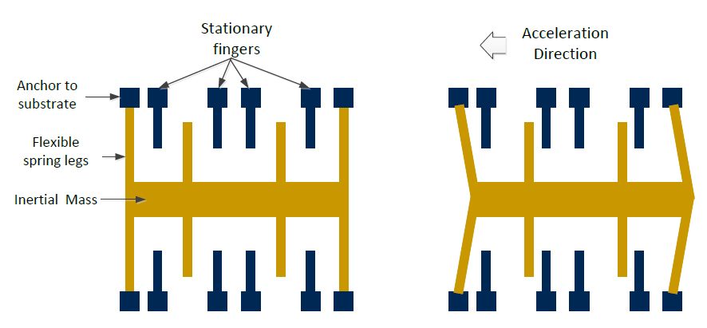
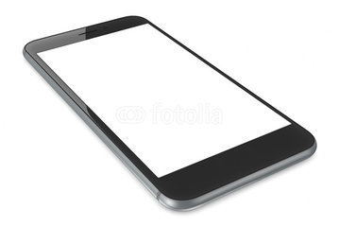
Accelerometer
Measures displacement of the device
  acceleration (m/s^2) in 3 axis of the phone
Z
X
Y

Slide 5
Accelerometer data
X
Z
X
Y
Y
Z
Why the baseline acceleration is close to 10 in Z axis?

Slide 6
Gyroscope
Measures the rotation of the device
  Radians/second around the 3 axis
Z
X
Y

Slide 7
Agenda
Sensor overview
  Accelerometer and gyroscope
Step counting
Heading detection
  Magnetometer and compass
  Use on WiFi localization
Gesture recognition
  Motion sensors on smartwatch
Voice sensing through accelerometer

Slide 8
Step counting
Pedometer in your smartphone
  Count steps using smartphone sensors
Quantified-self
  Measure your day-to-day activities
  Infer your habits – how much you move around, active/passive times
  Increase the active time
How to measure steps using smartphone?
  Use accelerometer
  Capture motion using accelerometer and see if the motion was a step

Slide 9
Step counting
Anatomy of a step
[1], [2]

Slide 10
Step counting
Anatomy of a step
Three different acceleration forces
  a = horizontal acceleration (acceleration in the direction of walking)
  h and g = vertical acceleration
[1]

Slide 11
Step counting
Acceleration in swing phases
[1]

Slide 12
Step counting
Acceleration in swing phases
  Horizontal acceleration – acceleration in the walking direction
  Vertical acceleration – acceleration in the in line with gravity
[1]
Horizontal acceleration
Vertical acceleration

Slide 13
Step counting
Acceleration in heel touch phase
[1]

Slide 14
Step counting
Acceleration in heel touch phase
[1]

Slide 15
Step counting
Putting the swing and heel touch down phases together
[1]
Vertical acceleration
Horizontal acceleration

Slide 16
Step counting
How does a step look like in reality in accelerometer data?
[1]
Vertical acceleration
Horizontal acceleration

Slide 17
Step counting
Algorithm 1 – Peak detection
  Smooth the accelerometer signal using moving average
    Remove the high-frequency noise
    Centered moving average for 0.3s windows
[3]
What is the reason behind the noise?

Slide 18
Step counting
Algorithm 1 – Peak detection
  Use a moving window and count peaks
    Heel strike peak is easier to detect
    Use a threshold to determine heel strike peaks
    Count a step from heel strike to heel strike

Slide 19
Step counting
Algorithm 2 – Mean crossing count
  Smooth the accelerometer signal using moving average
  Slice the signal into non-overlapping windows
  Calculate mean in each small window
  Count a step
    Number of mean crossings is twice the number of steps
  Choice of window size an open design parameter

Slide 20
Step counting
Algorithm 3 – Autocorrelation
Walking is periodic
  Cycles in periodic time series data can be detected using autocorrelation
  Count the peaks in autocorrelation signals (number of steps)
[4]

Slide 21
Step counting
Algorithm 4 – Dynamic Time Warping (DTW)
Create a accelerometer data template of “typical” step
  Use DTW to match the template in the observed accelerometer data
  A step in the observed accelerometer data can have
    Different amplitude (user takes a step with more intensity)
    Different time duration (user takes a faster step)
  DTW can match the shape of the step
    Even when the step is different in time and amplitude

Slide 22
Step counting
Challenges in designing step counting algorithms
  Different users have different walking behavior
    Difficult to determine the exact thresholds for peak detection
  False positives
    Other motions (moving of legs while sitting) can be counted as steps
    Peak detection and mean crossing methods have higher false positives
    Autocorrelation and DTW can reduce false positives as they are matching pattern of a step, not just one statistic
  Phone position
    Users can choose to phone anywhere – pant pocket, close to ear while talking, holding in the hand, in the purse etc.
    Heel strike is observed (with different intensity) in all positions
    Step counting should be robust to phone position

Slide 23
Agenda
Sensor overview
  Accelerometer and gyroscope
Step counting
Heading detection
  Magnetometer and compass
  Use on WiFi localization
Gesture recognition
  Motion sensors on smartwatch
Voice sensing through accelerometer

Slide 24
Magnetometer
Measures the ambient magnetic field force
  In microTesla in 3-axis
Accelerometer and gyroscope
  Measure motion compared to device’s own axis
  Relates to smartphone’s own coordinate system
In absence of any other magnetic field
  Magnetometer measures earth’s magnetic field force
  Similar to compass
Noise
  Any surrounding device with electromagnetic field

Slide 25
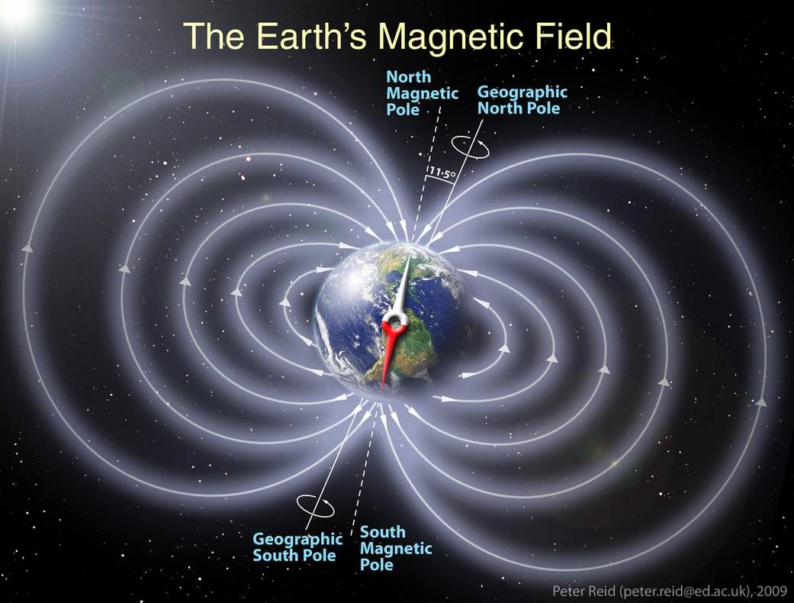
Magnetometer
Earth’s magnetic field
  Field line originating from a south pole and terminating at north pole

Slide 26
Magnetometer
Earth’s magnetic field at different points on earth
  At different places on earth, the magnetic field has different strength and direction of force
  For example, in north America, the field lines point downward towards north at an angle close to 70 degrees (called angle of inclination θ)
  Magnetometer measures Mx, My and Mz
[5]
Mz
M
My
θ
Mx

Slide 27

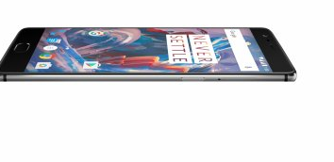
Heading determination
Determine the direction of walking
  Using magnetometer in smartphone
  Direction measured as relative angle to magnetic north pole
  Example: user is walking 30 degrees North
Magnetometer
  Mx and My are planar to earth’s surface
  can be used to determine the compass heading direction
Mz
M
My
θ
Mx

Slide 28
Heading determination
Observation
  Rotate in a circle with the smartphone in your hand (keep it level to ground, no magnetic interference)
  Positive or negative depending on heading direction
N
E
S
W
N
[5]
Y
Magnetometer readings
0
X
Heading direction

Slide 29
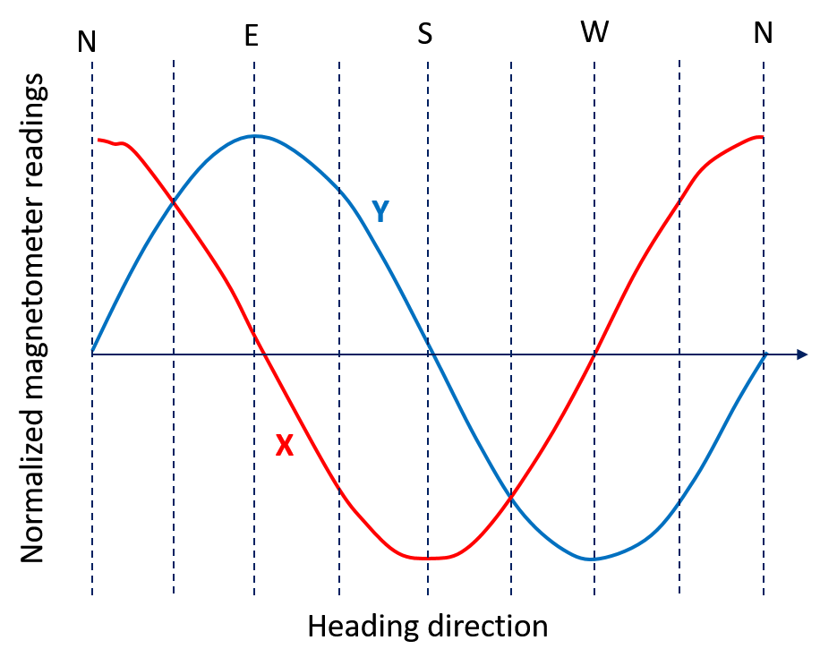
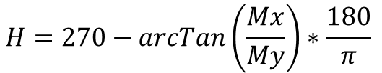
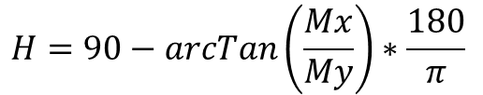


Heading determination
Mz
Heading direction (H) calculation
M
[5]
My > 0
My < 0
My = 0; Mx < 0
My = 0; Mx > 0
My
$$H=90−arcTan\left(\frac{Mx}{My}\right)∗\frac{180}{π}$$
θ
$$H=270−arcTan\left(\frac{Mx}{My}\right)∗\frac{180}{π}$$
Mx
$$H=180$$
$$H=0$$

Slide 30
Heading determination
Heading calculation requires accounting for declination angle
Declination angle
  Magnetic north/south poles and geographic poles are off by 11.5 degrees
  Requires adjustment to the calculated heading directions
  Different at every point on earth
  Maintained as a static database by National Geophysical Data Center
Heading direction in Fairfax when pointing to geographic North would be 9 degrees to the west
[5]

Slide 31
Heading calculation
Phone orientation
  A user can carry the phone anywhere on body
  Examples: pant pocket, in a bag/purse etc.
  How to know the heading direction when the phone is not at level to earth’s surface?
Magnetic Interference
  Magnetometer readings are affected by many different electromagnetic fields around us
  Ferromagnetic materials – iron, nickel objects
  Electrical devices – large power circuits
  How to isolate the impact of only earth’s magnetic field from the magnetometer readings?

Slide 32

Phone orientation
Z
What is phone orientation?
  Roll, pitch and yaw
  Yaw – measures device rotation around Z axis
    Angle relative to the magnetic north pole
  Pitch – measures device rotation around Y axis
    relative angle to ground surface
    0 means phone is flat on a surface (for example, table top)
    90 means phone is perpendicular to the surface (for example, phone standing vertically)
  Roll - measures device rotation around X axis
    0 means phone screen is facing the sky
    180 means phone screen in facing the ground
X
Y

Slide 33
Phone orientation
How to determine phone orientation?
  Accelerometer and magnetometer
Accelerometer measures gravity
  The 9.8 m/s^2 force is observed in all 3 axis
Magnetometer measures angle relative to North
  Mx, My and Mz measure earth’s magnetic field
Anchors
  Use gravity and magnetic north as anchors to calculate the pitch, roll and yaw
  Equations and sample code at
  https://www.nxp.com/files/sensors/doc/app_note/AN3461.pdf
  Android orientation
  https://developer.android.com/guide/topics/sensors/sensors_position.html

Slide 34
Magnetic interference
How to deal with magnetic interference?
Smoothing and gyroscope
  When a user is walking, she can pass by many ferromagnetic or electrical appliances, causing fluctuations in the magnetometer readings
  Smoothing can be applied to disregard the short-term variations, and only consider long-term variations
Gyroscope
  When user takes a turn while walking, gyroscope registers rotation in its 3 axis
  This can be used by the magnetometer to determine if the magnetometer variation occurred because of user’s turn
  If not, the variation could be inferred as magnetic interference and can be corrected

Slide 35
Heading determination
Measure accelerometer, gyroscope and magnetometer
Determine if user is walking
  Count steps
Find local heading direction
  Use accelerometer and phone’s orientation to determine the heading direction in smartphone’s coordinate system
Find global heading direction
  Use local heading, orientation and gyroscope to map the local heading to global heading direction
Open research problem
  Essential to indoor localization
  Accuracy in indoor scenarios is comparatively lower

Slide 36
Agenda
Sensor overview
  Accelerometer and gyroscope
Step counting
Heading detection
  Magnetometer and compass
  Use on WiFi localization
Gesture recognition
  Motion sensors on smartwatch
Voice sensing through accelerometer

Slide 37
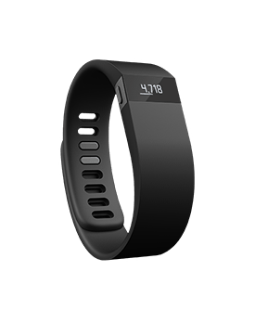
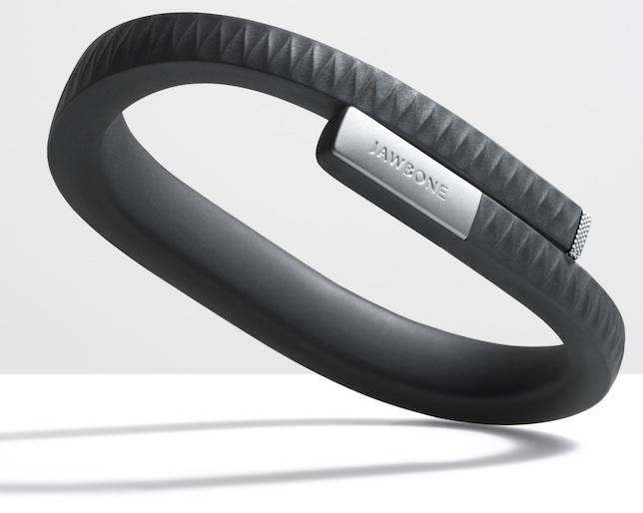
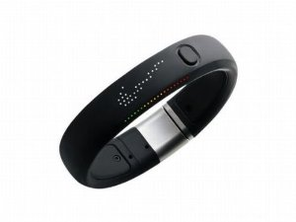
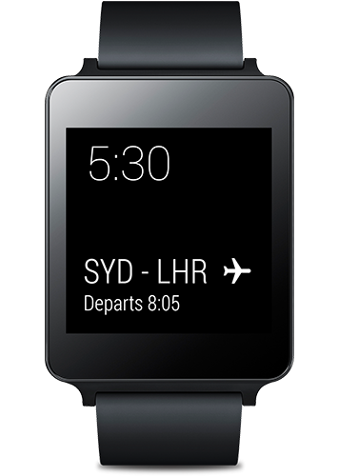
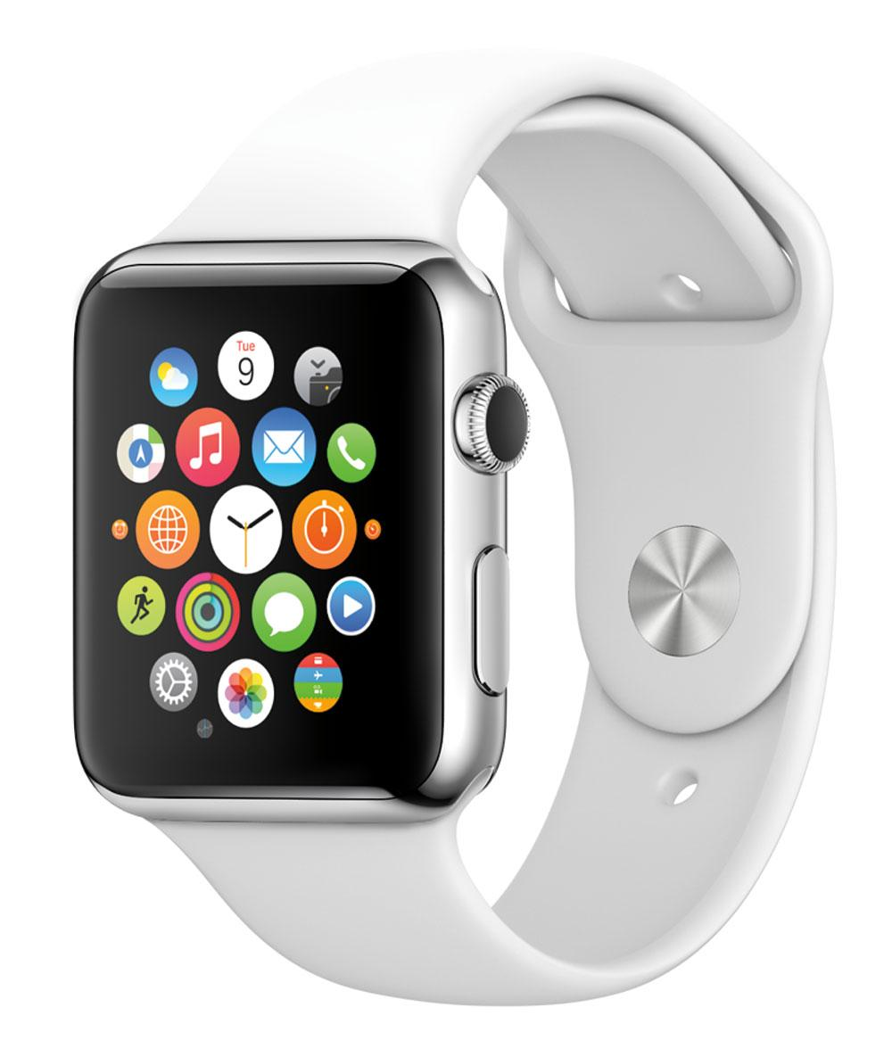
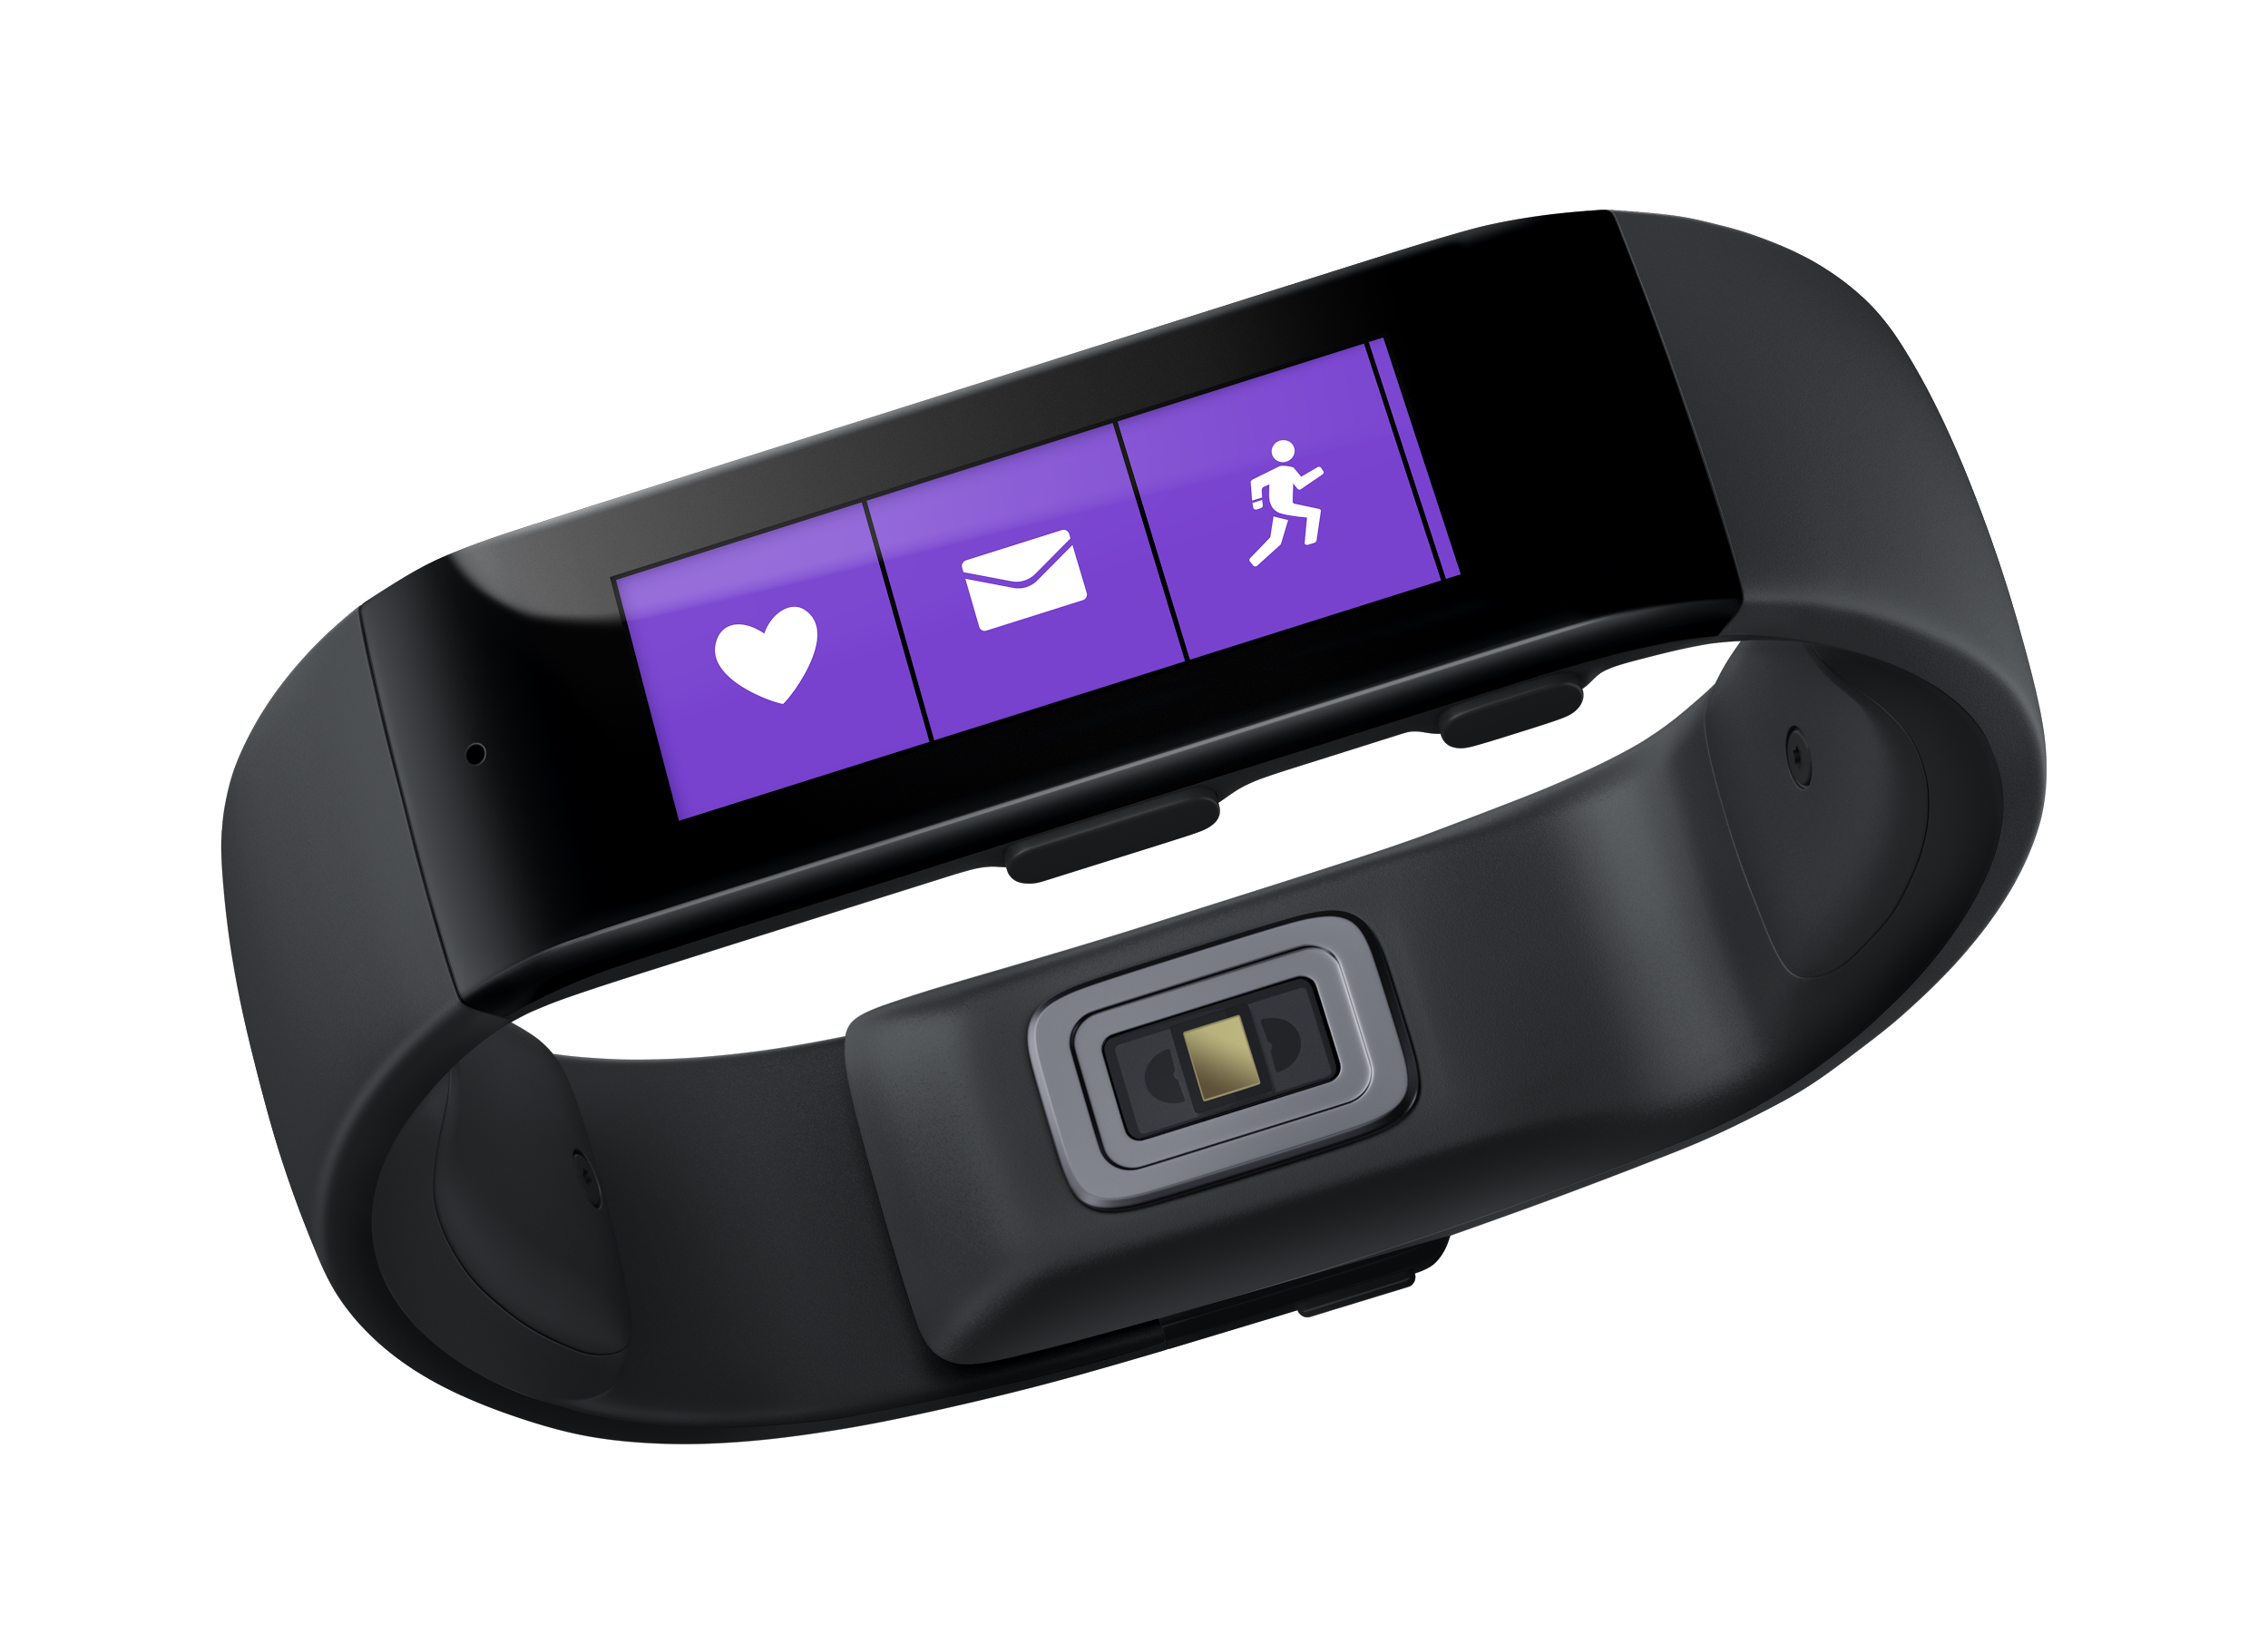
The rise of wrist-worn wearables
Activity tracking
Richer interaction

Slide 38
Smartwatch sensors
Motion sensors (3 axis)
  Accelerometer - measures linear acceleration
  Gyroscope - measures rotation
  Magnetometer - measures magnetic field
Optical sensors
  Photodiode - light measurement, color adjustment
  Heart rate sensor - Green LED and photodiode
GPS, Bluetooth, WiFi ...

Slide 39
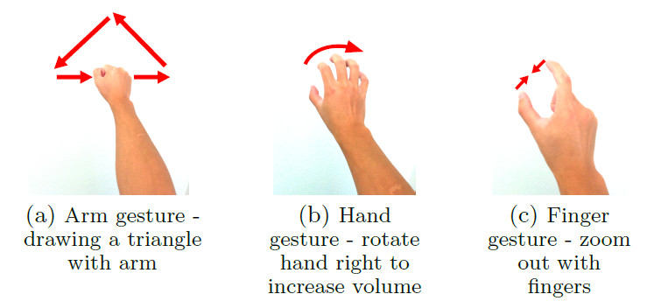
Opportunity
Always-on access to user’s arm and hand movements
  Accelerometer and gyroscope sensors
Arm, hand and finger gestures
Applications
  Remote control devices in the surrounding (smartphone, TV and many others)

Slide 40
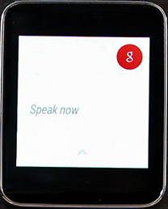
Challenges
Interacting with smartwatch
  Touch - small screen
  Voice - accuracy, energy
Using gestures
  finger-writing to input text

Slide 41
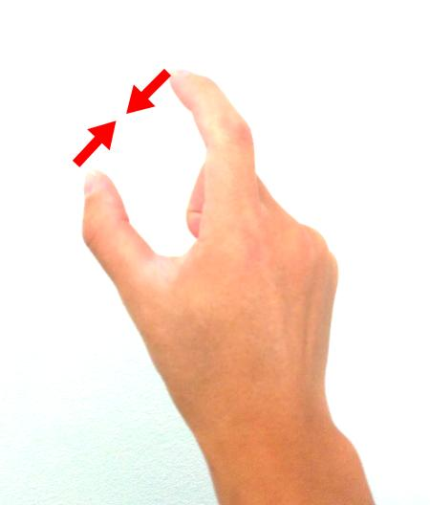
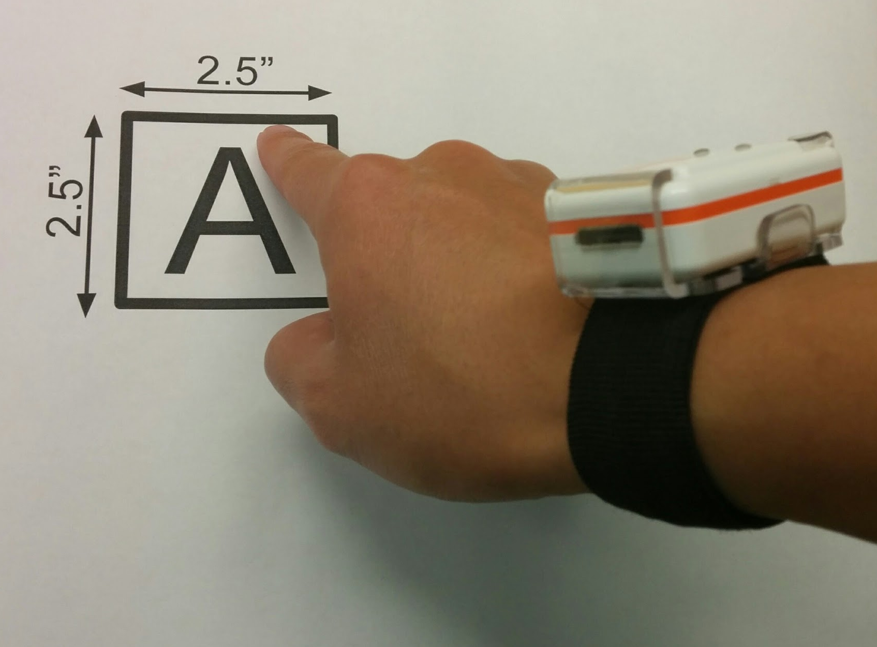
Questions
Can we recognize finger gestures using smartwatch sensors?
arm and hand gestures - easier
minor motion in finger gestures
Is finger-writing feasible using a smartwatch?
in the air or on a surface

Slide 42
Roadmap
Gesture type
  can we classify gestures - arm, hand or finger?
Motion energy for finger gestures
  how much energy is measured in wrist while doing a finger gesture?
Gesture recognition
  is the wrist movement sufficient to identify finger gestures?
Finger-writing with smartwatch
  how to detect characters written with index finger?

Slide 43
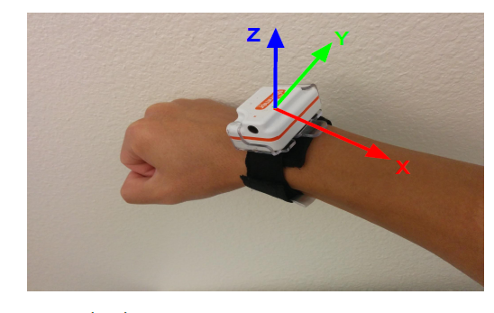
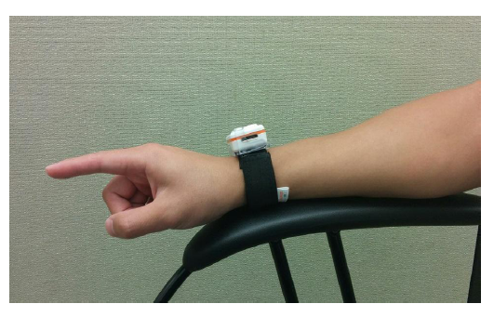
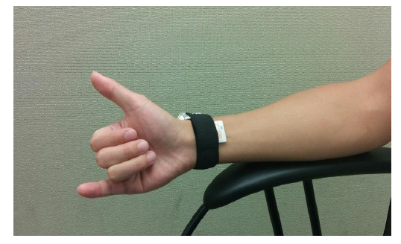
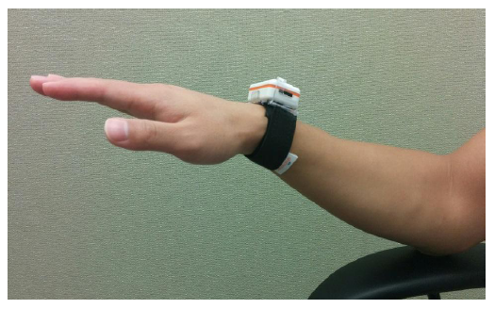
Arm, hand and finger gestures
[6]
Shimmer as the smartwatch
Accelerometer + gyroscope
128 Hz sampling rate
Finger gesture
Hand gesture
Arm gesture

Slide 44
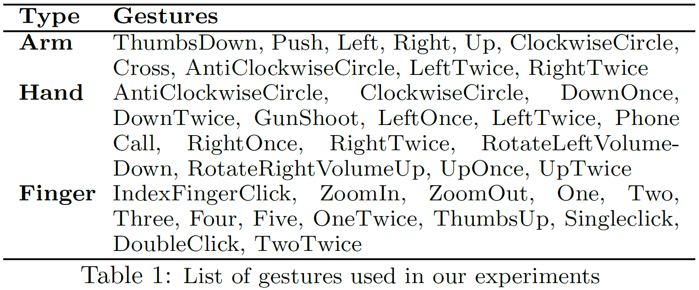
Sample gestures
Objective:
classify what type of gesture (arm, hand or finger)?
Identify which gesture was performed?
37 gestures: 13 finger, 14 hand and 10 arm

Slide 45
Motion energy
How to recognize the gesture type?
Can we measure the intensity of gesture using accelerometer and gyroscope?
  Intensity of arm gestures > intensity of hand gestures > intensity of finger gestures
Measuring intensity using “motion energy”
  Motion energy can be measured using frequency domain analysis
Motion energy
  Convert the time series ACC and GYR signals (all 3 axis) to frequency domain using FFT
  Measure the magnitude of FFT coefficients
  Motion energy is the sum of squares of the magnitude

Slide 46
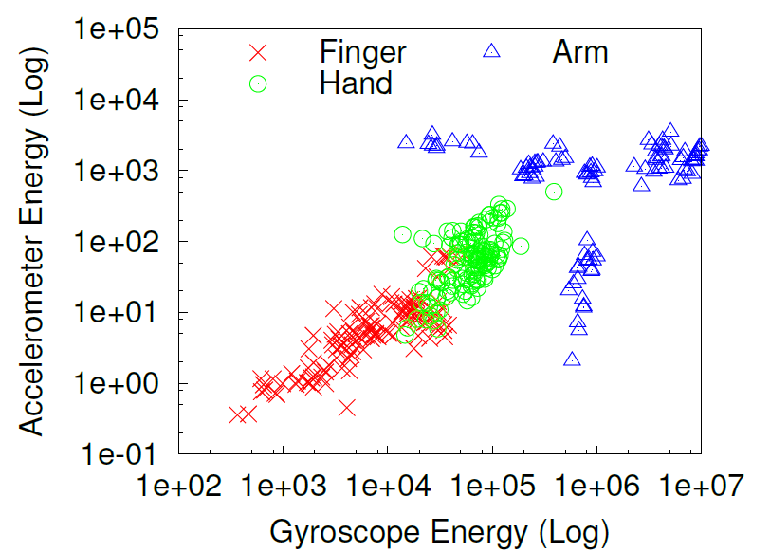
Motion energy
Motion energy for different type of gestures
[6]

Slide 47
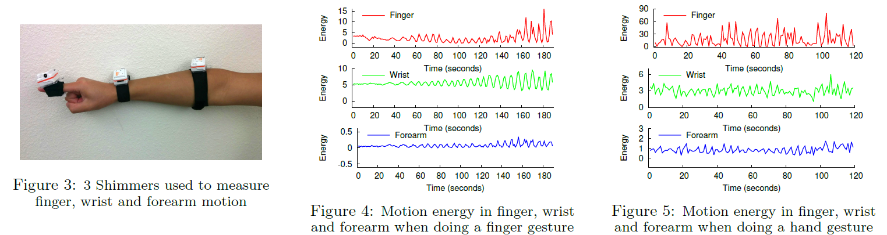
Motion energy
Is the motion energy measured in wrist enough?
  Do we observe sufficient motion in the wrist when doing small finger gestures?
Comparison of motion energy
  Finger – ground truth of the motion
  Wrist – motion observed by the smartwatch sensors
  Forearm – alternate devices like Myo band

Slide 48
Motion energy
Focus on finger and hand gesture
Wrist motion is smaller but noticeable
Finger gesture: index finger up-down with increasing frequency
Hand gesture: fist open and close

Slide 49
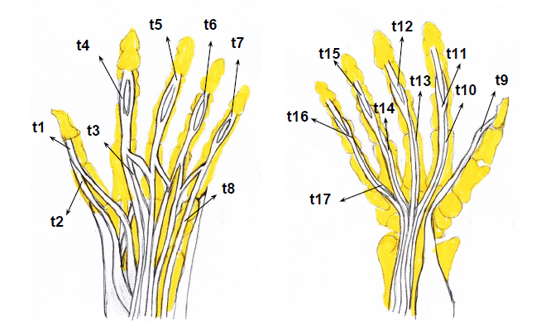
Tendons
Why is there a motion in wrist when moving fingers?
[6]
Tissues connecting muscles with finger bones
17 tendons move differently
while doing different finger
movements
Creates small but unique
signatures that help to
identify finger gestures

Slide 50
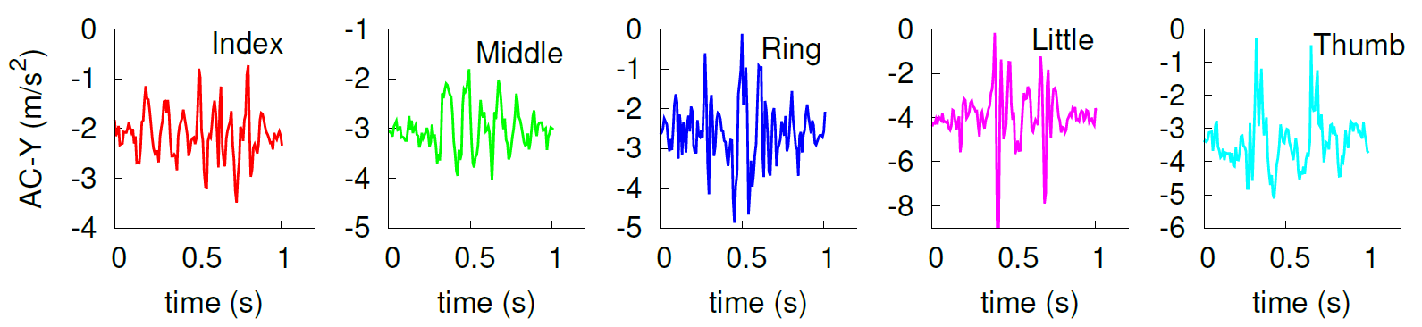
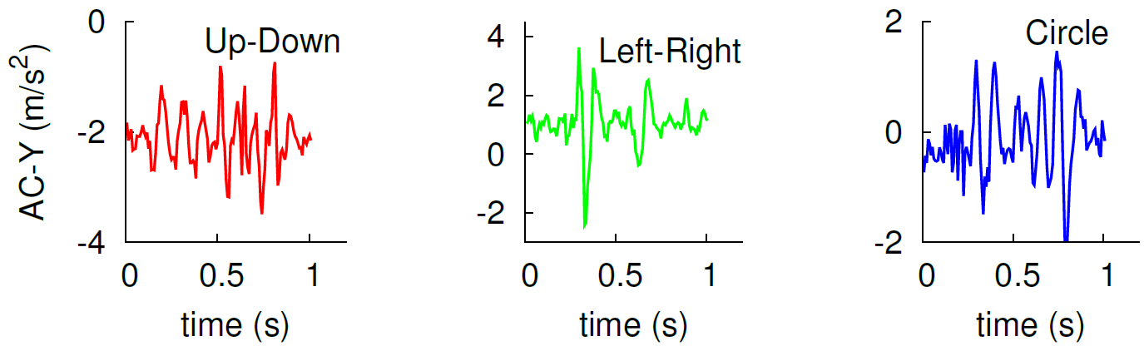
Primitive finger gestures
Up-down using different finger
3 motions using the index finger

Slide 51
Gesture identification
How to identify gestures?
  Calculate ACC and GYR statistics for different gestures
    Ges1 = (accS1, accS2, accS3, gyrS1, gyrS2..)
    Ges2 = (accS1, accS2, accS3, gyrS1, gyrS2..)
  Train machine learning model using sample gestures and its statistics
    Perform each gesture many times and calculate the statistic signatures
  Use the model to identify gestures
    When user does a gesture, look up the gesture signatures you had created in the training phase
    Machine learning model tries to find the best match, and output a guess of which gesture user did
  Some commonly used machine learning classifiers
    Naïve Bayes (NB), Logistic Regression (LR), Decision Tree (DT)

Slide 52
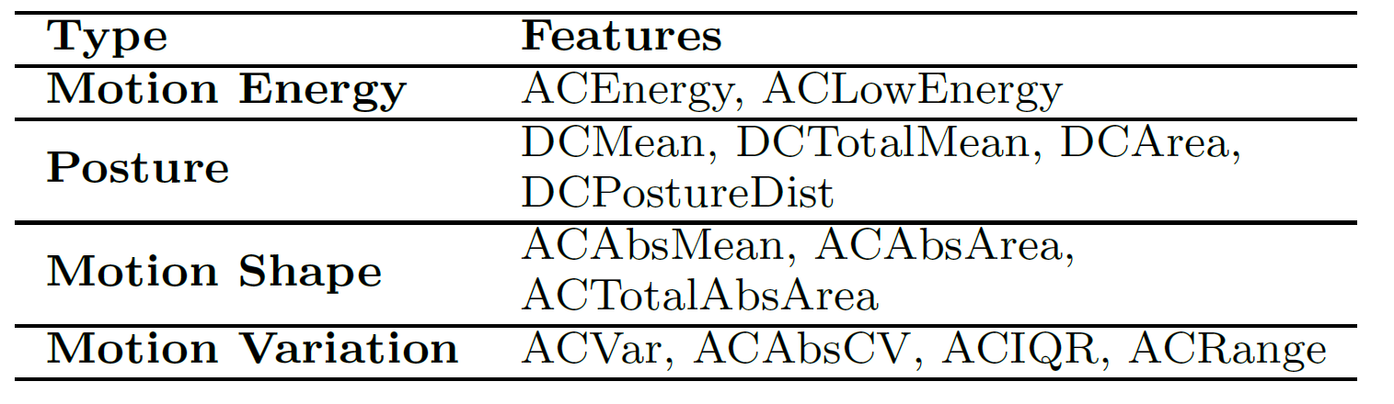
Statistics for ACC and GYR
The statistics are calculated for both ACC and GYR data
The statistics are referred as features in machine learning terms

Slide 53
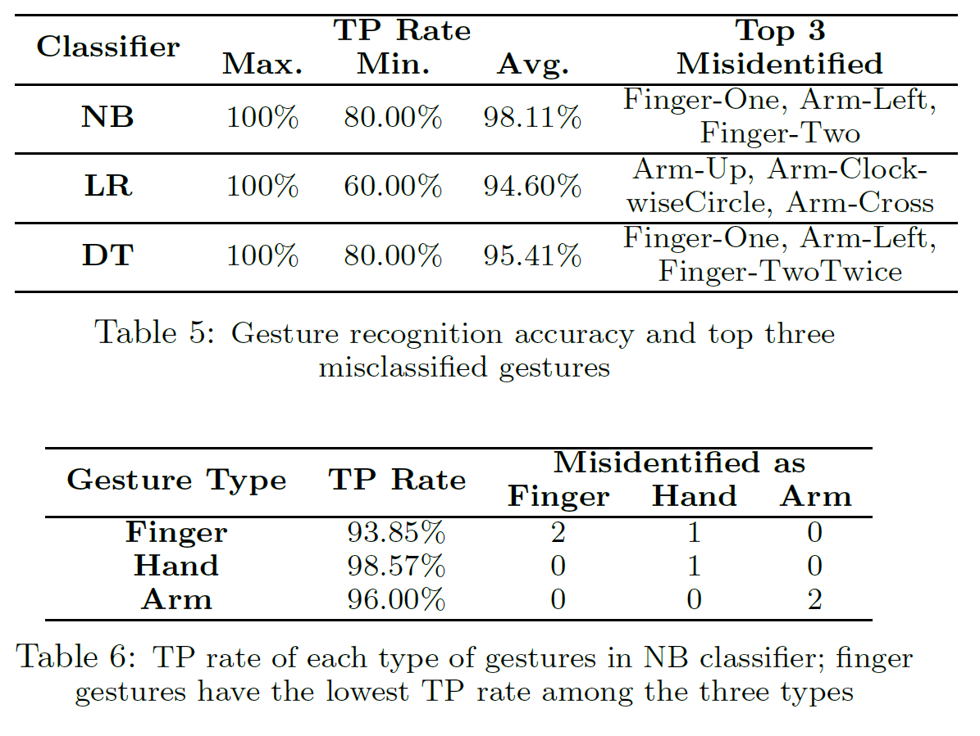
Gesture recognition
Accuracy and misclassification

Slide 54
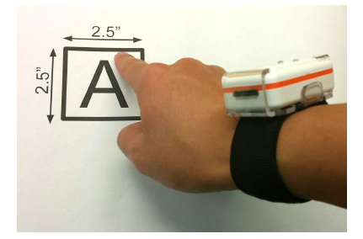
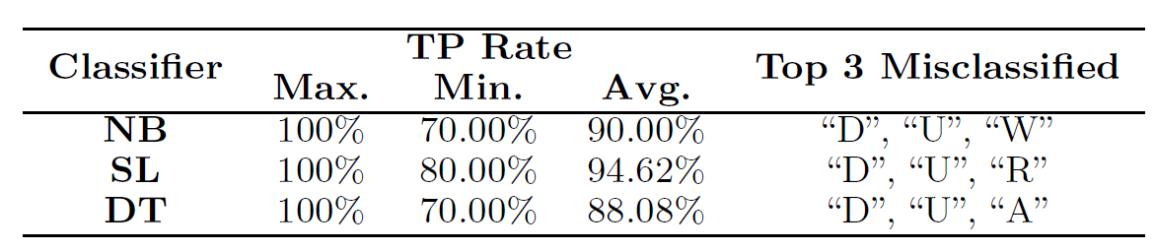
Finger writing
Writing characters with index finger on a surface
  Recognition using the same set of features

Slide 55
Challenges
Unconstrained movement of arm
  This work assumes arm is affixed to a support
  One possible approach: fine-grained freq. filtering
  Arm movements are lower frequency than finger
User-specific traits
  Left handed vs. right handed
  Training for individual users
More work required to understand/improve
  Computational, memory and energy requirements
  Detecting start/end of gestures

Slide 56
Agenda
Sensor overview
  Accelerometer and gyroscope
Step counting
Heading detection
  Magnetometer and compass
  Use on WiFi localization
Gesture recognition
  Motion sensors on smartwatch
Voice sensing through accelerometer

Slide 57
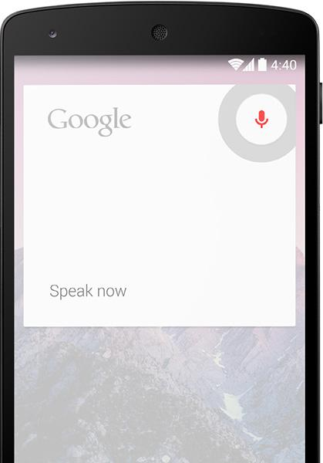
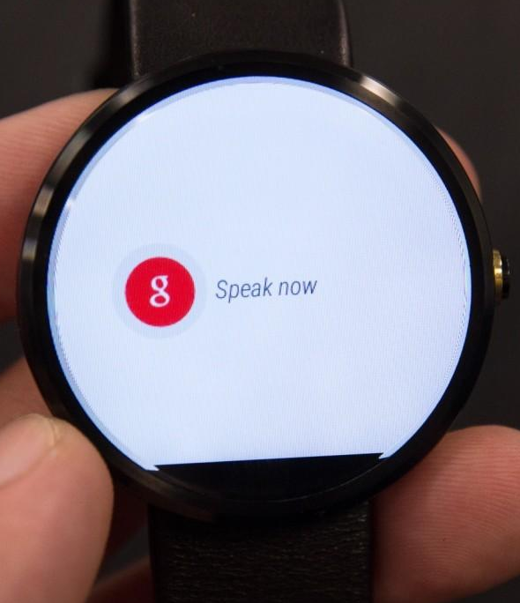
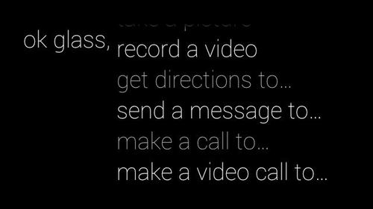
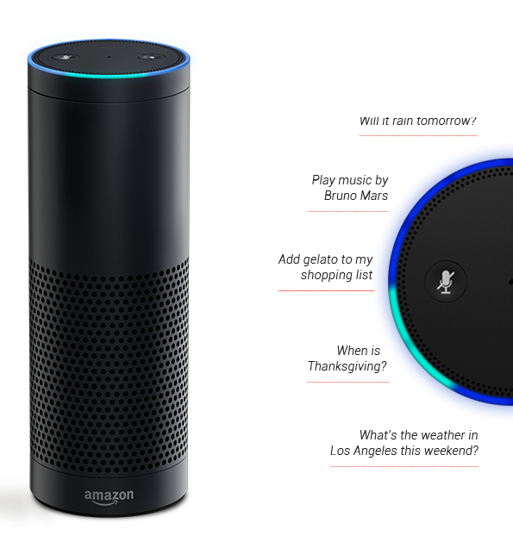
Voice control
Popular on smartphones
  Electronic assistant (Google now, Apple Siri)
Primary method of interaction for wearables (smartwatch, smartglass)
  Touch not always feasible for wearables
Internet-Of-Things (IoT) applications
  Low-cost, low-power, pervasive
  Example: Amazon Echo smart speaker

Slide 58
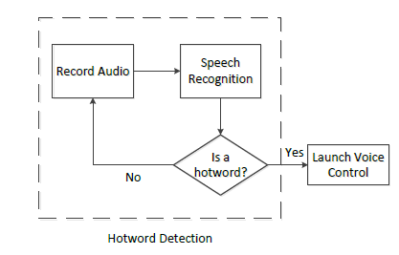
Current voice control applications
Hotword detection
  Detect the hotword “Ok Google”, “Hi Galaxy” etc. to start voice control
  Distinguishes between voice command and other conversations
Continuous audio sensing
  “Always” listen for hotword
[7]

Slide 59
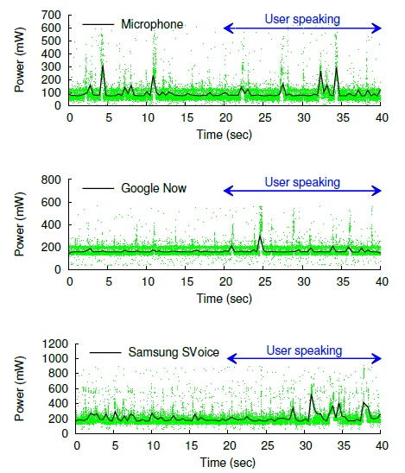
Energy hungry voice control
Current voice control and hotword detection is energy inefficient
  Microphone sampling rate - 44 KHz
Isolated measurement on Samsung Galaxy S4
  Disable network interfaces
  Deduct GUI power consumption
  No background apps

Slide 60
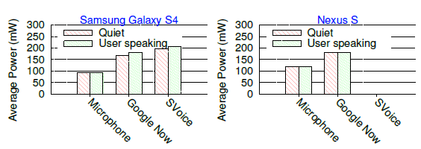
Energy hungry voice control
Power consumption after 30 minutes
Observations
  Voice control apps consume more power compared to “microphone”
Hotword detection
  “Quiet” and “User speaking” have similar power consumption
Continuously listening for hotword is a major factor for high power consumption of voice control apps

Slide 61
Ideal hotword detection scheme
High accuracy
  Dominant factor in adoption of voice control
  Frequent failure in hotword detection is unacceptable
Robustness to
  User mobility
  Different voice frequency (female/male)
  Noisy surroundings
Energy efficiency
  Essential for ubiquitous deployment

Slide 62
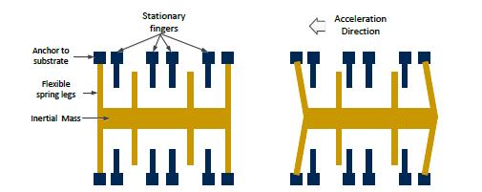
Hotword sensing using accelerometer
AccelWord idea
  Empirical evidence that accelerometers are sensitive to spoken voice
  Accelerometer registers acceleration when audio signals strike the inertial mass
  Can we “listen” using accelerometer?
Accelerometer sensor
  Included in almost all smart devices (phones, watches, glasses etc.)
  Low-cost (< $5) and low energy (sampling < 200 Hz)

Slide 63
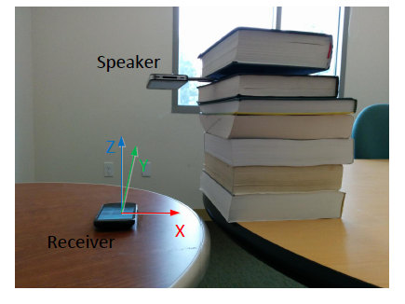
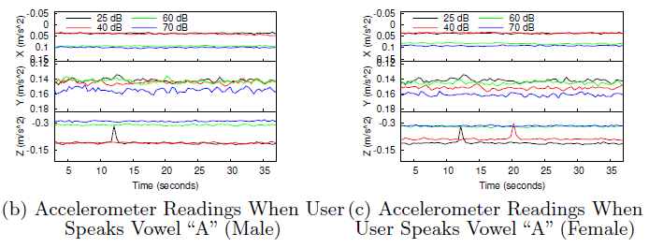
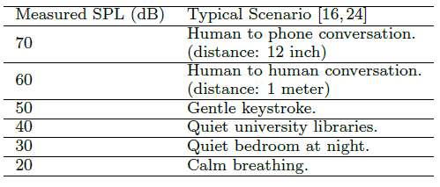
Feasibility study
Understand the impact of sound on accelerometer
  Different sound pressure levels (SPL = loudness)
Accelerometer registers sounds
  Higher SPL => higher acceleration

Slide 64
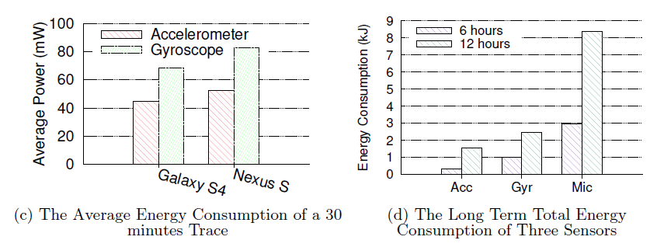
Hotword detection using accelerometer
Can we use accelerometer to “listen” for hotwords?
  If the hotword is detected using accelerometer, start the microphone for complete voice recognition
Advantage - lower energy consumption compared to microphone
  20 Hz - 22 KHz human voice modulated on 200 Hz accelerometer samples
  Lower sampling results in low-power sensing
[7]

Slide 65
AccelWord challenges
Hotword recognition
  Can accelerometer distinguish between hotword and other words?
  Complete speech recognition is difficult
Human mobility interference
  How to remove the mobility-related acceleration to distill voice-related acceleration data?
Noise cancellation
  Advanced techniques already exist for microphone to remove background noise
  Is the impact of background noise on accelerometer too detrimental?

Slide 66
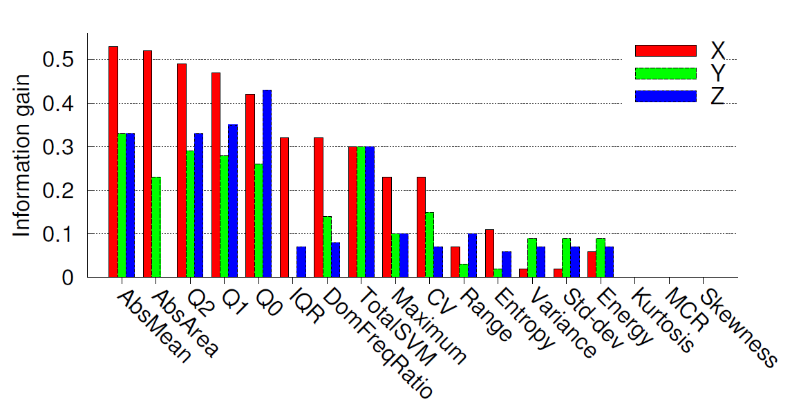
Analyzing accelerometer audio signals
Voice recognition features
  Designed to analyze high-frequency audio
  Unsuitable due to low sampling rate of accelerometer (200 Hz)
Activity recognition features
  Used to detect walking, running etc.
  Time and frequency domain analysis
  Information gain shows they are suitable for hotword detection
- Seperately for X, Y and Z axis
min, max, median, variance, std-dev, range, abs. mean, CV, skewness,
kurtosis, Q1, Q2, Q3, interquartile range, mean-crossing rate, abs. area
- Calculated across X, Y and Z axis
total abs. area, total SVM
- Frequency domain (separately for X, Y and Z axis)
Energy, entropy and dominant frequency ratio

Slide 67
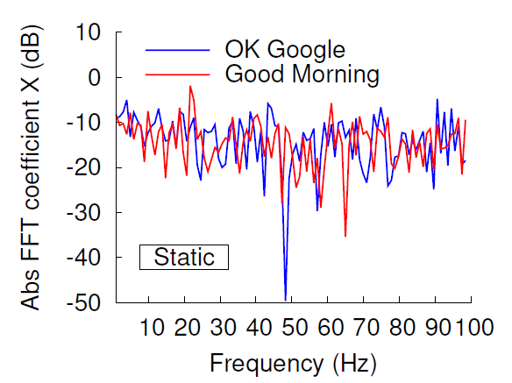
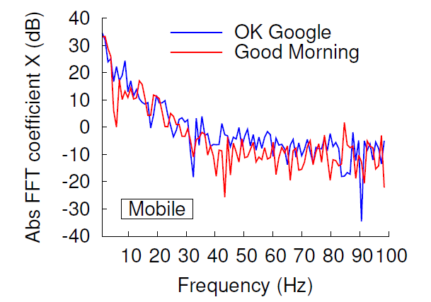
Combating mobility interference
Activity recognition literature suggests that user activities are
  Sedentary movements < 0.7 Hz
  Walking, low intensity movements <= 2 Hz
  Running, high intensity movements <= 20 Hz
Frequency domain analysis

Slide 68
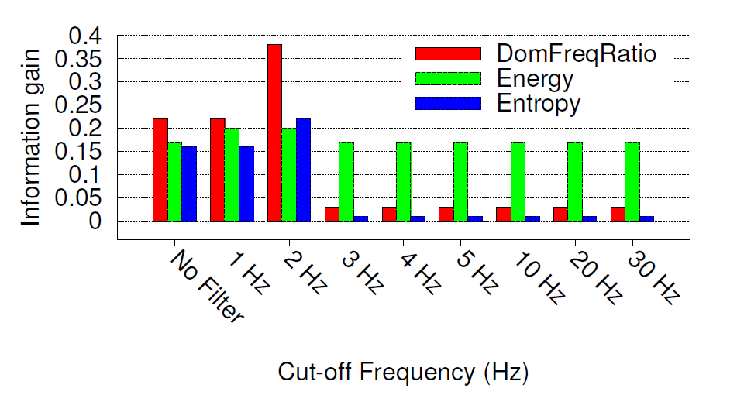
Filtering mobility interference
High-pass filter can be used to remove low-frequency mobility impact
Cut-off for high-pass filter
  Too low => does not remove mobility impact adequately
  Too high => removes useful voice-related variations
How well can we distinguish different hotwords with different cut-offs?
  Cut-off = 2 Hz

Slide 69
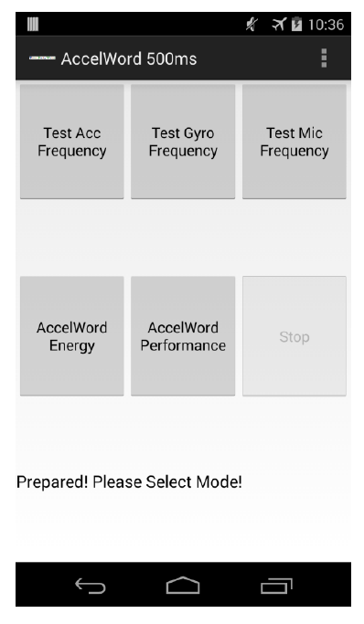
AccelWord classifier
Android implementation
  Android 4.4.2 on Samsung Galaxy S4 and Nexus S
Sliding window to buffer last few seconds data
  2 seconds sufficient to pronounce the hotword
Decision tree classifier
  One classifier trained per user

Slide 70
Performance evaluation
Smartphone implementation
  10 volunteers (5 females and 5 males)
  Samsung Galaxy S4 and Google Nexus S
Training
  10 Hotword instances (5 mobile, 5 stationary)
  20 random sentences
  Each played 10 times in different background noise
Comparison with
  Google Now and Samsung S Voice
  TP rate, FP rate and energy consumption

Slide 71
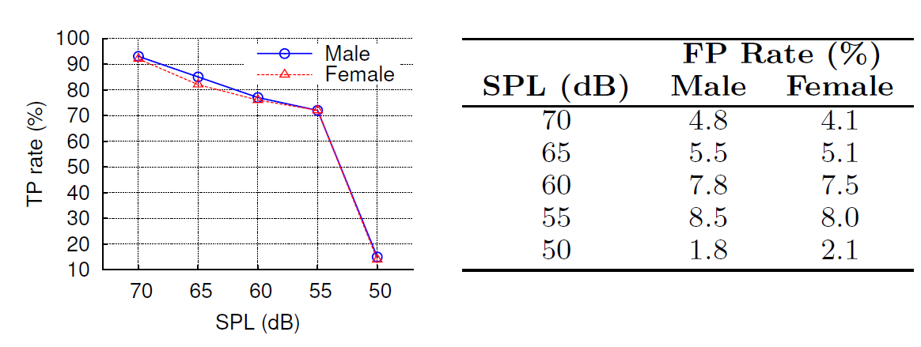
Hotword detection accuracy
Trained and tested with the same SPL
  TP rate measures the fraction of hotword instances correctly detected from all spoken instances including random sentences

Slide 72
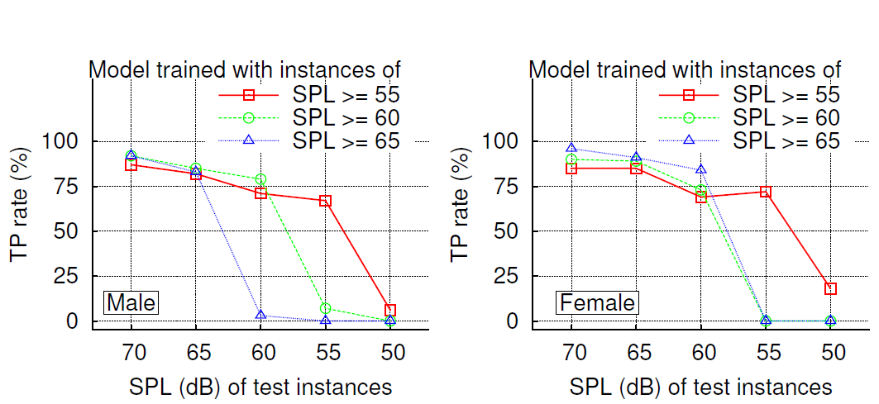
Hotword detection accuracy
Trained and tested with different SPL
  Lower TP rate compared to the case where classifier is trained and tested with same SPL
  Models trained and tested with same or higher SPL achieve higher TP rates

Slide 73

Comparison
TP rate comparison with Google Now and Samsung S Voice
  AccelWord model trained with instances of SPL >= 55 dB
  TP rate of AccelWord is 99.1% and 97.6% of the TP rates of Google Now and S Voice at SPL >= 65 dB

Slide 74

Comparison
In presence of background noise
  TP rate of AccelWord drops faster than the other two apps
  Expected given that current microphones use advanced noise cancellation techniques

Slide 75


Mobile scenario
Experiments with walking while speaking
TP rate is highest at 2 Hz cut-off for high pass filter
  2 Hz filter is sufficient to remove most indoor mobility-related interference
AccelWord is robust to user mobility

Slide 76



Energy efficiency
Energy savings mostly attributed to low-cost sensing through accelerometer
  With optimized implementation of AccelWord, further processing-related savings can be achieved

Slide 77

Speaker identification
Accelerometer signatures of hotwords can also be used
  To identify the speaker
Useful to ignore other user’s voice commands
  Only recognize hotword from the owner user
AccelWord
  Gender identification accuracy 100%
  Speaker identification
Female - 82%, Male - 88%

Slide 78
Scope for improvement
Accelword currently being adopted by an IoT startup
Noise Cancellation
  Techniques to remove the impact of background noise
Mobility patterns
  Extension to other types of mobility patterns - driving in car, running etc.
  Challenging to remove high frequency activity interference
Privacy
  Smartphone apps with only accelerometer access permission can “listen” to user’s conversations, record confidential information
  Designing protection mechanisms

Slide 79
References
[1] Kim, Jeong Won, Han Jin Jang, Dong-Hwan Hwang, and Chansik Park. "A step, stride and heading determination for the pedestrian navigation system." Positioning 1, no. 08 (2004): 0.
[2] Mariakakis, Alex T., Souvik Sen, Jeongkeun Lee, and Kyu-Han Kim. "SAIL: single access point-based indoor localization." In Proceedings of the 12th annual international conference on Mobile systems, applications, and services, pp. 315-328. ACM, 2014.
[3] Brajdic, Agata, and Robert Harle. "Walk detection and step counting on unconstrained smartphones." In Proceedings of the 2013 ACM international joint conference on Pervasive and ubiquitous computing, pp. 225-234. ACM, 2013.
[4] Rai, Anshul, Krishna Kant Chintalapudi, Venkata N. Padmanabhan, and Rijurekha Sen. "Zee: zero-effort crowdsourcing for indoor localization." In Proceedings of the 18th annual international conference on Mobile computing and networking, pp. 293-304. ACM, 2012.
[5] https://cdn-shop.adafruit.com/datasheets/AN203_Compass_Heading_Using_Magnetometers.pdf
[6] Xu, Chao, Parth H. Pathak, and Prasant Mohapatra. "Finger-writing with smartwatch: A case for finger and hand gesture recognition using smartwatch." In Proceedings of the 16th International Workshop on Mobile Computing Systems and Applications, pp. 9-14. ACM, 2015.
[7] Zhang, Li, Parth H. Pathak, Muchen Wu, Yixin Zhao, and Prasant Mohapatra. "Accelword: Energy efficient hotword detection through accelerometer." In Proceedings of the 13th Annual International Conference on Mobile Systems, Applications, and Services, pp. 301-315. ACM, 2015.

