Slide 1
Mobile Computing:
Indoor Localization
CS 655: Wireless and Mobile Computing
Parth H. Pathak

Slide 2
Indoor localization
GPS signals do not penetrate walls, concrete
Indoor localization
  Localize a mobile device in an indoor space (office, shopping mall)
Many applications
  Indoor navigation in large buildings
  Context aware applications
    Location-based services
  Emergency and medical/healthcare applications
  Many more..

Slide 3
Indoor localization
[1]
Next lecture
Our focus

Slide 4
Key requirements
Indoor localization
  Accuracy
    Higher accuracy expected in most applications
  Real time
    Smartphones should be able to localize in real-time to support navigation
  Cost
    Reduce the reliance on additional infrastructure, leverage what we have
  Energy efficiency
    Mobile devices, low computational overhead
  Scalable
    Many users can perform device localization at the same time
  Privacy
    Device-based solutions are more private, don’t let infrastructure track users

Slide 5
Indoor localization
Three important types
  WiFi-based
  Inertial sensors (+ WiFi)
  Visible light positioning

Slide 6
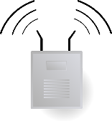

Triangulation
Indoor localization through distance triangulation
RSS on a mobile device is a function of distance
Problems?
  Distance and time variations – multipath, reflections, obstructions, motion
  Modelling not enough

Slide 7
RADAR
RADAR
  First RF based indoor localization system
  Proposed in 2000
  WaveLAN based system, pre-802.11b WiFi
RSS fingerprinting
  Offline phase (also called war-driving)
    Measure signal strength of APs at different locations
    Build a signal strength profile
    The RSS vector from different APs forms a “fingerprint” of the location
  Online phase
    A client measures the RSS from different APs
    Compares it with the fingerprints obtained in the offline phase
    Choose the location that matches most closely
[2]

Slide 8
RADAR – Proof-of-concept
With three APs, it is possible to distinguish different locations
Time variations
  How to account for time varying measurements?
  For each location, the fingerprint stores average of multiple RSS measurements
[2]

Slide 9
RSS matching
How can a mobile device measure RSS from multiple APs?
WiFi scanning functionality
  As defined in 802.11 standards, mobile devices can scan *beacons* of all APs within the range

Slide 10
RSS matching
RADAR uses k-nearest neighbors for RSS matching
  For the observed RSS values, determine the K nearest neighbors for which the RSS values are known during the offline phase
  The location estimate is an average of coordinates of K neighbors
  How many neighbors to consider? what should the value of k?
True location
Location estimate

Slide 11
RSS matching
Error increases for very few and very large number of neighbors
[2]

Slide 12
RSS matching
How many points should be included in the offline measurement phase?
  Of course, more is better
What’s the problem with having more points in the offline phase?

Slide 13
RADAR performance
Localization accuracy
  Median error of 2.1m
  90% of online experiments result in error < 10m
Limitations of RADAR
  Lower accuracy
  RSS matching requires significant time/computation
  Significant fingerprinting efforts necessary
Why is the accuracy low in RADAR?
  RSS fingerprinting relies on averaging
  For each location, multiple RSS measurements were averaged and stored as fingerprints
  Wireless channels are time varying

Slide 14
HORUS
RSS fingerprinting
  RADAR relies on deterministic fingerprinting
  RSS at each location assumed to be stable over time
HORUS
  Proposed in 2005
  Main idea
    Account for temporal and spatial variations in RSS fingerprinting and matching
  RSS fingerprinting should be probabilistic, not deterministic
[3]

Slide 15
HORUS
Offline RSS fingerprinting
  Distributions (time variations)
  Clustering (faster computations)
RSS distribution
  For each surveyed location, store a distribution of RSS measurements from multiple APs
  This means that for given location x, Horus stores probability distribution P(RSS|x)
  More RSS samples/measurements can be used to continuously update the distribution
Parametric vs. non-parametric
  Parametric: Horus shows that the RSS distributions can be modeled as Gaussian distribution
  Non-parametric option also considered
[3]

Slide 16
HORUS
RSS matching in RADAR
  Requires matching the observed RSS vector with all known fingerprints
  Long computation times
Horus proposes location clustering
  After the fingerprinting measurements, cluster the locations that are only covered by the same set of APs
Online RSS matching
  A mobile device collects multiple RSS samples
  The RSS distribution of multiple samples are compared with known fingerprint distributions
    Parametric and non-parametric: choose the location for which the distributions provide the best match (the probability is maximum)
  Use location clustering to only match within the cluster of observed APs

Slide 17
HORUS
Evaluation
  21 APs in a university building
  110 locations used in testing - each covered by on an average 4 APs
  Fingerprinting on spots at 1.52m (mostly in corridor)
[3]

Slide 18
HORUS
Performance
  90% error < 1.5 m
  Compared to RADAR where 90% error was < 10m
  RSS fingerprinting should take into account temporal and spatial variations
[3]

Slide 19
Chasing accuracy
RADAR and Horus
  When evaluated in practice at different locations, median location error is 4 to 7 meters
  Limitations of RSS
    RSS granularity is lower and variations are higher
    Accounting for variations beyond a certain level can increase the location error
Challenge
  Many applications require sub-meter location accuracy
  Examples
    User is facing a particular painting in a museum
    User is in aisle 3 in super market
    User is entering the door of a shop in a mall
How to improve accuracy?

Slide 20
PinLoc
PinLoc
  Proposed in 2012
  Main idea
    Do away with RSS and instead rely on Channel State Information (CSI)
  Objective
    Divide the indoor space into squares of 1m x 1m
    Use CSI to determine which 1m x 1m square user is in
    Referred as spot localization
[4]

Slide 21
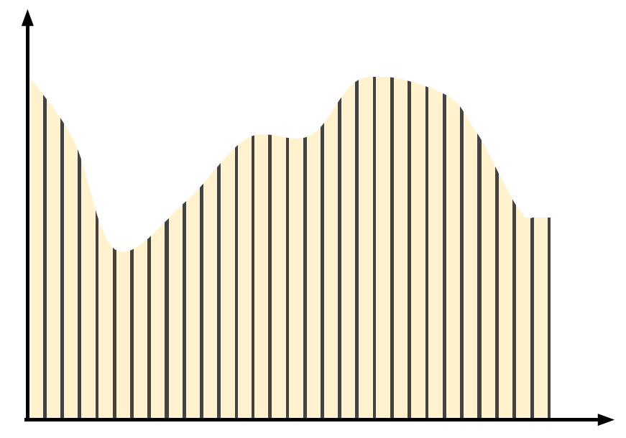


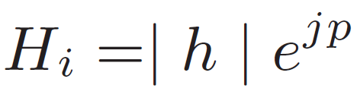
PinLoc
CSI for localization
  If RSS variation is an issue, shouldn’t CSI vary even more?
  PinLoc’s observation
    CSI varies continuously, but the underlying structure of amplitude and phase remains more or less unchanged at different locations
    CSI provides richer, fine-grained information – includes phase and amplitude
    Applying machine learning on CSI is more effective
RSS
Amplitude
Subcarriers

Slide 22
PinLoc
Three observations
Observation – 1
  The CSI at each location appears random but actually exhibits a statistical structure over time
[4]
Amplitude and phase of 50 randomly chosen packets for a laptop at a location and an AP
The fading in general for different subcarriers shows a pattern specific to location

Slide 23
PinLoc
CSI clusters
  Amplitude and phase both result in noticeable clusters
  Result of location specific propagation – LOS, strong reflections
Amplitude and phase of 20000 packets for the a laptop at a location and an AP

Slide 24
PinLoc
CSI (CFR – channel frequency response) clusters
  Most locations have few unique CSI clusters
[4]
For locations with many clusters, few of them are dominant (observed most of the time)

Slide 25
PinLoc
Observation – 2
  The distance over which the CSI structure is unique and stable is small
Cross-correlation extremely low beyond a meter

Slide 26
PinLoc
Observation – 3
  The CSI structure of a given location is different from that of all other locations
  CSI cluster fingerprinting is feasible and accurate
Consider a test CSI instance
Let S be the similarity between the test instance and training instances
S(own) = similarity of the test instance with the training instances of the same 1mx1m square
S(other) = similarity of the test instance with the training instances of other 1mx1m square
S(own) – S(other)
Negative indicates chances of misclassification

Slide 27
PinLoc
Building CSI clusters
[4]

Slide 28
PinLoc
Performance evaluation
  Evaluation is in terms of whether PinLoc correctly estimates the current 1m x 1m square
  90 % mean accuracy, 6 % false positives

Slide 29
PinLoc
PinLoc is designed for higher localization accuracy
  Accuracy still remains one of the two main open challenges
The other challenge?
  WiFi based localization relies on RSS fingerprinting maps generated through war-driving
  War-driving requires extensive efforts
  Does not scale even for small size buildings
  More locations
  More WiFi measurements per each location
Can we do localization without war-driving?
  What will be the impact on accuracy?

Slide 30
Zee
Zee
  Zero effort crowdsourcing for indoor localization
Main idea
  Use smartphone’s inertial sensors to estimate user’s walking paths and location
  Use the estimated location and scanned WiFi RSS values to build RSS maps
  Crowdsource data from many users to improve accuracy
No war-driving
  Zee does not require dedicated offline phase where each location of the building is inspected for RSS profile
  WiFi RSS maps are generated through crowdsourcing
[5]
What is crowdsourcing?

Slide 31
Zee
How does Zee work?
  When a user walks around in a building, collect ACC, GYR and MAG readings
    Use these to determine number of steps walked, walking directions and turns
    The process is referred as dead reckoning
  The walking trajectories created by dead reckoning are fit within the floor map
    The trajectories are likely to fit only in some part of the building
    This fitting yields user’s estimated location within the building
  Use the estimated location and collected WiFi RSS readings to create RSS maps
    Associate scanned RSS values with location
  More users will improve accuracy - crowdsourcing
    Keep improving the location and RSS mappings with every new walk and user

Slide 32
Zee
Zee architecture
[5]

Slide 33
Zee
Step 1
  Detect if user is walking using auto-correlation
Walking is a periodic motion
Auto-correlation very high compared to other idle and basic movements

Slide 34
Zee
Step 2
  Detect if user is walking using auto-correlation
  Count steps (also using auto-correlation)

Slide 35
Zee
Step 3
  Detect if user is walking using auto-correlation
  Count steps (also using auto-correlation)
  Estimate heading direction (correction can be applied through gyro)

Slide 36
Zee
Step 4
  Detect of user is walking using auto-correlation
  Count steps (also using auto-correlation)
  Estimate heading direction (correction can be applied through gyro)
  Fit the steps between the turns (change of heading direction, length of strides)

Slide 37
Zee
Step 5
  Map the walk trajectory onto the floor map
  There can be many possible locations of a trajectory
  Longer trajectory shrinks possible locations
  Zee uses particle filtering and backward propagation

Slide 38
Zee
[5]

Slide 39
Zee
Performance comparison
  Zee uses Horus or EZ for WiFi localization
Path only refers to testing locations that are within 5m of a crowdsource walking path

Slide 40
UnLoc
Zee
  Relies on dead reckoning for WiFi fingerprinting
UnLoc
  Another system proposed almost at the same time as Zee
Main idea
  If dead reckoning is used to identify the walking paths/directions, why not to use it directly for localization?
  Can we completely do away with WiFi fingerprinting?
[6]

Slide 41
UnLoc
Localization purely through inertial sensors and landmark (can use WiFi)
  In a building, different points (called landmarks) provide unique sensor (ACC, GYR, ACC) signatures
  A typical user moves around between these landmarks
  For example, staircase and elevators cause distinct patters in ACC and GYR. Similarly, magnetic interference (presence of large metal objects) can be profiled through MAG signatures
  Use crowdsourcing to identify landmarks
  Dead reckoning is used to track users between landmarks
    Can increase error but the error is reset when user reaches any landmark (known location)

Slide 42
UnLoc
Three main observations
Observation – 1
  Indoor environments provide many landmarks
  Types of landmarks
  Seed land marks (SLM)
  Organic land marks (OLM)
    Magnetic OLM
    Inertial OLM
    WiFi OLM

Slide 43
UnLoc
Seed landmarks
  Elevator
  Stairs
  Escalators
  Building entrances (indoor/outdoor transitions)
Easier to determine their physical locations from floor map
Clear signatures in inertial sensors
[6]

Slide 44
UnLoc
Organic landmarks (OLMs)
  Not necessarily structural like SLMs
  Primarily generated by signature from multiple sensors
  ACC, GYR, MAG, Compass and WiFi
WiFi OLMs
  Small areas which see unique set of Aps
WiFi OLMs

Slide 45
UnLoc
Magnetic OLMs
  Unique signatures emerging due to ferromagnetic materials
[6]

Slide 46
UnLoc
Observation – 2
  Dead reckoning can be accurate between the landmarks
  Dead reckoning
    Step count for finding displacement (accelerometer)
    Heading direction
  Heading direction accuracy
    Magnetometer + gyroscope
    Use gyro to deal with
    magnetic interference

Slide 47
UnLoc
Observation – 3
  Landmarks can be localized easily
Crowdsourcing
  Dead reckoning can be used for localizing landmarks
  But landmarks are used to improve dead reckoning error
  Prompt users to indicate their locations on floor map whenever they reach a landmark

Slide 48
UnLoc
[6]

Slide 49
UnLoc
Performance evaluation
Seed landmarks
  Easy to identify SLMs

Slide 50
UnLoc
Organic landmarks
  Many OLMs are found in typical environment
  More users/time -> more OLMs

Slide 51
UnLoc
Localization accuracy
[6]

Slide 52
Indoor localization
Three important types
  WiFi-based
  Inertial sensors (+ WiFi)
  Visible light positioning

Slide 53
Visible light positioning
WiFi based localization has limitations
  Accuracy
  War-driving
Recent interest in visible light communication
  Can we use the LED luminaires for localization of mobile devices?
Visible light positioning
  Exploit the LEDs (or CFLs) for relative positioning
  Density of LEDs is much higher compared to WiFi APs
  Better accuracy possible?

Slide 54
Epsilon
[7]
Epsilon
  First practical visible light positioning system
Visible light beacons
  Positioning through distance estimation

Slide 55
Epsilon
Visible light path loss depends on three main factors
  Irradiation angle, Tx-Rx distance and incident angle
m = 1 for most LEDs

Slide 56

Epsilon
Visible light beaconing
  LEDs can broadcast beacons
  Beacons can contain the position of the LED
  Additionally, they can include LED transmission characteristics (channel information, frequency etc.)
Modulation technique
  Frequency shift keying
  Lower data rate but robust demodulation
1
0

Slide 57
Epsilon
Beacon interference
  Multiple LEDs can transmit beacons at the same time
  How can the receiver distinguish the beacons?
Beacons are separated in frequency
  Available ON/OFF frequency range = 200 Hz to maximum allowable by LED
  Different LEDs pick different frequency channels
  Randomly hop between the channels
    Such that close-by LEDs are always on different frequency

Slide 58
Epsilon
Trilateration
  Use beacons available from multiple LED luminaires
  Three unknowns, solvable if more than 3 LED luminaries send beacons
What if three luminaires are not within the range?
  User can rotate the phone to change the incident angle to a known value
  Similarly, user can move around (stand below the LED luminaire) to change the irradiation angle to a known value

Slide 59
Epsilon
Implementation
  Light sensor in today’s smartphone offer sampling rate < 100 Hz
  Additional sensor board needed to increase it to few KHz
[7]
Transmitter
Receiver

Slide 60
Epsilon

Slide 61
Epsilon
VLP provides better localization accuracy
  Also does not require fingerprinting
[7]

Slide 62
Luxapose
Epsilon
  High accuracy but requires additional hardware (light sensor) on the receiver side
Luxapose
  Visible light positioning
  Main idea: use the rolling shutter camera on mobile device to receive the beacons sent from LED luminaires
New challenges
  With the use of camera, distance ranging (as used by Epsilon) is difficult
  Luxapose uses Angle-of-Arrival (AoA) for localization
[8]

Slide 63
Luxapose
[8]

Slide 64
Luxapose
Detecting location as well as orientation
[8]

Slide 65
Luxapose
Image processing pipeline
  FSK used by LEDs
[8]

Slide 66
Luxapose

Slide 67
State of the art in indoor localization
[8]

Slide 68
References
[1] Xiao, Jiang, Zimu Zhou, Youwen Yi, and Lionel M. Ni. "A Survey on Wireless Indoor Localization from the Device Perspective." ACM Computing Surveys (CSUR) 49, no. 2 (2016): 25.
[2] Bahl, Paramvir, and Venkata N. Padmanabhan. "RADAR: An in-building RF-based user location and tracking system." In INFOCOM 2000. Nineteenth Annual Joint Conference of the IEEE Computer and Communications Societies. Proceedings. IEEE, vol. 2, pp. 775-784. Ieee, 2000.
[3] Youssef, Moustafa, and Ashok Agrawala. "The Horus WLAN location determination system." In Proceedings of the 3rd international conference on Mobile systems, applications, and services, pp. 205-218. ACM, 2005.
[4] Sen, Souvik, Romit Roy Choudhury, Bozidar Radunovic, and Tom Minka. "Precise indoor localization using PHY layer information." In Proceedings of the 10th ACM Workshop on hot topics in networks, p. 18. ACM, 2011.
[5] Rai, Anshul, Krishna Kant Chintalapudi, Venkata N. Padmanabhan, and Rijurekha Sen. "Zee: zero-effort crowdsourcing for indoor localization." In Proceedings of the 18th annual international conference on Mobile computing and networking, pp. 293-304. ACM, 2012.
[6] Wang, He, Souvik Sen, Ahmed Elgohary, Moustafa Farid, Moustafa Youssef, and Romit Roy Choudhury. "No need to war-drive: unsupervised indoor localization." In Proceedings of the 10th international conference on Mobile systems, applications, and services, pp. 197-210. ACM, 2012.
[7] Li, Liqun, Pan Hu, Chunyi Peng, Guobin Shen, and Feng Zhao. "Epsilon: A visible light based positioning system." In 11th USENIX Symposium on Networked Systems Design and Implementation (NSDI 14), pp. 331-343. 2014.
[8] Kuo, Ye-Sheng, Pat Pannuto, Ko-Jen Hsiao, and Prabal Dutta. "Luxapose: Indoor positioning with mobile phones and visible light." In Proceedings of the 20th annual international conference on Mobile computing and networking, pp. 447-458. ACM, 2014.

