Slide 1
New Wireless Paradigms:
Visible Light Communication
CS 655: Wireless and Mobile Computing
Parth H. Pathak

Slide 2
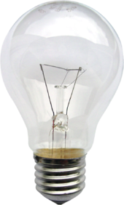

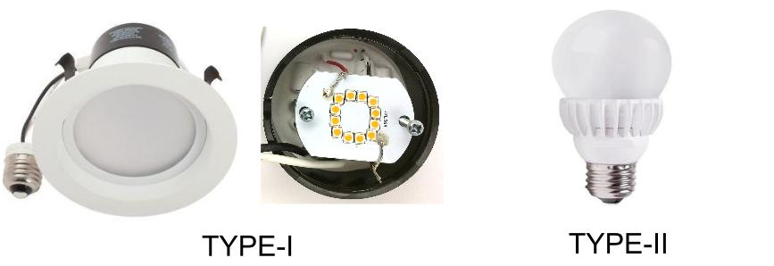
The rise of LEDs
The changing scene of indoor illumination
Incandescent bulb
  Invented over a century ago
  Most commonly used form of light bulbs before 20-30 years
Compact fluorescent (CFL)
  Introduced in 1990s
  Commonly used in lighting systems currently
LEDs
  The future of illumination

Slide 3
The rise of LEDs
Why LEDs?
  Luminous efficacy and lifespan
Luminous efficacy
  How much electricity is used to provide the intended illumination?
  A measure of how much electricity is wasted
  Incandescent and compact fluorescent: 15-60 lumens/watt
  LEDs: 113 lumens/watt as of 2015
Lifespan
  How long before you have to replace a luminaire?
  Compact fluorescent: 10K hours
  LEDs: 25K-50K hours
LED is the future of illumination
  Nearly 75% of all illumination will be provided by LEDs by year 2030 [1]

Slide 4
LEDs for communication
LEDs have a unique advantage
  They can switch on and off very fast (in MHz)
  Difficult to achieve in older illumination technologies without damaging the bulbs
Data communication
  Use the LED ON-OFF signals to send data
  For example, when LED in ON, it means 1, otherwise 0
What is the main advantage of LEDs for communication?
  LEDs are already deployed for illumination everywhere
  Using them for communication means no additional deployment cost

Slide 5
Visible light communication
LED communication utilizes visible light spectrum
Communication at Terahertz frequencies
Example of infrared communication?

Slide 6
VLC vs. RF
Why VLC?
  Reusing existing lighting infrastructure reduces deployment cost
  RF spectrum is congested
VLC can complement RF
  Existing RF networks suffer from severe interference
  Use VLC wherever necessary to relieve congestion
  Coexistence more likely than replacing RF
Advantages of VLC
  Smaller cell radius based on typical luminaire
  Very little interference between cells
  Secure?
Why is VLC more secure than RF?

Slide 7
VLC timeline
Pioneering research
  Keio university in Japan back in 2000
  White LEDs for communication in homes
Standardization
  2003: Visible Light Communication Consortium (VLCC), Japan
  2007: Two VLC communication standards
  Later became JEITA CP-1221 and CP-1222
  2009: Infrared Data Association (IrDA)
  OMEGA – hOME Gigabit Access project in EU
  2011: IEEE standard development
  IEEE 802.15.7 - Short-Range Wireless Optical Communication Using Visible Light

Slide 8
VLC network
Typical use cases
  Indoor networking with high speed, low interference communication
  Low-power communications between sensors
  Typical LED bulb contains many LEDs in it

Slide 9
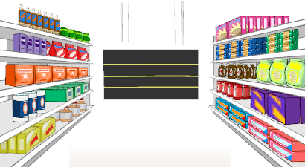




Applications of LED-camera communication
Applications of direct mobile-IoT communication

Slide 10
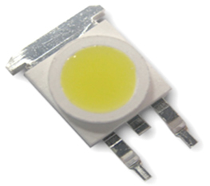
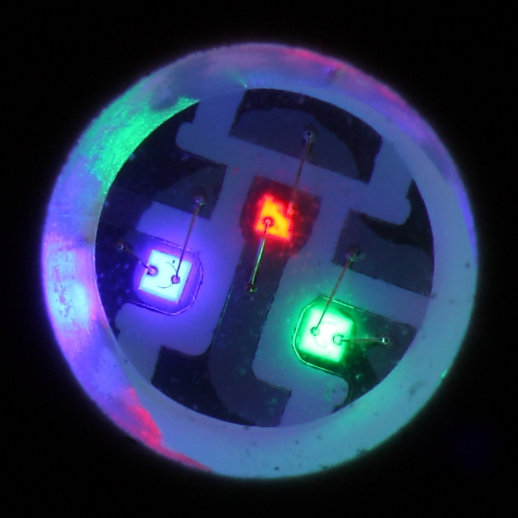
VLC transmitter
LED transmitter
  Typical indoor LEDs used for illumination is white light
White light LED – how LEDs produce white light?
  Blue LED with phosphor
    Blue LED produces blue light which goes through yellow phosphor layer, resulting in white light
    Different shades of white light produced by controlling the thickness of yellow phosphor layer
    Slower on-off speed
  RGB combination LED
    Each white LED is made of three separate LEDs – Red, Green, Blue
    When all three RGB LEDs are powered on, white light is produced
    More expensive than blue LED+phosphor solution
    More options of color configurations
    Faster on-off speeds

Slide 11
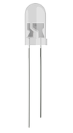
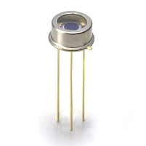
VLC receiver
Two types of VLC receivers
1. Photodetector
  Also called photodiode, non-imaging receiver
  Converts received light to current
  High speed – typical photodiodes can sample at tens or hundreds of MHz
Photodiode output

Slide 12
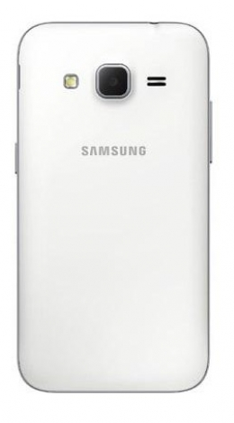
VLC receiver
Two types of VLC receivers
2. Imaging sensor
  Also called camera
  Matrix of photodetectors (pixels), combined with a concentrating lens
  Commonly available on today’s mobile devices
  Slower receiver - reading all pixels (capturing a picture frame) incurs delay
  Frames per second in typical camera in smartphones 40 fps
Matrix of photodiodes

Slide 13
Camera as receiver
Rolling shutter effect
  Today’s CMOS cameras read pixels one column or row at a time
  Analyze the captured picture frame to determine the transmitted data

Slide 14
Visible light propagation
Visible light propagation
  Path loss
  Reflections
  Shadowing
Channel characteristics
  Due to higher frequencies, visible light
    Attenuates much faster
    Cannot penetrate walls and obstacles
Challenge
  LEDs are designed to provide illumination (not communication)
  Using LEDs for communication requires understanding how we perceive light
  General design principle for VLC – do not compromise on LED’s primary purpose of providing illumination

Slide 15
Human eye perceiption
Understanding human eye’s perception of light
  Human eye does not perceive all colors with same sensitivity
  Maximum sensitivity to yellow-green region

Slide 16
LED radiant power
LED design
  Depending on its design, LED emits different amount of power at different wavelengths
Why are there spikes at blue and yellow?
[3]

Slide 17
LED transmitted power
Human eye’s perceived radiated power of LEDs
  Used to design LEDs whose primary purpose is illumination
  F_{T} = transmitted luminous flux (power) from LED, measured in lumens

Slide 18
Luminous path loss
Visible light path loss depends on three main factors
  Irradiation angle, Tx-Rx distance and incident angle
m = 1 for most LEDs

Slide 19
Received power and distance
[3]

Slide 20
Received power and irradiation angle
[3]

Slide 21
Received power and incident angle
  Field Of View (FOV) of a photodiode affects the incident power
  Different receivers can have different FOVs due to the lens in use
[3]

Slide 22
Photodiode receiving
Receiver spectral response
  Responsivity – how much of the optical energy is converted to electrical energy?
  Responsivity can be different for different wavelengths
[3]

Slide 23
Reflections
Light emitted by LEDs reflects from different objects
  Multi-path is also common in visible light communication
Indoor objects and their reflectivity
  Differs based on wavelength
Why?
[3]

Slide 24
Reflections
Received signal is combination of LOS and all non-LOS signals
Non-LOS paths
  Received signal depends on angles of irradiation and incident, and object reflectance
[3]

Slide 25
Reflections
Power delay profile
  LOS signal arrives at the receiver with least delay
  Non-LOS signals arrive after some delay
    Non-LOS paths can also have lower signal strength due to loss in reflection

Slide 26
VLC SNR
Signal to noise ratio (SNR) for visible light communication
  Visible light communication has many noise sources (ambient, shot, thermal)
Ambient noise
  Sunlight and other light sources such as incandescent and fluorescent lamps
  Makes it difficult to determine the data symbols transmitted by LEDs
  How to remove ambient noise?
    Ambient noise is a DC interference – slow moving component
    Remove DC component – apply FFT, remove all components close to 0 Hz frequency
Photodiode output
Ambient noise

Slide 27
VLC modulation
How to modulate data using visible light?
Phase modulations?
  Difficult to manipulate phase at Tera Hertz frequency
  High complexity of hardware design
  Phase and amplitude modulations not used in VLC
Intensity Modulation and Direct Detection (IM/DD)
  Change the intensity of emitted light to encode data
  Receive data using direct detection of intensity
1
1
1
1
1
1
1
1
0
0
0
0
0

Slide 28
IM/DD challenges
What are the challenges with IM/DD modulation?
1. Limited bandwidth
  Bandwidth is limited by how fast LEDs can change intensity
  Most commercial LEDs are designed with illumination in mind
  Current commercial LEDs can provide a bandwidth of 60-80 MHz
  Higher bandwidth possible if LED design is customized
1
1
1
1
1
1
1
1
0
0
0
0
0

Slide 29
IM/DD challenges
2. Dimming
  VLC modulation is based on intensity
  Most LEDs used in illumination allow dimming functionality
  Dimming saves energy - reduce LED intensity when not needed
    30-100 lux sufficient for simple visual tasks in public
    300-1000 lux necessary for office tasks
  If an LED is dimmed, what is its impact on modulation?
What is lux vs. lumens?

Slide 30
Dimming
Dimming is more complex due to human eye’s light perception
  Relationship between perceived light and measure light is non-linear
Non-linearity
  Human eye adapts to lower illumination by enlarging the pupil to allow more light to enter the eye
  A VLC modulation scheme should allow arbitrary level of dimming
Why is it non-linear?

Slide 31
IM/DD challenges
3. Flickering
  If LED is turned on and off for communication, a human eye can perceive it
    This effect is called flickering
  Avoiding flickering
    Research shows that flickering can cause serious detrimental physiological changes in humans
  How to avoid flickering?
    Human eye cannot perceive if LED on/off is faster than 200 Hz
    200 Hz shown to avoid any harmful effects
  Flickering can happen even when LED is switched on/off faster than 200 Hz
    What if your data is 100 0s followed by 100 1s?
Why?

Slide 32
Flickering
Long runs of 0s and 1s in data can cause flickering
Run Length Limited (RLL) codes
  Remove long runs of 0s and 1s with balanced repetition of bits
Types of RLL codes
  Manchester coding
    Replace 0 with 01, and 1 with 10
    Excellent flicker mitigation
    Poor data rate – 100% coding overhead
    Suitable for low data rate VLC
  4B6B (or 8B10B)
    4B6B: Replace each 4 bits sequence with 6 bits
    Carefully choose the 6 bit sequences that are known to have balanced bits
    Example: 0000 -> 001110
    Improved data rate
    Worse flickering performance compared to Manchester coding

Slide 33
Exercise
An LED transmitter is using On-Off Keying (OOK) with on-off frequency of 60 MHz to transmit data.
Receiver 1: A rolling-shutter camera receives the transmitted data. The camera has a resolution of 4160 x 4160 pixels per frame, and a maximum of 40 frames per second can be captured.
Receiver 2: A photodiode (sampling frequency 100 MHz) receives the transmitted data.
Q1: What is the maximum number of transmitted bits per second?
Q2: What is the maximum receiving data rate possible with Receiver 1?
Q3: What is the maximum receiving data rate possible with Receiver 2?
Q4: If the transmitter uses 6B8B RLL coding, what is the rate (bps) of useful data for Receiver 2?

Slide 34
VLC modulations
Important factors to consider
  LED bandwidth
  Dimming
  Flickering
Commonly used modulations
  On-Off Keying (OOK)
  Pulse modulations
  Color Shift Keying (CSK)

Slide 35
OOK modulation
On Off Keying (OOK)
  LED ON means bit 1, OFF means bit 0
  When transmitting 0, LED does not need to be OFF, can simply reduce intensity
  General form: higher intensity means 1, lower intensity means 0
OOK design challenges
  OOK’s efficiency purely depends on how fast an LED can be turned ON/OFF
  When white light is produced using blue LED and yellow phosphor
    Blue LED can achieve much faster ON/OFF speeds
    But yellow phosphor layer slows down ON/OFF speed
  Solution: use a blue light filter on the receiver
    Extract the blue light and use it to detect OOK pulses

Slide 36
Dimming in OOK
Dimming with LEDs
  A user can choose to dim an LED to an arbitrary level
  OOK modulation should work for any dimming level
Two dimming solutions in OOK
  Redefine ON and OFF levels
  Compensation periods

Slide 37
Dimming in OOK
Solution 1: Redefine OOK levels
  Redefine the ON and OFF symbol intensity to achieve the desired level of dimming
  Advantages
    Dimming without any overhead of additional symbols
  Issues?
    Difficult to distinguish ON and OFF at higher dimming levels
    Higher dimming levels provide smaller communication range because of lower pulse intensity
Dimming level
1
1
1
1
1
1
1
1
0 %
0
0
0
0
0
1
1
1
1
1
1
1
1
50 %
0
0
0
0
0
1
1
1
1
1
1
1
1
70 %
0
0
0
0
0

Slide 38
Dimming in OOK
Solution 2: Compensation periods
  Don’t redefine the ON and OFF intensity levels
  Instead achieve dimming by inserting additional ON or OFF symbols
  Additional ON or OFF periods are called compensation periods

Slide 39
Dimming in OOK
Which type (ON or OFF) of compensation periods to add?
  If dimming is more than 50%, add OFF periods
  If dimming is less than 50%, add ON periods
How many compensation periods to add?
  Given a desired dimming level D, the percentage time of active data transmission (γ) can be given by
  Example: for D = 0.7 (70% dimming), percentage time of active data transmission is 60% and compensation periods are transmitted for 40% of the time
Compensation periods
  Advantage?
    Dimming level does not change OOK communication range
  Disadvantage?
    Overhead of additional periods reduce the achievable data rate capacity
What dimming level achieves maximum percentage data transmission time?

Slide 40
VLC modulations
Important factors to consider
  LED bandwidth
  Dimming
  Flickering
Commonly used modulations
  On-Off Keying (OOK)
  Pulse modulations
  Color Shift Keying (CSK)

Slide 41
Pulse modulations
Two types of pulse modulations are used in VLC
  Pulse width modulation (PWM)
  Pulse position modulation (PPM)
Pulse width modulation (PWM)
  Different width of the pulse indicates 0 or 1
  Advantage – any desired level of dimming can be achieved by simply changing the pulse widths of 0 and 1
  Disadvantage – Difficult to distinguish pulse widths, especially at higher dimming levels

Slide 42
Pulse modulations
Pulse Position Modulation (PPM)
  Position of the pulse within the symbol interval indicates 0 or 1
  If the pulse is at the start of the interval, infer 0
  If the pulse is at the end of the interval, infer 1
  Advantage
    Independent of pulse width, more robust in detecting 0 or 1 compared to PWM
  Disadvantage?
    Difficult to achieve desired level of dimming
    Achieving dimming requires changing the intensity of pulses, which in turn reduces the range of PPM

Slide 43
Pulse modulations
Variable Pulse Position Modulation (VPPM)
  A combination of PWM and PPM – get the best of both schemes
  Use pulse position (similar to PPM) to indicate 0 or 1
  Use pulse width (as in PWM) to achieve desired level of dimming
[2,3]

Slide 44
VLC modulations
Important factors to consider
  LED bandwidth
  Dimming
  Flickering
Commonly used modulations
  On-Off Keying (OOK)
  Pulse modulations
  Color Shift Keying (CSK)

Slide 45
Color Shift Keying (CSK)
New generation of white LEDs
  Do not rely on blue LED and yellow phosphor to produce white light
  Instead, uses three separate red, green and blue LEDs
  When all three RGB LEDs are turned on together, white light is produced
Color Shift Keying (CSK)
  Use different colors to convey different symbols
  For example: Red – 00, Green – 01, Blue – 10, White - 11
  A large number of colors can be produced by mixing red, green and blue
  Control the intensity of R, G and B to achieve higher order CSK
How to design CSK modulation?

Slide 46
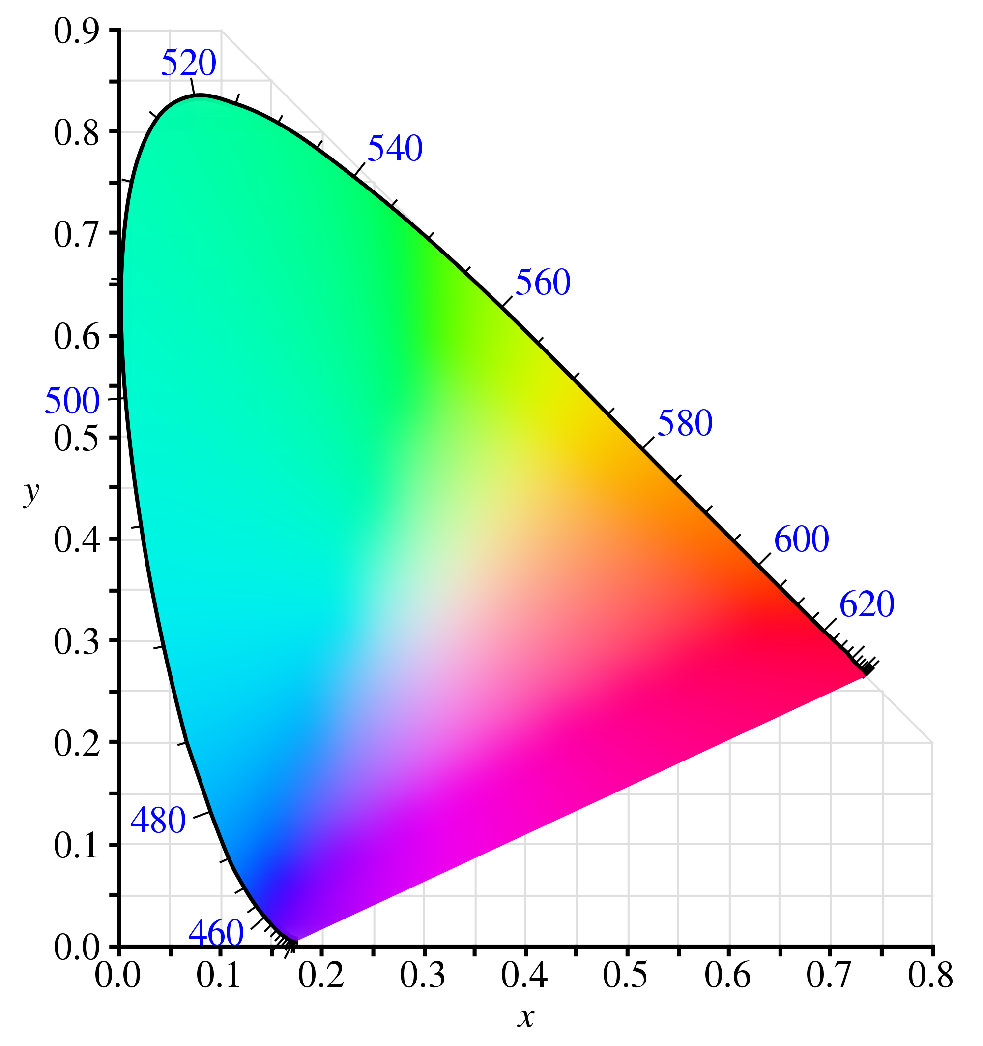
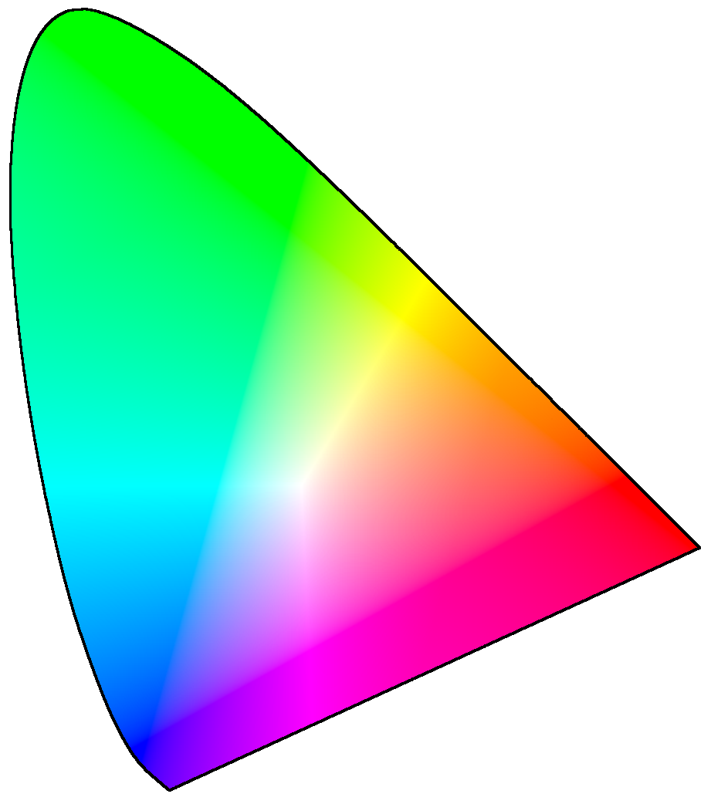
CSK constellation design
CSK constellation design
  Uses CIE 1931 color space diagram
CIE 1931 color space diagram
  A two dimensional representation of all human visible color wavelengths
[3]
Color wavelengths
CIE 1931 color space

Slide 47
CSK modulation
Step 1: draw constellation triangle on CIE 1931 color space
Constellation triangle
  Use the base line wavelength of R, G and B LEDs as three corners of triangle

Slide 48
CSK modulation
Step 1: draw constellation triangle on CIE 1931 color space
Constellation triangle
  Use the base line wavelength of R, G and B LEDs as three corners of triangle

Slide 49
CSK modulation
Step 2: Pick color symbols within the triangle

Slide 50
802.15.7 – VLC standard
IEEE 802.15.7
  PHY and MAC layer specification
  LEDs as transmitters and photodiodes as receivers
PHY layer specifications
  Modulations
    OOK, VPPM and CSK
  Error correction coding
    Reed Solomon (RS) codes and Convolution Codes (CC)
    RS (n, k) means a codeword of n bits is generated by adding n-k parity bits to k data bits
    RS (n, k) can detect errors in up to 2t bits and correct errors in up to t bits where 2t = n - k
  RLL coding
    Manchester, 4B6B and 8B10B

Slide 51
802.15.7 – PHY I
PHY – I
  Designed for reliability and low data rate applications
[2,3]

Slide 52
802.15.7 – PHY II
[2,3]

Slide 53
802.15.7 – PHY III
[2,3]
No RLL coding in CSK, is CSK flicker free?

Slide 54
Imaging receiver
Photodiodes
  Faster response time
  Better sampling rate
Challenges
  Dedicated photodiode must be deployed in mobile devices
  Current mobile devices contain a photodiode
  Sampling limited by smartphone OS
Imaging receivers (camera)
  Matrix of photodiodes
  Ubiquitous in mobile devices
  High resolution camera sensors already available in our smartphones
Challenge?
  Extremely slow in comparison to single photodiode
What’s the use of photodiode in today’s smartphone?

Slide 55
Camera as receiver
Rolling shutter effect
  Today’s CMOS cameras read pixels on column or row at a time
  Analyze the captured picture frame to determine the transmitted data

Slide 56
Applications of LED-camera communication
Applications of direct mobile-IoT communication

Slide 57
LED-camera communication
Mobile-IoT communication requirements
  IoT side
    Use low power communication techniques
  Mobile side
    Use existing sensors on the mobile device
Wireless communication techniques
  RF (Bluetooth, ZigBee etc.)
  NFC
  QR code – camera
  LED – camera
Transmitter visual association
  Look at an object and receive information specifically from it
  Difficult to achieve with RF
What are the differences?

Slide 58

LED-camera communication
Modulation schemes
On-Off Keying (OOK)
  Switch LED on and off to send 1 and 0 respectively
  Analyze the received camera frame to detect sent symbols
Problems
  Ambient light interference – photodiode saturates just because of ambient light, difficult to distinguish ON/OFF
  Wider pulses – slower ON/OFF frequency
    Lower data rate
    Flickering

Slide 59

LED-camera communication
Frequency Shift Keying (FSK)
  Different On-Off frequencies different symbols
  Lower inter-symbol interference
    Better demodulation accuracy
Problems
  Longer symbol duration
  Lower data rate (<12 bytes/second)
    Not sufficient for most applications, even sending long plain text messages
1
0

Slide 60
LED-camera communication
Color Shift Keying (CSK)
  Use different colors as different data symbols
  Especially suitable for camera receivers
    Today’s cameras can receive a wide variety of colors
How?
  Use RGB tri-LED instead of conventional white LED
  Conventional white LED: white light is produced using blue LED and yellow phosphor cover
  RGB tri-LED: when all R, G and B LEDs in the tri-LED are turned on, white light is produced
CSK
  Generate different colors by mixing different intensity of R, G and B

Slide 61
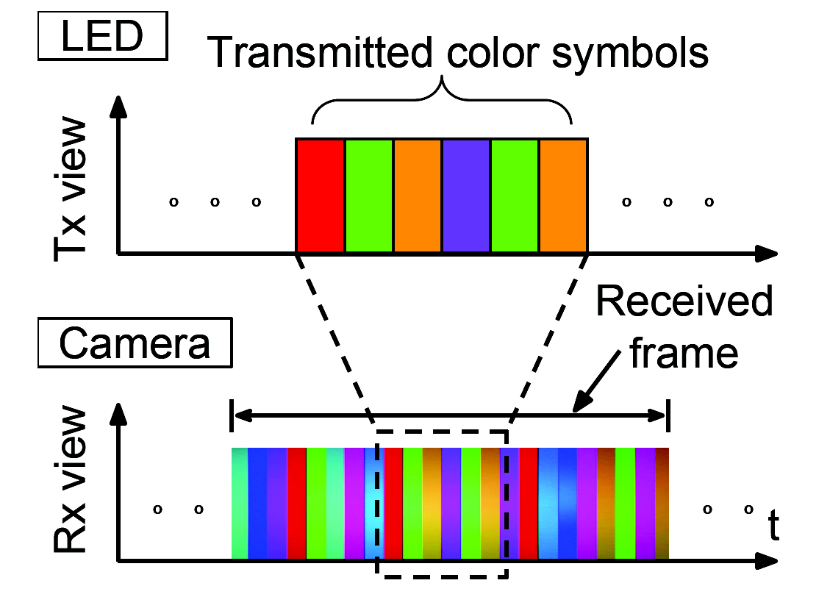
LED-camera communication
CSK modulation for LED-camera communication
How to choose the colors for symbols?
  Minimize inter-symbol interference

Slide 62
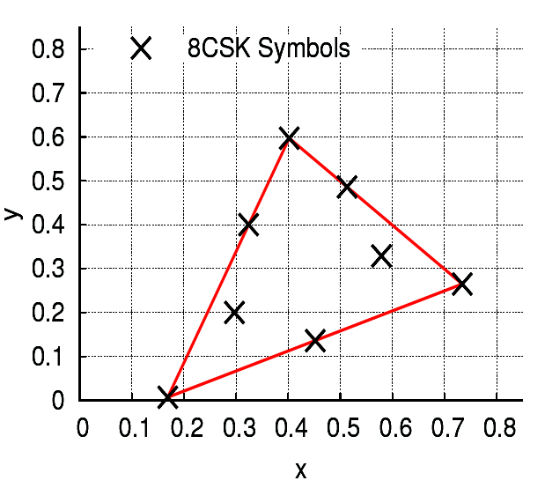
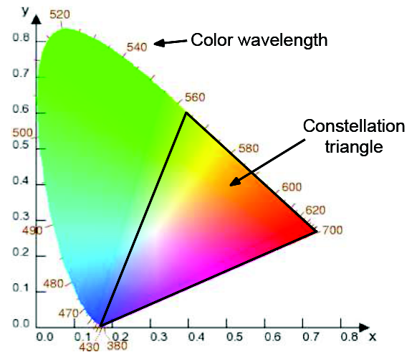
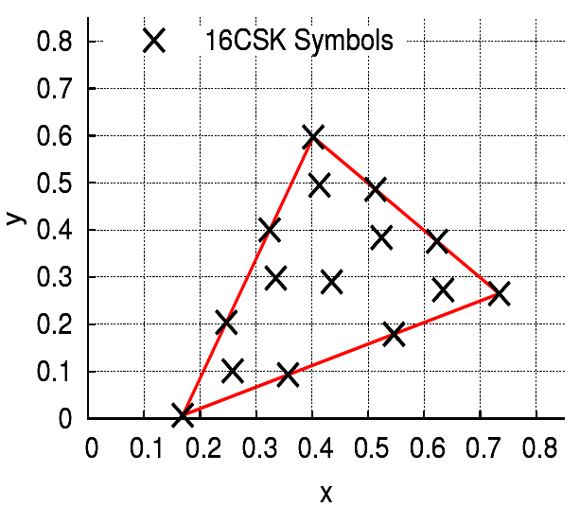
LED-camera communication
CSK as proposed in 802.15.7
  Use CIE 1931 color space
8 CSK
16 CSK

Slide 63
LED-camera communication
CSK in LED-camera communication
Challenges
  Color flicker
  Inter-frame data loss
  Receiver diversity
Color flicker
  LED’s primary purpose is illumination
  Guaranteeing white light illumination even when using CSK
  Avoiding human perceivable color or change of color

Slide 64
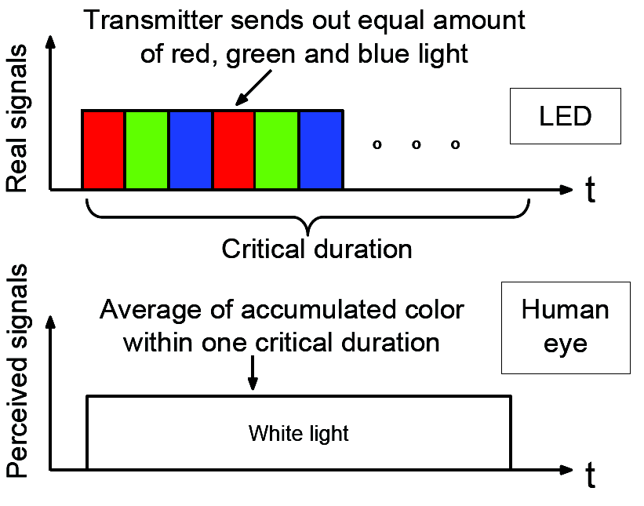
Color flicker
Temporal summation
  Human eye “accumulates” incoming photons for a period of time until it saturates
  The time period is called “critical duration”
Luminance and color perception
  The perceived color is the average of the received colors during the critical duration due to the temporal summation (Bloch’s law of vision)

Slide 65
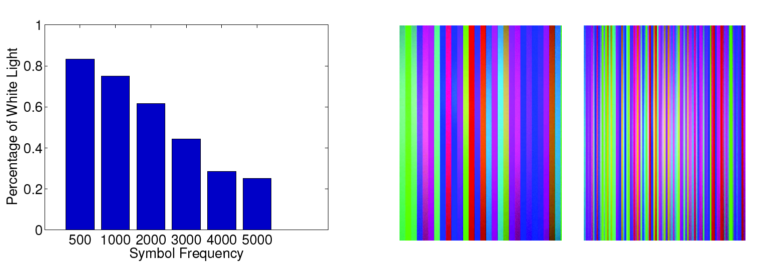
Color flicker
Difficult to ensure equal proportion of R, G and B within critical duration
Dedicated illumination symbols
  Inserted periodically
  Amount depends on symbol frequency, also subjective
Higher symbol freq. =>
more demodulation errors
10 volunteers
1000 Sym./sec.
3000 Sym./sec.

Slide 66
LED-camera communication
CSK in LED-camera communication
Challenges [4]
  Color flicker
  Inter-frame data loss
  Receiver diversity

Slide 67
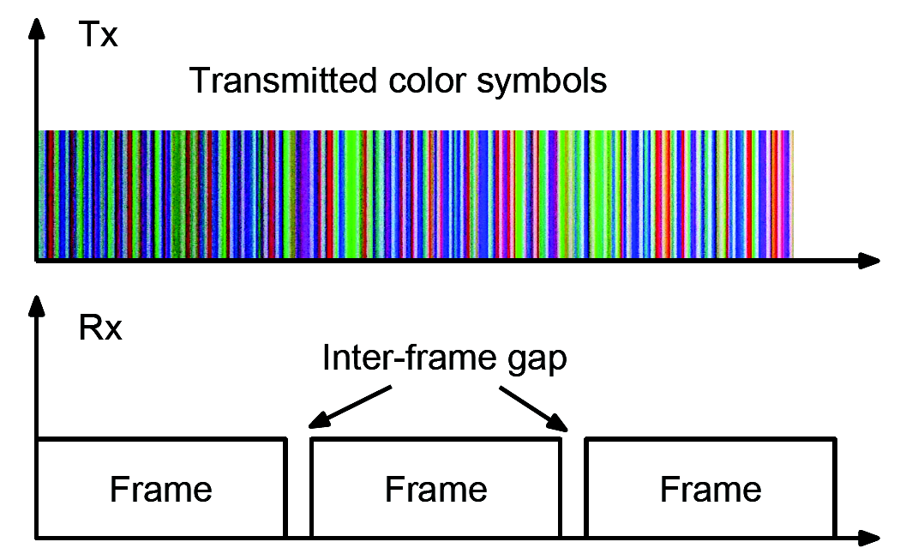
LED-camera communication
Inter-frame data loss
  Inter-frame gap of camera receivers
  Time gap between two consecutive frame captures
  Unidirectional communication
  How to ensure reliable data delivery?
Reed-Solomon error correction coding
  RS(n,k) can correct t bit errors where 2t = n - k, n is the size of the codeword and k is number of data bits

Slide 68
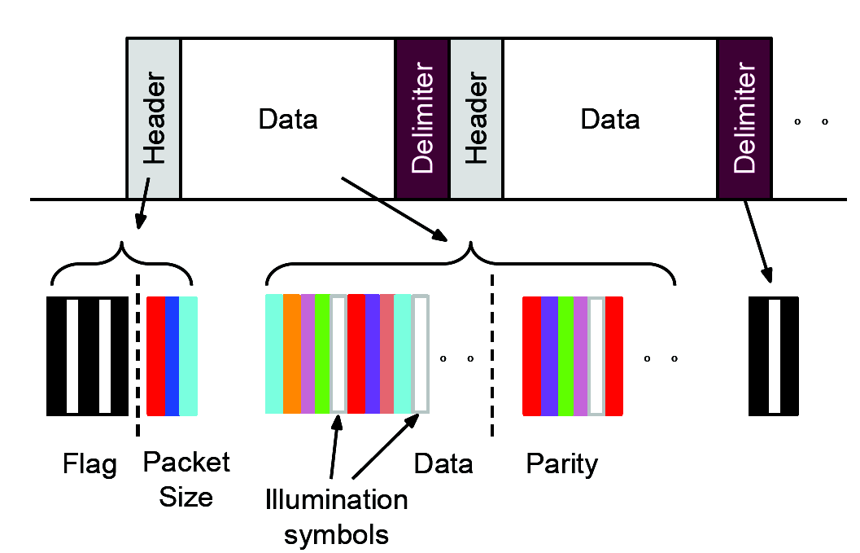
Packetization
Data, parity and illumination symbols are encapsulated in a packet
  Packet header includes
Flag indicating data or calibration packet
Size of the packet
Size of a packet is chosen to be total size of a frame and inter-frame gap

Slide 69
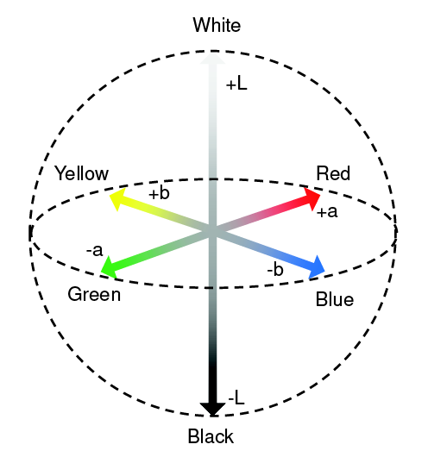
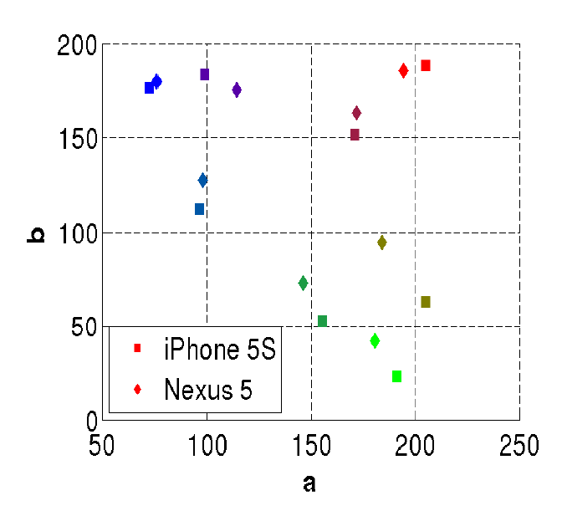
CSK for LED-camera communication
Receiver diversity
  Differences in cameras based on color filters, types and arrangements
  Same transmitted color captured differently by different cameras
  Reduce demodulation errors
Camera exposure time and ISO also affect the captured color
Solution?
  Calibration packets
  Transmitted periodically
  Includes all symbols of current CSK modulation
  Receiver uses the symbol colors for matching during demodulation
CIELab color space
Camera diversity

Slide 70
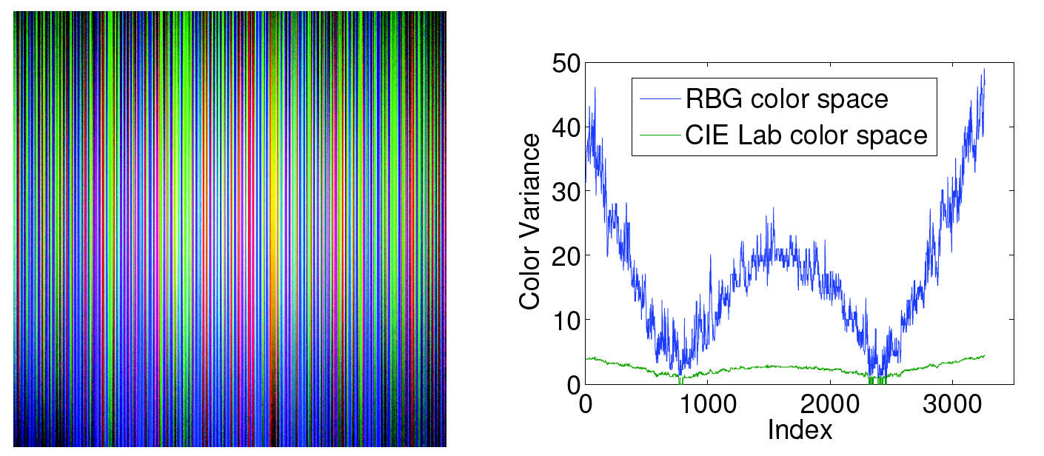
Demodulation
Demodulation uses CIELab color space
  Color is converted from RGB to {a, b}
Brightness is non-uniformly distributed in the captured frame
  Dimension L is removed
Colors of calibration packets used for matching (Euclidean distance in a,b-plane)
CIELab color space

Slide 71
Inter-frame loss ratio
Cameras on Nexus 5 and iPhone5S
  Frame rate - 30 frames per second
  How can we measure the inter-frame loss ratio of a phone?
Transmission Symbol Rate (Hz) | Received Symbol Rate (Hz)
 | Nexus 5 | iPhone 5S
1000 | 772.84 | 640.55
2000 | 1506.11 | 1263.56
3000 | 2352.65 | 1887.73
4000 | 3060.67 | 2431.01
Avg. Inter-frame Loss Ratio | 0.23 | 0.37

Slide 72
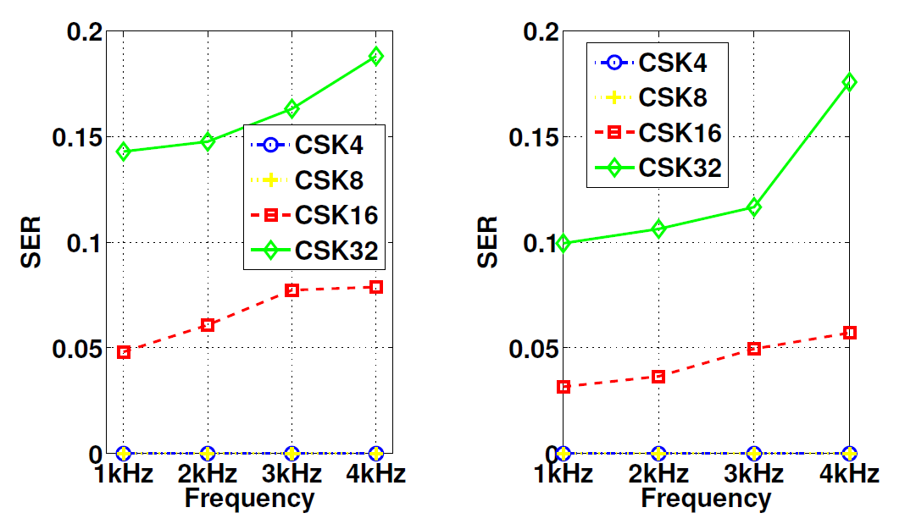
Symbol Error Rate (SER)
Fraction of symbols incorrectly demodulated
  Low SER for 4 and 8 CSK even at high symbol frequency
  High inter-symbol interference at 16 and 32 CSK
Nexus 5
iPhone 5S

Slide 73
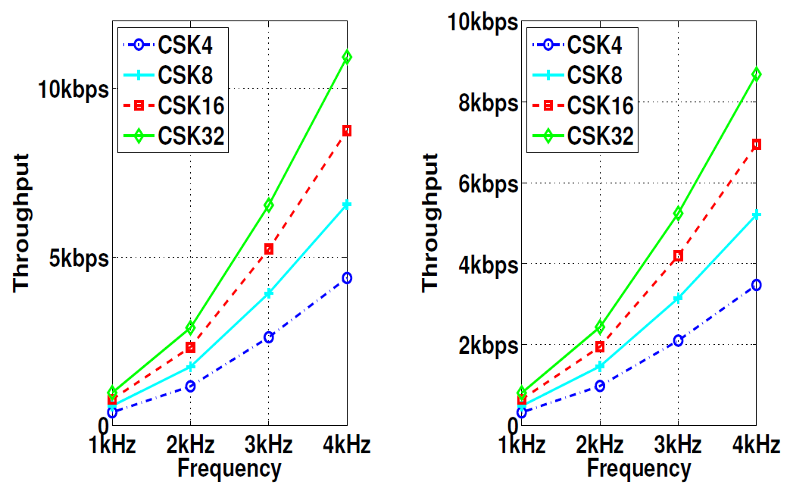
Throughput
Number of received symbols without any error correction
  Excluding the illumination symbols
Lower throughput of iPhone 5S?
  due to its larger inter-frame gap
Nexus 5
iPhone 5S

Slide 74
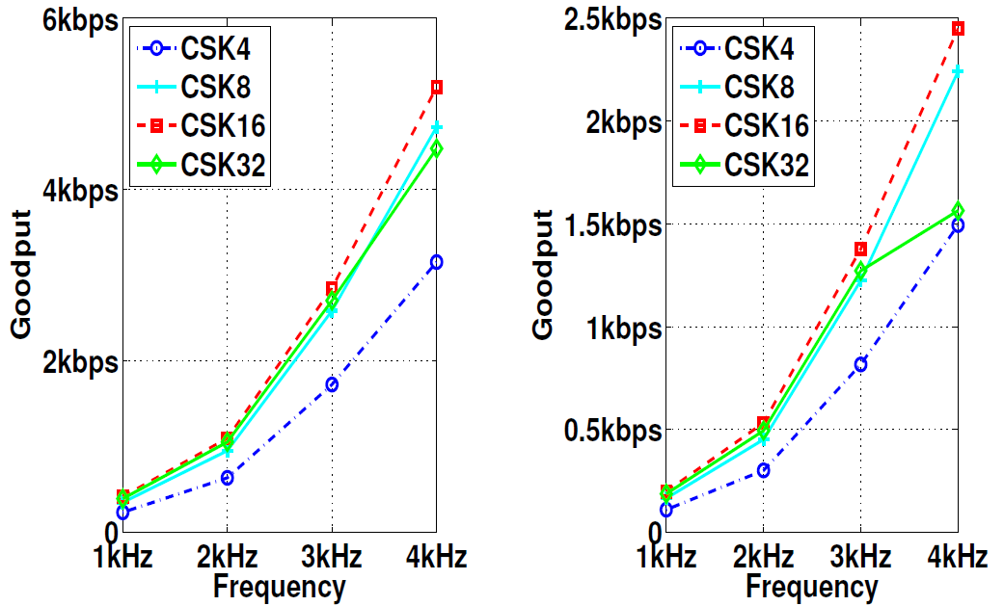
Goodput
RS decoding and error correction
Lower goodput of iPhone 5S?
  Due to higher overhead of parity bits (larger inter-frame gap)
Nexus 5
iPhone 5S
5.2 Kbps
2.5 Kbps

Slide 75
Challenges
  [1] http://apps1.eere.energy.gov/buildings/publications/pdfs/ssl/energysavingsforecast14.pdf
  [2] Rajagopal, Sridhar, Richard D. Roberts, and Sang-Kyu Lim. "IEEE 802.15. 7 visible light communication: modulation schemes and dimming support."IEEE Communications Magazine 50, no. 3 (2012): 72-82.
  [3] Pathak, Parth H., Xiaotao Feng, Pengfei Hu, and Prasant Mohapatra. "Visible light communication, networking, and sensing: A survey, potential and challenges." IEEE Communications Surveys & Tutorials 17, no. 4 (2015): 2047-2077.
  [4] Hu, Pengfei, Parth H. Pathak, Xiaotao Feng, Hao Fu, and Prasant Mohapatra. "ColorBars: Increasing Data Rate of LED-to-Camera Communication using Color Shift Keying." Proceedings of the ACM CoNEXT(2015): 1-12.

