Slide 1
Wireless Networking - I:
MAC Design
CS 655: Wireless and Mobile Computing
Parth H. Pathak

Slide 2
Wireless networking - I
Today’s agenda
  802.11 overview
  CSMA/CA – 802.11 MAC design
  Wide band channel access
    802.11n/ac MAC
    Energy efficiency

Slide 3
How we got here?
The evolution of IEEE 802.11 standards
From 802.11ac: A Survival Guide, by Matthew Gast, O'Reilly Media.

Slide 4

WiFi and Internet protocol layers
Application
HTTP, HTTPS, FTP, SSH, DNS etc.
Transport
End-to-end transport
TCP, UDP
Difference between LLC and MAC?
Network
Internet addressing, routing
IP
802.11
MAC
Logical Link Layer (LLC) + Medium Access Control (MAC)
PHY
Physical layer

Slide 5








Link Layer: introduction
terminology:
hosts and routers: nodes
communication channels that connect adjacent nodes along communication path: links
  wired links
  wireless links
  LANs
layer-2 packet: frame, encapsulates datagram
data-link layer has responsibility of
transferring datagram from one node
to physically adjacent node over a link

Slide 6
Link layer: context
datagram transferred by different link protocols over different links:
  e.g., Ethernet on first link, frame relay on intermediate links, 802.11 on last link
each link protocol provides different services
  e.g., may or may not provide reliable delivery over link

Slide 7

Link layer services
framing, link access:
  encapsulate datagram into frame, adding header, trailer
  channel access if shared medium
  “MAC” addresses used in frame headers to identify source, destination
    different from IP address!
reliable delivery between adjacent nodes
  seldom used on low bit-error link (fiber, some twisted pair)
  wireless links: high error rates
    Q: why both link-level and end-end reliability?

Slide 8
Link layer services (more)
error detection:
  errors caused by signal attenuation, noise.
  receiver detects presence of errors:
    signals sender for retransmission or drops frame
error correction:
  receiver identifies and corrects bit error(s) without resorting to retransmission

Slide 9
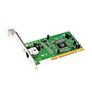
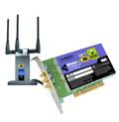

Where is the link layer implemented?
in each and every host
link layer implemented in “adaptor” (aka network interface card NIC) or on a chip
  Ethernet card, 802.11 card; Ethernet chipset
  implements link, physical layer
attaches into host’s system buses
combination of hardware, software, firmware
application
transport
network
link
cpu
memory
link
physical
host
bus
(e.g., PCI)
controller
physical
transmission
network adapter
card

Slide 10
Adaptors communicating
datagram
datagram
controller
controller
sending host
receiving host
datagram
frame
sending side:
  encapsulates datagram in frame
  adds error checking bits, rdt, etc.
receiving side
  looks for errors, rdt, etc.
  extracts datagram, passes to upper layer at receiving side

Slide 11
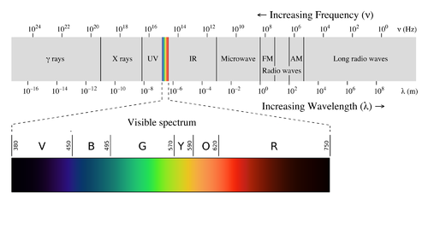
Electromagnetic Spectrum
  https://en.wikipedia.org/wiki/Electromagnetic_radiation

Slide 12
Radio spectrum
Radio frequency spectrum: 3 KHz to 300 GHz
https://www.ntia.doc.gov/files/ntia/publications/spectrum_wall_chart_aug2011.pdf

Slide 13
Spectrum and WiFi ISM bands
ISM = Industrial, Scientific and Medical purposes
  Unlicensed!!
2.4 GHz ISM band
5 GHz ISM band

Slide 14
802.11 PHY and MAC
 | 802.11b | 802.11a | 802.11g | 802.11n | 802.11ac
Frequency | 2.4 GHz | 5 GHz | 2.4 GHz | 2.4/5 GHz | 5 GHz
Channel width
PHY
MIMO & beamforming
Max. data rate

Slide 15
802.11 PHY and MAC
 | 802.11b | 802.11a | 802.11g | 802.11n | 802.11ac
Frequency | 2.4 GHz | 5 GHz | 2.4 GHz | 2.4/5 GHz | 5 GHz
Channel width | 20 MHz | 20 MHz | 20 MHz | 20/40 MHz | 20/40/80/160 MHz
PHY
MIMO & beamforming
Max. data rate

Slide 16
802.11 PHY and MAC
 | 802.11b | 802.11a | 802.11g | 802.11n | 802.11ac
Frequency | 2.4 GHz | 5 GHz | 2.4 GHz | 2.4/5 GHz | 5 GHz
Channel width | 20 MHz | 20 MHz | 20 MHz | 20/40 MHz | 20/40/80/160 MHz
PHY | DSSS/CCK | OFDM | OFDM, DSSS/CCK | OFDM | OFDM
MIMO & beamforming
Max. data rate

Slide 17
802.11 PHY and MAC
 | 802.11b | 802.11a | 802.11g | 802.11n | 802.11ac
Frequency | 2.4 GHz | 5 GHz | 2.4 GHz | 2.4/5 GHz | 5 GHz
Channel width | 20 MHz | 20 MHz | 20 MHz | 20/40 MHz | 20/40/80/160 MHz
PHY | DSSS/CCK | OFDM | OFDM, DSSS/CCK | OFDM | OFDM
MIMO & beamforming | No | No | No | Yes | Yes
Max. data rate

Slide 18
802.11 PHY and MAC
 | 802.11b | 802.11a | 802.11g | 802.11n | 802.11ac
Frequency | 2.4 GHz | 5 GHz | 2.4 GHz | 2.4/5 GHz | 5 GHz
Channel width | 20 MHz | 20 MHz | 20 MHz | 20/40 MHz | 20/40/80/160 MHz
PHY | DSSS/CCK | OFDM | OFDM, DSSS/CCK | OFDM | OFDM
MIMO & beamforming | No | No | No | Yes | Yes
Max. data rate | 11 Mbps | 54 Mbps | 54 Mbps | 600 Mbps | ~6933 Mbps
Are these the speeds you get?

Slide 19
802.11 PHY and MAC
MAC:
CSMA/CA and wideband medium access
 | 802.11b | 802.11a | 802.11g | 802.11n | 802.11ac
Frequency | 2.4 GHz | 5 GHz | 2.4 GHz | 2.4/5 GHz | 5 GHz
Channel width | 20 MHz | 20 MHz | 20 MHz | 20/40 MHz | 20/40/80/160 MHz
PHY | DSSS/CCK | OFDM | OFDM, DSSS/CCK | OFDM | OFDM
MIMO & beamforming | No | No | No | Yes | Yes
Max. data rate | 11 Mbps | 54 Mbps | 54 Mbps | 600 Mbps | ~6933 Mbps
PHY-I:
OFDM and modulation
PHY-II:
MIMO and beamforming

Slide 20
Non-overlapping channels
2.4 GHz ISM band
  11 channels of ~20 MHz bandwidth
  3 non overlapping channels (1, 6, 11)
  802.11 b/g/n
(1) 2.412 GHz | (2) 2.417 GHz | (3) 2.422 GHz | (4) 2.427 GHz | (5) 2.432 GHz | (6) 2.437 GHz | (7) 2.442 GHz | (8) 2.447 GHz | (9) 2.452 GHz | (10) 2.457 GHz | (11) 2.462 GHz

Slide 21
Non-overlapping channels
5 GHz ISM band
  20 MHz bandwidth channels for 802.11a/n/ac
  40 MHz bandwidth channels for 802.11n/ac
  80 and 160 MHz bandwidth channels for 802.11ac
Non-overlapping channels
20 MHz | 25
40 MHz | 12
80 MHz | 6
160 MHz | 2
InSSIDer

Slide 22




Multiple access links, protocols
two types of “links”:
point-to-point
  PPP for dial-up access
  point-to-point link between Ethernet switch, host
broadcast (shared wire or medium)
  old-fashioned Ethernet
  upstream HFC
  802.11 wireless LAN
shared wire (e.g.,
cabled Ethernet)
shared RF
(e.g., 802.11 WiFi)
shared RF
(satellite)
humans at a
cocktail party
(shared air, acoustical)

Slide 23
Multiple access protocols
single shared broadcast channel
two or more simultaneous transmissions by nodes: interference
  collision if node receives two or more signals at the same time
multiple access protocol
distributed algorithm that determines how nodes share channel, i.e., determine when node can transmit
communication about channel sharing must use channel itself!
  no out-of-band channel for coordination

Slide 24
An ideal multiple access protocol
given: broadcast channel of rate R bps
desiderata:
  1. when one node wants to transmit, it can send at rate R.
  2. Fair: when M nodes want to transmit, each can send at average rate R/M
  3. fully decentralized:
    no special node to coordinate transmissions
    no synchronization of clocks, slots
  4. simple

Slide 25
MAC protocols: taxonomy
three broad classes:
channel partitioning
  divide channel into smaller “pieces” (time slots, frequency, code)
  allocate piece to node for exclusive use
random access
  channel not divided, allow collisions
  “recover” from collisions
“taking turns”
  nodes take turns, but nodes with more to send can take longer turns

Slide 26
Channel partitioning MAC protocols: TDMA
TDMA: time division multiple access
access to channel in "rounds"
each station gets fixed length slot (length = packet transmission time) in each round
example: 6-station LAN, 1,3,4 have packets to send, slots 2,5,6 idle
problem?
  unused slots go idle
6-slot
frame
6-slot
frame
1
3
4
1
3
4

Slide 27
Channel partitioning MAC protocols: FDMA
FDMA: frequency division multiple access
channel spectrum divided into frequency bands
each station assigned fixed frequency band
unused transmission time in frequency bands go idle
example: 6-station LAN, 1,3,4 have packet to send, frequency bands 2,5,6 idle
time
frequency bands
FDM cable

Slide 28
Random access protocols
when node has packet to send
  transmit at full channel data rate R.
  no a priori coordination among nodes
two or more transmitting nodes ➜ “collision”,
random access MAC protocol specifies:
  how to detect collisions
  how to recover from collisions (e.g., via delayed retransmissions)
examples of random access MAC protocols:
  slotted ALOHA
  ALOHA
  CSMA, CSMA/CD, CSMA/CA

Slide 29
CSMA (carrier sense multiple access)
CSMA: listen before transmit:
if channel sensed idle: transmit entire frame
if channel sensed busy, defer transmission
human analogy: don’t interrupt others!
Can collisions still occur?

Slide 30
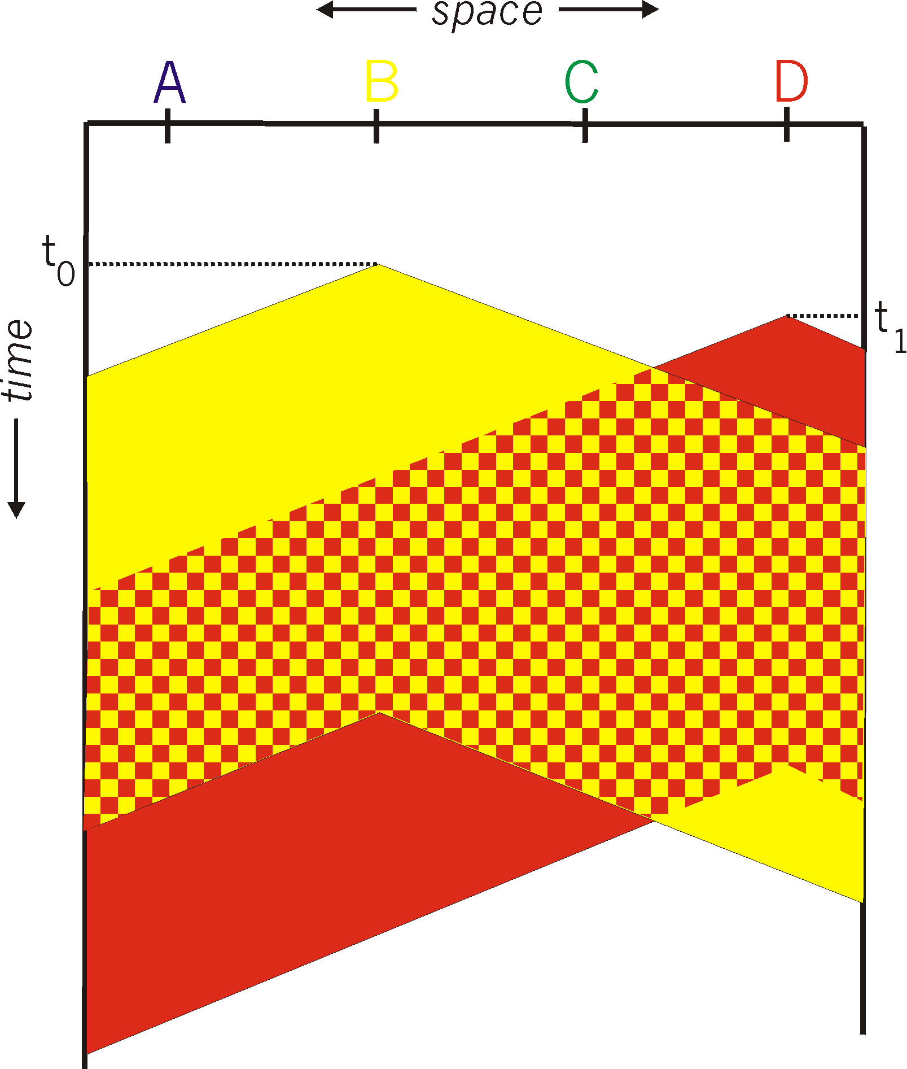
CSMA collisions
spatial layout of nodes
collisions can still occur: propagation delay means two nodes may not hear each other’s transmission
collision: entire packet transmission time wasted
  distance & propagation delay play role in in determining collision probability

Slide 31
CSMA/CD (collision detection)
CSMA/CD: carrier sensing, deferral as in CSMA
  collisions detected within short time
  colliding transmissions aborted, reducing channel wastage
collision detection:
  easy in wired LANs: measure signal strengths, compare transmitted, received signals
  difficult in wireless LANs: received signal strength overwhelmed by local transmission strength
human analogy: the polite conversationalist

Slide 32
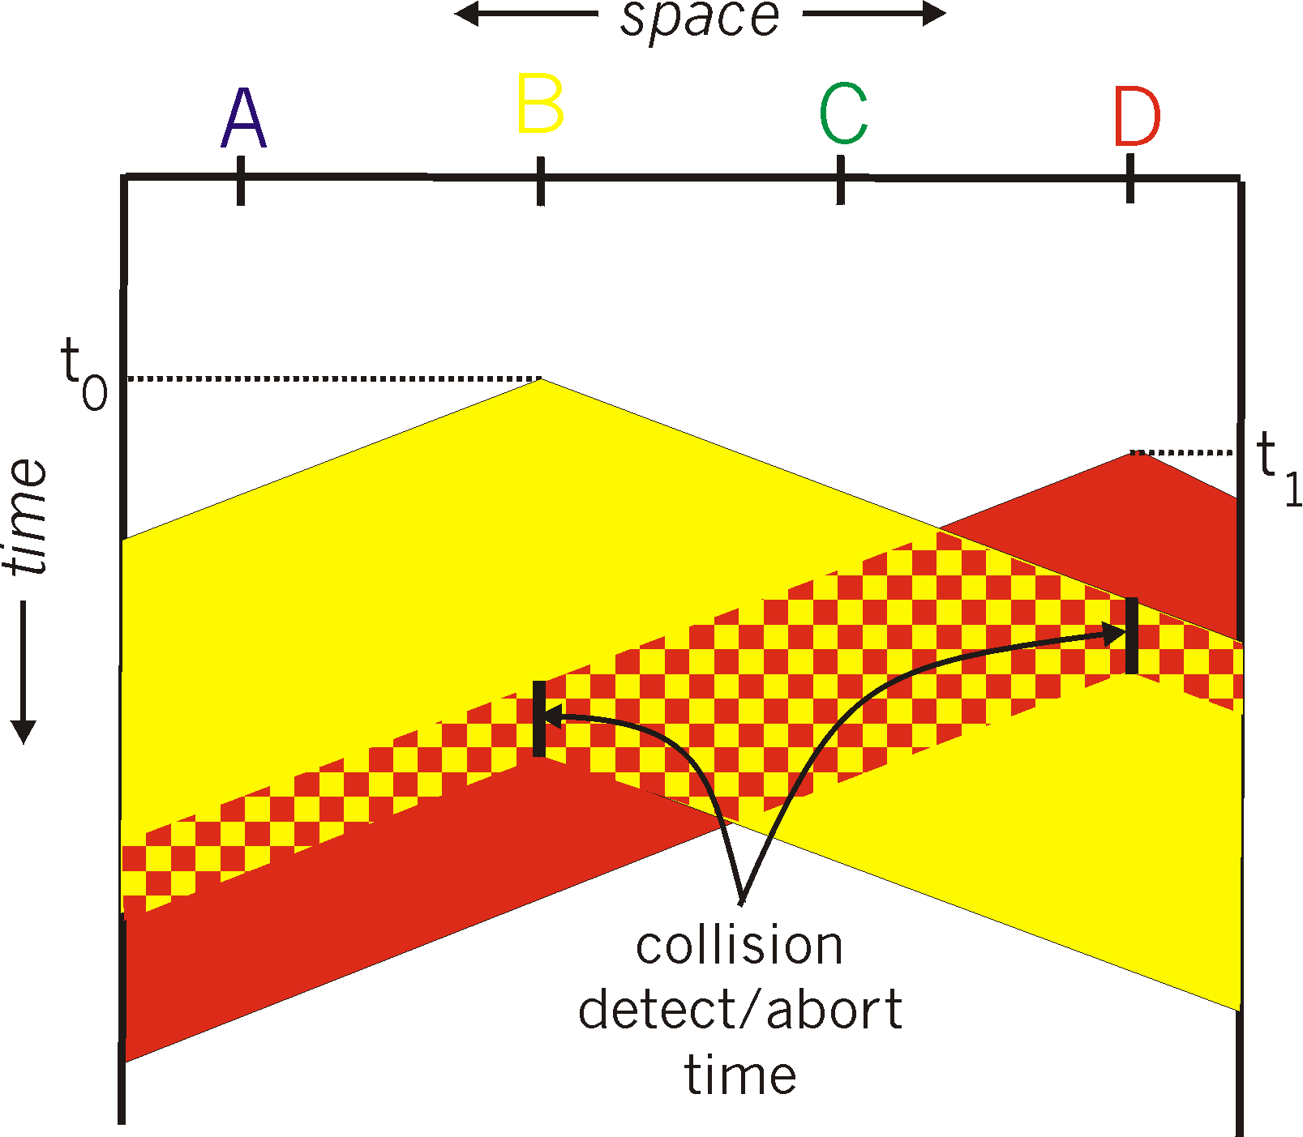
CSMA/CD (collision detection)
spatial layout of nodes

Slide 33
Ethernet CSMA/CD algorithm
1. NIC receives datagram from network layer, creates frame
2. If NIC senses channel idle, starts frame transmission. If NIC senses channel busy, waits until channel idle, then transmits.
3. If NIC transmits entire frame without detecting another transmission, NIC is done with frame !
4. If NIC detects another transmission while transmitting, abort transmission
5. After aborting, go to step 2
Any possible issues executing this algorithms

Slide 34
Ethernet CSMA/CD algorithm
1. NIC receives datagram from network layer, creates frame
2. If NIC senses channel idle, starts frame transmission. If NIC senses channel busy, waits until channel idle, then transmits.
3. If NIC transmits entire frame without detecting another transmission, NIC is done with frame !
4. If NIC detects another transmission while transmitting, abort transmission
5. After aborting, NIC enters binary (exponential) backoff:
  after mth collision, NIC chooses K at random from {0,1,2, …, 2^{m}-1}. NIC waits K·512 bit times, returns to Step 2
  longer backoff interval with more collisions

Slide 35
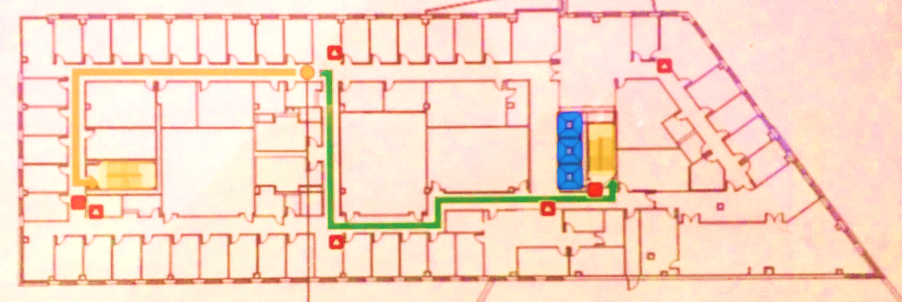
Frequency reuse and interference
Deploy a WiFi network in the Engineering building

Slide 36
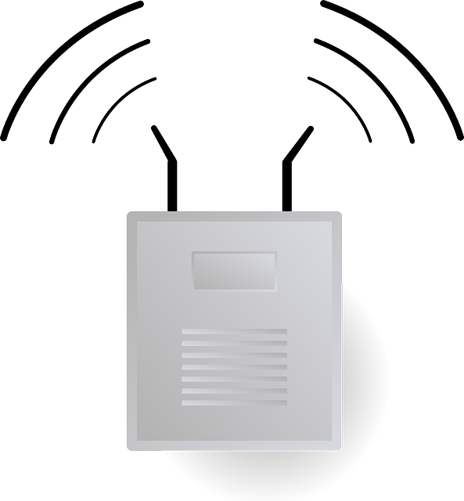

Frequency reuse and interference
Deploy a WiFi network in the Engineering building
  Use one channel from (1,6,11)
  Cons: Interference between adjacent cells
  Pros: Seamless mobility for clients roaming around different cells
Single channel network
client
cell

Slide 37
Frequency reuse and interference
Deploy a WiFi network in the Engineering building
  Use three channels (1,6,11)
  Pros: lower interference between cells – higher data rates
  Cons: client mobility between cells is challenging
Multi channel network
client
cell

Slide 38
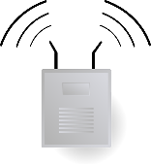
CSMA – listen before you talk
Simultaneous packet transmissions -> packet collisions
  Difficult to decode packets
  Time and bandwidth wasted
CSMA: if there is an ongoing transmission
  Defer your transmission to avoid collision
How to listen, defer and transmit?
  Measure the energy on the channel
  If energy > threshold
    Defer
  If energy < threshold
    Transmit
How to choose the “Carrier Sense Threshold?”
  Crucial in detecting an ongoing transmission
A
C
B

Slide 39
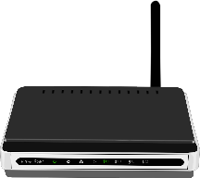

Wireless signal propagation
Transmitted signal attenuates with distance
  Received power can be very small at a farther distance
  Difficult to present in mW; dBm and dB units are often used
Tx power = 10 mW
Rx power = 0.0001 mW

Slide 40

Wireless signal propagation
Transmitted signal attenuates with distance
  Received power can be very small at a farther distance
  Difficult to present in mW; dBm and dB units are often used
  Loss or gain in power is presented with dB
  $PdB=10\log{10}\frac{P}{P0}$
  When P₀=1 mW, power P in mW can be converted to dBm
P₀= reference power
mW | dBm
1 | 0
10 | 10
100 | 20
1000 | 30
mW | dBm
0.1 | -10
0.01 | -20
0.001 | -30
0.0001 | -40

Slide 41
Transmitted and received power
Transmitted power (Tx)
  Example: RF Tx power is 18dBm and access point has an antenna of 7dB, the total Tx power is 25dBm
Received power (Rx)
  Tx power (dBm) = NIC Tx power (dBm) + Tx antenna gain (dB)
  Rx power (dBm) = Tx power (dBm) + Rx antenna gain (dB) – Losses (dB)
  What are these losses?

Slide 42
Path loss
Signal attenuation with distance – called path loss (L_{dB})
  f = signal frequency in MHz (e.g. 2.4 or 5 GHz),
  d = distance between Tx and Rx in meters,
  n = path loss exponent
  $$LdB=20\log{10 f+10 n\log{10d −27.55}}$$

Slide 43
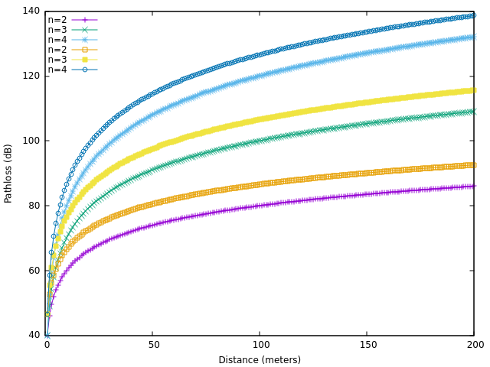
Path loss
  $$LdB=20\log{10 f+10 n\log{10d −27.55}}$$
2.4 GHz
5 GHz
  n can be as high as 6 in dense indoor environment

Slide 44
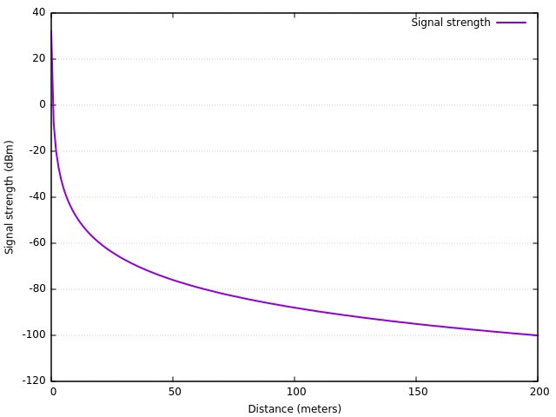
CST and path loss example
Consider Tx and Rx where
  NIC Tx power = 18 dBm, Tx antenna gain = 7 dB, Rx antenna gain = 7 dB
  Freq. = 2.4 GHz, n = 4
  Carrier sense threshold = -90 dBm
1. Node at 100m from TX
Defers its transmission
2. Node at 115m from Tx
Can transmit simultaneously
112 meters

Slide 45
Carrier sense threshold (CST)
Lower CST value results in larger carrier sense range
  A node will defer for ongoing transmission of other nodes at farther distances
CST = -90 dBm
CST = -85 dBm
CST = -80 dBm
C
A
D
B
C does not have to defer its transmission to D if CST = -85 dBm

Slide 46
Is CSMA collision free?
If CST is properly chosen, can collisions be completely avoided?
Hidden terminal problem
  Two transmitters outside each other’s range
C is the hidden terminal for A
B
C
A
A is transmitting to B
C cannot know A->B, and can still interfere

Slide 47
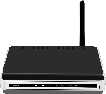
How to deal with hidden terminal problem?
IEEE 802.11 suggests using explicit control frames
  RTS – Request To Send
  CTS – Clear To Send
CSMA/CA – CSMA with Collision Avoidance
  Nodes receiving RTS and CTS defer their transmissions
RTS
RTS
A
B
A
B
CTS
Node A sends RTS to B, all neighboring nodes receiving RTS defer their transmission
Node B sends CTS to A, all neighboring nodes receiving CTS defer their transmission

Slide 48
CSMA/CA
How much neighboring nodes should wait?
  RTS packet includes a time duration value which indicates the total time required for CTS return, data transmission and ACK return
  Neighboring nodes set their Net Allocation Vector (NAV) to this duration and wait
Data
A
B
A
B
ACK

Slide 49
CSMA/CA
Does CSMA/CA completely eliminate collisions?
Wireless medium results in frequent unpredictable packet losses
  CSMA/CA assumes RTS and CTS packets are correctly received by all neighboring nodes
  A neighboring node not receiving RTS/CTS can initiate its own transmission, and cause a collision

Slide 50
Wireless signal propagation
Asymmetry in propagation range is common in real-world deployments
  Stationary objects (buildings, walls, trees etc.) result in non-uniform propagation
Nine example coverage regions in GoogleWiFi at Moutain View, CA
[1] J. Robinson, M. Singh, R. Swaminathan and E. Knightly, "Deploying Mesh Nodes under Non-Uniform Propagation," INFOCOM, 2010

Slide 51
Shadow fading
Non-uniform propagation range is modeled using
  Log-normal shadow fading model
  Studies show that σ can vary from 6 to 12 dB in outdoor environment
  $$LdB=20\log{10 f+10 n\log{10d −27.55\text{ +}\text{S}\text{σ}}}$$
Shadow fading loss
S_{σ} is a normal random variable with zero mean and standard deviation of σ dB
Distance dependent path loss; n is path loss exponent

Slide 52
CSMA/CA
Are there any other issues with CSMA/CA?
Exposed terminal problem
  Two receiver’s outside each other’s range
  Prohibits possible simultaneous transmissions
D
C
B
A
C cannot transmit to D, even though C->D will not interfere with A->B
A is transmitting to B
C is the exposed terminal for A

Slide 53
CSMA/CA, CST and collisions
If RTS/CTS is not used (or if CST value is too high),
  Higher number of hidden terminals increase collisions
  Too aggressive
If RTS/CTS is used (or if CST value is too low),
  More terminals become exposed terminals
  Results in fewer collisions but reduces the overall bandwidth usage
  Too conservative
Finding an optimized solution is difficult
  Packet losses depend on deployment and environment
  Device diversity and mobility
  In practice, a heuristic approach is often used - enable/disable RTS/CTS based on observed packet losses at select access points

Slide 54
Contention between multiple nodes
What if two or more clients have data to send exactly at the same time
  Common situation in practice
  Backlogged clients – there is always data to send
Collisions
  CSMA - Nodes will send data at the same time
  CSMA/CA - Nodes will send RTS at the same time
A
C
B

Slide 55
Exponential backoff
Solution
  Use exponential backoff
Use randomly chosen delay before initiating transmission
  Pick a random number T from (0, CW_{min})

Slide 56
CSMA/CA with exponential backoff
  Step – 1:
  Every node:
  Pick a random backoff counter T between 0 and CW_{min}
  Countdown to T
  For (t=0; t<T; t++)
  {
  Perform carrier sensing to see if channel is busy;
  If channel is busy:
  Freeze the counter
  }
  Goto Step – 2

Slide 57
CSMA/CA with exponential backoff
  Step – 2:
  Node whose countdown reached 0:
  Transmit RTS
  RTS contains NAV (time for CTS, Data and Ack)
  Neighbors (Nodes which received the RTS)
  If the node is the intended receiver:
  Reply with CTS
  Goto Step – 3
  Else:
  Freeze the countdown
  Read NAV (time for CTS, Data, Ack) from RTS and defer any transmission till NAV

Slide 58
CSMA/CA with exponential backoff
  Step – 3:
  Transmitter and receiver nodes
  Transmitter node sends Data
  Receiver node replies with Ack
  Step – 4:
  Other nodes resume their countdown after NAV time
  Transmitter picks a new random countdown and goes back to Step – 1

Slide 59
CSMA/CA with exponential backoff
  802.11a/g: CWmin is 15 or 31 slots; each slot is 9 microseconds
  Step – 1:
  Every node:
  Pick a random backoff counter T between 0 and CW_{min}
  Countdown to T
  For (t=0; t<T; t++)
  {
  Perform carrier sensing to see if channel is busy;
  If channel is busy:
  Freeze the counter
  }
  Goto Step – 2

Slide 60
CSMA/CA with exponential backoff
  Step – 2:
  Node whose countdown reached 0:
  Transmit RTS
  RTS contains NAV (time for CTS, Data and Ack)
  Neighbors (Nodes which received the RTS)
  If the node is the intended receiver:
  Reply with CTS
  Goto Step – 3
  Else:
  Freeze the countdown
  Read NAV (time for CTS, Data, Ack) from RTS and defer any transmission till NAV
  If RTS sent, but no CTS received
  Pick a new random number from 0 to (2^i x CWmin) for i^{th} retry
  Return to countdown (step – 1)

Slide 61
CSMA/CA with exponential backoff
  Step – 3:
  If Data is lost,
  Pick a new random number from 0 to (2^i x CWmin) for i^{th} retry
  Return to countdown (step – 1)
  Transmitter and receiver nodes
  Transmitter node sends Data
  Receiver node replies with Ack
  Step – 4:
  Other nodes resume their countdown after NAV time
  Transmitter picks a new random countdown and goes back to Step – 1

Slide 62
802.11 PHY and MAC
MAC:
CSMA/CA and wideband medium access
 | 802.11b | 802.11a | 802.11g | 802.11n | 802.11ac
Frequency | 2.4 GHz | 5 GHz | 2.4 GHz | 2.4/5 GHz | 5 GHz
Channel width | 20 MHz | 20 MHz | 20 MHz | 20/40 MHz | 20/40/80/160 MHz
PHY | DSSS/CCK | OFDM | OFDM, DSSS/CCK | OFDM | OFDM
MIMO & beamforming | No | No | No | Yes | Yes
Max. data rate | 11 Mbps | 54 Mbps | 54 Mbps | 600 Mbps | ~6933 Mbps
PHY-I:
OFDM and modulation
PHY-II:
MIMO and beamforming

Slide 63
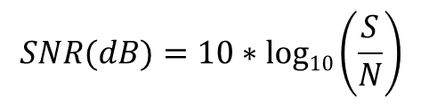
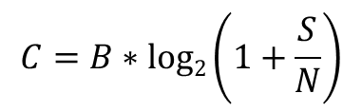
Wider channel width
Wider channel bandwidth provides higher link capacity
  Emergence of 40, 80 and 160 MHz channel bandwidths in WiFi
  802.11n uses 40 MHz, 802.11ac uses 40, 80 and 160 MHz
Shannon’s theorem
  Provides the upper bound on link capacity
  For a given SNR, wider bandwidth channels provide more bits per second (data rate)
$$C=B∗log2\left(1+\frac{S}{N}\right)$$
B = bandwidth (Hz)
S/N = Signal to noise ratio (SNR)
$$SNR(dB)=10∗log10\left(\frac{S}{N}\right)$$

Slide 64
Wider channel width
20 MHz and its multiples
Non-overlapping channels
20 MHz | 25
40 MHz | 12
80 MHz | 6
160 MHz | 2

Slide 65
802.11n vs. 802.11ac
Wider channel width is an effective mean of increasing data rate
  Challenge – scarce spectrum

Slide 66
Wider channel width
Why not always use larger bandwidths?
  Reduces spatial reuse (number of wireless links that can operate in parallel)
Throughput-delay tradeoff
  Narrow bandwidth channels allow more parallel communications at lower data rate (shorter delay but lower throughput)
  Wider bandwidth channels allow fewer parallel communications but each at faster data rate (larger delay but higher throughput)
C1
C2
20 MHz
20 MHz
A
B
A
B
C1
C1 + C2
X->Y
A->B
X->Y
C2
A->B
X
Y
t
X
Y
t
  Any example of delay sensitive applications?

Slide 67
Wider channel width
Static channel width assignment
  Wider channels
    Reduces spatial reuse (number of parallel data transmissions)
  Narrower channels
    Can underutilize channel if traffic load is less
Can we decide the channel width dynamically?

Slide 68
There is another issue in practice
Heterogeneous channel bandwidths
  Clients with 20, 40, 80 and 160 MHz all coexist
  How to coordinate medium access between heterogeneous clients?
A
(20 MHz)
C
(80 MHz)
AP
(20/40/80/160 MHz)
D
(160 MHz)
B
(40 MHz)

Slide 69
Dynamic channel bonding
Determine the channel width dynamically
  Proposed by IEEE 802.11ac
Basic idea
  If transmitter (Tx) and receiver (Rx) can decide following two things “on the fly” before they communicate
    What is the maximum channel width supported by both (Tx and Rx)?
    What is the actual channel width available (which no one else is using)?

Slide 70
Dynamic channel bonding
A
(20 MHz)
C
(80 MHz)
AP
(20/40/80/160 MHz)
D
(160 MHz)
B
(40 MHz)

Slide 71
But there are many APs..
How can APs share wider channels opportunistically?

Slide 72
Dynamic Channel Bonding
Medium access is controlled through the use of “primary channel”
Primary channel
  20 MHz primary channel chosen by each AP
  Beacons and management frames are sent on the primary channel
AP 1
AP 2
AP 3
AP 4
AP 5
AP 6
AP 7
AP 8
20 MHz
40 MHz
80 MHz
160 MHz

Slide 73
Dynamic Channel Bonding
Backward compatibility
  Legacy clients can connect to latest Aps
  Example - 802.11 a/n clients can connect to 802.11ac AP
AP 1
AP 2
AP 3
AP 4
AP 5
AP 6
AP 7
AP 8
20 MHz
40 MHz
80 MHz
160 MHz

Slide 74
Enhanced RTS/CTS Protocol
Dynamic channel bonding is achieved through Enhanced RTS/CTS protocol
E-RTS/CTS protocol
  Determine supported and available channel width at once
  Tx and Rx exchanges RTS and CTS on all 20 MHz channels they want/can use for communication

Slide 75
Enhanced RTS/CTS Protocol
AP 1
(80 MHz)
AP 2
(80 MHz)
AP 1
AP 2
20 MHz
40 MHz
80 MHz
X
(80 MHz)
Y
(40 MHz)

Slide 76
Enhanced RTS/CTS Protocol
  Case 1: AP1 -> X, no contention
C1
C2
C3
C4
AP 1
(80 MHz)
AP 2
(80 MHz)
AP 1
AP 2
20 MHz
40 MHz
80 MHz
X
(80 MHz)
Y
(40 MHz)
C1
RTS
CTS
Data
(AP1->X)
C2
RTS
CTS
Data is sent over continuous larger channel without any replication
C3
RTS
CTS
C4
RTS
CTS
AP1
X

Slide 77
Enhanced RTS/CTS Protocol
  Case 2: AP1 -> X, but Y->AP2 starts in between
C1
C2
C3
C4
AP 1
(80 MHz)
AP 2
(80 MHz)
AP 1
AP 2
20 MHz
40 MHz
80 MHz
X
(80 MHz)
Y
(40 MHz)
C1
RTS
CTS
Data
(AP1->X)
C2
RTS
CTS
What if only C3 was being used by Y->AP2? i.e. C4 was available
C3
RTS
Channel occupied by Y->AP2
C4
RTS
AP1
X

Slide 78
CSMA/CA with channel bonding
  Step – 1:
  Pick a random backoff counter T between 0 and CW_{min}
  Countdown to T:
  Perform carrier sensing to see if PRIMARY channel is busy;
  If PRIMARY channel is busy:
  Freeze the counter
  Sense the SECONDARY channels for a short time (<<T) just before countdown is close to reach 0
  After time T:
  Send RTS on PRIMARY and any available continuous SECONDARY channels
  …

Slide 79
CSMA/CA with channel bonding
Secondary channels are sensed for only a short duration just prior to end of primary channel’s countdown
Known issues
  What if secondary channel(s) was busy mostly when it was sensed, idle otherwise
Why not to sense secondary channels simultaneously?
  Carrier sensing is expensive – computation, energy
  Channel switching consumes time
Sensing secondary channels
(Primary) C1
Backoff counter
C2
C3
C4

Slide 80
Energy Efficiency
WiFi hardware can be in one of three modes
Active
  Device is actively transmitting or receiving
  Power consumption is very high in comparison
  Receiving also consumes substantial power
Idle listening
  Waiting to send/receive data, sensing
  Not actively communicating
Sleep
  Can not transmit or receive packets
  Energy efficient

Slide 81
Average Power Consumption
A WiFi device that is not in sleep mode
  Spends most of its time in “idle listening”
Average power consumption
P_{active} = Average power consumption in active mode
P_{idle} = Average power consumption in idle listening mode
T_{active} = Percentage of time WiFi radio is active
T_{idle} = Percentage of time WiFi radio is in idle listening mode

Slide 82
Average Power Consumption
Experiment results
  802.11ac laptop sends data to an access point (also 802.11ac) at 1 Mbps data rate
  MIMO enabled (later)
Transmitting or receiving
Idle listening

Slide 83
Static Channel Width
Idle listening is more expensive for wider channels

Slide 84
Static Channel Width
Idle listening dominates the average power consumption

Slide 85
Dynamic channel bonding
Carrier sensing is performed mostly on the primary channel
  Secondary channels are sensed for a shorter duration
Dynamic channel bonding more energy efficient compared to static channel width assignment
  Idle listening mostly restricted to primary channel
Sensing secondary channels
(Primary) C1
Backoff counter
C2
C3
C4

Slide 86
Power Consumption
If idle listening consumes so much
  Why not sleep during the idle listening and be active when required?
Sleep scheduling in WLANs
  How to know when there is an incoming packet?
  CSMA further complicates estimating actual arrival time
A
C
B

Slide 87
802.11 Power Saving Mode
Client devices sleep when idle
  Wake up “periodically” to receive any data
  Wakeup interval is multiple of beacon interval of the AP
  Beacon interval - typically 100ms
Access point
  Buffers all client data when the client is sleeping
  Broadcasts Traffic Indication Map (TIM) in beacons
  TIM is used to let the client know if there is buffered data
Client
  Periodically wakes up and checks beacons for TIM
  If TIM indicates data, switches to active mode to receive the data
  Sends AP a message (PS-poll) to notify that its ready to receive
  Goes back to sleep after receiving

Slide 88
802.11 Energy Efficiency
Energy consumed depends on many factors
  Type of modulation
  Data rate
  MIMO multiplexing
  Channel quality
  More..

Slide 89
Announcements
First reading review posted
Start thinking about project
  Pick your topic early – discuss with me
  Pick your partner

