Slide 1
Wireless Networking - II:
OFDM and Modulation
CS 655: Wireless and Mobile Computing
Parth H. Pathak

Slide 2
802.11 PHY and MAC
MAC:
CSMA/CA and wideband medium access
 | 802.11b | 802.11a | 802.11g | 802.11n | 802.11ac
Frequency | 2.4 GHz | 5 GHz | 2.4 GHz | 2.4/5 GHz | 5 GHz
Channel width | 20 MHz | 20 MHz | 20 MHz | 20/40 MHz | 20/40/80/160 MHz
PHY | DSSS/CCK | OFDM | OFDM, DSSS/CCK | OFDM | OFDM
MIMO & beamforming | No | No | No | Yes | Yes
Max. data rate | 11 Mbps | 54 Mbps | 54 Mbps | 600 Mbps | ~6933 Mbps
PHY-I:
OFDM and modulation
PHY-II:
MIMO and beamforming

Slide 3
Wireless networking - II
Today’s agenda
  Modulation primer
  OFDM and modulation
  802.11 a/n/ac PHY
  Rate adaptation

Slide 4
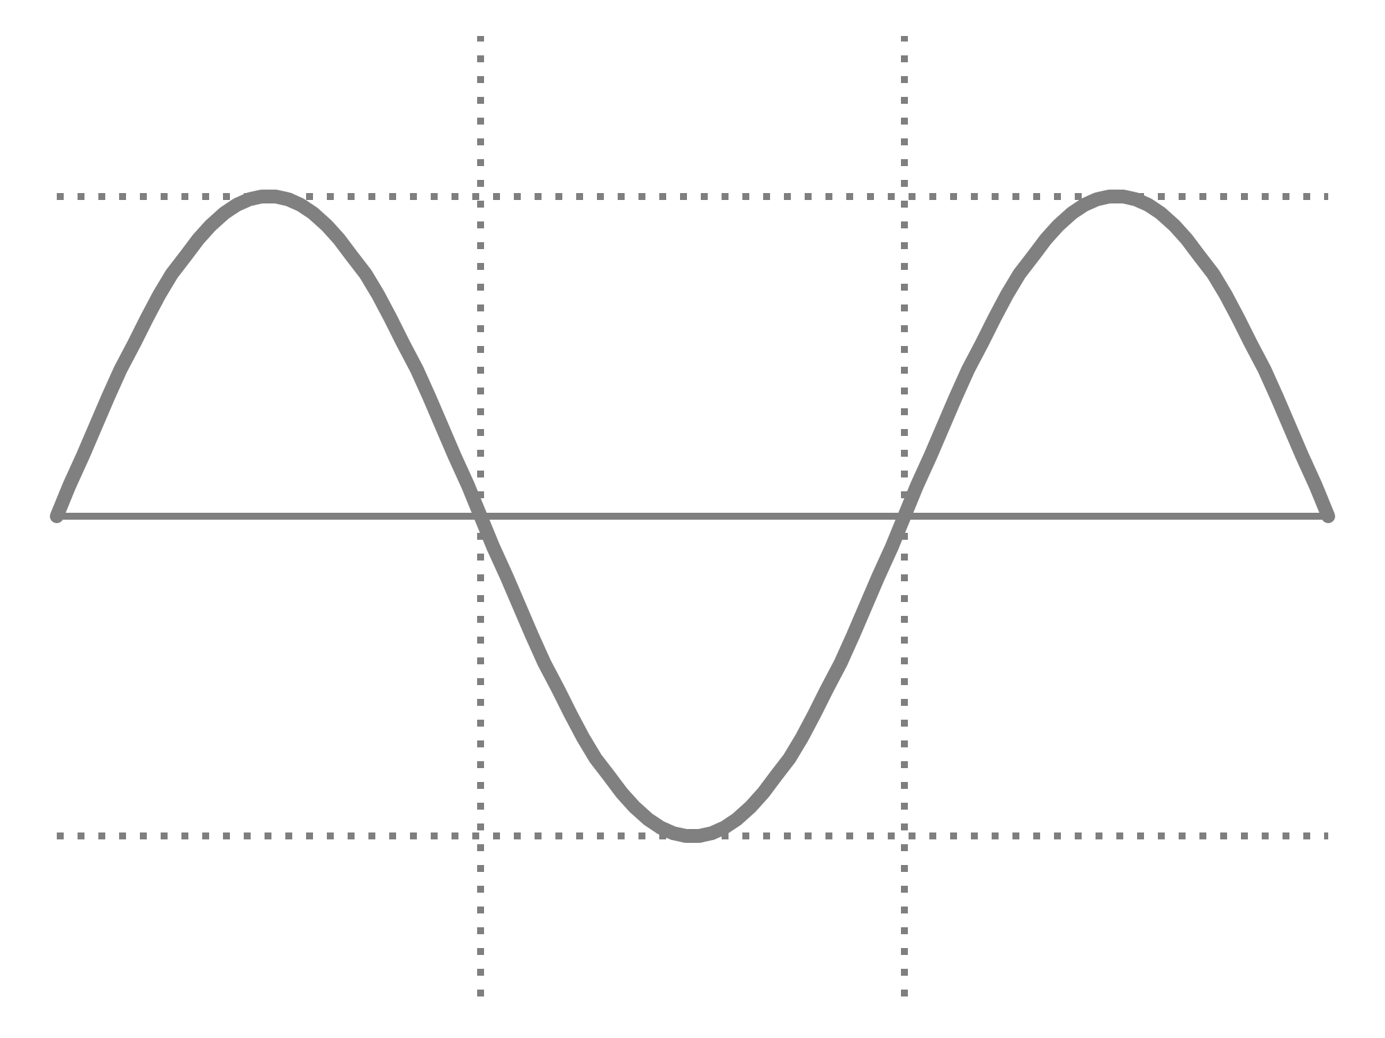


Wireless communication primer
Sine wave
  Frequency, amplitude and phase
WiFi
f = 20 MHz
$$A Sin (2πft+ φ)$$
Amplitude
f = 1 Hz
A = 1
1
$φ$= 0
0
-1
Time (t)
0
0.5
1
1.5
2

Slide 5

Modulation
Use the RF signal to represent bits
Amplitude, frequency and/or phase can be modulated
$$A Sin (2πft+ φ)$$
Amplitude
Phase
Frequency

Slide 6
Modulation
Bit 0
Bit 1
1
0.5
Amplitude
Modulation
0
-0.5
-1
Time (t)
Bit 0
Bit 1
1
Frequency
Modulation
0.5
0
-0.5
-1
Time (t)

Slide 7

Phase modulation
Binary Phase Shift Keying
    Bit 1: phase $π$, Bit 0: phase 0
  Differential BPSK
    Bit 0 : no change in phase compared to previous bit
    Bit 1 : phase changes by $π$ compared to previous bit
0
1
0
BPSK
0
1
0
Differential PSK

Slide 8




Phase modulation
Polar representation of phase shift keying schemes
01
00
$$\frac{3π}{4}$$
$$\frac{π}{4}$$
1
0
$$\frac{5π}{4}$$
$$\frac{7π}{4}$$
11
10
BPSK
Quadrature PSK (QPSK)

Slide 9
QAM modulation schemes
Quadrature Amplitude and Phase Modulation (QAM)
  Modulates both phase and amplitude of the signal
Commonly used in wired and wireless communications
  Most current 802.11 standards utilize QAM of different orders
  Also used in Long Term Evolution (LTE) 4G cellular networks

Slide 10

I/Q representation
Instantaneous state of a sine wave can be represented using polar coordinate system
Amplitude
$$φ (phase)$$

Slide 11






I/Q representation
The polar representation is referred as I/Q data representation
$$Q Axis$$
$$I\left(t\right)=A\left(t\right)\cos{φ(t)}$$
$$(I,Q)$$
Amplitude
$$Q\left(t\right)= A\left(t\right)\sin{φ(t)}$$
$$φ$$
$$I Axis$$
What is I/Q data? Tutorial: http://www.ni.com/tutorial/4805/en/

Slide 12
Why use I/Q representation?
I/Q representation closely matches hardware design
In reality, changing the phase of high frequency signal is difficult to achieve in hardware
Instead, two separate signals are “mixed”
  One sine and the other cosine – both of same frequency
  The change of phase in the resultant mixed signal is achieved by changing the amplitude of the sine and cosine signals
  Simplifies hardware design

Slide 13



I/Q example
Change of phase in the desired signal
$$\sin{(2πft+ \frac{π}{3})}$$
$$= sin\left(2πft\right)\cos{\frac{π}{3}} +\sin{\frac{π}{3}}\cos\left(2πft\right)$$
$$= \frac{1}{2}sin\left(2πft\right) +\frac{\sqrt{3}}{2}\cos\left(2πft\right)$$
Change of amplitude in the sine and cosine signals

Slide 14
QAM schemes
Q
Q
01
00
I
I
11
10
4 QAM
4 symbols
Each symbol represents 2 bits
16 QAM
16 symbols
Each symbol represents 4 bits

Slide 15
Wireless networking - II
Today’s agenda
  Modulation primer
  OFDM and modulation
  802.11 a/n/ac PHY
  Rate adaptation

Slide 16
OFDM
Orthogonal Frequency Division Multiplexing
A PHY layer technique
  Commonly used in wireless networks including 802.11 WiFi networks, LTE etc.
Properties
  Central idea: divide a large channel in multiple smaller subchannels, transmit data by encoding on the subchannels
  Why? Robustness against multi-path fading

Slide 17
OFDM vs FDM
  FDM
    Non-overlapping subchannels
    Wastage of bandwidth necessary to separate subchannels
  OFDM
    Overlapping but orthogonal subchannels
    Carefully chosen subchannels – at the peak of each subcarrier, all other subcarriers are zero

Slide 18
OFDM subcarriers
At the peak of each subcarrier, all other subcarriers are zero
Amplitude
Freq.

Slide 19
OFDM
How to spread information over the subcarriers?
Serial to parallel
Subcarrier 1
Parallel to serial
Subcarrier 2
Bit stream
Subcarrier 3
0 1 0 0 1 1
o o o
Subcarrier n

Slide 20
OFDM
Example with 8 subcarriers
0 1 0 0 1 1 0 1 1 0 0 1 0 1 0 1
Sub 1 | 0 | 1
Sub 2 | 1 | 0
Sub 3 | 0 | 0
Sub 4 | 0 | 1
Sub 5 | 1 | 0
Sub 6 | 1 | 1
Sub 7 | 0 | 0
Sub 8 | 1 | 1
Step 1: Serial to parallel

Slide 21
OFDM
Step 2: Modulate bits on each subcarrier
0
1
BPSK
Sub 1 | 0 | 1
Sub 2 | 1 | 0
Sub 3 | 0 | 0
Sub 4 | 0 | 1
Sub 5 | 1 | 0
Sub 6 | 1 | 1
Sub 7 | 0 | 0
Sub 8 | 1 | 1

Slide 22
OFDM
Step 2: Modulate bits on each subcarrier
0
1
BPSK
Sub 1 | 0 | 1
Sub 2 | 1 | 0
Sub 3 | 0 | 0
Sub 4 | 0 | 1
Sub 5 | 1 | 0
Sub 6 | 1 | 1
Sub 7 | 0 | 0
Sub 8 | 1 | 1
0
0

Slide 23
OFDM
Step 3: Combine subcarriers using IFFT to generate one channel waveform
Sub 1 | 0 | 1
Sub 2 | 1 | 0
Sub 3 | 0 | 0
Sub 4 | 0 | 1
Sub 5 | 1 | 0
Sub 6 | 1 | 1
Sub 7 | 0 | 0
Sub 8 | 1 | 1
o o o
IFFT
Resultant OFDM signal
o o o
o o o

Slide 24
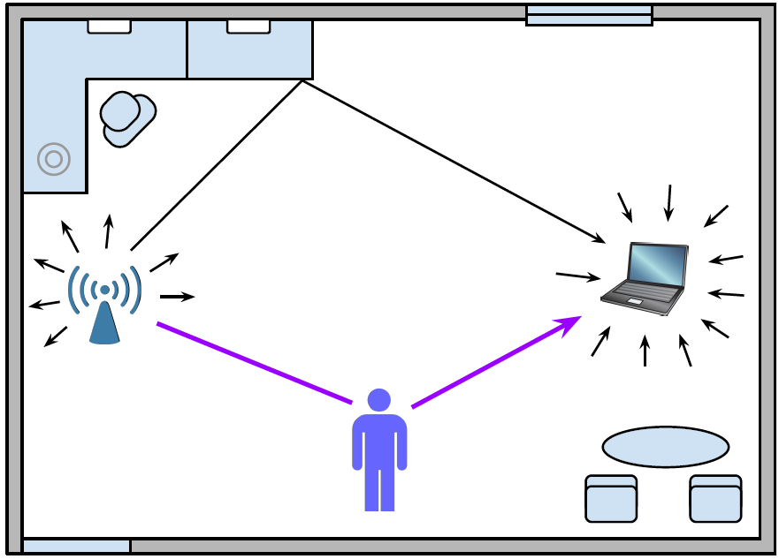
Why OFDM?
Wireless signal propagation is complex
  Stationary and moving objects affect the received signal
Signal reaches the receiver over multiple paths
  Variations in the environment results in frequency-selective fading

Slide 25
Why OFDM?
Frequency selective fading
  Some frequencies within the channel fade severely
  These frequencies are uncorrelated
Is it the same as path loss and shadow fading?
Ideal channel
Reality
A
A
f
f
Deep faded frequencies

Slide 26
Why OFDM?
Frequency selective affects only some subcarriers in OFDM
  Lower bit error rate
Single carrier
OFDM
A
A
f
f
Deep faded frequencies

Slide 27

OFDM Block Diagram
Transmitter
Error correction coding
Interleaving
(serial to parallel)
Subcarrier modulation
IFFT
Receiver
FFT
Subcarrier demodulation
Parallel to serial
Error correction decoding

Slide 28
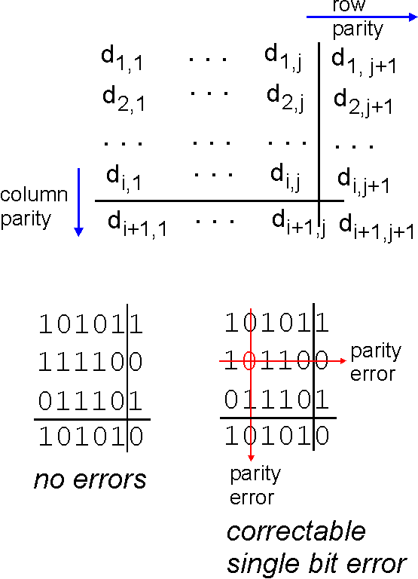
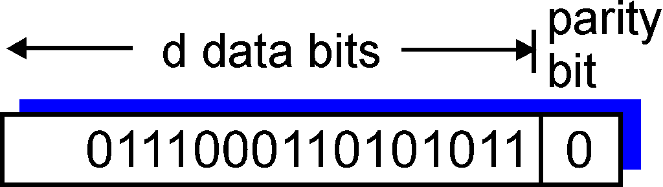

Parity checking
single bit parity:
detect single bit errors
two-dimensional bit parity:
detect and correct single bit errors
Any limitations of this method?
0
0

Slide 29
Forward Error Correction (FEC)
Wireless channel is inherently error prone
  Bit errors are common
  Can significantly reduce the achievable data rate
FEC
  Receiver can detect (to some extent) which bits were corrupted and correct them
  Additional parity bits are added to the data bits
  Commonly used FEC in 802.11 – Convolution codes
Coding rate
  No. of data bits / (no. of data bits + no. of parity bits)
  Coding rate of 1/2 means 50% bits are additional parity bits for FEC
  Coding rate of 3/4 means 25% bits are additional parity bits for FEC

Slide 30
Wireless networking - II
Today’s agenda
  Modulation primer
  OFDM and modulation
  802.11 a/n/ac PHY
  Rate adaptation

Slide 31
OFDM in 802.11a PHY
Channel bandwidth – 20 MHz
Total number of OFDM subcarriers – 48
FEC applied first to the incoming data bits
  Resultant data+parity bits are input to interleaving

Slide 32
OFDM Block Diagram
Transmitter
Error correction coding
Interleaving
(serial to parallel)
Subcarrier modulation
IFFT
Receiver
FFT
Subcarrier demodulation
Parallel to serial
Error correction decoding

Slide 33
Interleaving
Process of mapping the incoming data bits to subcarriers
  In practice, serial to parallel interleaving is not round-robin
General rule
  Map the consecutive bits to subcarriers far away from each other
  Reduces the probability of consecutive bits being dropped due to fading in nearby subcarriers – improves FEC performance
A
0 1 0 0 1 1 0
f

Slide 34
Modulation
802.11a supports following modulation schemes
Modulation | Bits per symbol
BPSK | 1
QPSK | 2
16-QAM | 4
64-QAM | 6

Slide 35
Block Interleaving
802.11a example
  48 subcarriers
  Modulation chosen - 64 QAM (6 bits per symbol)
Interleaver buffer size = 48 x 6 = 288 bits
More complex versions of block interleavers used
b₂₄₁ | b₂₄₂
b₁₉₃ | b₁₉₄
b₁₄₅ | b₁₄₆
b₉₇ | b₉₈
b₄₉ | b₅₀
b₁ | b₂
b₂₈₈
b₂₄₀
b₁₉₂
b₁₄₄
b₉₆
b₄₈
0, 1, 0, … , 1
b₁, b₂, b₃, … , b₂₈₈
…
…
…
c₁
c₂
…
c₄₈
Subcarrier no.

Slide 36
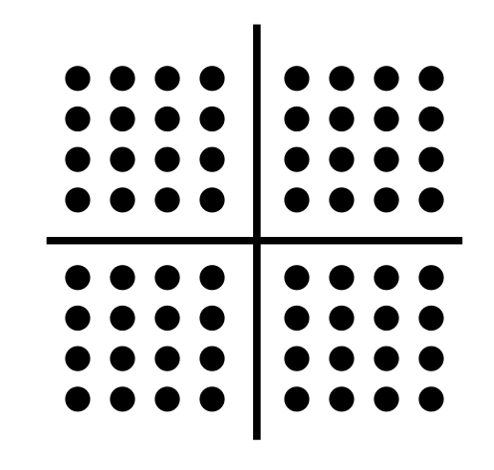
Subcarrier Modulation
Subcarrier symbol
b₂₄₁ | b₂₄₂
b₁₉₃ | b₁₉₄
b₁₄₅ | b₁₄₆
b₉₇ | b₉₈
b₄₉ | b₅₀
b₁ | b₂
b₂₈₈
b₂₄₀
b₁₉₂
b₁₄₄
b₉₆
b₄₈
0, 1, 0, … , 1
b₁, b₂, b₃, … , b₂₈₈
…
…
…
c₁
c₂
…
c₄₈

Slide 37
IFFT
Combine subcarriers
b₂₄₁ | b₂₄₂
b₁₉₃ | b₁₉₄
b₁₄₅ | b₁₄₆
b₉₇ | b₉₈
b₄₉ | b₅₀
b₁ | b₂
b₂₈₈
b₂₄₀
b₁₉₂
b₁₄₄
b₉₆
b₄₈
0, 1, 0, … , 1
b₁, b₂, b₃, … , b₂₈₈
…
…
…
c₁
c₂
…
c₄₈
…
IFFT
Resultant OFDM symbol

Slide 38
802.11a OFDM PHY
Modulation | Coding rate | Coded bits per subcarrier symbol | Coded bits per OFDM symbol | Data bits per OFDM symbol | Data rate (Mbps)
BPSK | 1/2
BPSK | 3/4
QPSK | 1/2
QPSK | 3/4
16-QAM | 1/2
16-QAM | 3/4
64-QAM | 2/3
64-QAM | 3/4

Slide 39
802.11a OFDM PHY
Modulation | Coding rate | Coded bits per subcarrier symbol | Coded bits per OFDM symbol | Data bits per OFDM symbol | Data rate (Mbps)
BPSK | 1/2 | 1
BPSK | 3/4 | 1
QPSK | 1/2 | 2
QPSK | 3/4 | 2
16-QAM | 1/2 | 4
16-QAM | 3/4 | 4
64-QAM | 2/3 | 6
64-QAM | 3/4 | 6

Slide 40
802.11a OFDM PHY
Modulation | Coding rate | Coded bits per subcarrier symbol | Coded bits per OFDM symbol | Data bits per OFDM symbol | Data rate (Mbps)
BPSK | 1/2 | 1 | 48
BPSK | 3/4 | 1 | 48
QPSK | 1/2 | 2 | 96
QPSK | 3/4 | 2 | 96
16-QAM | 1/2 | 4 | 192
16-QAM | 3/4 | 4 | 192
64-QAM | 2/3 | 6 | 288
64-QAM | 3/4 | 6 | 288

Slide 41
802.11a OFDM PHY
Modulation | Coding rate | Coded bits per subcarrier symbol | Coded bits per OFDM symbol | Data bits per OFDM symbol | Data rate (Mbps)
BPSK | 1/2 | 1 | 48 | 24
BPSK | 3/4 | 1 | 48 | 36
QPSK | 1/2 | 2 | 96 | 48
QPSK | 3/4 | 2 | 96 | 72
16-QAM | 1/2 | 4 | 192 | 96
16-QAM | 3/4 | 4 | 192 | 144
64-QAM | 2/3 | 6 | 288 | 192
64-QAM | 3/4 | 6 | 288 | 216

Slide 42
802.11a OFDM PHY
Modulation | Coding rate | Coded bits per subcarrier symbol | Coded bits per OFDM symbol | Data bits per OFDM symbol | Data rate (Mbps)
BPSK | 1/2 | 1 | 48 | 24 | 6
BPSK | 3/4 | 1 | 48 | 36 | 9
QPSK | 1/2 | 2 | 96 | 48 | 12
QPSK | 3/4 | 2 | 96 | 72 | 18
16-QAM | 1/2 | 4 | 192 | 96 | 24
16-QAM | 3/4 | 4 | 192 | 144 | 36
64-QAM | 2/3 | 6 | 288 | 192 | 48
64-QAM | 3/4 | 6 | 288 | 216 | 54

Slide 43
OFDM Block Diagram
Transmitter
Error correction coding
Interleaving
(serial to parallel)
Subcarrier modulation
IFFT
Receiver
FFT
Subcarrier demodulation
Parallel to serial
Error correction decoding

Slide 44
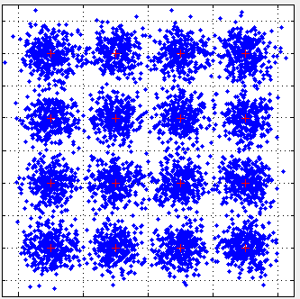
Demodulation
Received symbols depend on channel variations
  Multi-path – common reason behind amplitude and phase changes
Inter-symbol interference
Transmitter
Receiver
Mathworks - digital modulation with Matlab http://www.mathworks.com/help/comm/ug/digital-modulation_ja_JP.html

Slide 45
Demodulation
Hard decision
  Calculate the distance to the constellation points, pick the one with the lowest distance
  Can be overly conservative
Receiver

Slide 46
Demodulation
Soft decision
  For the received symbol, calculate its distance to the nearby constellation points
  Use the distance to associate a probability to the constellation point
  Combine the probabilities with FEC decoding to minimize errors
Receiver

Slide 47
Bit to symbol mapping
Natural vs. gray mapping in 16 QAM
Gray mapping: adjacent constellation points only differ in 1 bit
  Reduces bit error compared to natural mapping where adjacent points can have multiple bits different from each
3 (0011)
2 (0010)
1 (0001)
0 (0000)
2 (0010)
6 (0110)
14(1110)
10(1010)
7 (0111)
6 (0110)
5 (0101)
4 (0100)
3(0011)
7(0111)
15(1111)
11(1011)
11(1011)
10(1010)
9 (1001)
8 (1000)
1(0001)
5(0101)
13(1101)
9(1001)
15(1111)
14(1110)
13(1101)
12(1100)
0(0000)
4(0100)
12(1100)
8 (1000)
Natural mapping
Gray mapping

Slide 48
RSS, SNR and SINR
Commonly used measures of channel quality
RSS – Received Signal Strength
  Measured in dBm
  Often available through RSSI register on WiFi chipsets
SNR – Signal to Noise Ratio (S/N)
  Measured in dB
  Ratio of RSS and measured noise, available or can be derived
SINR – Signal to Noise and Interference Ratio (S/I+N)
  Measured in dB
  Considers how much interference is caused by other transmissions
  Very useful metric but difficult to measure
Why is it difficult to measure?

Slide 49
Receiver sensitivity
Better signal strength (higher SNR) ensures lower inter-symbol interference (ISI)
802.11 standards associate a receiver sensitivity with each modulation and data rate
What is the difference between receiver sensitivity and carrier sense threshold?
Modulation
BPSK
BPSK
QPSK
QPSK
16-QAM
16-QAM
64-QAM
64-QAM
Data rate (Mbps) | Receiver sensitivity (dBm)
6 | -82
9 | -81
12 | -79
18 | -77
24 | -74
36 | -70
48 | -66
54 | -65
802.11a
Can CST threshold be higher than lowest modulation’s receiver sensitivity?

Slide 50
OFDM in 802.11n
802.11n uses 20 and 40 MHz channel widths
  Following data rates refer to 20 MHz channels
Modulation | Coding rate | Data rate (Mbps)
BPSK | 1/2 | 6.5
QPSK | 1/2 | 13
QPSK | 3/4 | 19.5
16-QAM | 1/2 | 26
16-QAM | 3/4 | 39
64-QAM | 2/3 | 52
64-QAM | 3/4 | 58.5
64-QAM | 5/6 | 65

Slide 51
OFDM in 802.11ac
802.11ac introduces the use of 256 QAM
  256 QAM – 8 bits per symbol
MCS index | Modulation | Coding rate | Receiver sensitivity (dBm)
0 | BPSK | 1/2 | -82
1 | QPSK | 1/2 | -79
2 | QPSK | 3/4 | -77
3 | 16-QAM | 1/2 | -74
4 | 16-QAM | 3/4 | -70
5 | 64-QAM | 2/3 | -66
6 | 64-QAM | 3/4 | -65
7 | 64-QAM | 5/6 | -64
8 | 256-QAM | 3/4 | -59
9 | 256-QAM | 5/6 | -57
MCS index – a unique index given to a modulation and coding scheme combination

Slide 52
OFDM in 802.11ac
802.11ac uses wider channel widths
  20, 40, 80 and 160 MHz
  More subcarriers for OFDM
For higher data rates, 160 MHz channel width and 256 QAM modulation can be used
Channel width (MHz) | OFDM subcarriers
20 | 52
40 | 108
80 | 234
160 | 468

Slide 53
802.11ac OFDM, QAM example
802.11ac example
  160 MHz channel has 468 subcarriers
  Modulation chosen – 256 QAM
  Coding rate – 3/4
Bits per symbol = ______
Interleaver buffer size = ______ bits
Number of coded bits per OFDM symbol = ______
Number of data bits per OFDM symbol = ______

Slide 54
802.11ac in practice
Throughput vs. distance for an 802.11ac link [12]
  80 MHz channel width with different MCS
Observations?
Does SNR change with modulation?

Slide 55
Wireless networking - II
Today’s agenda
  Modulation primer
  OFDM and modulation
  802.11 a/n/ac PHY
  Rate adaptation

Slide 56
Rate selection
MCS index | Modulation | Coding rate | Receiver sensitivity (dBm)
0 | BPSK | 1/2 | -82
1 | QPSK | 1/2 | -79
2 | QPSK | 3/4 | -77
3 | 16-QAM | 1/2 | -74
4 | 16-QAM | 3/4 | -70
5 | 64-QAM | 2/3 | -66
6 | 64-QAM | 3/4 | -65
7 | 64-QAM | 5/6 | -64
8 | 256-QAM | 3/4 | -59
9 | 256-QAM | 5/6 | -57

Slide 57
Rate Adaptation
802.11 standards allow choice of multiple transmission data rates
Rate adaptation refers to selecting a data rate dynamically based on channel quality
  Not dependent on interference
  Assume one link alone trying to find the best rate based on channel condition
Rate adaptation is crucial in realizing high link data rates
  If the selected rate is too high, more and more packets are lost, reducing the throughput
  If the selected rate is too low, the channel capacity is underutilized
Dynamically changing data rate per frame is extremely challenging
  Wireless channel is constantly changing with complex multipath

Slide 58
Rate Adaptation Algorithms
Rate adaptation techniques can rely on multiple channel quality indicators
Different type of rate adaptation algorithms [11]
  RSS and SNR based rate adaptation
  Frame loss based rate adaptation
  Frame loss with collision differentiation
  Cross-layer rate adaptation

Slide 59
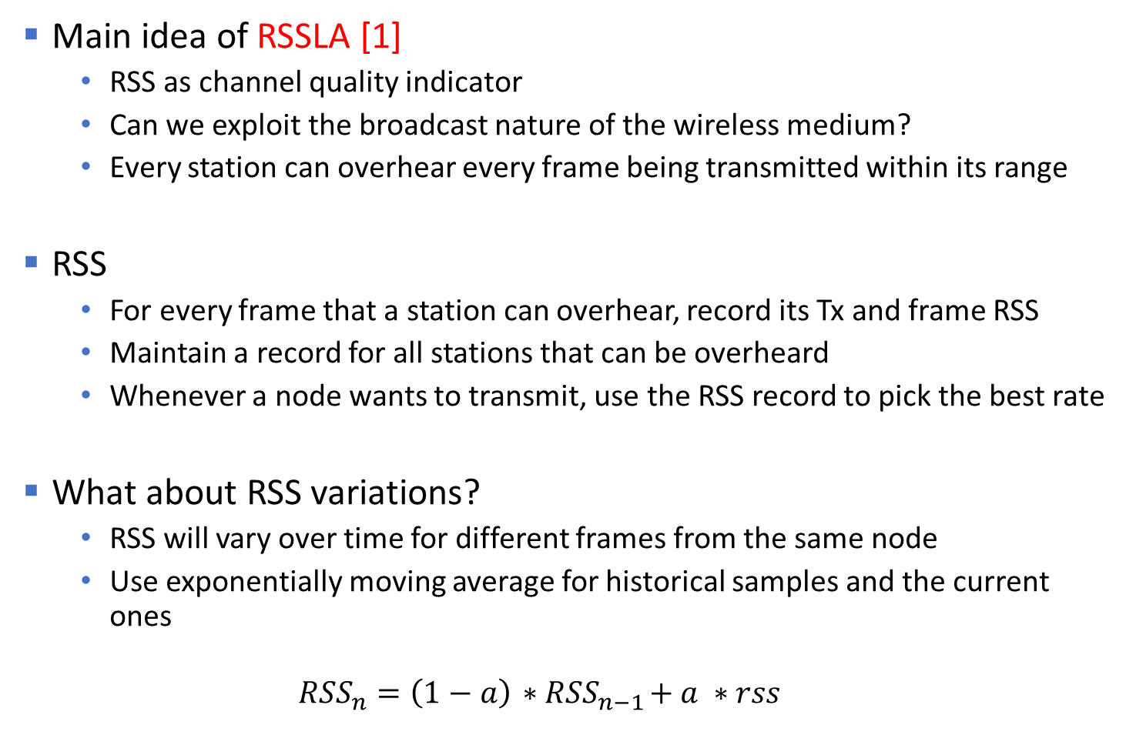
RSS-based Rate Adaptation
Main idea of RSSLA [1]
  RSS as channel quality indicator
  Can we exploit the broadcast nature of the wireless medium?
  Every station can overhear every frame being transmitted within its range
RSS
  For every frame that a station can overhear, record its Tx and frame RSS
  Maintain a record for all stations that can be overheard
  Whenever a node wants to transmit, use the RSS record to pick the best rate
What about RSS variations?
  RSS will vary over time for different frames from the same node
  Use exponentially moving average for historical samples and the current ones
  $${RSS}_{n}=\left(1−a\right){ ∗RSS}_{n−1}+a ∗rss$$

Slide 60
Beacon Assisted Rate Adaptation (BARA)
Main idea of BARA [2]
  Similar to RSSLA, but sniffing all frames is expensive
  Can we simply rely on RSS of beacons?
  Beacons are sent out every 100ms from WiFi APs
  Received by all clients that support scanning
RSS of beacons
  BARA especially suitable for uplink traffic from clients to AP
  APs can rely on client frames for estimating their RSS
Energy efficient
  BARA allows clients to use Power Saving Mode while performing rate adaptation
  Clients periodically wake up (multiple of beacon intervals), measure RSS of beacons, record RSS, send/receive traffic and go back to sleep
Recall: what is power saving mode?

Slide 61
RSS and SNR based rate adaptation
Is RSS or SNR an accurate representation of channel condition?
In ideal conditions
[13]

Slide 62
RSS and SNR based rate adaptation
But in reality…
  RSS and SNR are loosely correlated with actual number of successful packet transmissions
  RSS and SNR based rate adaptation schemes do not achieve optimal rates
[13]

Slide 63
Rate Adaptation Algorithms
Rate adaptation techniques can rely on multiple channel quality indicators
Different type of rate adaptation algorithms
  RSS and SNR based rate adaptation
    RSSLA, BARA
  Frame loss based rate adaptation
  Frame loss with collision differentiation
  Cross-layer rate adaptation

Slide 64
Auto Rate Fallback (ARF)
Main idea of ARF [3]
  Use the frame loss as an indicator of channel performance
  Widely implemented in first generation of 802.11 devices
Algorithm
  Transmitter starts out by sending frames at the lowest rate
    If the sender succeeds in sending N (typically 10) frames at the rate
      Increase the rate (go to next available data rate)
    If the first frame sent at the new rate fails (no Ack)
      Decrease the rate
    If there are two or more consecutive lost frames
      Decrease the rate
Problems?
  Channel conditions are unpredictable
    Constant fluctuations

Slide 65
Adaptive Auto Rate Fallback (AARF)
Main idea of AARF [4]
  Keep using frame loss as an indicator of channel performance
  But adapt the threshold number of packets to increase the rate
Algorithm
  Transmitter starts out by sending frames at the lowest rate
    If the sender succeeds in sending N frames at the rate
      Increase the rate (go to next available data rate)
    If the first frame sent at the new rate fails
      Decrease the rate, and double the threshold to 2N for increase attempt
    Else
      Keep N frames as the threshold for next increase

Slide 66
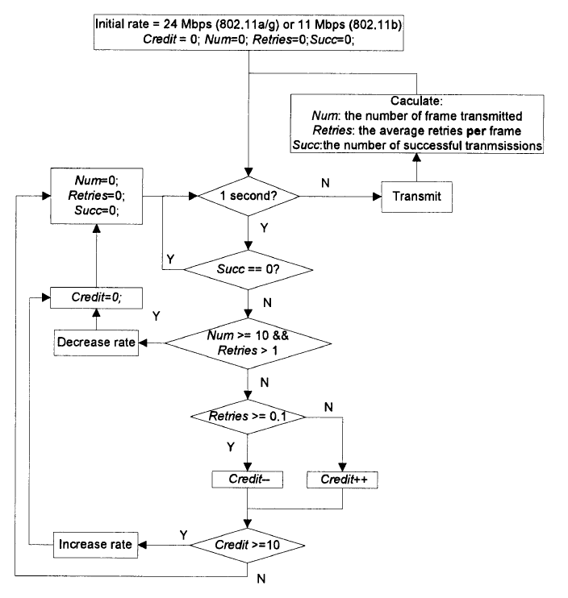
Onoe
Onoe [5]
credit based algorithm
MadWiFi open source driver implementation
Try to the best rate with a loss ratio less than 50%
Advantage – reduces rate fluctuations
Disadvantage – slower when channel quality is better

Slide 67
SampleRate
Main idea of SampleRate [6]
  Try to choose a data rate that would achieve smallest average transmission time for sending the frame
  Keep a record of all data rates and their performance in current channel
Algorithm
  Transmitter starts out at the highest possible data rate
    Keep reducing the data rate if the current data rate results in four consecutive losses
  Every 10th packet is sent using a randomly chosen data rate higher than the current data rate
    If fewer losses, measure and record the transmission time

Slide 68
SampleRate
Average transmission time
  For each data-rate, record the time it took to send a frame and receive an Ack
  Data rate is ineligible for recording if it had 4 consecutive lost frames
  Average the transmission time for multiple frames
Choice of the data rate
  At any point, choose the data rate that provides the smallest average transmission time
Strengths
  Lowering average transmission time automatically guarantees higher throughput
  Reduces fluctuations in data rates being used

Slide 69
Comparison
ARF vs. AARF vs. Onoe vs. SampleRate

Slide 70
Receiver Based Auto Rate (RBAR)
Main idea of RBAR [7]
  Try and estimate the conditions at the receiver for better channel estimation
  Can the Tx ask the Rx what rate can work best?
Rx’s observed SNR for Tx a good indicator of what rate will be supported by the channel
How can Tx get a feedback from Rx?
  Use the RTS/CTS frames of CSMA/CA
  Before each data transmission, RTS and CTS frames are exchanged

Slide 71
Receiver Based Auto Rate (RBAR)
How to use RTS/CTS for rate estimation?
  RTS and CTS frames contain expected transmission time (time for CTS + data + ACK)
  Time for data was calculated using the current rate
  Used by neighboring nodes to set their NAV and remain silent
Modify RTS/CTS
  To include best possible rate and packet length instead
What data rate is used for RTS/CTS?

Slide 72
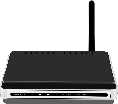
Receiver Based Auto Rate (RBAR)
Algorithm
  Tx picks up a best possible rate (current or higher) and includes it in RTS
  Tx also includes the packet’s data length
  Rx receives the RTS and also measures the SNR at which RTS was received
  Rx revises the proposed rate using SNR
  RX sends out a CTS with its rate choice, along with the packet size
  Neighboring nodes receiving the CTS use the rate and packet size to determine the value NAV
RTS
A
B
CTS

Slide 73
Receiver Based Auto Rate (RBAR)
What about the nodes that only received RTS but no CTS?
  RTS included data rate suggested by Tx, Rx might have revised it in CTS
Use an additional message – called RSH (Reservation SubHeader)
  Sent by TX after CTS and before data
  Contains the rate that was suggested by Rx in CTS message
RTS
A
B
CTS

Slide 74
Frame loss
Frames can be lost because of one of the two reasons
  Bad channel quality
  Collision with other transmissions
The rate adaptation algorithms we looked at do not distinguish between the two
  If frame loss is due to bad channel, data rate should be reduced
  But if it is due to collision, data rate should be unaffected
    Collisions can be reduced with the use of RTS/CTS
Challenge
  How to know why a frame was lost?
Decreasing rate can increase collisions, Why?

Slide 75
Rate Adaptation Algorithms
Rate adaptation techniques can rely on multiple channel quality indicators
Different type of rate adaptation algorithms
  RSS and SNR based rate adaptation
    RSSLA, BARA
  Frame loss based rate adaptation
    ARF, AARF, Onoe, SampleRate, RBAR
  Frame loss with loss differentiation
  Cross-layer rate adaptation

Slide 76
Rate adaptation with loss differentiation
CARA – Collision Aware Rate Adaptation
Main idea of CARA [8]
  Differentiate whether a frame was lost due to channel condition or collision
  Use RTS/CTS frames adaptively to differentiate
RTS probing
  RTS frames are less likely to be lost because of collisions
    They are too small in size
    Sent at lowest data rate
  If RTS frames are successfully transmitted, but following data frames are lost
    It is possible that data frames were sent at a higher rate
    Loss of data frames indicate bad channel quality to support its rate
    Collision an unlikely reason (RTS was sent successfully just before the data frame)

Slide 77
Rate adaptation with loss differentiation
CARA – Collision Aware Rate Adaptation
Algorithm
  Tx sends data frame with RTS/CTS
  If the frame is lost (no ack), Use RTS/CTS for the next data frame transmission
    Lost data frame indicates bad channel quality, so lower the rate
  If the frame was sent successfully, keep using the same rate
    Do not have to use RTS/CTS unless there is a data frame loss
General focus on decreasing the rate from the highest rate

Slide 78
CARA
Pth = 1
Nth = 2
Mth = 10

Slide 79
CARA vs. ARF
  Stations (clients) placed in a star topology, AP at the center
ARF reduces rate even when frames are lost due to collisions

Slide 80
Rate adaptation with loss differentiation
Robust Rate Adaptation Algorithm (RRAA)
Main idea of RRAA [9]
  Differentiate between collision and channel quality related losses
  Channel quality losses are sporadic in nature – due to client mobility
  Use percentage of frames lost – instead of consecutive frames lost
Adaptive RTS
  Balance the overhead of RTS with its usefulness in collision avoidance

Slide 81
Rate adaptation with loss differentiation
Robust Rate Adaptation Algorithm (RRAA)
Short term statistics
  Calculate loss *ratio* for frames sent over a window (20-100ms)
  Include consecutive or non-consecutive losses
Use a threshold to trigger rate change
  If loss ratio < P1
    Increase rate
  If loss ratio > P2
    Decrease rate
  Otherwise
    No changes in rate

Slide 82
Rate adaptation with loss differentiation
Robust Rate Adaptation Algorithm (RRAA)
Adaptive RTS to reduce collisions while maintaining low RTS overhead
  Use additive increase and multiplicative decrease
  Maintain a variable RTSw – number of consecutive frames to be transmitted with RTS
Algorithm
  If frame is lost without RTS
    The loss is likely to due to collisions
    Additively increase the no. of frames that are sent with preceding RTS (RTSw++)
  If frame transmission is successful without RTS, or frame is lost with RTS
    Unlikely to due to collisions
    Exponentially reduce the RTSw (RTSw = RTSw/2)

Slide 83
Rate adaptation with loss differentiation
Robust Rate Adaptation Algorithm (RRAA)
  Improved performance in presence of mobility

Slide 84
Rate Adaptation Algorithms
Rate adaptation techniques can rely on multiple channel quality indicators
Different type of rate adaptation algorithms
  RSS and SNR based rate adaptation
    RSSLA, BARA
  Frame loss based rate adaptation
    ARF, AARF, Onoe, SampleRate, RBAR
  Frame loss with collision differentiation
    CARA, RRAA
  Cross-layer rate adaptation

Slide 85
Cross layer data rate adaptation
Information sharing between MAC and PHY
  Can information available at PHY layer be useful in MAC rate adaptation?
MAC
PHY

Slide 86
Cross layer data rate adaptation
SNR and RSS based rate adaptation performs poorly
Frame loss provides only coarse-grained measure of channel quality
Is it possible to estimate Bit Error Rate (BER) from PHY?
If channel BER is possible to be estimated
  Rate adaptation can be made more precise
How to estimate BER?

Slide 87
Cross layer data rate adaptation
BER based data rate adaptation – SoftRate [10]
Observation – at any given SNR, BER is a monotonically increasing function of bit rate
Sender determines the BER ranges in which each of the data rate can be supported
Receiver estimates the BER and sends the estimate to sender for data rate adaptation
Receiver uses SoftPHY hints to estimate BER

Slide 88
SoftRate
Channel
Quality
SoftPHY
Hints
Per-bit
Confidences
Estimate BER
Detect Interference
SoftRate
Interference-free BER
SoftRate slides used from Author’s (Dr. Mythili Vutukuru) Sigcomm ‘09 conference presentation/talk with permission

Slide 89
SoftPHY Hints
TX
Encoder
Modulator
Bits
Coded bits
Symbols
RX
Soft Output
Decoder
Demodulator
Decoder
Symbols
Coded Bits
Bits
Error vectors
SoftPHY
Hints
(rcvd symbol – closest valid symbol)

Slide 90
BER from SoftPHY hints
decoded bits
Decoder
Pr(correctly decoded)
log
Pr(incorrectly decoded)
Log Likelihood Ratio
1
Probability of bit error
p
=
1 + e^{s}
BER = Average p over all bits in the packet

Slide 91
BER based rate adaptation
R . Frame Delivery Rate = f(BER)
BER
Throughput
24 Mbps
18 Mbps
10⁻⁷
10⁻⁶
10⁻⁵
10⁻⁴
10⁻³
12 Mbps
Adjacent rates have an order of
magnitude difference in BER

Slide 92
When is the current rate optimal?
BER
Throughput
24 Mbps
Optimality range for 18 Mbps
18 Mbps
10⁻⁷
10⁻⁶
10⁻⁵
10⁻⁴
10⁻³
12 Mbps

Slide 93
When to lower the rate?
BER
Throughput
24 Mbps
18 Mbps
10⁻⁷
10⁻⁶
10⁻⁵
10⁻⁴
10⁻³
12 Mbps

Slide 94
When to increase the rate?
BER
Throughput
24 Mbps
18 Mbps
10⁻⁷
10⁻⁶
10⁻⁵
10⁻⁴
10⁻³
12 Mbps

Slide 95

Cross layer data rate adaptation
Data
BER
Sender
Precompute optimality ranges
If BER below optimality range,
increase rate.
If above range, decrease rate.
Otherwise, continue at current rate.

Slide 96
SoftRate performance
Walking Speed
Up to 2X over best frame-based algorithm

Slide 97
References
[1] Pavon, Jd P., and Sunghyun Choi. "Link adaptation strategy for IEEE 802.11 WLAN via received signal strength measurement." In Communications, 2003. ICC'03. IEEE International Conference on, vol. 2, pp. 1108-1113. IEEE, 2003.
[2] Wu, Shaoen, Saâd Biaz, Bing Qi, and Kehao Zhang. "BARA: a sender based rate adaptation in wireless networks." In Proceedings of the 45th annual southeast regional conference, pp. 179-184. ACM, 2007.
[3] Kamerman, Ad, and Leo Monteban. "WaveLAN®-II: a high-performance wireless LAN for the unlicensed band." Bell Labs technical journal 2, no. 3 (1997): 118-133.
[4] Lacage, Mathieu, Mohammad Hossein Manshaei, and Thierry Turletti. "IEEE 802.11 rate adaptation: a practical approach." In Proceedings of the 7th ACM international symposium on Modeling, analysis and simulation of wireless and mobile systems, pp. 126-134. ACM, 2004.
[5] http://madwifi-project.org/wiki/UserDocs/RateControl
[6] Bicket, John Charles. "Bit-rate selection in wireless networks." PhD diss., Massachusetts Institute of Technology, 2005.
[7] Holland, Gavin, Nitin Vaidya, and Paramvir Bahl. "A rate-adaptive MAC protocol for multi-hop wireless networks." In Proceedings of the 7th annual international conference on Mobile computing and networking, pp. 236-251. ACM, 2001.

Slide 98
References
[8] Kim, Jongseok, Seongkwan Kim, Sunghyun Choi, and Daji Qiao. "CARA: Collision-Aware Rate Adaptation for IEEE 802.11 WLANs." In INFOCOM, vol. 6, pp. 1-11. 2006.
[9] Wong, Starsky HY, Hao Yang, Songwu Lu, and Vaduvur Bharghavan. "Robust rate adaptation for 802.11 wireless networks." In Proceedings of the 12th annual international conference on Mobile computing and networking, pp. 146-157. ACM, 2006.
[10] Vutukuru, Mythili, Hari Balakrishnan, and Kyle Jamieson. "Cross-layer wireless bit rate adaptation." ACM SIGCOMM Computer Communication Review 39, no. 4 (2009): 3-14.
[11] Biaz, Saad, and Shaoen Wu. "Rate adaptation algorithms for IEEE 802.11 networks: A survey and comparison." In Computers and Communications, 2008. ISCC 2008. IEEE Symposium on, pp. 130-136. IEEE, 2008.
[12] Zeng, Yunze, Parth H. Pathak, and Prasant Mohapatra. "A first look at 802.11 ac in action: energy efficiency and interference characterization." InNetworking Conference, 2014 IFIP, pp. 1-9. IEEE, 2014.
[13] Halperin, Daniel, Wenjun Hu, Anmol Sheth, and David Wetherall. "Predictable 802.11 packet delivery from wireless channel measurements." In ACM SIGCOMM Computer Communication Review, vol. 40, no. 4, pp. 159-170. ACM, 2010.

