Slide 1
Wireless Networking - III:
MIMO and Beamforming
CS 655: Wireless and Mobile Computing
Parth H. Pathak

Slide 2
802.11 PHY and MAC
MAC:
CSMA/CA and wideband medium access
 | 802.11b | 802.11a | 802.11g | 802.11n | 802.11ac
Frequency | 2.4 GHz | 5 GHz | 2.4 GHz | 2.4/5 GHz | 5 GHz
Channel width | 20 MHz | 20 MHz | 20 MHz | 20/40 MHz | 20/40/80/160 MHz
PHY | DSSS/CCK | OFDM | OFDM, DSSS/CCK | OFDM | OFDM
MIMO & beamforming | No | No | No | Yes | Yes
Max. data rate | 11 Mbps | 54 Mbps | 54 Mbps | 600 Mbps | ~6933 Mbps
PHY-I:
OFDM and modulation
PHY-II:
MIMO and beamforming

Slide 3
Wireless networking - I
Today’s agenda
  MIMO overview
  MIMO rate adaptation
  MIMO energy consumption
  Beamforming
  MU-MIMO and user selection

Slide 4
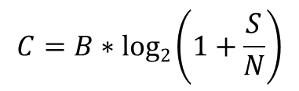
Wireless Capacity
Wireless channel capacity – Shannon’s theorem
How can we increase the capacity (achievable data rate/speed) of a wireless link/channel?
$$C=B∗log2\left(1+\frac{S}{N}\right)$$
B = bandwidth (Hz)
S/N = Signal to noise ratio (SNR)
How about we simply increase channel bandwidth (B)?
Problem: spectrum scarcity – Nearly impossible to find usable bandwidth, frequency

Slide 5
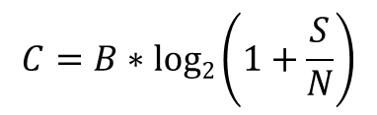
Wireless Capacity
Wireless channel capacity – Shannon’s theorem
How can we increase the capacity (achievable data rate/speed) of a wireless link/channel?
$$C=B∗log2\left(1+\frac{S}{N}\right)$$
B = bandwidth (Hz)
S/N = Signal to noise ratio (SNR)
The quest for more wireless channel capacity –
by far the most important research problem
Increase spectral efficiency -> bits/sec/Hz
How about increasing SNR? Increase the signal power to increase S?
SNR (dB) | C/B (bits/sec./Hz)
0 | 1
5 | 2.19
10 | 3.46
15 | 5.03
20 | 6.66
25 | 8.31
30 | 9.97
Problem: increasing transmission power will also increase your interference to other links
More channel sharing, more collisions, lower speeds

Slide 6
Multiple Antenna Systems
Wireless devices can be equipped with multiple antennas
  Can multiple antennas increase the achievable capacity?
Multiple antenna systems
  Early research in 1990s showed huge capacity gains
  Practical systems developed in early 2000s
  Commonly used in current WiFi, LTE, WiMax systems
Capacity gains
  If only one end point (Tx or Rx) has multiple antennas
    Linear increase in SNR without increasing transmission power
  If both Tx and Rx have multiple antennas
    Linear increase in capacity for every pair of Tx, Rx antenna

Slide 7
MIMO
Tx
Rx
Tx
Rx
SISO (Single Input Single Output)
MISO (Multiple Input Single Output)
All antenna utilize the same frequency and channel
Tx
Rx
Tx
Rx
SIMO (Single Input Multiple Output)
MIMO (Multiple Input Multiple Output)

Slide 8
Spatial Diversity
Paths between antennas
  Multiple antennas enable multiple paths between Tx and Rx
  These paths observe independent fading
Spatial paths
  Independent paths between antennas can be exploited to increase gain
Shannon’s capacity
  Capacity gain through spatial diversity/freedom
Tx
Rx

Slide 9




Channel Matrix
Tx
Rx
Received signal
noise
$$H$$
$$y=Hx+n$$
SISO
Channel matrix/vector
Transmitted signal
OFDM with S subcarriers,
$H=\{C1,C2,$ $C3,$… $Cs\}$
where
$$Ci=\left|Ci\right|e^{jp}$$
Phase
Amplitude

Slide 10





Channel Matrix
Tx
$$H11$$
Rx
$$H12$$
$$H13$$
$$y=Hx+n$$
H is a M x N x S matrix
Where
M = number of Tx antenna
N = number of Rx antenna
S = number of subcarriers
SIMO (Single Input Multiple Output)
OFDM with S subcarriers,
$Hmn=\{C1,C2,$ $C3,$… $Cs\}$

Slide 11
MIMO Techniques [1]
How to take advantage of multiple antennas at Tx, Rx or both?
Multi-antenna systems
MISO/SIMO
MIMO
Selection Combining (SEL)
Maximal-Ratio Combining (MRC)
Spatial multiplexing
Direct-mapped
MIMO
Precoded
MIMO

Slide 12



SIMO
SIMO – Single Input Multiple Output
  Each receiving antenna receives a copy of the transmitted signal
  Signal variation can be measured at the receiver using the H matrix
How to combine the received signal at the receiver?
Tx
$$H11$$
Rx
MIMO notation (M x N)
where
M is number of transmit antenna
N is number of receive antenna
$$H12$$
$$H13$$
1 x 3 MIMO

Slide 13



SIMO
Receiver diversity techniques
Selection Combining (SEL)
  Pick the antenna with the strongest SNR
  Used in early generation 802.11a/g devices
  Does not take advantage of other available antennas
Tx
$$H11$$
Rx
$$H12$$
$$H13$$
1 x 3 MIMO

Slide 14



SIMO
Receiver diversity techniques
Maximal Ratio Combining (MRC)
  Use signal available through each Rx antenna
  Signal combining
    Weight the signal of each antenna using its SNR
    Amplify useful signal and reduce noise
    Sum the weighted signals
  Challenges?
    Each signal received on different path (separate H_{mn})
    Phase is different for each received signal
    Align the phase through a reference before combining the signal
Tx
$$H11$$
Rx
$$H12$$
$$H13$$
1 x 3 MIMO

Slide 15



SEL vs. MRC
802.11n link with 1x3 configuration
  Each Rx antenna (A, B, C) observes independent channel fading
  SEL selects B – best SNR
  MRC (for AB and ABC) substantially improves the SNR
  MRC more complex to implement but higher performance gain compared to SEL
[1]
Tx
$$A$$
Rx
$$B$$
$$C$$
1 x 3 MIMO

Slide 16
MISO
Transmit diversity techniques
Selection Combining (SEL)
  Pick the best (highest SNR) antenna to send the signal
Maximal Ratio Combining (MRC)
  Transmitter precodes the signal
    Apply more power to the antenna path which provides higher SNR
    Delay the phase in such as way that transmitted signal from all antennas combine constructively at the receiver
  How to know which antenna is the best?
Tx
Rx
MISO (Multiple Input Single Output)

Slide 17
MISO
Transmit diversity techniques
  Requires feedback
Channel feedback from receiver
  Transmitter sends data to receiver
  Receiver observe the channel matrix for each spatial path
  Receiver sends the measured channel matrix back to transmitter
  Transmitter uses the feedback for SEL or MRC
Reciprocity
  Transmitter measures the channel matrix when it receives a packets from receiver
  Calibration required to account for differences (different hardware, number of antennas)
Tx
Rx
MISO (Multiple Input Single Output)

Slide 18

MIMO and Capacity
[1]
MIMO technique | Capacity (bits/second)
SISO
$$C=B∗log2\left(1+SNR\right)$$

Slide 19

MIMO and Capacity
[1]
MIMO technique | Capacity (bits/second)
SISO
SIMO (1 x N) Receiver diversity
$$C=B∗log2\left(1+SNR\right)$$
$$C=B∗log2\left(1+N∗SNR\right)$$

Slide 20

MIMO and Capacity
[1]
MIMO technique | Capacity (bits/second)
SISO
SIMO (1 x N) Receiver diversity
MISO (M x 1) Transmit diversity
$$C=B∗log2\left(1+SNR\right)$$
$$C=B∗log2\left(1+N∗SNR\right)$$
$$C=B∗log2\left(1+M∗SNR\right)$$

Slide 21

MIMO and Capacity
[1]
MIMO technique | Capacity (bits/second)
SISO
SIMO (1 x N) Receiver diversity
MISO (M x 1) Transmit diversity
MIMO (M x N) Transmit and receiver diversity
$$C=B∗log2\left(1+SNR\right)$$
$$C=B∗log2\left(1+N∗SNR\right)$$
$$C=B∗log2\left(1+M∗SNR\right)$$
$$C=B∗log2\left(1+M∗N∗SNR\right)$$

Slide 22

MIMO and Capacity
[1]
MIMO technique | Capacity (bits/second)
SISO
SIMO (1 x N) Receiver diversity
MISO (M x 1) Transmit diversity
MIMO (M x N) Transmit and receiver diversity
MIMO (M x N) Spatial multiplexing
$$C=B∗log2\left(1+SNR\right)$$
$$C=B∗log2\left(1+N∗SNR\right)$$
$$C=B∗log2\left(1+M∗SNR\right)$$
$$C=B∗log2\left(1+M∗N∗SNR\right)$$
$$C=min\left(M, N\right) ∗B ∗log2\left(1+SNR\right)$$

Slide 23

MIMO
M x N antenna systems
  Diversity techniques simply increase SNR
Spatial multiplexing
  Use the independent spatial paths enabled by M x N antennas to send parallel streams of data (referred as spatial streams)
  Each spatial stream carries different data
  All spatial streams occupy same frequency channel and time
  Number of spatial streams can be min(M, N)
  Parallel spatial paths over the same frequency channel
  Min(M, N) fold increase in capacity
Tx
Rx
MIMO (Multiple Input Multiple Output)
$$C=min\left(M, N\right) ∗B ∗log2\left(1+SNR\right)$$

Slide 24

MIMO spatial multiplexing
Direct Mapped MIMO
  Transmitter divides the transmit power equally among all spatial streams
  Each spatial stream transmitted out of one transmit antenna
  802.11n/ac devices use training fields at the start of the frame
  Receiver uses the training fields to estimate H
  Use H to decode the transmitted data over each stream
  Two types of common receivers
    Zero forcing (ZF) receivers
    Minimum Mean Square Error (MMSE) receivers
$$y=Hx+n$$

Slide 25
MIMO spatial multiplexing
Precoded MIMO
  Direct mapped MIMO makes decoding to be completely receiver’s responsibility
  In precoded MIMO, transmitter can use the channel matrix to precode the data before transmitting over the antennas
  Requires explicit channel feedback from the receiver
  Improves receiver’s ability to untangle the spatial streams and decode data
Precoded vs. direct mapped
  Precoded MIMO performs better (closer to maximum achievable capacity)
  Direct mapped simpler to implement
  802.11n/ac devices can use all variations of MIMO described here

Slide 26
MIMO in 802.11n
MCS index | Modulation | Coding rate | Spatial streams | 20 MHz Mbps | 40 MHz Mbps
0 | BPSK | 1/2 | 1 | 6.5 | 13.5
1 | QPSK | 1/2 | 1 | 13 | 27
2 | QPSK | 3/4 | 1 | 19.5 | 40.5
3 | 16-QAM | 1/2 | 1 | 26 | 54
4 | 16-QAM | 3/4 | 1 | 39 | 81
5 | 64-QAM | 2/3 | 1 | 52 | 108
6 | 64-QAM | 3/4 | 1 | 58.5 | 121.5
7 | 64-QAM | 5/6 | 1 | 65 | 135
MCS index | Modulation | Coding rate | Spatial streams | 20 MHz Mbps | 40 MHz Mbps
8 | BPSK | 1/2 | 2 | 13 | 27
9 | QPSK | 1/2 | 2 | 26 | 54
10 | QPSK | 3/4 | 2 | 39 | 81
11 | 16-QAM | 1/2 | 2 | 52 | 108
12 | 16-QAM | 3/4 | 2 | 78 | 162
13 | 64-QAM | 2/3 | 2 | 104 | 216
14 | 64-QAM | 3/4 | 2 | 117 | 243
15 | 64-QAM | 5/6 | 2 | 130 | 270
Single Stream (SS) mode - uses transmit and/or receiver diversity techniques
Double Stream (DS) mode – uses spatial multiplexing

Slide 27
MIMO in 802.11ac
MCS index | Modulation | Coding rate | 160 MHz Data rate (Mbps)
 |  |  | 1x1 | 2x2 | 4x4 | 8x8
0 | BPSK | 1/2 | 65 | 130 | 260 | 520
1 | QPSK | 1/2 | 130 | 260 | 520 | 1040
2 | QPSK | 3/4 | 195 | 390 | 780 | 1560
3 | 16-QAM | 1/2 | 260 | 520 | 1040 | 2080
4 | 16-QAM | 3/4 | 390 | 780 | 1560 | 3120
5 | 64-QAM | 2/3 | 520 | 1040 | 2080 | 4160
6 | 64-QAM | 3/4 | 585 | 1170 | 2340 | 4680
7 | 64-QAM | 5/6 | 650 | 1300 | 2600 | 5200
8 | 256-QAM | 3/4 | 780 | 1566 | 3120 | 6240
9 | 256-QAM | 5/6 | 866.7 | 1733.3 | 3466.7 | 6933.3

Slide 28
802.11 PHY and MAC
MAC:
CSMA/CA and wideband medium access
 | 802.11b | 802.11a | 802.11g | 802.11n | 802.11ac
Frequency | 2.4 GHz | 5 GHz | 2.4 GHz | 2.4/5 GHz | 5 GHz
Channel width | 20 MHz | 20 MHz | 20 MHz | 20/40 MHz | 20/40/80/160 MHz
PHY | DSSS/CCK | OFDM | OFDM, DSSS/CCK | OFDM | OFDM
MIMO & beamforming | No | No | No | Yes | Yes
Max. data rate | 11 Mbps | 54 Mbps | 54 Mbps | 600 Mbps | ~6933 Mbps
PHY-I:
OFDM and modulation
PHY-II:
MIMO and beamforming

Slide 29
Wireless networking - I
Today’s agenda
  MIMO overview
  MIMO rate adaptation
  MIMO energy consumption
  Beamforming
  MU-MIMO and user selection

Slide 30
Rate adaptation with MIMO
MIMO and rate adaptation
  Use of spatial streams further complicates rate adaptation
How to design an ideal rate adaptation scheme?
Dynamically choose rate based on many factors
  Before MIMO
    RSS, SNR
    Channel quality
    Frame loss (not collisions)
    PHY indicators – BER
  With MIMO
    Number of spatial streams
    Diversity techniques or spatial multiplexing
Have to address questions like
  Choose a higher modulation order (e.g. 64QAM) with 1 spatial stream or lower modulation order (16QAM) with 2 spatial streams?

Slide 31
Rate Adaptation with MIMO
MIMO Rate Adaptation (MiRA) [2]
  802.11n specific
MiRA
  Identifies that pre-MIMO rate adaptation algorithms are not suitable for MIMO
  Shows that rate increase/decrease can be non-monotonic, requires switching back and forth between number of spatial streams

Slide 32
MiRA Rate Space
802.11n rates with 1 or 2 spatial streams
MCS index | Modulation | Coding rate | Spatial streams | 20 MHz Mbps | 40 MHz Mbps
0 | BPSK | 1/2 | 1 | 6.5 | 13.5
1 | QPSK | 1/2 | 1 | 13 | 27
2 | QPSK | 3/4 | 1 | 19.5 | 40.5
3 | 16-QAM | 1/2 | 1 | 26 | 54
4 | 16-QAM | 3/4 | 1 | 39 | 81
5 | 64-QAM | 2/3 | 1 | 52 | 108
6 | 64-QAM | 3/4 | 1 | 58.5 | 121.5
7 | 64-QAM | 5/6 | 1 | 65 | 135
MCS index | Modulation | Coding rate | Spatial streams | 20 MHz Mbps | 40 MHz Mbps
8 | BPSK | 1/2 | 2 | 13 | 27
9 | QPSK | 1/2 | 2 | 26 | 54
10 | QPSK | 3/4 | 2 | 39 | 81
11 | 16-QAM | 1/2 | 2 | 52 | 108
12 | 16-QAM | 3/4 | 2 | 78 | 162
13 | 64-QAM | 2/3 | 2 | 104 | 216
14 | 64-QAM | 3/4 | 2 | 117 | 243
15 | 64-QAM | 5/6 | 2 | 130 | 270
Single Stream (SS) mode - uses transmit and/or receiver diversity techniques
Double Stream (DS) mode – uses spatial multiplexing

Slide 33
802.11n Frame Error Rate
MiRA utilizes frame loss as a channel quality indicator
  Compares data rate and goodput
802.11n frame aggregation
  11n/ac utilizes large MAC frames (A-MPDU) where each frame contains multiple MAC frames (MPDU)
  A-MPDU – Aggregate MAC Protocol Data Unit
MiRA uses SFER to measure frame loss in presence of aggregation
  SFER – Sub-Frame Error Rate
  Percentage of sub-frames lost
  Also accounts for loss of A-MPDU
What is the advantage of frame aggregation?

Slide 34
MiRA Case Study
[2]
Current rate adaptation algorithms not sufficient for 802.11n MIMO links

Slide 35
MiRA Case Study
Why RRAA, SampleRate and other algorithms perform worse?
  They assume monotonic relationship between rate and SFER
  Increase/decrease the rate by probing the higher/lower rate
But with MIMO
  Rates and SFER are non-monotonic
[2]

Slide 36
Rate and Frame Loss Rate
How to adapt rate if frame loss not monotonous with data rate?
  Basis of most conventional algorithms
  Monotonicity still holds within one (SS) or two (DS) spatial stream mode
  Challenge – how and when to switch between SS and DS rates?
[2]

Slide 37
MiRA algorithm
MiRA relies on goodput estimate
  Expected goodput = frame loss rate x data rate
For the current rate r
  Observe the goodput G(r)
  If measured goodput G(r) <= G(r)_{avg} – 2 G(r)_{std} ,
    Start probing downward to a lower rate
  Else
    Start probing upward to a higher rate
Sequence of rates to probe
  Probe the intra-mode rates first
Moving average

Slide 38
MiRA algorithm
Candidate rates for probing
  When probing upward,
    Start by probing the immediate higher rate in the same mode
    Probing within the same mode stops
      When the next higher rate gives a goodput estimate smaller than the highest goodput estimate obtained so far
      If so, start inter-mode probing
      Start by probing the lowest rate for which loss-free goodput estimate is higher than the current goodput
  Similar procedure followed while probing downward
    Start by probing immediate lower rate within the same mode until the highest goodput estimate so far is larger than the next lower rate

Slide 39
MiRA example
MiRA strategy
  Favor intra-mode increase/decrease over inter-mode
  Probe upward/downward within the same mode (SS or DS) until no better rate can be found before changing mode
[2]

Slide 40
Channel quality vs. collisions
MIMO also changes how collisions can be detected
Frame aggregation in 802.11n
  Difference in entire frame lost or some sub-frames lost
RTS/CTS
  Relying on RTS to detect collision requires using RTC/CTS
  With higher data rates of 802.11n, RTS/CTS is significant overhead
  MiRA uses adaptive RTS/CTS
  Send RTS before the frame if the transmission time of the frame (size/rate) is higher than (k x time for RTS)
  k = 1.5 is the cost/benefit ratio – avoid cases when retransmission at a high data rate consumes lesser time than sending RTS

Slide 41
MiRA Performance

Slide 42
Wireless networking - I
Today’s agenda
  MIMO overview
  MIMO rate adaptation
  MIMO energy consumption
  Beamforming
  MU-MIMO and user selection

Slide 43
MIMO Power Consumption
More antennas require more radio chains for signal processing
  Increases the power consumption on devices
[3]

Slide 44
MIMO Energy Consumption
Calculated for Intel 802.11n chipset
[4]

Slide 45
MIMO vs. Channel width
MIMO
  Increasing number of spatial streams by k gives k-fold increase in data rate
Channel width
  Doubling the channel width doubles the data rate
  Which technique is better in terms of energy consumption?

Slide 46
MIMO vs. Channel width
Increasing SS is a more energy-efficient alternative compared with doubling the channel width for achieving the same percentage increase in throughput
[5]
Why?

Slide 47
Wireless networking - I
Today’s agenda
  MIMO overview
  MIMO rate adaptation
  MIMO energy consumption
  Beamforming
  MU-MIMO and user selection

Slide 48

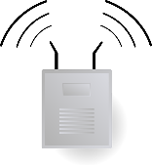
Omni-directional antenna
Omni directional antenna
  Commonly used in 802.11 WiFi networks
Advantages
  Coverage in all directions
  Simpler hardware design
Disadvantages
  A large amount of radiated power is wasted
  Can we concentrate the radiated transmission energy towards the intended receivers?
    Can increase SNR for intended receivers
    Reduce interference to other devices
A
C
B

Slide 49
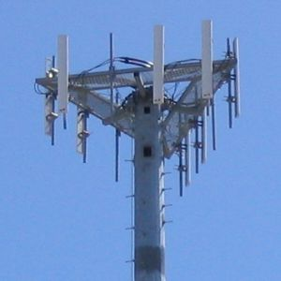
Omni-directional antenna
Directional antenna
  Widely used in special purpose applications
Advantages
  Higher signal strength in desired direction
  Reduced interference to other devices
Disadvantages
  Coverage restricted to some direction
  Costly - multiple antennas needed for omni coverage, capacity (similar to sectors used in cellular network base stations)
  Solution – electronic beamforming
A
C
B
Av Dori - Image taken by Dori, Offentlig eiendom, https://commons.wikimedia.org/w/index.php?curid=100638

Slide 50
Beamforming
Beamforming
  Use omni-directional antennas to focus signal in specific direction
  Exploit multiple antennas used for MIMO

Slide 51
Beamforming
Signal strength
  Beamforming can increase the SNR in desired direction
  Depending on number of antennas used, SNR gain can be very high
Rate over range effect
  Beamforming can increase the range till a given data rate can be supported
MCS
9
8
7
5
4
3
2
1
0
6
Distance from AP
MCS
9
8
7
5
4
3
2
1
0
6
Distance from AP

Slide 52
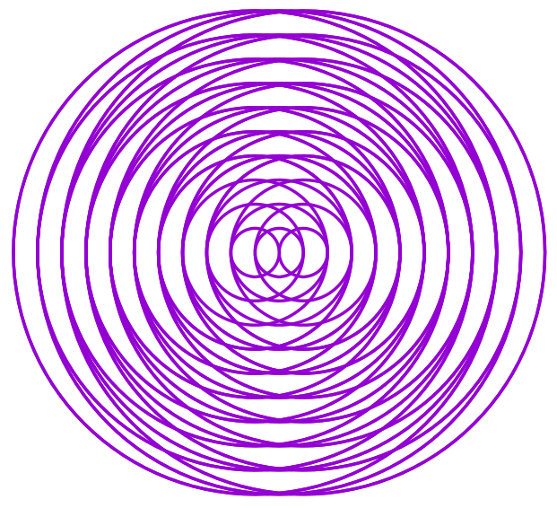
Beamforming
Beamforming using multiple antenna

Slide 53
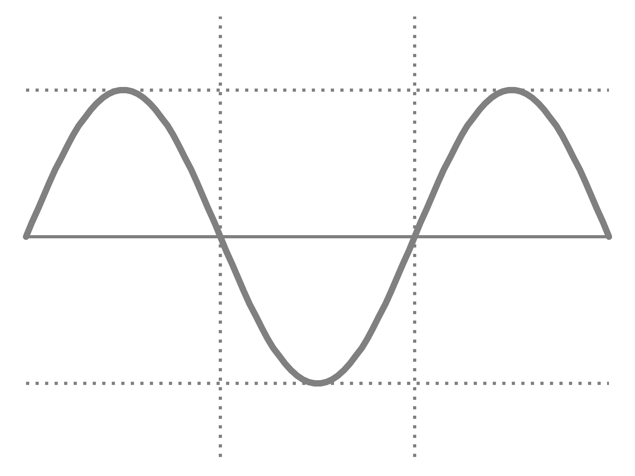
Beamforming
Beamforming
  Constructive interference
  When signal meet in phase, resultant signal strength increases
Higher signal strength; 3x in an ideal case

Slide 54
Beamforming
Beamforming
  Destructive interference
  When signal meet out of phase, resultant signal strength weakens
Lower signal strength

Slide 55
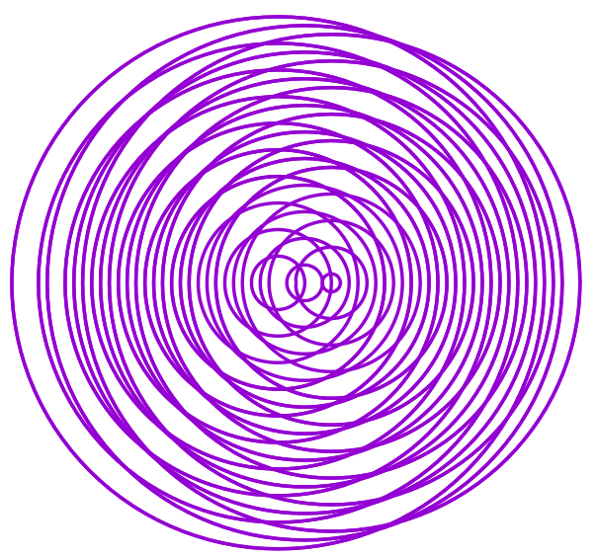
Beamforming
Beamforming
  Use omni-directional antennas to focus signal in a specific direction
  Change the phase of signal emitting from different antenna
  Intelligent phase modification can result in beams in desired direction
Same frequency, different phase

Slide 56
Beamforming
How can Tx form a beam towards Rx?
  Actual received signal at Rx is mixture of direct and reflected multi-paths
  Multi-path reflections also modify phase
  Rx can measure Tx’s signal and provide channel measurement feedback to Tx
  Explicit feedback more robust in capturing true channel state
What else affect the phase of received signal in practice?

Slide 57
Beamforming
Channel sounding procedure
  Explicit feedback
  Beamformer asks the beamformee to provide a feedback of channel measurement
[6]
Request channel measurement
Measure channel response
Channel measurement feedback
Calculate beam steering matrix
Data packets (beamformed)
Beamformer (e.g. AP)
Beamformee
(e.g. laptop)

Slide 58
Channel sounding in 802.11ac
NULL Data Packet (NDP) Announcement
  Beamformer first sends NDP announcement packet
  Gain control over channel till channel sounding procedure is complete
  Stations other than the beamformee will remain silent during the sounding process
NULL data packet announcement
Beamformer
Beamformee

Slide 59
Channel sounding in 802.11ac
NULL Data Packet (NDP)
  Beamformer follows NDP announcement with NDP packet
  As the name suggests, no data in included in NDP
  NDP contains training fields/sequences which is used by the beamformee to measure the channel response
NDP
announcement
NDP
Beamformer
Beamformee

Slide 60
Channel sounding in 802.11ac
Channel feedback – compressed beamforming feedback
  Beamformee measure the channel response using NDP packet
  Includes the measured channel response in feedback packet and sends it to beamformer
  Feedback is compressed before sending – resultant feedback is called Compressed Beamforming Feedback (CBF)
NDP
announcement
NDP
Beamformer
Compressed beamforming feedback
Beamformee

Slide 61
Channel matrix
Channel State Information (CSI)
  Also used as feedback for MIMO spatial multiplexing
  Use NDP training fields to measure phase and amplitude of each OFDM subcarriers, each Tx antenna and each Rx antenna
  Challenge – the CSI matrix can be very large in size, especially for wider channel widths (e.g. 160 MHz)
  Frequent feedback necessary for accurate beamforming – high overhead
Feedback matrix
Number of subcarriers
Number of Tx antenna
Number of Rx antenna

Slide 62
Channel feedback
Compressed Beamforming Feedback (CBF)
  Instead of sending the entire CSI matrix, beamformee transforms the matrix through Singular Value Decomposition
  Further compresses it using “Givens rotation” and quantization to yield CBF
    Reduction in size over 120% compared to full CSI
  After compression, beamformee sends the CBF to beamformer
Beamformer
  After receiving the CBF, the beamformer calculates the steering matrix
  The steering matrix is used to adjust the phase on each antenna such that their transmitted signal meets constructively at the beamformee, essentially creating a signal beam

Slide 63
Wireless networking - I
Today’s agenda
  MIMO overview
  MIMO rate adaptation
  MIMO energy consumption
  Beamforming
  MU-MIMO and user selection

Slide 64
Multi-User Beamforming
Can the AP form beams to multiple clients at the same time?
Can it send separate data to each client at the same time?
A
C
B

Slide 65
Multi-User MIMO (MU-MIMO)
MU-MIMO
  Use multi-user beamforming to send data
  AP can send separate spatial streams of data to different clients at the same time
MIMO vs. MU-MIMO
MU-MIMO
Rx 1
MIMO
Tx
Tx
Rx
Rx 2
Rx 3
Different color arrows indicate separate Spatial data streams

Slide 66
MU-MIMO
MU-MIMO
  A major change in wireless communication paradigm
  Sending separate data to different receivers over the same frequency at the same time
Advantages in practice
  In WLANs, APs typically have more antennas (e.g. 4-8) than clients (e.g. 1-3)
  Using MIMO, number of spatial streams can be minimum of Tx and Rx antennas
  With MU-MIMO, all antennas at the AP can be used for serving different clients in parallel
MU-MIMO
Rx 1
Tx
Rx 2
Rx 3

Slide 67
Channel sounding in MU-MIMO
Channel feedback
  Beamformer first sends NDP to one beamformee
  Followed by BF report poll messages asking for channel feedback (CBF) from other beamformees one after the other
Beamformer
NDPA
NDP
BF report poll
BF report poll
Beamformee - A
Channel feedback
Beamformee - B
Channel feedback
Beamformee - C
Channel feedback

Slide 68
MU-MIMO Data Transmission
MU-MIMO MAC
  Significant gains as AP doesn’t have to enter in carrier sense phase for every frame
  Multiple frames to different clients can be sent in channel access
Beamformer
Data - A
Data - A
ACK
Data - B
Data - C
ACK
[7]
Beamformee - A
ACK
Data - AP
Beamformee - B
ACK
Beamformee - C
ACK
Data - AP

Slide 69
Challenges in MU-MIMO
Complexity of signal processing
  Hardware design
  802.11ac restricts MU-MIMO to downlink only (AP -> clients)
  Maximum number of clients per AP MU-MIMO = 4
Interference
  Inter-user interference if the clients of MU-MIMO are not far enough from each other
  Two techniques
    Null steering
    User grouping

Slide 70
Interference in MU-MIMO
Null steering
  Calculate the beam steering matrix (Q) for each client such that signal is maximum for the intended client and zero for all others
Q[Rx 1] * H[Rx 1] = high
Q[Rx 2] * H[Rx 1] = 0
Q[Rx 3] * H[Rx 1] = 0
Rx 1
[6]
Q[Rx 1] * H[Rx 2] = 0
Q[Rx 2] * H[Rx 2] = high
Q[Rx 3] * H[Rx 2] = 0
Tx
Rx 2
Q[Rx i] = steering matrix to Rx i
H[Rx i] = channel matrix for Rx i
Rx 3
Q[Rx 1] * H[Rx 3] = 0
Q[Rx 2] * H[Rx 3] = 0
Q[Rx 3] * H[Rx 3] = high

Slide 71
User Grouping in MU-MIMO
User Grouping
  AP groups the client devices for MU-MIMO
  Optimal groups are the ones where there is no interference between the devices/users within the same group
  AP serves users of only one group (downlink) at a time
D
E
D
E
A
A
C
C
B
B
G
G
F
F

Slide 72
User Grouping
802.11ac standard does not suggest any user grouping technique
Two categories of techniques proposed in research based on
  Complete CSI feedback
  Compressed CFB feedback

Slide 73
User Grouping
Optimal user grouping at AP
  Request complete CSI (not the compressed CBF) from each user
  Determine groups of users that do not interference with each other
  Regroup further such that the sum of PHY data rate for each group is maximized
  Ensure data rate fairness among the groups
Computational complexity
  Prohibitively large – even for today’s Aps
  Overhead of complete CSI feedback more than MU-MIMO benefits

Slide 74
User Grouping
Incremental user selection
AP chooses the first user with best channel quality
Legacy-US: Greedy expansion of group [8]
  Add the next user such that it does not interfere with the current user
  Addition ensures high performance of the group
  Continue until the maximum allowable number of users per group, and all users are added to a group

Slide 75
User Grouping
OPUS protocol [8]
Incremental grouping with restricted feedback
How it works?
  AP first receives CSI from the core user (the one included in NDP)
  AP then calculates (signal) directions that are non-interfering to the core user
  It beamforms to these candidate signal directions and transmits BF report poll asking for CSI
  It then greedily picks the next user which maximizes group performance

Slide 76
User Grouping
In practice, user grouping needs to consider multiple factors other than inter-group interference
Other factors?
  Channel width
    Users with different channel widths cannot be grouped
    AP can transmit at one frequency and one bandwidth at a time
    Grouping should consider channel widths available and supported by users
  Data rate
    Depending on channel conditions, it is possible that different users support different rates at a time
    MU-MIMO spatial streams can use different data rates
    Grouping should consider how to maximize the total achievable data rate

Slide 77
User Grouping
Legacy-US: multiple clients (each with spatial stream) served in parallel
SU-MIMO: one client served at a time
[9]
Legacy-US performs really poorly (even worse than SU-MIMO)

Slide 78
User Grouping
Challenge – how to estimate inter-user interference using CBF (no CSI)?
New approach – MUSE [9]
Proves that higher correlation in CBF is an indication of inter-user interference
  Defines SINR through CBF correlation
The calculated SINR remains more or less constant for different channel widths
  Reason – total power in all subcarriers is constant

Slide 79
User Grouping
MUSE algorithm
SINR
  Calculate SINR using CBF feedback from all users
Bandwidth – greedy strategy
  Starts a greedy search from the highest bandwidth (e.g., 80MHz), and considers only the users who can support that bandwidth
  Sorts in descending order, the users based on their current throughput and iteratively goes through the list to group the users that provide the highest aggregate throughput with those already selected users.
  At each iteration, it also ensures that user’s SINR is greater than a threshold
  Search terminates when the group is complete, or when adding more users to a group results in lower aggregate throughput than serving them in SU-MIMO mode.
  Search is repeated at lower bandwidths for only the incomplete groups, to allow for more grouping opportunities.

Slide 80
MUSE Performance
[9]
Bandwidth adaptation is crucial in MU-MIMO user selection
Joint selection of users, rates and bandwidth is a complex and open research problem

Slide 81
References
[1] Halperin, Daniel, Wenjun Hu, Anmol Sheth, and David Wetherall. "802.11 with multiple antennas for dummies." ACM SIGCOMM Computer Communication Review 40, no. 1 (2010): 19-25.
[2] Pefkianakis, Ioannis, Yun Hu, Starsky HY Wong, Hao Yang, and Songwu Lu. "MIMO rate adaptation in 802.11 n wireless networks." In Proceedings of the sixteenth annual international conference on Mobile computing and networking, pp. 257-268. ACM, 2010.
[3] Halperin, Daniel, Ben Greenstein, Anmol Sheth, and David Wetherall. "Demystifying 802.11 n power consumption." In Proceedings of the 2010 international conference on Power aware computing and systems, p. 1. 2010.
[4] Khan, Muhammad Owais, Vacha Dave, Yi-Chao Chen, Oliver Jensen, Lili Qiu, Apurv Bhartia, and Swati Rallapalli. "Model-driven energy-aware rate adaptation." In Proceedings of the fourteenth ACM international symposium on Mobile ad hoc networking and computing, pp. 217-226. ACM, 2013.
[5] Zeng, Yunze, Parth H. Pathak, and Prasant Mohapatra. "A first look at 802.11 ac in action: energy efficiency and interference characterization." InNetworking Conference, 2014 IFIP, pp. 1-9. IEEE, 2014.
[6] Gast, Matthew S. 802.11 ac: A survival guide. " O'Reilly Media, Inc.", 2013
[7] http://www.arubanetworks.com/pdf/technology/whitepapers/WP_80211acInDepth.pdf
[8] Xie, Xiufeng, and Xinyu Zhang. "Scalable user selection for MU-MIMO networks." In IEEE INFOCOM 2014-IEEE Conference on Computer Communications, pp. 808-816. IEEE, 2014.
[9] Sur, Sanjib, Ioannis Pefkianakis, Xinyu Zhang, and Kyu-Han Kim. "Practical MU-MIMO User Selection on 802.11 ac Commodity Networks.“ MobiCom 2016

