Slide 1
Multi-gigabit Wireless:
Millimeter-wave Networking
CS 655: Wireless and Mobile Computing
Parth H. Pathak

Slide 2
802.11ac and beyond
  WiFi data speed has increased significantly over the last few years
MCS index | Modulation | Coding rate | 160 MHz Data rate (Mbps)
 |  |  | 1x1 | 2x2 | 4x4 | 8x8
0 | BPSK | 1/2 | 65 | 130 | 260 | 520
1 | QPSK | 1/2 | 130 | 260 | 520 | 1040
2 | QPSK | 3/4 | 195 | 390 | 780 | 1560
3 | 16-QAM | 1/2 | 260 | 520 | 1040 | 2080
4 | 16-QAM | 3/4 | 390 | 780 | 1560 | 3120
5 | 64-QAM | 2/3 | 520 | 1040 | 2080 | 4160
6 | 64-QAM | 3/4 | 585 | 1170 | 2340 | 4680
7 | 64-QAM | 5/6 | 650 | 1300 | 2600 | 5200
8 | 256-QAM | 3/4 | 780 | 1566 | 3120 | 6240
9 | 256-QAM | 5/6 | 866.7 | 1733.3 | 3466.7 | 6933.3

Slide 3
Challenges
Problem
  Noticeable difference in practice and theory
Possible contributing factors?
  Sharing in space, time and frequency
  Spectrum scarcity
    Insufficient number of orthogonal channels
    Requires sharing of frequency in time
  Interference
    Omni directional wireless propagation reduces spatial reuse
    Spatial reuse – number of links that can be operate in parallel
  Mobile devices
    Resource constrained, example
    Energy, computation, memory, form factor
    Example – limited use of MIMO

Slide 4



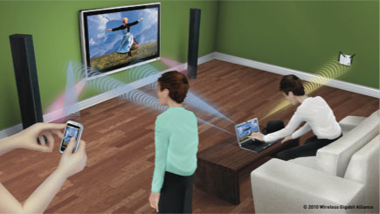


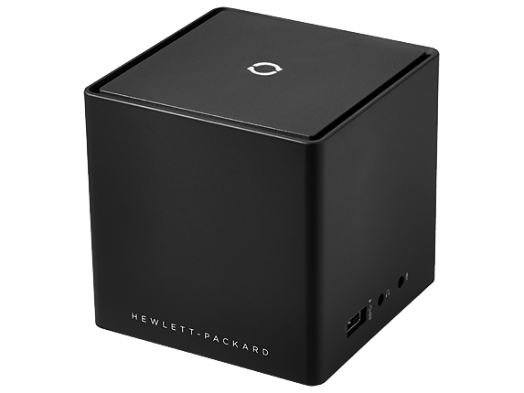

The quest for high speed wireless
Applications driving the growth
Sync and go
High definition (4K and beyond) video streaming
  Tether less interfaces
    Wireless USB, PCI buses, HDMI
Wireless docking, screen mirroring

Slide 5
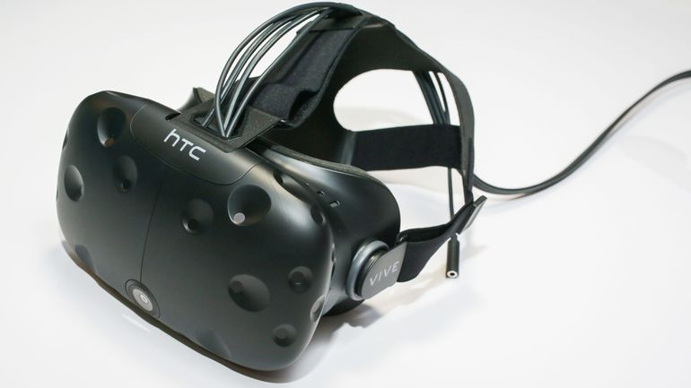
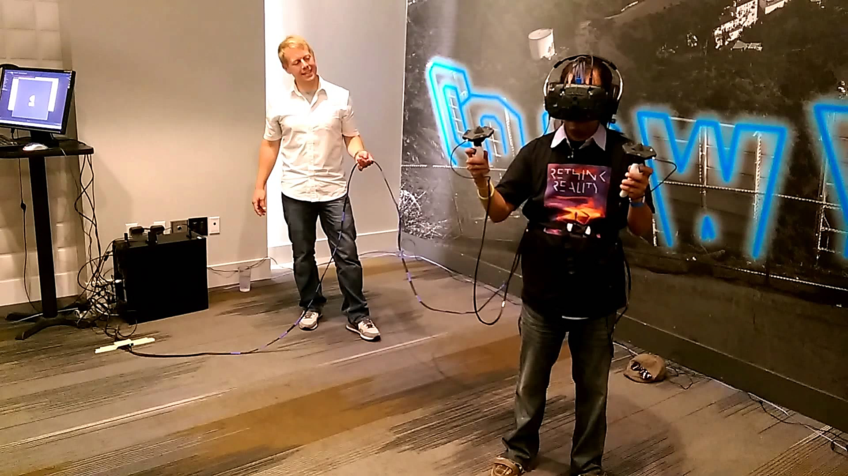
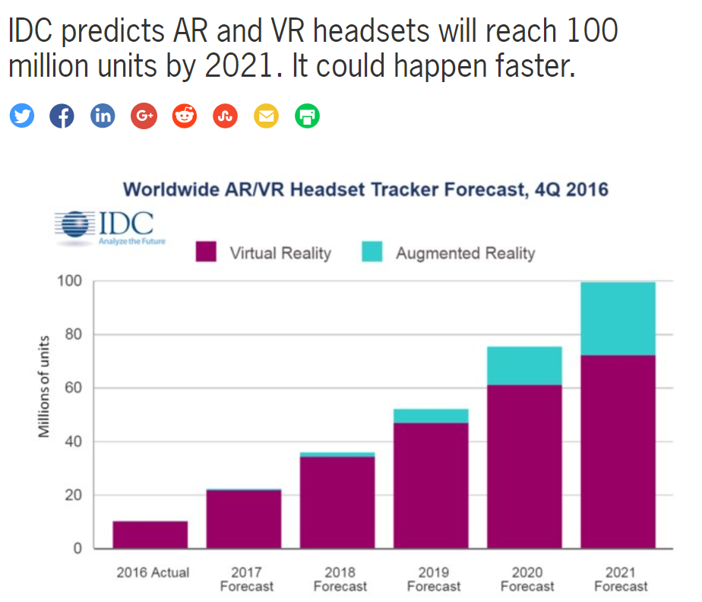

The quest for high speed wireless
Virtual reality
https://www.youtube.com/watch?v=Oxfj-qoV5KE

Slide 6
Search for more bandwidth
60 GHz ISM band

Slide 7
Search for more bandwidth
How can we create wireless networks that can provide multi-gigabit per second data rate?
  Per link speed should be > 3 Gbps
Millimeter wave wireless networks
Why is it called millimeter wave?
Major millimeter wave spectrum bands
Spectrum bands | Bandwidth
28 GHz | 1.3 GHz
39 GHz | 1.4 GHz
60 GHz | 14 GHz
74 GHz | 5 GHz
84 GHz | 5 GHz
Current WiFi operates in 2.4 and 5 GHz
ISM

Slide 8
60 GHz Millimeter wave band
57-64 GHz spectrum
  Unlicensed
  Even more being made available for unlicensed use
Federal Communications Commission FCC 16-89
  64-71 GHz Band
We are making available the 64‑71 GHz frequency band for use by unlicensed devices pursuant to the same technical standards as in the 57‑64 GHz frequency band under Section 15.255 of our rules, with slight modifications. As the Commission has consistently stated, it is optimal to include a balance of licensed rights and opportunities to operate on an unlicensed basis in order to meet the country’s wireless broadband needs. Our action here creates a 14-gigahertz segment of contiguous spectrum in these frequency bands to encourage the development of new and innovative unlicensed applications, and promote next‑generation high-speed wireless links with higher connectivity and 47 CFR § 15.255.

Slide 9
How bad is the path loss at 60 GHz?
Transmit power = 18 dBm
Transmit antenna gain = 8 dB, receive antenna gain = 8 dB
Receiver sensitivity for minimum MCS = -80 dBm
  $$LdB=20\log{10 f+10 n\log{10d −27.55}}$$
  f = signal frequency in MHz
  d = distance between Tx and Rx in meters,
  n = 4 (path loss exponent)
f | Range (m)
2.4 GHz
5 GHz
60 GHz

Slide 10
How bad is the path loss at 60 GHz?
Transmit power = 18 dBm
Transmit antenna gain = 8 dB, receive antenna gain = 8 dB
Receiver sensitivity for minimum MCS = -80 dBm
  $$LdB=20\log{10 f+10 n\log{10d −27.55}}$$
  f = signal frequency in MHz
  d = distance between Tx and Rx in meters,
  n = 4 (path loss exponent)
f | Range (m)
2.4 GHz | 70
5 GHz | 48
60 GHz | 14

Slide 11
60 GHz path loss
How to deal with such high path loss?
  Directionality – concentrate the radiated energy in one direction
Omni-directional transmission
Directional transmission

Slide 12
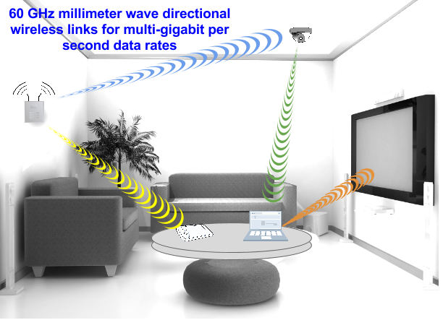
60 GHz Network

Slide 13
60 GHz Network
Many advantages over conventional omni-directional networks
Directionality
  Smaller interference footprint
  Higher spatial reuse
  Many directional links can operate in parallel without interfering with each other
  Different from omni directional cases where sharing in time, frequency and space is inevitable
Wireless networking standards
  IEEE 802.11ad – derived from WiGig
  IEEE 802.11ay – in development
  Other – 802.15.3c, WirelessHD

Slide 14
802.11ad overview
57.05 GHz
64 GHz
60 GHz ISM band in USA/Canada
Channel 1
57.24 GHz
Channel 2
59.40 GHz
Channel 3
61.56 GHz
63.72 GHz

Slide 15
802.11ad PHY overview
MCS 1-12
  Single carrier
  BPSK, QPSK and 16 QAM
  Coding rate – 1/2, 5/8, 3/4, 13/16
  Data rates – 385 Mbps to 4620 Mbps
MCS 13-24
  OFDM
  512 subcarriers in total per channel
  QPSK, 16 QAM, 64 QAM
  Coding rate – 1/2, 5/8, 3/4, 13/16
  Date rates – 693 Mbps to 6756.75 Mbps
What’s the difference with this and 802.11ac’s highest rate?

Slide 16
Dual band and tri band WiFi
https://www.abiresearch.com/whitepapers/80211ad-will-vastly-enhance-wi-fi/

Slide 17
Directionality
Types of beamforming
  Mechanical beamforming
  Digital beamforming

Slide 18
Directional antenna terminology
3-dB and first null to null beamwidths
  First null to null beamwidth – angle between points where the gain is zero
  3-dB beamwidth – angle between the points where the gain is half of the peak gain (or 3 dB lower than the peak gain)
90
0
Full beamwidth (first null to null beamwidth)
-5
-10
-15
Half power beamwidth
(3-dB beamwidth)
-20
180
0
270

Slide 19
Directionality
Mechanical beamforming
Problems
  Large form factor
  Slow mechanical rotation for beam-switching

Slide 20
60 GHz Digital beamforming
Phased antenna array
  Multiple antennas combined to form a larger antenna array
  Each antenna in the array is referred as antenna element
  Smaller form factor – can fit in mobile devices
  More antenna elements
    Higher directional gain
    Complex high-precision design required
Rule of thumb for antenna spacing
  Antennas spaced at a distance that is half of the signal wavelength increase beamforming gain
60 GHz multi-antenna systems
  Wavelength in millimeter means that antennas can be placed very close to each other

Slide 21
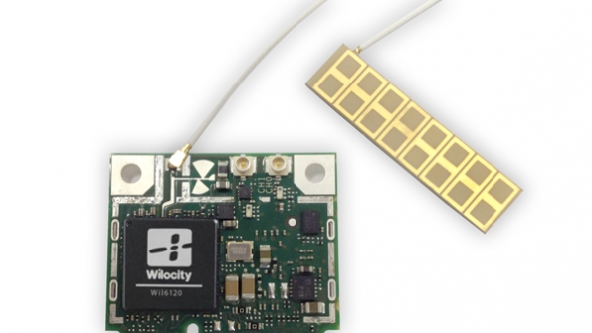
Phased antenna array
Wilocity, Qualcomm 60 GHz antenna array
http://wilocity.com/products/chipsets

Slide 22
Phased antenna array
[1]

Slide 23
Beamforming - Challenges
Device mobility
  Transmitter and receiver beams can be misaligned if either of them are mobile
  Requires fast beam switching – constantly adapt the direction of beam
Link outage
  Misalignment can result in disconnection of the link
  Requires complete exhaustive search to re-establish link

Slide 24
Adaptive beamforming
Adaptive beamforming
  Tx measure the channel conditions and constantly adapt the beam based on Rx mobility
Channel feedback
  Rx actively provides channel measurement (CSI)
  Tx uses the CSI to calculate the beam steering matrix
  Beam steering matrix – phase of each beamforming matrix
Challenges in using adaptive beamforming for 60 GHz?
  Large number of Tx and Rx antenna
  Wider channels mean many subcarriers
  CSI (Tx antenna x Rx antenna x subcarriers) can be very large
  Prohibitive overhead to share CSI constantly

Slide 25
Codebook
An alternative to adaptive beamforming
Codebook
  A pre-calculated collection of beam directions
  All beam directions together cover the entire space
How to use codebook?
  Choose a beam direction that maximizes the link connection strength
  Switching beam directions can be achieved with very small latency (in nano seconds)

Slide 26
Codebook
Codebook patterns
  Codebook contains multiple patterns
  Each pattern is a set of weights applied to the antenna elements
  Applying the weights results in creation of beams of that pattern
[1]

Slide 27
Codebook Generation
DFT codebook generation
  Consider a node with P antenna, and you want to generate Q patterns, the weights of each pattern are calculated using –
[1]

Slide 28
Digital Beamforming
How to apply the codebook weights?
  Codebook weight is a complex number representing the phase shift and amplitude modification for each antenna element
Pattern generation
  When all weights of a pattern are applied to the antenna elements, the corresponding beam pattern is generated
Signal: s(t) = x(t) + j y(t)
Weight: w = a (cos θ) + j a (sin θ)
a = amplitude
θ = phase shift
For each antenna element:
calculate s(t) * w

Slide 29
Codebook example
[2]

Slide 30

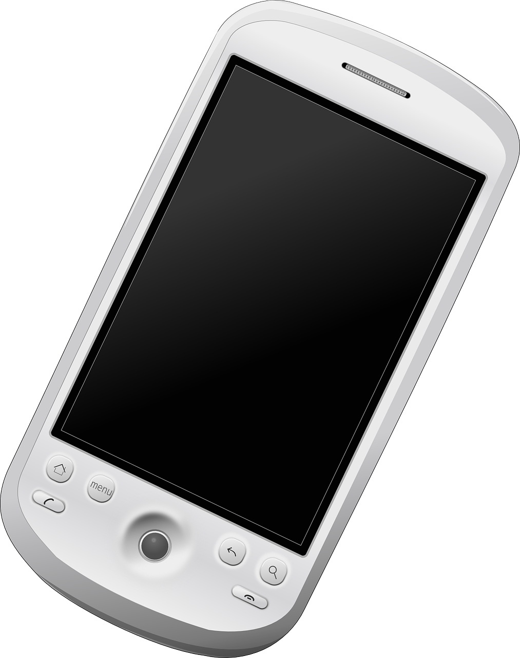
Beamforming
IEEE 802.11ad beamforming protocol
How can two nodes form beams towards each other?
  Both nodes have their own codebooks configured
Determine which beams are best for communication

Slide 31
Beamforming
In case of obstruction blocking the line-of-sight (LOS)
  Use reflection (from walls, objects etc.) to establish link
Beamforming need not be over LOS

Slide 32
Beamforming procedure – I
Start with quasi-omni pattern
Probe each half
Estimate coarse-grained direction
A
B
Quasi-omni pattern
A
B

Slide 33
Beamforming procedure – II
Sector Level Sweep (SLS)
Next, probe each sector within the half
Determine the sectors with high signal strength
A
B
Sector pattern
A
B

Slide 34
Beamforming procedure – III
Beam refinement procedure
Tx probes Rx through sectors
Rx replies through beams with maximum signal strength
A
B
Beam pattern
A
B

Slide 35
Beamforming procedure – IV
Tx probes Rx through beams within the sector
Tx and Rx agree on beams to use
A
B
A
B

Slide 36
Propagation evaluation
Evaluating path loss model
  Comparison with experiment results
  $$LdB=20\log{10 f+10 n\log{10d −27.55}}$$
[3]
Better match between model and experiments at
- shorter distances
- narrow beamwidth
- high antenna placement
Why?

Slide 37
Signal loss with blockage
60 GHz signals can be partially or fully blocked by obstacles
Diffraction
Scattering
Penetration and refraction
Reflection
A crucial design challenge

Slide 38
Signal loss
[3]
Tx and Rx distance 1m with object in between

Slide 39
Signal loss
[3]

Slide 40
Signal loss
[3]

Slide 41
Signal loss
[3]

Slide 42



Human blockage
60 GHz networks
  Human mobility – results in unpredictable blockage of links
  Self blockage - human body blocks link to mobile device - specifically a challenge for mobile devices

Slide 43
Human blockage
Blockage and reflection of millimeter wave signal from human body
  Depends on many factors
    Human skin permittivity
    Signal frequency
    Signal incident angle

Slide 44
Human blockage
Skin permittivity
  Relative to permittivity of free space
  Permittivity decreases with increase in signal frequency
[5]

Slide 45
Human blockage
Incident angle
  Power reflection coefficient – ratio of reflected power to the incident power
  Incident power – power of the signal that impinged on human body
  Reflected power – power of the signal that reflected from human body
If the transmitted power is P(Tx), how to calculate incident power?
Incident angle

Slide 46
Human blockage
Incident angle
  Power reflection coefficient – ratio of reflected power to the incident power
  As the incident angle increases, more incident power is reflected
[4]

Slide 47
Coverage
How do 60 GHz links perform in real office environment?
  Tx and Rx use 180 degree beamwidth antenna
  Even in presence of blockage and obstructions, 60 GHz link can provide high data rates within enclosed spaces
[3]

Slide 48
Coverage
How do 60 GHz links perform in real office environment?
  Evaluation with different beamwidths and comparison with WiFi
  Narrower beamwidths can provide higher data rates upto farther distances
  Challenge – narrower beams are more vulnerable to blockages
[3]

Slide 49
Beam forming overhead
What is the overhead of beamforming in practice?
  Sector level sweep followed by beam refinement procedure
  Searching using narrower beams consumes more time
  What are the trade-offs? Why not to use larger beamwidths always?
[3]

Slide 50
Beam forming overhead
AP discovery through beam search
  AP broadcasts beacons over quasi-omni beams
  More antenna elements on client used to create narrow beams
  Client mobility further increases the beamforming overhead
[3]

Slide 51

Blockage and mobility
Two important open challenges
  Blockage and mobility
Blockage
  Commonly caused by human mobility over Tx, Rx path
  Human body blockage can result in complete link outage, especially when narrow beamwidth is in use
Mobility
  One or both endpoints of a 60 GHz link are mobile
  Requires constant tracking of mobile endpoints
  Beam steering – change beam direction based on observed direction
Blockage
Mobility

Slide 52
Two possible solutions
Two solutions have been proposed to overcome blockage and mobility related outages
Beamwidth dilation/adaptation
  When link is blocked or the other endpoint is mobile, increase beamwidth to maintain link
Beam steering
  Use an alternate path when current path is blocked or unavailable due to endpoint mobility

Slide 53
Two possible solutions
Beamwidth dilation
Beam steering
Blockage
Mobility

Slide 54
Beam steering for blockage
How effective is beam steering in presence of human blockage?
Beam steering performs better when
  Blockage is not closer to Tx or Rx
  There exists sufficient reflective objects in the environment
R0 = link rate with LOS before blockage
R1 = link rate after beam steering
[3]

Slide 55
Beam steering and dilation
No “one-size-fits-all”
No general consensus (yet) but
  Beam steering a better solution for blockage
  Beam dilation more effective in mobility
Factors which must be considered in design
  Environment’s reflection profile
  Available beamwidths and codebook design
[3]
Blockage
Mobility

Slide 56
801.11ad MAC
MAC should tackle following issues -
  T1: A, B and C are already connected to the AP, D joins AP’s network
    How should your beacons work? Omni or directional?
  T2: A moves from its position
    Beam searching?
  T3: A and B both have traffic to send to AP
    Can A’s communication to AP be heard at B?
    Will you use TDM or CSMA?
    How will RTS/CTS work? Do we need them?
B
All nodes use codebook
A
AP
C
D

Slide 57
801.11ad MAC
Beacon Header Interval (BHI)
  Beacon Transmission Interval (BTI) – send out directional beacons
  Association Beamforming Training (A-BFT) – beam forming towards associated stations
    Update the beams (on AP and client) if the previous beam pair is no longer useful (may be because the client moved or there is an obstruction)
  Announcement Transmission Interval (ATI) – used to transmit management frames to clients (which are now beamformed)
    Also poll the clients if they have data to send
[8]

Slide 58
801.11ad MAC
Data Transmission Interval (DTI)
  Service Period (SP) – dedicated time for communication
    Time divided – No channel access or RTS/CTS is necessary
  Contention based Access Period (CBAP)
    Use medium access and RTS/CTS (directional)
[8]

Slide 59
Addressing mobility
How to address mobility?
  Use beam steering/switching and beamwidth dilation/adaptation together
SAMBA (Sensor-Assisted Multi-Level Codebook-based Beam Adaptation)
  Main idea: increase beamwidth if client’s mobility is not significant; switch beams otherwise

Slide 60
Addressing mobility
Challenge – codebook design
  Current codebooks can only provide some few candidate beamwidths to choose from in each direction
  Can we design a codebook where
    In each direction, there are multiple possible beams with different beamwidths

Slide 61
Multi-level codebook design
Multi-level codebook
  Combine codebook design with antenna subset selection
Antenna subset selection
  Selectively activate different parts of the phased antenna array
  Different combination of m x n are activated from M x N antenna array
8 x 8 phased antenna array
Activating 1 x 8 subset

Slide 62
Antenna subset selection
Property – 1
  Increasing the number of rows increases the directive gain in the desired beamforming direction while the beamwidth remains unchanged
[1]

Slide 63
Antenna subset selection
Property – 2
  Increasing the number of columns increases the directive gain in the desired beamforming direction while decreasing the beamwidth
[1]

Slide 64
Antenna subset selection
Property – 3
  As the antenna element arrangement changes from square to rectangular to linear for the same number of antenna elements, the beamwidth decreases while the directive gain increases
[1]

Slide 65
Multi-level codebook design
For the given M x N antenna
  Pick subsets of m x n
  m and n are chosen to be 2^x – known to maximize gain

Slide 66
Multi-level codebook design
For each subset m x n
  Develop its own codebook
  Number of patterns in each (sub)codebook chosen to be number of columns in that subset – avoids generating repeated patterns

Slide 67
Multi-level codebook design
Merge the codebooks
  Combine codebooks of subsets to form multi-level codebook
  Elements are deactived by using a weight of 0
Multi-level codebook
[1]

Slide 68
Multi-level codebook design
An example multi-level codebook for 4 x 8 antenna array
[1]

Slide 69
Sensor assisted beam adaptation
How to use multi-level codebook?
Predict client mobility
  Estimate where client will be at the next time unit
  Make a choice – which beam patterns from multi-level codebook will cover the estimated location

Slide 70
Client mobility
Predicting client mobility through sensors on mobile devices
  Client provides its mobility as a feedback to the AP
Three components in predicting client’s next location
  Estimating AP-client distance
    Assumption – LOS path is available
    Calculation of AP-client distance based on round trip propagation time of the signal between AP and client
  Estimating client’s heading direction
    Magnetometer sensor
    Measure heading direction relative to magnetic
    north pole
  Estimating the distance travelled by client
    Accelerometer sensor on mobile device
    Assumption – walking speed

Slide 71
Beamforming algorithm
[1]

Slide 72
Multi-codebook performance
[1]

Slide 73
Multi-codebook performance
[1]

Slide 74
Multi-codebook performance
The advantage of using multi-codebook design
  More reliability through beamwidth
[1]

Slide 75
SAMBA
Advantages
  Multi-level codebook allows instant beamwidth dilation
  Combines beamwidth dilation and beam switching
Limitations
  Reliance on mobile device’s sensor data to predict mobility
  Sensor estimation known to be noisy and erroneous in practice

Slide 76
MOCA
Mobility resilience and overhead constrained adaptation (MOCA) [6]
Main idea
  Rely on multi-level codebook for beamwidth dilation in presence of mobility related outage
  No sensor input from mobile devices expected
Control packets
  Probe and detect if current path is operational
  Use short probe packets – request and response just before actual data transmission
Fail-over paths
  Tx and Rx not only agree on one best path to use for communication, but also determine and record alternate fail-over paths for future use

Slide 77
MOCA
[6]
Check if the current path is operational or not
Tx sends beam sounding request and waits for reply
If Rx responds,
  Tx uses the reply to infer operational path
  Tx estimates the SNR and adjusts the data rate for data
  Tx sends data packet
  Rx sends the ACK
If Rx does not respond,
  Tx infers link broken due to blockage or Rx mobility

Slide 78
MOCA
[6]
Tx infers link broken due to blockage of Rx mobility
Tx chooses the next level in multi-level codebook (wider beamwidth – beamwidth dilation)
Tx sends beam sounding request on expanded (wide beamwidth sector)
If Rx responds, use the expanded sector for data transmission and ACK
If no Rx response, Tx infers that link is broken due to blockage

Slide 79
MOCA
If no Rx response, Tx infers that link is broken due to blockage
Tx sends of beam sounding probes on alternate (possibly reflection) paths
If Rx responds, use the reflected path (fail-over sectors) for data transmission and ACK
If no Rx response, infer unrecoverable link outage
Tx initiates sector level sweep to reestablish link with Rx

Slide 80
MOCA
[6]

Slide 81
MOCA
Advantages
  Per-packet control frames ensure reliable path discovery and recovery
  Combined beam switching, beamwidth adaptation and rate selection
  No reliance on sensor data or mobility estimation from mobile device
Disadvantages
  High per-packet overhead of using control frames
  Poor performance in presence of high mobility
  Like other protocols, reactive in nature

Slide 82
BeamSpy
BeamSpy
  Addresses blockage due to human mobility
Main idea
  Due to shared antenna gain, blockage of one path affects others too
  Instead of probing, estimate/predict the signal strength of other paths
  Switch to the best one in case of blockage
[7]

Slide 83
BeamSpy
Observation – 1: Channel Sparsity
  In a typical environment, there are only a few paths available between Tx and Rx
  LOS path and a few strong reflected paths
[7]

Slide 84
BeamSpy
Observation – 1: Channel sparsity
  Experiments for 50 different links 3 types of environments
[7]

Slide 85
BeamSpy
Observation – 2: Spatial correlation
  Blockage of one beam affects the performance of other beams
  RSS correlation remains unchanged before and after blockage
[7]

Slide 86
BeamSpy
BeamSpy framework
  Pre-calculate paths and their correlations
  When a blockage occurs, use the correlation to calculate SNR of all other paths
  Estimate which path will provide highest signal quality, and switch to it
Advantages
  No probing of current or alternate paths required before switching
  Low overhead scheme
Disadvantages
  Does not deal with endpoint mobility because path correlations mostly apply to stationary nodes

Slide 87
Millimeter wave sensing
Millimeter wave propagation is unique
  Directionality
  Large RF spectrum
  Blockage and reflection from human body
Exploit human body reflections
  Can we analyze the signal reflected from human body to identify any human motion?

Slide 88
mmVital
Millimeter wave sensing of vital signs
  Signal reflected from human body can be analyzed to determine
    Breathing rate
    Heart rate

Slide 89
mmVital
Millimeter wave (mmwave) signal characteristics
Directionality
  Because mmwave signal requires directionality, multi-path effect is substantially reduced compared to omni-directional propagation (e.g. WiFi)
mmVital advantages
  No wearables
    A user does not have wear any devices to measure the breathing and heart rates
  Smart home and offices
    Enables smarthome type applications where sensors deployed in the home constantly sense human activities and health
  Infrastructure reuse
    Reuse the communication infrastructure for performing sensing reduces the cost of deploying additional sensors

Slide 90
mmVital
How to measure vital signs using reflected signal?
Measure the RSS at the receiver
  RSS varies due to human body motion of heart beat and breathing
Apply frequency filtering
  Normal breathing rate: 5-25 Breaths per minute (Bpm)
    Frequency range: 0.08 – 0.42 Hz
  Normal heart rate: 50-220 beats per minute (bpm)
    Frequency range: 0.83 – 3.66 Hz

Slide 91
mmVital
Time series RSS values
t
FFT
f
Breathing filter
(0.08 – 0.42 Hz)
Heart rate filter
(0.83 – 3.66 Hz)
IFFT
IFFT

Slide 92
mmVital
What are the challenges in measuring vital signs using millimeter wave?
Signal incident angle
  Can we sense human vital signs even when signal strikes the human body at many different angles
Directionality introduces new problems
  How to know where the human is before sensing vital signs?
Multiple humans
  Can we sense multiple humans at the same time? How far do they have to be from each other?

Slide 93
1. Incident angle
Impact of signal incident angle
Reflection coefficient
  Higher incident angle means more signal power is reflected
Incident angle

Slide 94
1. Incident angle
Impact of signal incident angle on vital sign monitoring
Vital sign monitoring is more accurate at higher incident angles
  Accuracy still acceptable at lower incident angles

Slide 95
2. Human finding
Human finding
  Determine where the human is before start sensing its vital signs?
Main idea
  Tx and Rx scans the entire 360 degrees, and observes all possible reflections
  One of these reflections is from human body

Slide 96
2. Human finding
Scanning
  Continuously scan to see if there are any new reflections
  Compare current profile with previous profile
Each new reflection
  Can be because of a new/moved object or a person
  How to distinguish if a reflection is from human or object?

Slide 97
2. Human finding
Distinguishing human and object reflections
Reflection loss
  Measure the reflection loss which will be different for human and objects
How to calculate reflection loss based transmitted and received power?
Transmit side and receiver side path loss can be calculated
Total loss = transmitted power – received power
Reflection loss

Slide 98
2. Human finding
Reflection loss calculation
Step 1: calculate transmit side distance (d_{T}) and receiver side distance (d_{R})
  Tx and Rx knows transmit angle (α), receiver angle (β) and distance between them (d)

Slide 99
2. Human finding
Step 2: calculate transmit side and receiver side path loss
Step 3: calculate reflection loss
  $$LdB=20\log{10 f+10 n\log{10d −27.55}}$$
Transmit side and receiver side path loss can be calculated
Total loss = transmitted power – received power
Reflection loss

Slide 100
2. Human finding
Distinguishing human and object reflections
  Reflection loss is different for humans and objects
  Use the pre-known values of reflection losses to determine if a reflection is human or an object

Slide 101
2. Human finding
Another observation
  If a reflection is from human, the RSS will vary over time due to heart beat and breathing motions
  No/less variations will be observed if reflection is from objects
Algorithm
  For every new reflection, get k samples (dwell time) of RSS values
  Calculate mean and variance of the k samples
  If mean reflection loss is typical loss value of human and variance is higher than a threshold
    Reflection is from a human
  Else
    Reflection is from an object

Slide 102
2. Human finding
Human finding accuracy

Slide 103
3. Sensing multiple humans
Can we sense vital signs of multiple people?
  Useful in homes, offices etc.
Multiple humans and mmwave propagation
  Can result in blockage and interference

Slide 104
3. Sensing multiple humans

Slide 105
3. Sensing multiple humans

Slide 106
mmVital
Breathing and heart rate estimation accuracy

Slide 107
References
[1] Yang, Zhicheng, Parth H. Pathak, Yunze Zeng, and Prasant Mohapatra. "Sensor-assisted codebook-based beamforming for mobility management in 60 ghz wlans." In Mobile Ad Hoc and Sensor Systems (MASS), 2015 IEEE 12th International Conference on, pp. 333-341. IEEE, 2015.
[2] Wang, Junyi. "Beam codebook based beamforming protocol for multi-Gbps millimeter-wave WPAN systems." IEEE Journal on Selected Areas in Communications 27, no. 8 (2009): 1390-1399.
[3] Sur, Sanjib, Vignesh Venkateswaran, Xinyu Zhang, and Parmesh Ramanathan. "60 ghz indoor networking through flexible beams: A link-level profiling." In ACM SIGMETRICS Performance Evaluation Review, vol. 43, no. 1, pp. 71-84. ACM, 2015.
[4] Yang, Zhicheng, Parth H. Pathak, Yunze Zeng, Xixi Liran, and Prasant Mohapatra. "Monitoring Vital Signs Using Millimeter Wave.“ ACM MobiHoc 2016
[5] Wu, Ting, Theodore S. Rappaport, and Christopher M. Collins. "The human body and millimeter-wave wireless communication systems: Interactions and implications." In 2015 IEEE International Conference on Communications (ICC), pp. 2423-2429. IEEE, 2015.
[6] MK Haider, EW Knightly, Mobility resilience and overhead constrained adaptation in directional 60 GHz WLANs: protocol design and system implementation, Proceedings of the 17th ACM International Symposium (MobiHoc) 2016
[7] Sur, Sanjib, Xinyu Zhang, Parmesh Ramanathan, and Ranveer Chandra. "BeamSpy: enabling robust 60 GHz links under blockage." In 13th USENIX Symposium on Networked Systems Design and Implementation (NSDI 16), pp. 193-206. 2016.
[8] Assasa, Hany, and Joerg Widmer. "Implementation and Evaluation of a WLAN IEEE 802.11 ad Model in ns-3." Proceedings of the Workshop on ns-3. ACM, 2016.

